Slide 1
Small Talk about Trace Code
Viller Hsiao <villerhsiao@gmail.com>

Slide 2



Rights to Copy copyright © 2014 Viller Hsiao
Attribution – ShareAlike 3.0
You are free
  to copy, distribute, display, and perform the work
  to make derivative works
  to make commercial use of the work
Under the following conditions
    Attribution. You must give the original author credit.
    Share Alike. If you alter, transform, or build upon this work, you may distribute the resulting work only under a license identical to this one.
For any reuse or distribution, you must make clear to others the license terms of this work.
  Any of these conditions can be waived if you get permission from the copyright holder.
Your fair use and other rights are in no way affected by the above.
License text: http://creativecommons.org/licenses/by-sa/3.0/legalcode
Source of image icon in slide background
  http://image.dfdaily.com/2012/5/4/634716931128751250504b050c1_nEO_IMG.jpg
Corrections, suggestions, contributions and translations are welcome!

Slide 3

Who am I ?
Viller Hsiao
Embeded Linux / RTOS engineer

Slide 4

An Embedded Programmer
Hardware
Spec
musl
uclibc
gcc
makefile
armcc
newlib
makefile
menuconfig
ld
objdump
kbuild
glibc
memory
management
Linker
script
uboot
http://ext.pimg.tw/aabb52043/1367377582-3526768649_n.png

Slide 5
Topic Today
How to trace kernel source

Slide 6
Topic Today
How to trace kernel source
Dynamically
Trace from execution result

Slide 7
Problems when Tracing OS Sources
Too much #if/#elif/#endif macros
Refer to too much child/grandchild macros
Configurable included files
Some thing defined in command line
Too much redundant code
Multi-task environment
Hard the catch original design idea

Slide 8
Agenda Today
Build environment
  Config system
  Makefile
  Toolchain tips
C/C++ source
  Qemu log
  Linux ftrace

Slide 9
Agenda
Build environment
  Config system
  Makefile
  Toolchain tips
C/C++ source
  Qemu log
  Linux ftrace

Slide 10
Tracing from execution log
provides some clues to trace code

Slide 11
Tips – Filter Source by Built Objects
$ find ./ -name \*.o
./phy/libphy.o
./phy/phy.o
./phy/mdio_bus.o
./phy/phy_device.o
./virtio_net.o
./mii.o
./Space.o
./loopback.o
./ethernet/wiznet/built-in.o
./ethernet/built-in.o
./ethernet/smsc/smsc911x.o

Slide 12
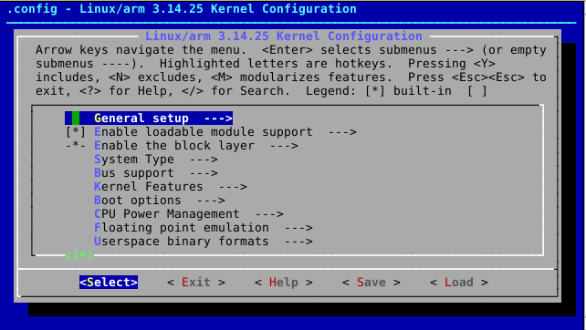
Build – menuconfig

Slide 13
Build Tips – menuconfig
Linux/.config
#
# Automatically generated file; DO NOT EDIT.
# Linux/arm 3.14.25 Kernel Configuration
#
CONFIG_ARM=y
CONFIG_SYS_SUPPORTS_APM_EMULATION=y
#
# General setup
#
CONFIG_INIT_ENV_ARG_LIMIT=32
CONFIG_CROSS_COMPILE=""
# CONFIG_COMPILE_TEST is not set
CONFIG_LOCALVERSION=""
# CONFIG_LOCALVERSION_AUTO is not set
CONFIG_HAVE_KERNEL_GZIP=y
CONFIG_HAVE_KERNEL_LZ4=y
CONFIG_KERNEL_GZIP=y
# CONFIG_KERNEL_LZMA is not set
# CONFIG_KERNEL_XZ is not set

Slide 14
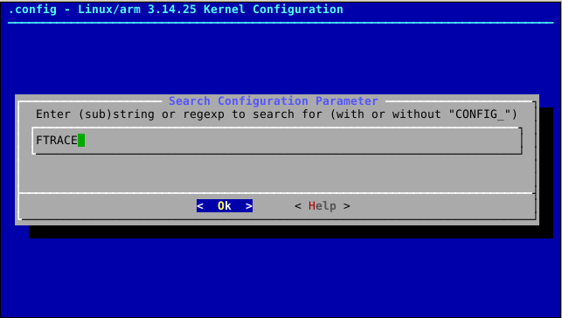
Build Tips – menuconfig
Press '/' to search specific configurations

Slide 15
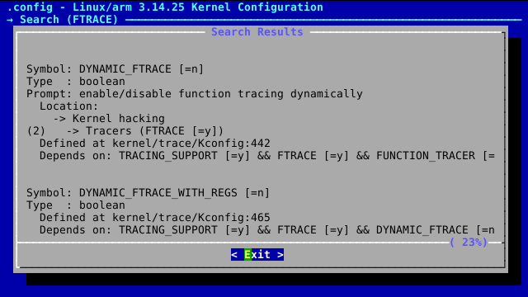
Build Tips – menuconfig
Search result
Menu path
Dependency

Slide 16
Build Tips – Kbuild Tips
Add compile flags for some object
Remove compile flags for some object
All subdirectory
CFLAGS_foo.o = -O0 -g -save-temp
CFLAGS_REMOVE_foo.o = -Os
subdir-ccflags-y = -save-temps

Slide 17
Build Tips – GCC Options
-save-temps
Use astyle to pretty final result
$ gcc -save-temps -o main main.c
$ ls
main main.c main.i main.o main.s Makefile
$ astyle -A8 main.i

Slide 18
.i file
Final Included headers of some definition
# 5 "include/linux/linkage.h" 2
# 1 "include/linux/stringify.h" 1
# 6 "include/linux/linkage.h" 2
# 1 "include/linux/export.h" 1
# 26 "include/linux/export.h"
struct kernel_symbol
{
unsigned long value;
const char *name;
};

Slide 19
.i file
Macro expanded
# 5 "include/linux/linkage.h" 2
# 1 "include/linux/stringify.h" 1
# 6 "include/linux/linkage.h" 2
# 1 "include/linux/export.h" 1
# 26 "include/linux/export.h"
struct kernel_symbol
{
unsigned long value;
const char *name;
};

Slide 20
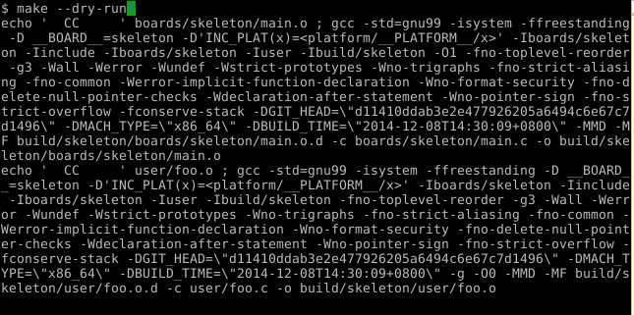
Build – GNU Make
make --dry-run

Slide 21
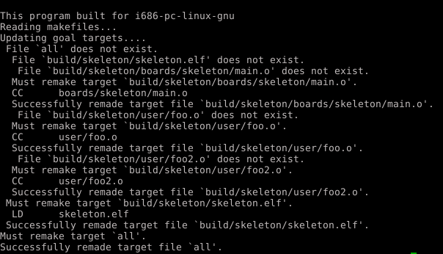
Build – GNU Make
make --debug

Slide 22
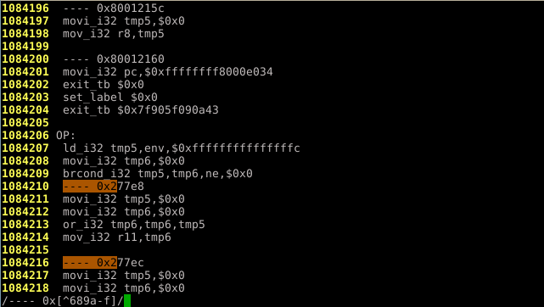
Runtime – Qemu Log
Qemu log + regular expression
Setup the search rule
Example: get first user space entry point

Slide 23
Runtime – Qemu Log
Other tips
  Qemu log + disassembly (objdump)
  Qemu + gdb ( + qemu log)
    -s or -gdb tcp::2345: enable gdb port
    -S: freeze CPU at startup

Slide 24
Ftrace – Overview
Kernel function tracer ( > 2.6.28 ?)
  Record execution log of kernel function
  Implemented by “-pg”
    Use dynamic ftrace to reduce overhead
Accessing API – debugfs
  /path/to/debug/tracing/

Slide 25
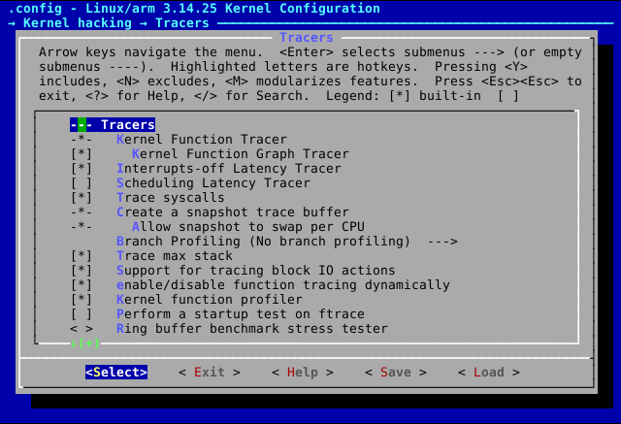
Ftrace – Configs

Slide 26
Ftrace – Steps
[tracing]$ echo “*mtd*” > set_ftrace_filter
[tracing]$ echo “*blk*” >> set_ftrace_filter
[tracing]$ echo “*:mod:ext3” >> set_ftrace_filter
[tracing]$ echo function > current_tracer
[tracing]$ echo 1 > tracing_on; do_test; echo 0 > tracing_on;
[tracing]$ cat trace

Slide 27
Ftrace – Available Tracer
[tracing] $ cat available_tracers
function
function_graph
nop

Slide 28
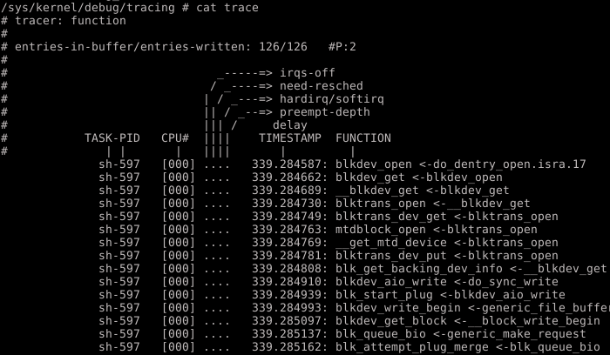
ftrace
function tracer

Slide 29
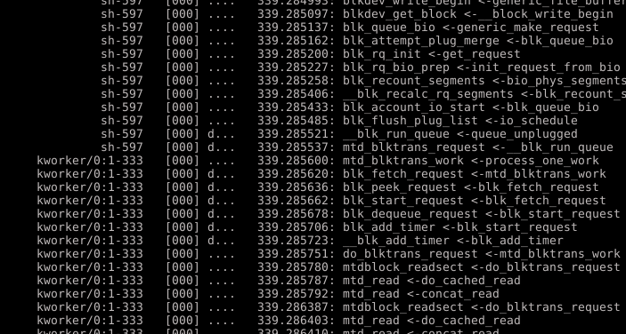
ftrace
function tracer

Slide 30
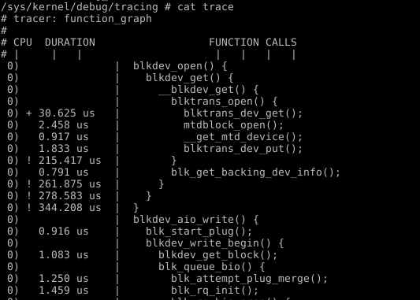
ftrace
function_graph tracer

Slide 31
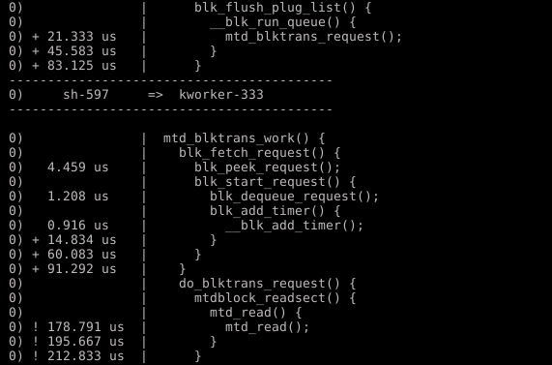
ftrace
function_graph tracer
Task
switch

Slide 32
Ftrace – Code Trace
Ftrace provides clues of
  Per-module view
  Top-down view
  Procedure excution flow
  Tasks/Threads model relationship

Slide 33
Ftrace – Other tracer
Trace event
  ftrace + tracepoint
Probe event
  ftrace + kprobe
Other tracer
  Stack tracer
  Irqoff latency tracer
  Syscall tracer
And so forth … not the topic today

Slide 34
Reference
Building embedded linux demo
  Sherif Mousa (Mar 26, 2014), “Building Embedded Linux”
  Linaro wiki, “cross-NG”
Linux-3.14 documentation, “kbuild/makefile.txt”
Linux-3.14 documentation, “trace/ftrace.txt”
池田宗廣，大岩尚宏，島本裕志，竹步晶雄，平松雅巳(Jan. 2014), “Linux kernel hacks”

Slide 35
THE END

