Slide 1
COMP 1409 Introduction to Software Development 1
session 03

Slide 2
Incrementing and Decrementing
int number = 1;
Increment: number = number + 1;
can also be expressed: number++;
or ++number;
Decrement: number = number - 1;
can also be expressed: number--;
or --number;

Slide 3
Arithmetic operators used with the assignment operator
+= add then assign
-= subtract then assign
*= multiply then assign
/= divide then assign
%= remainder then assign

Slide 4
int number = 1;
int value = 3;
number = number + value;
can also be expressed: number += value;
number = number - value;
can also be expressed: number -= value;
etc.

Slide 5
Grouping object references
Arrays

Slide 6
Rationale
Often we end up dealing with a large number of variables during the execution of a program
The larger the number the more difficult it becomes to manage all those variables
What we need is something to contain the variables as well as provide a convenient way to store and access them at runtime.
We need to “gather” the variables into a single container.
This is what an Array represents.

Slide 7
Fixed-size collections
An array is a fixed-size collection, meaning the number of elements it holds is set when it is created and never changes.
Programming languages usually offer a special fixed-size collection type: an array.
Java arrays can store object references or primitive-type values.
Arrays use a special syntax.

Slide 8
Creating an array
private int[] hourCounts = new int[24];
Array variable declaration
Array object creation

Slide 9
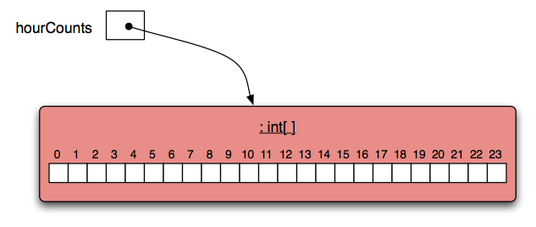
The hourCounts array
Array element index
“0” offset
Array element

Slide 10
Accessing Array Elements
Square-bracket notation is used to access an array element: hourCounts[...]
Elements are used like ordinary variables.
On the left of an assignment:
hourCounts[hour] = ...;
In an expression:
adjusted = hourCounts[hour] – 3;
hourCounts[hour]++;

Slide 11
Standard array use
private int[] hourCounts;
private String[] names;
...
hourCounts = new int[24];
...
hourcounts[0] = 0;
hourcounts[0]++;
System.out.println(hourcounts[0]);
declaration
creation
Could also be a variable
use

Slide 12
Array literals
Array literals are typically used in initialisations where you know beforehand the values it will contain.
declaration and initialisation
private int[] numbers = { 3, 15, 4, 5 };
System.out.println(numbers[ndx]);

Slide 13
Array length
private int[] numbers = { 3, 15, 4, 5 };
int n = numbers.length;
This is an operator, NOT a method (no brackets)

Slide 14
Repeating Code Segments
Loops Part 1

Slide 15
The “for” loop
There are two variations of the for loop, for-each and for.
The for loop is often used to iterate a fixed number of times.
Often used with a variable that changes a fixed amount on each iteration.

Slide 16
For loop pseudo-code
General form of a for loop
for(initialization; condition; post-body action) {
code to be repeated
}

Slide 17
A Java example
for loop version
for(int hour = 0; hour < hourCounts.length; hour++) {
System.out.println(hour + ": " + hourCounts[hour]);
}

Slide 18
Practice
Given an array of numbers, print out all the numbers in the array, using a for loop.
int[] numbers = { 4, 1, 22, 9, 14, 3, 9};
for ...

Slide 19
for loop with bigger step
// Print multiples of 3 that are below 40.
for(int num = 3; num < 40; num = num + 3) {
System.out.println(num);
}

Slide 20
Accumulating value variable
Another common use of a local variable is to hold an accumulating value.
Values are often accumulated through looping structures.
Each iteration of the loop does something to change the value in the accumulating value variable.

Slide 21
for without an array
// Sum all even numbers from 2 to 30.
int sum = 0;
for(index = 2; index <= 30; index+=2) {
sum += index;
}
System.out.println(“Sum is: ” + sum);
Notes:
Objects First with Java
© David J. Barnes and Michael Kölling
21
Objects First with Java
© David J. Barnes and Michael Kölling
21

