Slide 1
COMP 1409
Introduction to Software Development 1
session 4

Slide 2
Fundamental concepts
classes
object
reference
constructors
methods
  parameter
data fields
  state
modifiers
email: pmills5@learn.bcit.ca © 2018 Paul Mills, All rights reserved
Notes:
You don’t always need to show all these slides in class.
These are intended as summaries. Discuss these topics
with a demo, or in a dialog, or in any way you like.

Slide 3
Classes, Objects, References
classes
  a “blueprint” that defines a type (example: “dog”, “cat”, “car”)‏
objects
  actually a memory block that holds information about a given type. It represent ‘things’ from the real world, or from some problem domain (example: “the black dog walking towards me”, “my cat Garbo”, “my blue Corolla”)‏
references
  a pointer that holds an object’s memory address. It is used to access the object and thus the information it holds
email: pmills5@learn.bcit.ca © 2018 Paul Mills, All rights reserved

Slide 4
Constructors
Initialize an object.
Have the same name as their class.
No return type
  Returns an object address when called
Close association with the fields.
Store initial values into the fields.
email: pmills5@learn.bcit.ca © 2018 Paul Mills, All rights reserved
Notes:
Objects First with Java
© David J. Barnes and Michael Kölling
Objects First with Java
© David J. Barnes and Michael Kölling

Slide 5
Constructors…default
To create a default object
Used for testing
Used when no data is available
Used to support class inheritance
public MyClass() {
  }
Typical default ctor.
Default values for fields apply.
email: pmills5@learn.bcit.ca © 2018 Paul Mills, All rights reserved

Slide 6
Constructor…overloaded
Additional ctor that uses parameters to assign values to fields.
public MyClass(String myName, int myAge) {
name = myName;
age = myAge;
}
email: pmills5@learn.bcit.ca © 2018 Paul Mills, All rights reserved

Slide 7
Methods
Methods implement the behavior of objects.
Methods have a consistent structure comprised of a header and a body.
The header or signature describes “what” the method does. We call this the “interface”.
The body describes “how” the method perform the function. We call this the “implementation”.
email: pmills5@learn.bcit.ca © 2018 Paul Mills, All rights reserved
Notes:
Objects First with Java
© David J. Barnes and Michael Kölling
Objects First with Java
© David J. Barnes and Michael Kölling

Slide 8
Method structure
The header provides the method’s signature:
  public void doSomething()
The header gives us definition, and answers the question what:
  What is the name of the method?
  What parameters does it take?
  What is its return type?
  What is its visibility to objects of other classes?
The body gives us the implementation and answers the question how
  How does the method do its job?
email: pmills5@learn.bcit.ca © 2018 Paul Mills, All rights reserved
Notes:
Objects First with Java
© David J. Barnes and Michael Kölling

Slide 9
A Typical Method
return type
visibility modifier
method name
parameter list (empty)
public void doSomething()
{
System.out…;
}
program logic
start and end of method body (block)
email: pmills5@learn.bcit.ca © 2018 Paul Mills, All rights reserved
Notes:
Objects First with Java
© David J. Barnes and Michael Kölling
Objects First with Java
© David J. Barnes and Michael Kölling

Slide 10
Calling (invoking) Methods
Classes implement behaviours that objects can be invoke (called methods, functions, behaviours)‏
To call a method:
  SomeClass ref = new SomeClass();
  ref.doSomething();
object reference
method name
parameter
email: pmills5@learn.bcit.ca © 2018 Paul Mills, All rights reserved

Slide 11
Fields
Fields store values for an object.
They are also known as instance variables.
Fields define the state of an object.
Use Inspect to view the state.
Some values change often.
Some change rarely (or not at all).
type
visibility modifier
variable name
private int age;
email: pmills5@learn.bcit.ca © 2018 Paul Mills, All rights reserved
Notes:
Objects First with Java
© David J. Barnes and Michael Kölling
Objects First with Java
© David J. Barnes and Michael Kölling

Slide 12
Data types
computer programs consist of instructions and data
the programmer must specify what sort of data the program uses, e.g. numbers, letters
this tells the computer how much memory is required
email: pmills5@learn.bcit.ca © 2018 Paul Mills, All rights reserved

Slide 13
Data types
some common data types:
  int (whole numbers) e.g. 78, 490
  double(decimal numbers) e.g. 23.6, 199.3
  char (single) e.g. ‘A’, ‘8’, ‘$’
  boolean e.g. true, false
  string (Unicode characters) e.g.
  “OO Programming”, “hello”, “abc123”
email: pmills5@learn.bcit.ca © 2018 Paul Mills, All rights reserved

Slide 14
Data Types
primitive types (also known as value types)‏
  int is default integer type - whole numbers
  double is default floating-point type, numbers with decimal places
  boolean - true or false
  char - a single Unicode character
email: pmills5@learn.bcit.ca © 2018 Paul Mills, All rights reserved

Slide 15
Reference Types
reference types
  String is an class type in Java - every string is an object of the String class
  a string is enclosed in double quotes,
  e.g. “this is a string”
  everything that is not a primitive type is an object type
email: pmills5@learn.bcit.ca © 2018 Paul Mills, All rights reserved

Slide 16
Other observations
Many instances can be created from a single class.
An object has attributes: values stored in fields.
The class defines what fields a reference type has, but each object has its own unique set of values. This is called the state of the object.
email: pmills5@learn.bcit.ca © 2018 Paul Mills, All rights reserved

Slide 17
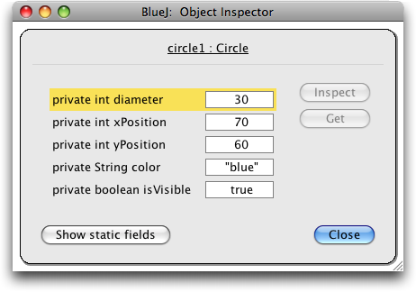
State
An object’s state is determined by the filed values.
The state of an object is set when the object is created.
Object states often change at runtime.
email: pmills5@learn.bcit.ca © 2018 Paul Mills, All rights reserved

Slide 18
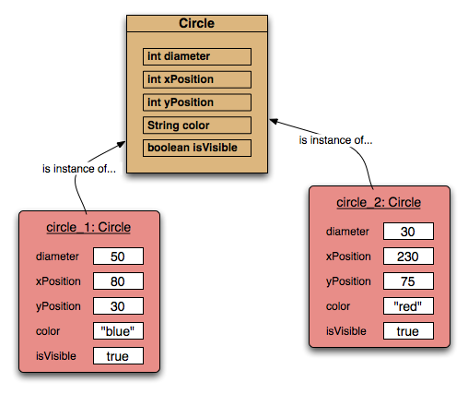
Two circle objects
email: pmills5@learn.bcit.ca © 2018 Paul Mills, All rights reserved

Slide 19
Javadoc comments
Every class has a comment at the top that explains what the class is and what it is used for.
Every ctor has comments that describe its purpose and the purpose of the parameters is uses
Every method has a comment that includes information about parameters (if any) and return value (if any).
Javadoc comments and tags e.g. @author, @version, @return, @param are used to generate documentation for the class.
email: pmills5@learn.bcit.ca © 2018 Paul Mills, All rights reserved
Notes:
Objects First with Java
© David J. Barnes and Michael Kölling
Objects First with Java
© David J. Barnes and Michael Kölling

