Slide 1
COMP 1409 Introduction to Software Development 1
session 6

Slide 2
Understanding class definitions
Looking inside classes
Notes:
Objects First with Java
© David J. Barnes and Michael Kölling
2

Slide 3
Main concepts to be covered
local variables
static variables
symbolic constants
overloading
switch/case selection

Slide 4
Variables – a recap
Fields are one sort of variable.
They store values through the life of an object.
They are accessible throughout the class.
Parameters are another sort of variable:
They receive values from outside the method.
They help a method complete its task.
Each call to the method receives a fresh set of values.
Parameter values are short lived.
Notes:
Objects First with Java
© David J. Barnes and Michael Kölling
4

Slide 5
Local variables
Methods can define their own, local variables:
Short lived, like parameters.
The method sets their values – unlike parameters, they do not receive external values.
Used for ‘temporary’ calculation and storage.
They exist only as long as the method is being executed.
They are only accessible from within the method.

Slide 6
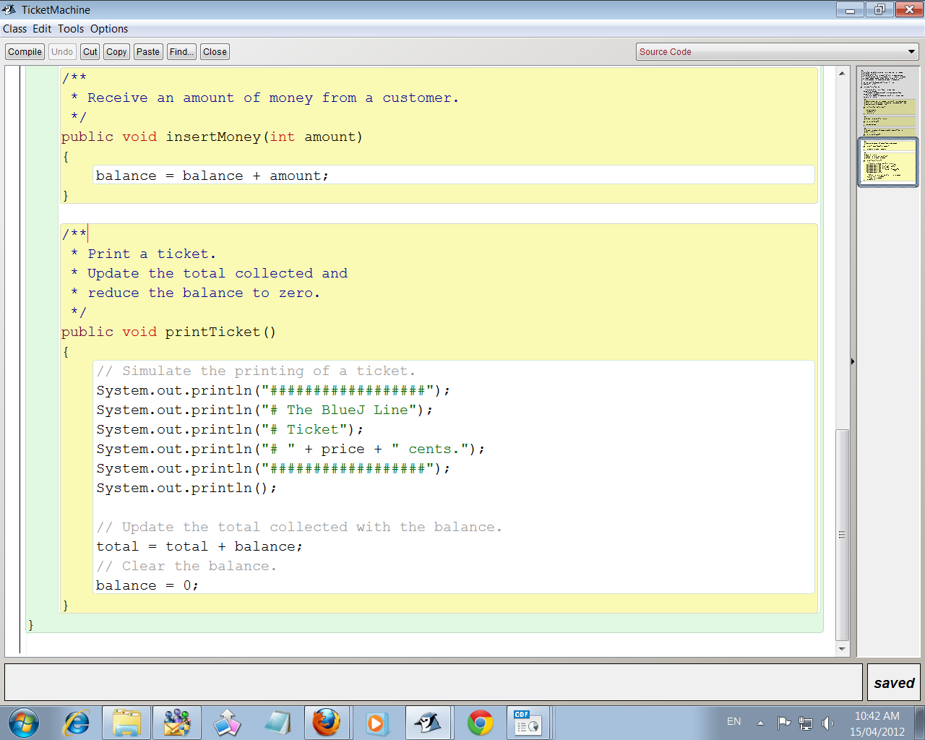
Scope highlighting

Slide 7
Scope and lifetime
Each block defines a new scope.
Class, method and statement.
Scopes may be nested:
statement block inside another block inside a method body inside a class body.
Scope is static (textual).
Lifetime is dynamic (runtime).
Notes:
Objects First with Java
© David J. Barnes and Michael Kölling
7

Slide 8
Local variables
A local variable
public int refundBalance()
{
int amountToRefund;
amountToRefund = balance;
balance = 0;
return amountToRefund;
}
No visibility
modifier
Notes:
Objects First with Java
© David J. Barnes and Michael Kölling
8

Slide 9
Scope and lifetime
The scope of a local variable is the block in which it is declared.
The lifetime of a local variable is the time of execution of the block in which it is declared.
The scope of a field is its whole class.
The lifetime of a field is the lifetime of its containing object.

Slide 10
Static variables
‘static' is a Java key word that describes variables (or methods) that belong to the class rather than to the individual instances (objects) of the class.
Only one copy exists in memory and all objects of that class share it.

Slide 11
Static variables
public class DemoStatic
{
private static int count = 0;
public DemoStatic()
{
// keeps count of objects
count = count + 1;
}
}

Slide 12
Symbolic constants
A constant is a value that will not change, e.g. literal values like 5, -20, “hello”.
The key word ‘final’ indicates a memory location set aside for a value that will not change while the program is running.

Slide 13
Symbolic constants...
static and final together indicate a symbolic constant in Java.
Symbolic constant is a synonym for a constant value.
Must be assigned its value when declared. static final double PI = 3.14159; static final double PRIME_RATE = 4.25;

Slide 14
Static methods
A static method, like a static variable, is shared by all objects. There is only one copy in memory.
Because a static method exists outside any object it can be called without any object existing.
Static methods cannot access non-static members
public static void main(String[] args)

Slide 15
Overloading
Now that we have added a default constructor to the TicketMachine, it has two constructors.
This is overloading.
Both constructors and methods can be overloaded.
Overloading requires different signatures.

Slide 16
Overloading
There are three ways in which signatures can be different:
different number of parameters
different data types
different order of parameters.

Slide 17
Overloading Constructors
public TicketMachine()
public TicketMachine(int cost)
Or for a Dog class:
public Dog()
public Dog(String name)
Public Dog(int age)
public Dog(String name, int age)
public Dog(int age, String name)

Slide 18
Overloading Methods
public void display(String data)
public void display(int number1, int number2)
public void display (String data, int number)
NOT overloading if return types are different
public void display(String data)
public String display(String data)
NOT OVERLOADING

Slide 19
Switch/Case Selection
int month = 2;
int year = 2000;
int numDays = 0;
switch (month) {
case 1: case 3: case 5:
case 7: case 8: case 10: case 12:
numDays = 31;
break;
case 4: case 6: case 9: case 11:
numDays = 30;
break;
case 2:
if (((year % 4 == 0) && !(year % 100 == 0)) || (year % 400 == 0))
numDays = 29;
else
numDays = 28;
break;
default:
System.out.println("Invalid month.");
break;
}
test value
cases can be combined
result if case is true
break takes you out of the structure
so remaining cases are not tested
always be prepared to
handle bad input

Slide 20
Switch/Case Selection…
Can also work with chars and Strings
char grade = 'C';
switch(grade) {
case 'A' :
System.out.println("Excellent!");
break;
case 'B' : case 'C' :
System.out.println("Well done");
break;
…
}
String dayOfWeek = “Tuesday”;
String typeOfDay;
switch (dayOfWeek) {
case "Monday":
typeOfDay = "Start of work week";
break;
case "Tuesday": case "Wednesday":
case "Thursday":
typeOfDay = "Midweek";
break;
…
}

Slide 21
Things to remember…
class field scope
local variable scope
static vs. Instance
symbolic constants \ final
Constructor overloading
Method overloading
Notes:
Objects First with Java
© David J. Barnes and Michael Kölling
21

