Slide 1
COMP 1409 Introduction to Software Development 1
session 07

Slide 2
Grouping object references
Arrays

Slide 3
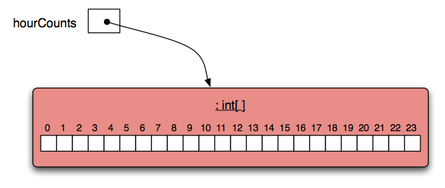
RECALL: Array Anatomy
Array element index
“0” offset
Array element

Slide 4
Arrays of object references
Arrays in Java can hold reference (Object) types. /*array to hold Dog references */ Dog[] dogs = new Dog[25]; /* a Dog reference*/ Dog myDog = new Dog(“Fido”); /* put reference into array */ dogs[0] = myDog;

Slide 5
Arrays of object references
Java initializes object arrays to null, i.e. no object.
Must check for null when accessing the array elements.
Potential for NullPointerException if we try to follow a reference to an object that does not exist.

Slide 6
Arrays of object references
/** show ages of all dogs in the array */
public void showAges()‏
{
for(int i = 0; i < dogs.length; i++ ){
if (dogs[i] != null){
System.out.print(dogs[i].getAge());
}
}
}
We must check the array index to see if it holds a null value. If it does then attempting to access the age will throw a NullPointerException.

Slide 7
Searching a Array
Often we want to search an array for a specific information
Necessarily indefinite.
We must code for both success and failure – exhausted search.
Both must make the loop’s condition false.
Notes:
Objects First with Java
© David J. Barnes and Michael Kölling
7

Slide 8
Finishing a search
How do we finish a search?
Either there are no more items to check: index >= arrayRef.length
Or the item has been found: found == true found ! searching
Notes:
Objects First with Java
© David J. Barnes and Michael Kölling
8

Slide 9
Continuing a search
Within a for loop we need to state the condition for continuing
So the loop’s condition will be the opposite of that for finishing
if(index < arrayRef.length && !found) if(index < arrayRef.length && searching)
Notes:
Objects First with Java
© David J. Barnes and Michael Kölling
9

Slide 10
Searching an array
public void searchForString(String searchString){
int index = 0;
boolean found = false;
for(int i = 0; i < arrayRef.length; i++){
if(index < arrayRef.length && !found) {
String value = arrayRef[index];
if(value.equals(searchString)) {
// We don't need to keep looking.
found = true;
return;
} else {
index++;
}
}
}
// Either we found it at index,
// or we searched the whole collection.
...
}
Notes:
Objects First with Java
© David J. Barnes and Michael Kölling
10
Objects First with Java
© David J. Barnes and Michael Kölling
10

Slide 11
null
null is a special value in Java
Object fields are initialized to null by default.
You can test for and assign null: private NumberDisplay hours; if(hours != null) { ... } hours = null;
email: pmills5@learn.bcit.ca © 2018 Paul Mills, All rights reserved

Slide 12
this keyword
refers to the current object
The object references itself
Useful for making a distinction between fields and parameters
email: pmills5@learn.bcit.ca © 2018 Paul Mills, All rights reserved

Slide 13
this keyword
public class Student
{
private String name;
public Student(String name)‏
{
this.name = name;
}
}
email: pmills5@learn.bcit.ca © 2018 Paul Mills, All rights reserved

Slide 14
Time to practice!

