Slide 1
COMP 1409
Introduction to Software Development 1
session 6
Notes:
Objects First with Java
© David J. Barnes and Michael Kölling

Slide 2
Main concepts to be covered
object interaction
abstraction
modularization
classes as data types
external method calls
email: pmills5@learn.bcit.ca
Notes:
Objects First with Java
© David J. Barnes and Michael Kölling

Slide 3
Object interaction
Creating cooperating objects
email: pmills5@learn.bcit.ca
Notes:
Objects First with Java
© David J. Barnes and Michael Kölling
Objects First with Java
© David J. Barnes and Michael Kölling

Slide 4
Abstraction and modularization
Abstraction is the ability to ignore details of parts to focus attention on a higher level of a problem.
Modularization is the process of dividing a whole into well-defined parts, which can be built and examined separately, and which interact in well-defined ways.
email: pmills5@learn.bcit.ca
Notes:
Objects First with Java
© David J. Barnes and Michael Kölling
Objects First with Java
© David J. Barnes and Michael Kölling

Slide 5
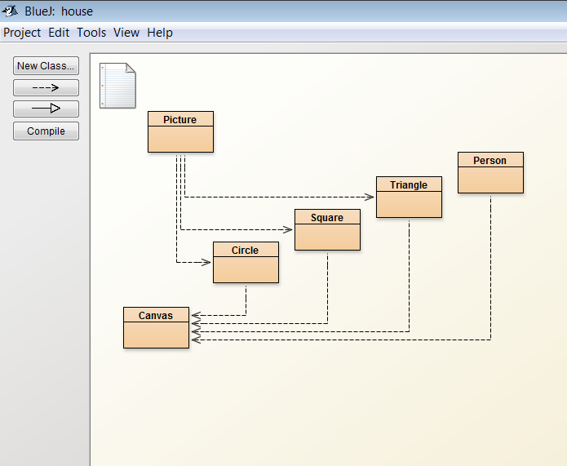
Let's visit the House project
email: pmills5@learn.bcit.ca
Notes:
Objects First with Java
© David J. Barnes and Michael Kölling
Objects First with Java
© David J. Barnes and Michael Kölling

Slide 6
Abstraction and modularization
Picture is modular – composed of wall, window, roof and sun.
public class Picture
{
private Square wall;
private Square window;
private Triangle roof;
private Circle sun;
email: pmills5@learn.bcit.ca
Notes:
Objects First with Java
© David J. Barnes and Michael Kölling
Objects First with Java
© David J. Barnes and Michael Kölling

Slide 7
Abstraction and modularization
Picture uses abstraction – we work with the components without worrying about their details.
public void draw()
{
wall = new Square();
wall.moveHorizontal(-140);
wall.moveVertical(20);
email: pmills5@learn.bcit.ca
Notes:
Objects First with Java
© David J. Barnes and Michael Kölling
Objects First with Java
© David J. Barnes and Michael Kölling

Slide 8
Classes as data types
Anything that is not a primitive data type in Java is an object type. We have worked with String objects.
Now we will work with other objects.
private Square wall;
private Square window;
private Triangle roof;
private Circle sun;
email: pmills5@learn.bcit.ca
Notes:
Objects First with Java
© David J. Barnes and Michael Kölling
Objects First with Java
© David J. Barnes and Michael Kölling

Slide 9
Coding for real
We can create objects on the BlueJ object bench by right-clicking and selecting 'new' e.g. 'new Circle()'
We then right-click on the object and invoke (call) its methods.
We can also create objects and invoke their methods by using code.
email: pmills5@learn.bcit.ca
Notes:
Objects First with Java
© David J. Barnes and Michael Kölling
Objects First with Java
© David J. Barnes and Michael Kölling

Slide 10
Creating objects
An object is created by using the Java key word 'new' and calling the object's constructor.
new Circle() creates an object from the Circle class.
email: pmills5@learn.bcit.ca
Notes:
Objects First with Java
© David J. Barnes and Michael Kölling
Objects First with Java
© David J. Barnes and Michael Kölling

Slide 11
Creating objects
When creating an object with code we first declare a variable and assign the new object to that variable, e.g.
Circle c = new Circle();
The data type is Circle.
The variable name is c.
email: pmills5@learn.bcit.ca
Notes:
Objects First with Java
© David J. Barnes and Michael Kölling
Objects First with Java
© David J. Barnes and Michael Kölling

Slide 12
Calling methods
We have created an object:
Circle c = new Circle();
Now we can call methods of the Circle class, e.g.
c.makeVisible();
c.changeColor(“red”);
c.moveDown();
email: pmills5@learn.bcit.ca
Notes:
Objects First with Java
© David J. Barnes and Michael Kölling
Objects First with Java
© David J. Barnes and Michael Kölling

Slide 13
Calling methods
When we created the object we put its ADDRESS into the REFERENCE “c”.
To call a method we specify the reference, followed by the dot operator, followed by the method name and parameter list.
c.slowMoveVertical();
c.moveHorizontal(40);
c.changeSize(500);
email: pmills5@learn.bcit.ca
Notes:
Objects First with Java
© David J. Barnes and Michael Kölling
Objects First with Java
© David J. Barnes and Michael Kölling

Slide 14
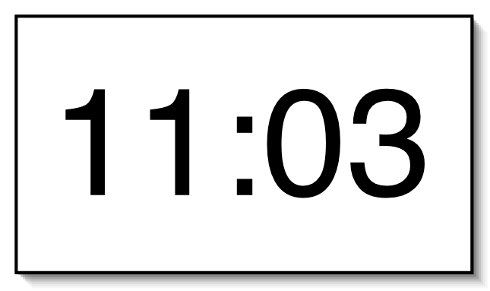
EXAMPLE: A digital clock
email: pmills5@learn.bcit.ca
Notes:
Objects First with Java
© David J. Barnes and Michael Kölling
Objects First with Java
© David J. Barnes and Michael Kölling

Slide 15



Modularizing the clock display
One four-digit display?
Or two two-digit displays?
email: pmills5@learn.bcit.ca
Notes:
Objects First with Java
© David J. Barnes and Michael Kölling
Objects First with Java
© David J. Barnes and Michael Kölling

Slide 16
Implementation - NumberDisplay
public class NumberDisplay
{
private int limit;
private int value;
Constructor and
methods omitted.
}
email: pmills5@learn.bcit.ca
Notes:
Objects First with Java
© David J. Barnes and Michael Kölling
Objects First with Java
© David J. Barnes and Michael Kölling

Slide 17
Implementation - ClockDisplay
public class ClockDisplay
{
private NumberDisplay hours;
private NumberDisplay minutes;
Constructor and
methods omitted.
}
email: pmills5@learn.bcit.ca
Notes:
Objects First with Java
© David J. Barnes and Michael Kölling
Objects First with Java
© David J. Barnes and Michael Kölling

Slide 18
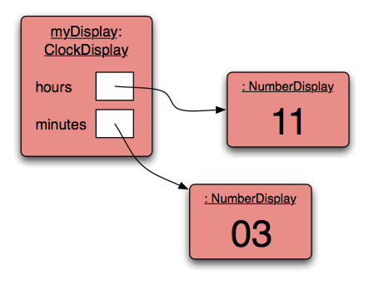
Object diagram
email: pmills5@learn.bcit.ca
Notes:
Objects First with Java
© David J. Barnes and Michael Kölling
Objects First with Java
© David J. Barnes and Michael Kölling

Slide 19
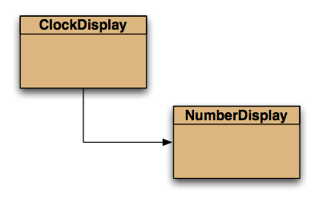
Class diagram
email: pmills5@learn.bcit.ca
Notes:
Objects First with Java
© David J. Barnes and Michael Kölling
Objects First with Java
© David J. Barnes and Michael Kölling

Slide 20
Source code: NumberDisplay
    public NumberDisplay(int rollOverLimit)
    {
    limit = rollOverLimit;
    value = 0;
    }
    public void increment()
    {
    value = (value + 1) % limit;
    }
email: pmills5@learn.bcit.ca
Notes:
Objects First with Java
© David J. Barnes and Michael Kölling
Objects First with Java
© David J. Barnes and Michael Kölling

Slide 21
Source code: NumberDisplay
    public String getDisplayValue()
    {
    if(value < 10) {
    return "0" + value;
    }
    else {
    return "" + value;
    }
    }
email: pmills5@learn.bcit.ca
Notes:
Objects First with Java
© David J. Barnes and Michael Kölling
Objects First with Java
© David J. Barnes and Michael Kölling

Slide 22
Things to remember…
abstraction
modularization
Class types as fields
“new” operator
references
email: pmills5@learn.bcit.ca

