Slide 1
COMP 1409 Introduction to Software Development 1
session 11

Slide 2
Main concepts to be covered
identity vs equality
Java Iterator
anonymous object references
Notes:
Objects First with Java
© David J. Barnes and Michael Kölling
2

Slide 3
The String class
The String class is defined in the java.lang package.
It has some special features that need a little care.
In particular, comparison of String objects can be tricky.

Slide 4
Side note: String equality
tests identity
if(input == "bye") {
...
}
if(input.equals("bye")) {
...
}
Always use .equals for text equality.
tests equality
Notes:
Objects First with Java
© David J. Barnes and Michael Kölling
4
if desired, include more detailed discussion of identity vs equality here.
(That's the next 5 slides, up to "Identity vs equality (Strings)". Skip these if this
is not needed now.

Slide 5
Identity vs equality 1
Other (non-String) objects:
:Person
:Person
“Fred”
“Jill”
person1
person2
person1 == person2 ?
Notes:
Objects First with Java
© David J. Barnes and Michael Kölling
5
== is not true here (of course)

Slide 6
Identity vs equality 2
Other (non-String) objects:
:Person
:Person
“Fred”
“Fred”
person1
person2
person1 == person2 ?
Notes:
Objects First with Java
© David J. Barnes and Michael Kölling
6
== is still not true here (different objects, == tests identity)

Slide 7
Identity vs equality 3
Other (non-String) objects:
:Person
:Person
“Fred”
“Fred”
person1
person2
person1 == person2 ?
Notes:
Objects First with Java
© David J. Barnes and Michael Kölling
7
== is true now (same object)

Slide 8
Identity vs equality (Strings)
String input = reader.getInput();
if(input == "bye") {
...
}
== tests identity
:String
:String
==
?
"bye"
"bye"
input
→ (may be) false!
Notes:
Objects First with Java
© David J. Barnes and Michael Kölling
8
== is still not true here (different objects, == tests identity)

Slide 9
Identity vs equality (Strings)
String input = reader.getInput();
if(input.equals("bye")) {
...
}
equals tests equality
:String
:String
equals
?
"bye"
"bye"
input
→ true!
Notes:
Objects First with Java
© David J. Barnes and Michael Kölling
9
== is still not true here (different objects, == tests identity)

Slide 10
The problem with Strings
The compiler merges identical String literals in the program code.
The result is reference equality for apparently distinct String objects.
But this cannot be done for identical strings that arise outside the program’s code;
e.g., from user input.

Slide 11
Moving away from String
Our collection of String references for music tracks is limited.
No separate identification of artist, title, etc.
A Track class with separate fields:
artist
title
filename

Slide 12
Grouping objects
Iterators
Notes:
Objects First with Java
© David J. Barnes and Michael Kölling
12
also explain: how to pass an ArrayList for testing

Slide 13
Iterator and iterator()
Collections have an iterator() method.
This returns an Iterator reference.
Iterator<E> has three methods:
boolean hasNext()
E next()
void remove()

Slide 14
Using an Iterator
java.util.Iterator
returns an Iterator object
Iterator<ElementType> it = myCollection.iterator();
while(it.hasNext()) {
call it.next() to get the next object
do something with that object
}
public void listAllFiles()
{
Iterator<Track> it = files.iterator();
while(it.hasNext()) { Track tk = it.next();
System.out.println(tk.getDetails());
}
}
Notes:
Objects First with Java
© David J. Barnes and Michael Kölling
14

Slide 15
Iterator mechanics
Notes:
Objects First with Java
© David J. Barnes and Michael Kölling
15

Slide 16
myList:List
myList.iterator()
:Element
:Element
:Element
:Element
:Iterator
Notes:
Objects First with Java
© David J. Barnes and Michael Kölling
16

Slide 17
myList:List
:Element
:Element
:Element
:Element
:Iterator
:Iterator
hasNext()?
✔
next()
Element e = iterator.next();
Notes:
Objects First with Java
© David J. Barnes and Michael Kölling
17

Slide 18
myList:List
:Element
:Element
:Element
:Element
:Iterator
:Iterator
hasNext()?
✔
next()
Notes:
Objects First with Java
© David J. Barnes and Michael Kölling
18

Slide 19
myList:List
:Element
:Element
:Element
:Element
:Iterator
:Iterator
hasNext()?
✔
next()
Notes:
Objects First with Java
© David J. Barnes and Michael Kölling
19

Slide 20
myList:List
:Element
:Element
:Element
:Element
:Iterator
:Iterator
hasNext()?
✔
next()
Notes:
Objects First with Java
© David J. Barnes and Michael Kölling
20

Slide 21
myList:List
:Element
:Element
:Element
:Element
:Iterator
✗
hasNext()?
Notes:
Objects First with Java
© David J. Barnes and Michael Kölling
21

Slide 22
Index versus Iterator
Ways to iterate over a collection:
for-each loop.
Use if we want to process every element.
while loop.
Use if we might want to stop part way through.
Use for repetition that doesn't involve a collection.
Iterator.
Use if we might want to stop part way through.
Often used with collections where indexed access is not very efficient, or impossible.
Use to remove from a collection.
Iteration is an important programming pattern.
Notes:
Objects First with Java
© David J. Barnes and Michael Kölling
22

Slide 23
Removing from a collection
Iterator<Track> it = tracks.iterator();
while(it.hasNext()) {
Track t = it.next();
String artist = t.getArtist();
if(artist.equals(artistToRemove)) {
it.remove();
}
}
Use the Iterator’s remove method.

Slide 24
Review
Loop statements allow a block of statements to be repeated.
The for-each loop allows iteration over a whole collection.
The while loop allows the repetition to be controlled by a boolean expression.
All collection classes provide special Iterators that provide sequential access to a whole collection.
Notes:
Objects First with Java
© David J. Barnes and Michael Kölling
24

Slide 25
The auction project
The auction project provides further illustration of collections and iteration.
Examples of using null.
Anonymous references.
Chaining method calls.
Notes:
Objects First with Java
© David J. Barnes and Michael Kölling
25

Slide 26
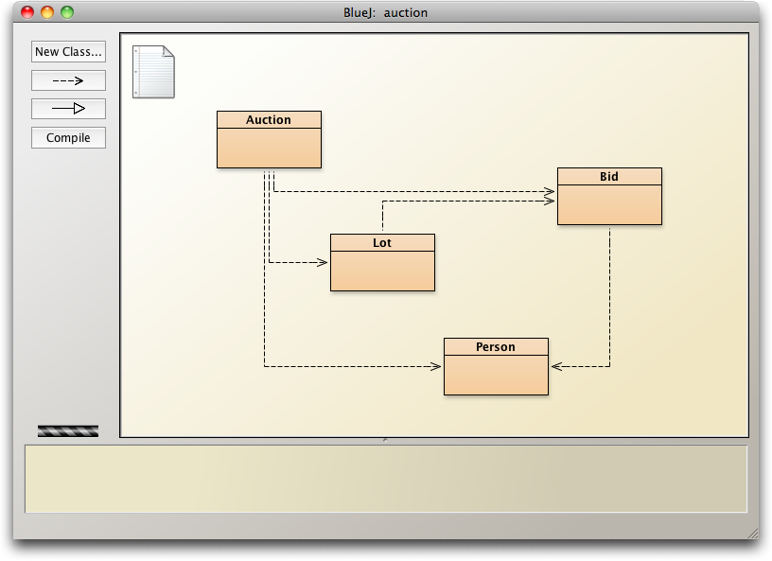
The auction project

Slide 27
null
Used with object types.
Used to indicate, 'no object'.
We can test if an object variable holds the null value: if(highestBid == null) …
Used to indicate ‘no bid yet’.

Slide 28
Anonymous objects
Objects are often created and handed on elsewhere immediately: Lot furtherLot = new Lot(…); lots.add(furtherLot);
We don’t really need furtherLot: lots.add(new Lot(…));

Slide 29
Chaining method calls
Methods often return object references.
We often immediately call a method on the returned reference. Bid bid = lot.getHighestBid(); Person bidder = bid.getBidder();
We can use the anonymous reference concept and chain method calls: lot.getHighestBid().getBidder()

Slide 30
Chaining method calls
Each method in the chain is called on the object returned from the previous method call in the chain.
String name = lot.getHighestBid().getBidder().getName();
Returns a Bid reference from the Lot
Returns a Person reference from the Bid
Returns a String reference from the Person

