Slide 1

Artificial intelligence
Heiderich Valentin
2023
Notes:
Welcome

Slide 2
Content
The Theory
The Brain
Neural Networks in programming
Social Aspects and Politics
AI Act
Notes:
The Content -> The Theory -> The Social Aspects and politics

Slide 3
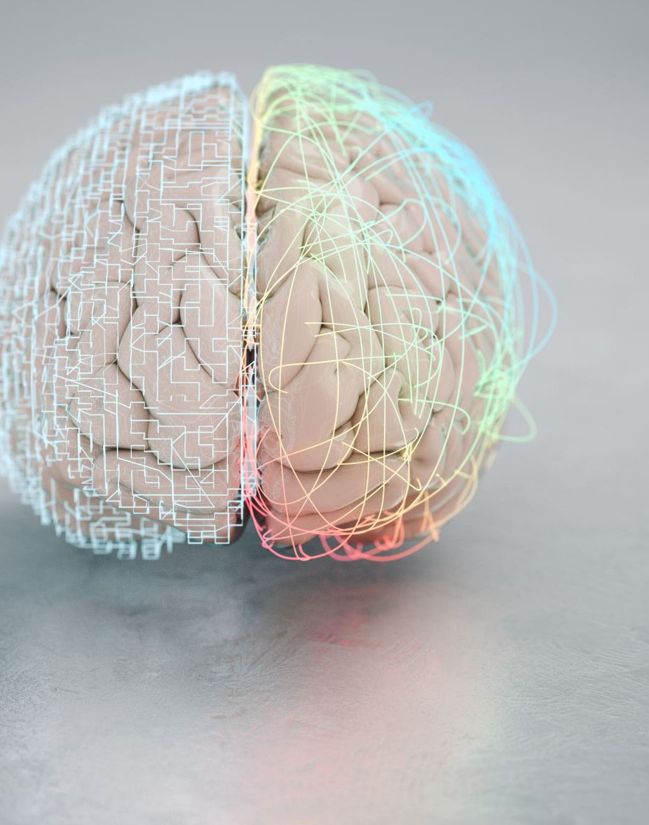
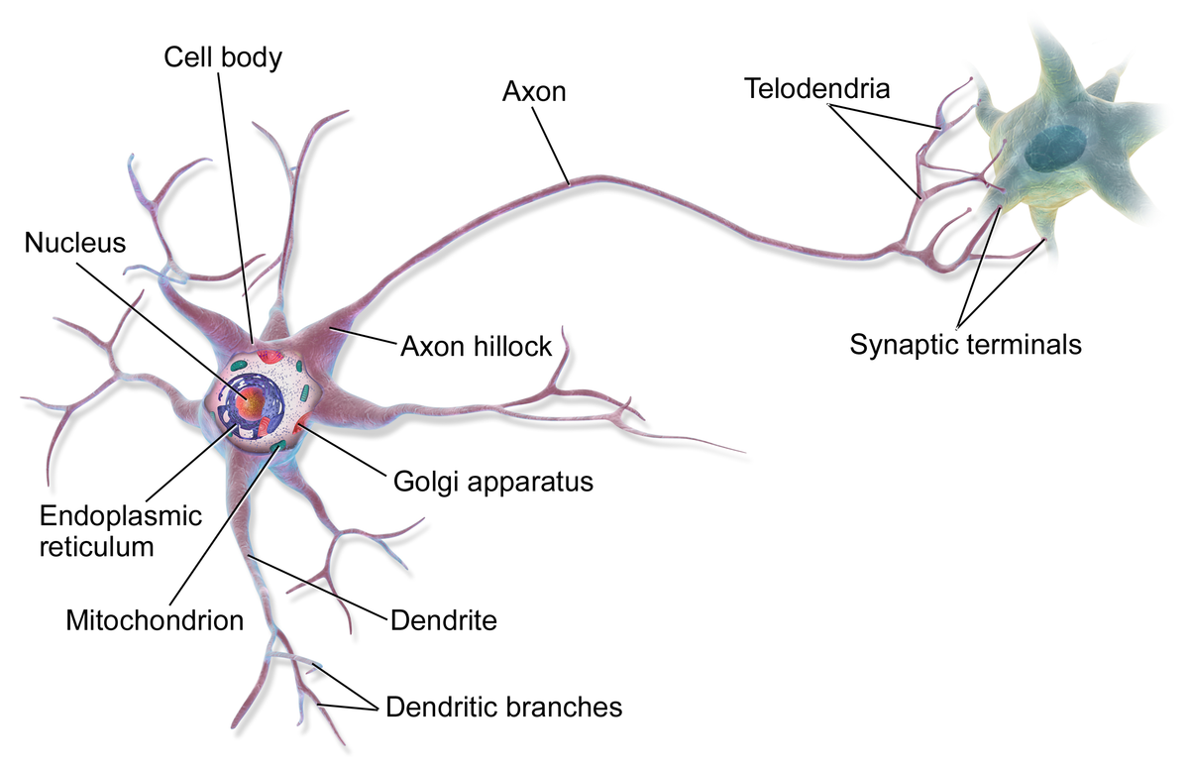
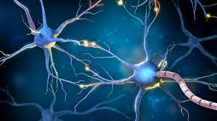
The Brain
Neurons:
Neural Networks:
Image URL
Image URL
Notes:
Our Brain: connected neurons -> neural network
Each neuron will pass charge if triggered by enough charge
How can we represent this in computer sience?

Slide 4
Neural Networks in programming
i0
o0
h0
i1
o1
i2
h0
h0
o2
i3
o3
h1
i4
Notes:
Linear network, h0!=h0!=h1, different layers, different hidden layers, data types, connections, activation functions, clamping

Slide 5
Neural Networks in programming
o0
i0
h2
h3
o1
i1
o2
i2
h0
i3
o3
h1
i4
https://www.youtube.com/watch?v=N3tRFayqVtk
Notes:
Nonlinear, different ways to interpret outputs

Slide 6

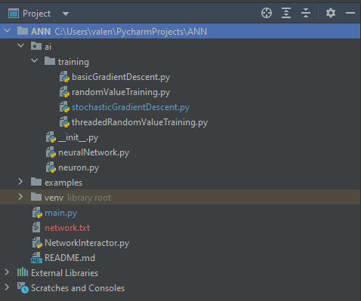
Notes:
Structure of own module for neural networks, python, no external libraries except for debugging, training

Slide 7
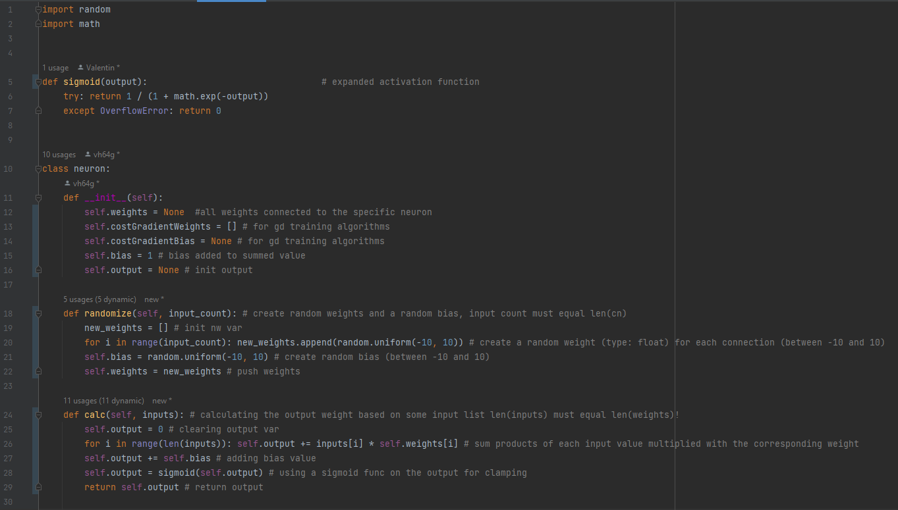
Notes:
Short!

Slide 8
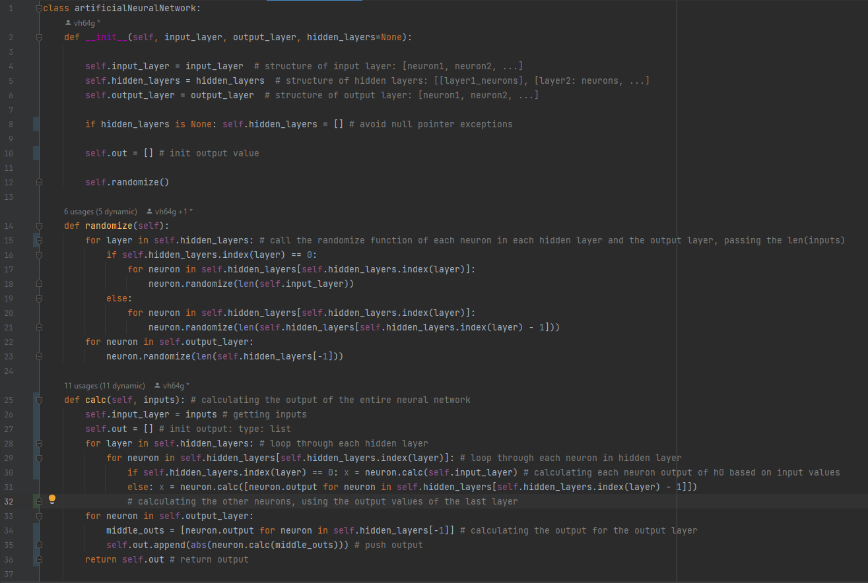
Notes:
Short, nearly no one will understand your code! Just don’t be boring!

Slide 9
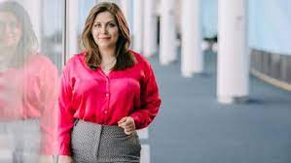
AI Act
Svenja Hahn MEP
Some text ‘bout the AI Act
https://fdphamburg.de/sites/default/files/styles/uv_full_content_large_16_9/public/2023-02/Svenja%20Hahn%20EP.jpg?itok=elfRan2t
https://www.europarl.europa.eu/meps/de/197444/SVENJA_HAHN/home
Notes:
Stuttgart, JuLis, FDP, Europa parliament, law proposal

