Slide 1
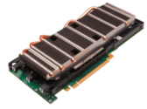
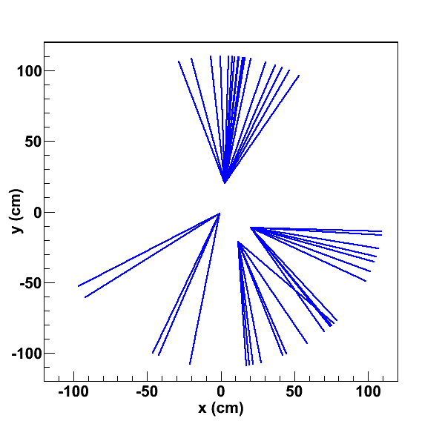
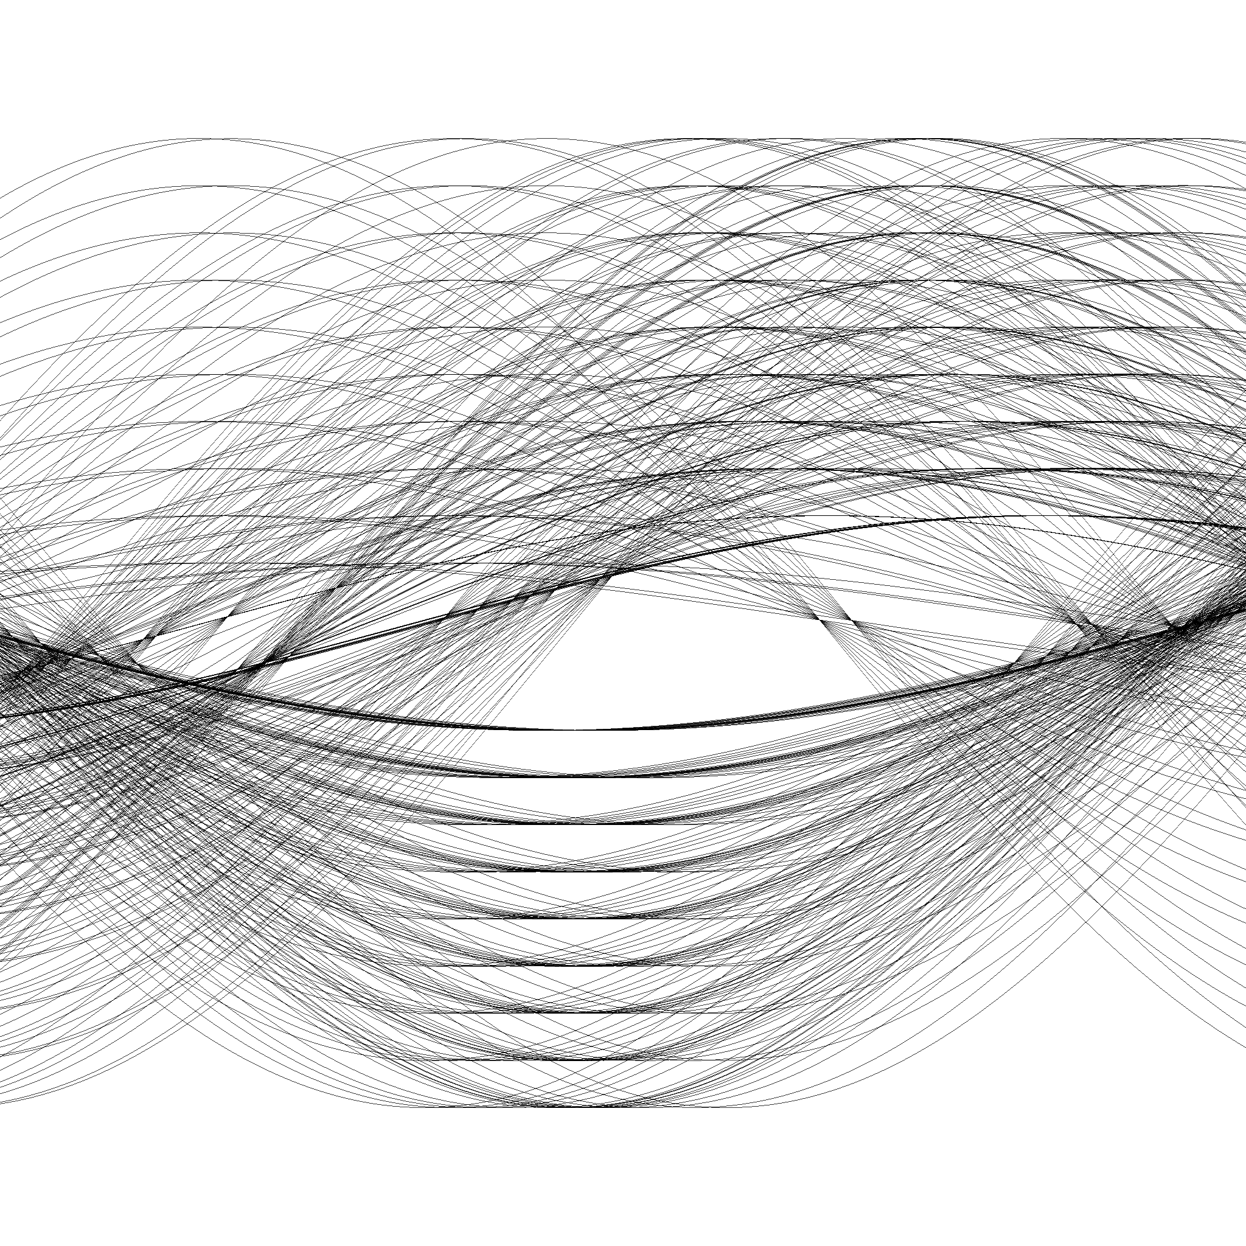

GPU Enhancement of HLT
Floating-Point Operations per Second
for the CPU and GPU
Why GPU ?
GPU uses a highly scalable architecture that closely tracks Moore’s Law
High performance memory system with >= 5x bandwidth compared to CPU
Better performance / Watt compared to CPU
Hardware and software support for moving data directly from network interface to GPU memory
Preliminary implementation shows opportunity to trigger
on displaced jets in the tracker with ~90% efficiency
in an event with 3000 prompt tracks in 70ms
>x60
arxiv 1305.4855
[accepted to JINST]
arxiv 1309.6275

