Slide 1

TITLE: Q3 FY2026 Departmental Budget Report
ORGANIZATION: Northwind Analytics
DEPARTMENT: Finance
SENSITIVITY: Confidential
VERSION: 1.1
EFFECTIVE_DATE: 2026-10-05
Q3 FY2026 Departmental Budget Report
Finance | Confidential | v1.1 | 2026-10-05

Slide 2
1. Executive Summary — At a Glance
Total Actual Spend
$4.2M
vs. $4.5M budget
Overall Variance
6.7%
Favorable (under budget)
Departments Over Budget
1 of 4
Operations

Slide 3
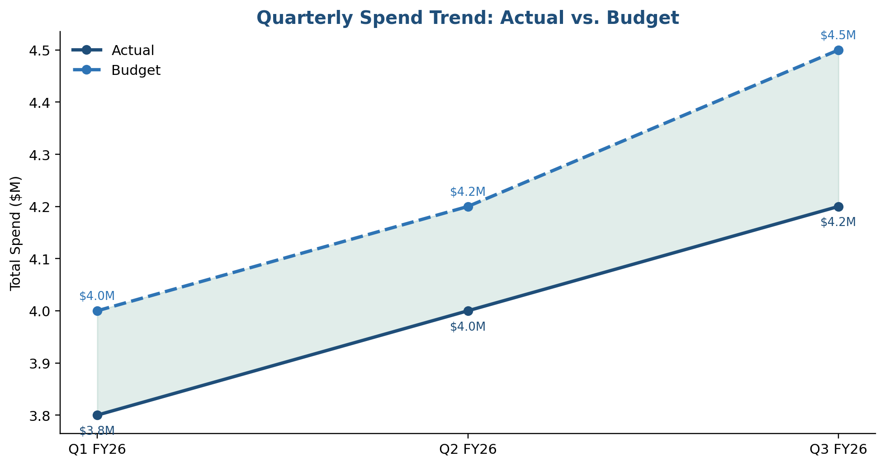
Executive Summary
Total spend for Q3 FY2026 was $4.2M against a budget of $4.5M, resulting in a 6.7% favorable variance.
The variance was primarily driven by delayed hiring in Engineering (3 open headcount unfilled) and lower than expected marketing spend on the Q3 campaign.
Spend has grown steadily quarter over quarter, tracking under budget throughout

Slide 4
2. Department Breakdown
Department | Actual | Budget | Variance
Engineering | $1.8M | $2.0M | 10% under (hiring delay)
Sales & Marketing | $1.1M | $1.2M | 8% under
Operations | $0.7M | $0.65M | 8% over (facilities maintenance overrun)
G&A | $0.6M | $0.65M | 8% under

Slide 5
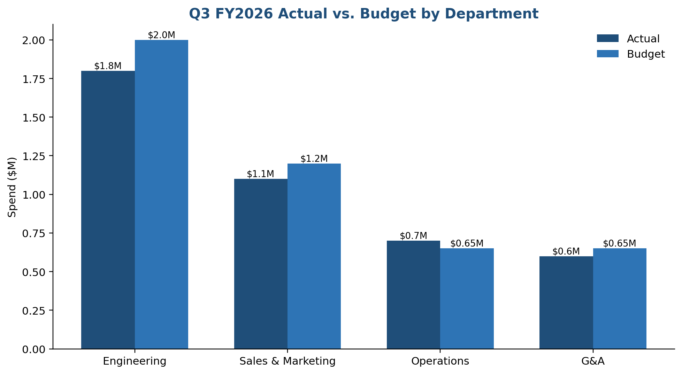
Actual vs. Budget by Department
• Engineering shows the largest favorable variance, driven by the hiring delay discussed in the Key Risks section.
• Operations is the only department over budget this quarter, tied to an unplanned facilities maintenance cost.
Actual vs. budget spend, all four departments

Slide 6
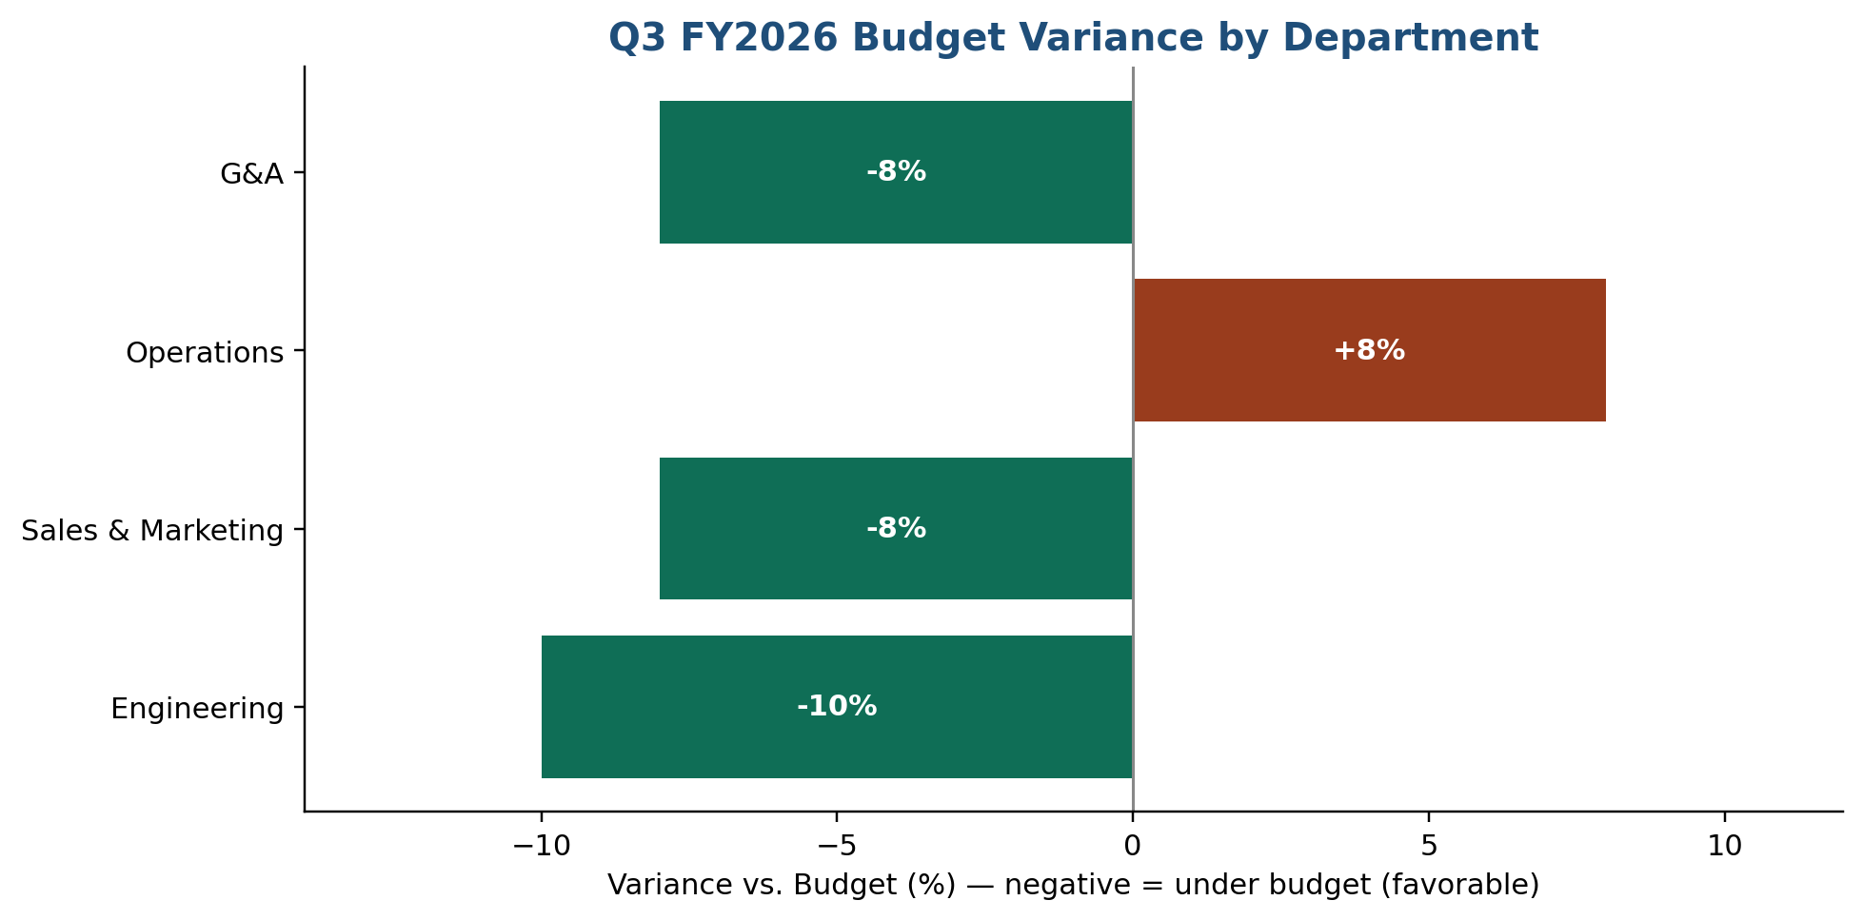
Variance by Department
A closer look at variance as a percentage of budget, by department.
Negative = under budget (favorable); positive = over budget

Slide 7
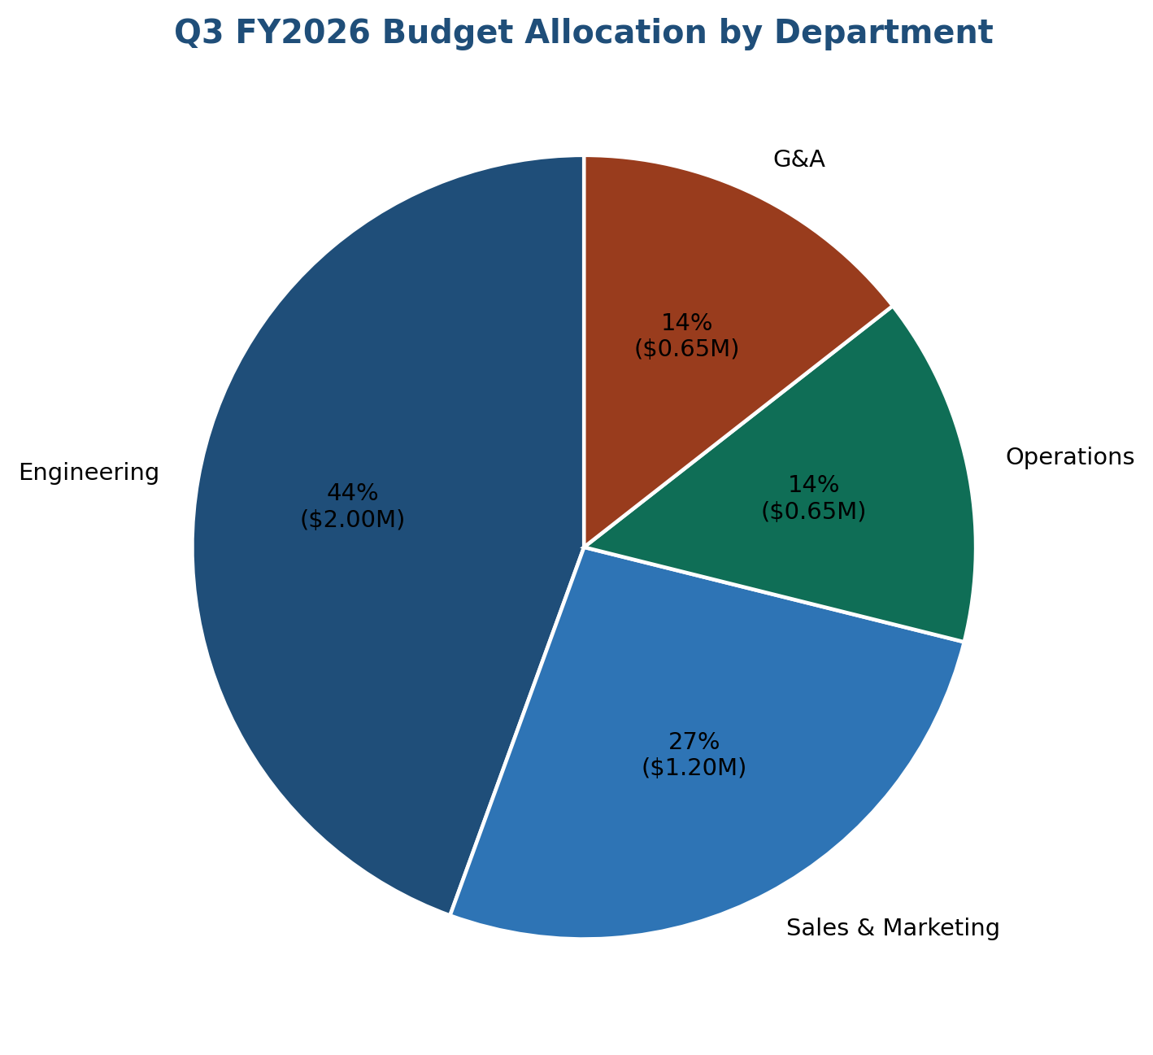
Budget Allocation
Engineering and Sales & Marketing together account for 71% of total departmental budget this quarter.
Share of total Q3 FY2026 budget by department

Slide 8
3. Key Risks for Q4
• Operations overspend trend, if continued, could result in a full-year overrun of approximately $180K; Operations has been asked to submit a cost-containment plan by end of October.
• Engineering hiring delay may catch up in Q4, potentially causing a budget overshoot if all 3 open roles are filled simultaneously.

Slide 9
4. Recommendation
Reallocate $150K of the Q3 favorable variance from Engineering to Operations to cover the facilities overrun, pending CFO approval.

Slide 10
5. Prepared By
Northwind Analytics FP&A Team
finance-fpa@company.com
This departmental budget report is prepared as part of the Q3 FY2026 reporting cycle; see Q3_FY2026_Financial_Report.pdf for the full consolidated financial statements.

