Slide 1

TITLE: Nova CRM — Internal Product Overview
ORGANIZATION: Northwind Analytics, Inc.
DEPARTMENT: Engineering
SENSITIVITY: Internal
VERSION: 2.0
EFFECTIVE_DATE: 2026-04-05
Nova CRM — Internal Product Overview
Engineering | Internal | v2.0 | 2026-04-05

Slide 2
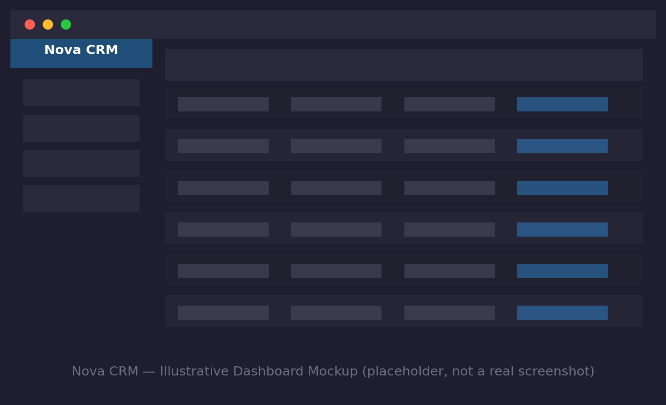
What is Nova CRM?
Nova CRM is our internal platform for managing accounts, opportunities, and the client relationship lifecycle across IT Services and Manufacturing key accounts.
• Version 2 launched in early 2026, replacing the legacy on-premise system.
Illustrative dashboard mockup

Slide 3
Who Uses It
• Sales — pipeline management and forecasting
• Customer Success — account health tracking and renewal management
• IT Services Delivery — client onboarding handoff and engagement tracking
• Manufacturing Key Account Managers — order visibility for top accounts

Slide 4
Core Modules
• Accounts & Contacts — the single source of truth for client relationship data
• Opportunities — deal tracking from qualification through close
• Reporting & Dashboards — pipeline, forecast, and account health views
• Integration Hub — syncs with the ERP system and Manufacturing order tracking

Slide 5
Getting Access
• Access is provisioned automatically for Sales, CS, and Delivery roles during onboarding, per the Employee Onboarding SOP.
• Other roles needing access should request it via the IT Service Portal with manager approval.
• Training modules are available on-demand in the Learning Portal under "Nova CRM Fundamentals."

