Slide 1

TITLE: Q2 Product Launch Retrospective - "Atlas" Release
ORGANIZATION: Northwind Analytics, Inc.
DEPARTMENT: Operations
SENSITIVITY: Internal
VERSION: 1.0
EFFECTIVE_DATE: 2026-07-10
Q2 Product Launch Retrospective - "Atlas" Release
Operations | Internal | v1.0 | 2026-07-10

Slide 2
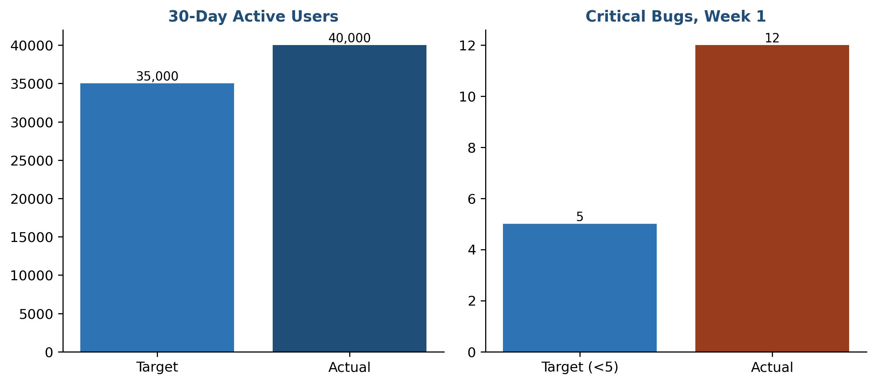
1. Summary
The Atlas release launched on schedule on June 15, 2026, reaching 40,000 active users within the first 30 days against a target of 35,000 (114% of target).
Customer-reported critical bugs were higher than expected in the first week (12 vs a target of <5).
Target vs. actual, key launch metrics

Slide 3
Launch Metrics at a Glance
Metric | Target | Actual | Result
30-day active users | 35,000 | 40,000 | 114% of target
Critical bugs (week 1) | < 5 | 12 | Above target

Slide 4
2. What Went Well
• Cross-functional launch readiness checklist (Engineering, Support, Marketing) was completed 100% on time, a first for a major release.
• Marketing campaign drove 25% more signups in week 1 than the previous major release.
• Support team's pre-launch training (see Customer Support Training Manual) resulted in a 30% faster average resolution time for launch-related tickets compared to the prior release.

Slide 5
3. What Didn't Go Well
• Critical bug count (12) exceeded target due to insufficient load testing under real-world traffic patterns; the QA environment did not simulate the actual user concurrency seen at launch.
• On-call rotation was understaffed for the first 48 hours post-launch, leading to slower incident response for 3 of the 12 critical bugs.

Slide 6
4. Action Items
Owner | Action | Due
QA Lead | Implement production-traffic-pattern load testing before the next major release | Before Q3 release
Ops Director | Increase on-call staffing to 2x normal levels for the first 72 hours after any major release | Immediate, all future launches
Support Enablement Lead | Formalize the pre-launch training program as the standard process for all future major releases | Next release cycle

Slide 7
5. Prepared By
Product Operations
product-ops@company.com

