Slide 1

Paycheck and Billing System: FarmaFACT
Select Topics on Computing Engineering II

Slide 2
Index

Slide 3
Preface
FarmaFACT brings an easier way to create, process & monitor all your company’s money transactions within your company employees and exchange transactions (Sales)
Lets you store your processes, transactions and file media on the Cloud, saving you costs on storage and file usage. (SaaS)
Aligns with your Tax implementations and local government’s mandatory regulations (CFDI 3.0)

Slide 4

Goals
Easy-to-use design |  | Versatile & Dynamic System
For us, it’s crucial to have an intuitive & easy interface, so that implies to have a clean design and a clear browsing for your usage |  | We adapt our system to the on-demand premises, so we design the best platform and give you the best options according to your current business needs
Consolidated Data |  | Tx Monitoring
We use all the high-level security tools (data encryption & user multi-layer authentication methods) to secure the integrity and confidentiality of your information |  | We setlle real-time analytic tools to inspect & monitor all your currency transactions (Tx) and relevant events, so you can get all updated reports & security alerts

Slide 5
MVP
Se inserta aquí el video

Slide 6
Operation Costs of Project
Position | Monthly (MXN) | Yearly (MXN) | Daily (MXN) | Effective hours(h) | Project Cost (MXN)
QA | $ 30,500.00 | $ 2,287.50 | $ 190.63 | 92.5 | $ 17,632.81
Business Analyst | $ 28,500.00 | $ 2,137.50 | $ 178.13 | 143.5 | $ 25,560.94
Developer | $ 32,500.00 | $ 2,437.50 | $ 203.13 | 114 | $ 23,156.25
DataBase Analyst | $ 30,500.00 | $ 2,287.50 | $ 190.63 | 186.5 | $ 35,551.56
Leader | $ 42,000.00 | $ 3,150.00 | $ 262.50 | 39 | $ 10,237.50
Total | $ 164,000.00 | $ 12,300.00 | $ 1,025.00 | 575.50 | $ 112,139.06

Slide 7
Project Timing Costs
Stage | Process | BA | QA | Dev | DBA | Leader
Analysis | Requirement List |  | 2 | 6 |  | 1.5
 | Database Analysis (DB) | 3 |  | 1 |  | 0.5
 | Design Analysis | 2 |  | 2 |  | 0.5
Subtotal |  | 5 | 2 | 9 | 0 | 2.5
Design | Database Modeling |  | 6 | 8 |  | 0.5
 | Graphic Interface Design |  | 8 | 8 |  | 0.5
 | Architecture Design |  |  | 2
Subtotal |  | 0 | 14 | 18 | 0 | 1
Development | Catalog Implementation |  |  | 6 |  | 0.5
 | Backend Development |  | 60 | 60 |  | 0.5
 | Graphic Interface Development |  | 40 |  | 90 | 0.5
 | Infrastructure Creation |  | 12 | 6 | 15 | 0.5
 | Flux Deployment Creation | 0.5 | 0.5 | 4 | 10 | 0.5
 | Containers Creation |  |  | 8 |  | 0.5
Subtotal |  | 0.5 | 112.5 | 84 | 115 | 3
Testing | DB Testing |  |  |  |  | 0.5
 | General Testing | 60 |  |  |  | 0.5
 | Proving Evidences | 24 | 12 |  | 24 | 1
 | GUI Units Testing |  |  |  | 44 | 0.5
Subtotal |  | 84 | 12 | 0 | 68 | 2.5
Product Release | App Deployment |  |  |  | 1.5 | 0.5
Subtotal |  | 0 | 0 | 0 | 1.5 | 0.5
Project management | Business Planning | 1 | 1 | 1 | 1 | 16
 | Risks Analysis | 1 | 1 | 1 | 1 | 5
 | Change Controls | 1 | 1 | 1 | 1 | 8
 | Delivery & Project Closure |  |  |  | 0.5 | 1
Subtotal |  | 3 | 3 | 3 | 3.5 | 30
Total (h) |  | 92.5 | 143.5 | 114 | 186.5 | 39

Slide 8
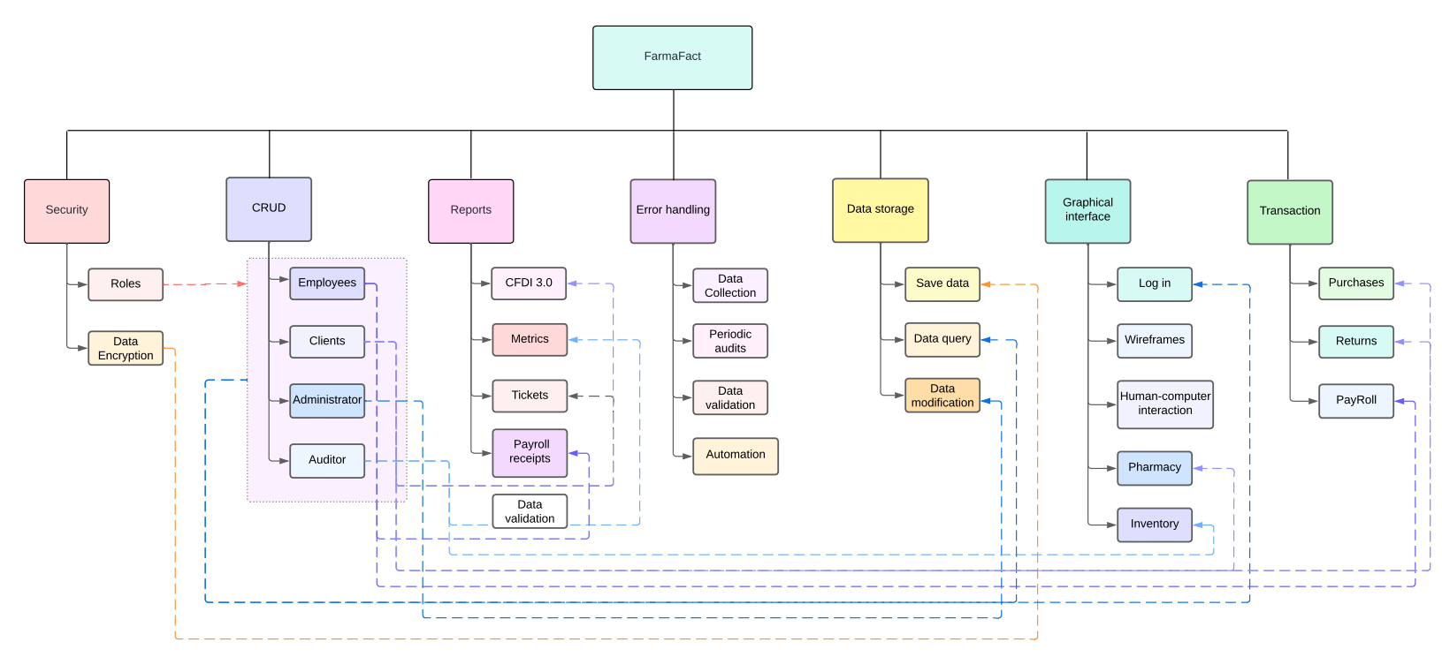
WBS

Slide 9
Project Status (as of End of May, 2024)
Jan 2024 | Feb 2024 | Mar 2024 | April 2024 | May 2024 | June 2024
Start | On track | On Track | Delayed | Delayed | Delayed
Overall | Scope | People Management | Resources | Risks & Issues
n | n | n | n | n
Overall Status: Program is deployed on test platform ready to be released on production, pending testing on end-users. | Route to Green: Will push testing to be delivered the final product before end of June 2024. | Leadership Decision: Will reconsider if program is viable to release on Production to High Management.
I/R | Description | Mitigation/Action | Severity | Owner | Target Date
R | Covid-19 or any disease that can get any team member | Have a backup plan & file documentation stored on a cloud or servers | Low | PM | -
I | Database / Program coding lost due to stolen equipment | Mitigate the consequences of the lost data and recover the process & project updates, save all updates | Medium | All | 19-05-2024
I | University strike | Align to the deadlines and process all work to deliver timely the product | Medium | All | 11-05-2024
Key Milestones | Priority | Baseline | Target | Status
MVP | Medium | Feb-2024 | 20-Apr-2024 | C
Product Testing | Medium | Apr-2024 | 15-May-2024 | G
Product Releasing | High | May 2024 | 25-May-2024 | A
Project Management & Documentation | High | May 2024 | 31-May-2024 | NS
Phase | Planned Activities (Milestones)
MVP | QA validation
Product Testing | Testing Final Users
Product Releasing | Testing & Monitoring
RAG Explanation (non-printing info)
Key:  Blue:- Complete  Green:-On track  Amber: -Off-track with mitigation  Red:-Off-track-no mitigation  Stone:-Not started

Slide 10
Lessons Learned

Slide 11
Thanks for your attention!

