Slide 1

Bioinformatic approaches to regulatory genomics and epigenomics
376-​1347-00L | week 02
Pierre-Luc Germain

Slide 2
Plan for today
Debriefing on the assignments
The notion of gene
Genome builds and transcriptome assemblies
Practical:
AnnotationHub and EnsDb objects
GenomicRanges and their manipulations

Slide 3
Debriefing on the assignment
Many are registered to the course but didn’t give me their github username (nor have forked the repo)
2 students forked the repo but did not upload an assignment

Slide 4
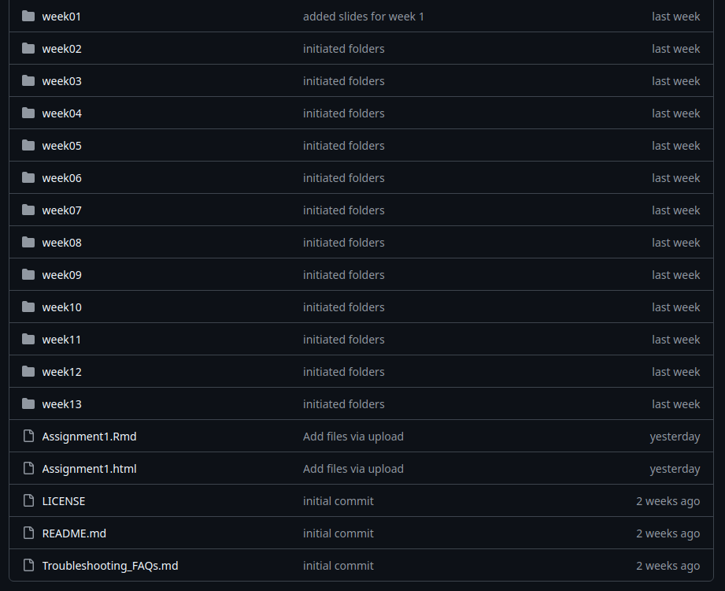
Should
be here

Slide 5
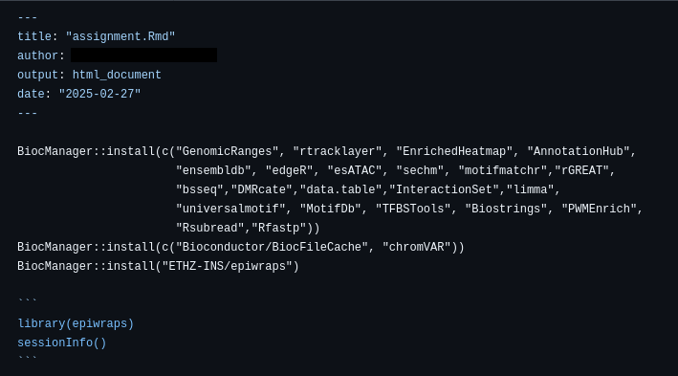
This is a code chunk:
```{r}
```

Slide 6
A very brief history of genetics & genomics
… or why nobody knows how many genes we have

Slide 7
A very brief history of genetics & genomics
1900 - Rediscovery of Mendel’s work (1860s)
1903 - Chromosomes are hereditary units
1913 - Chromosomes are linear arrays of genes
1941 - Beadle & Tatum: the one-gene-one-enzyme hypothesis
1944 - DNA is the genetic material
1951 - First protein sequences
1953 - DNA is a double helix
1961 - Jacob and Monod: the lac operon
1977 - DNA sequencing
1977 - Eukaryotic genes are spliced
1995 - First bacterial genomes sequenced
2000 - Next Generation Sequencing (NGS)
2001 - Draft of the human genome
2003 - RNA-seq
2006 - ChIP-seq
2012 - ENCODE, ATAC-seq

Slide 8
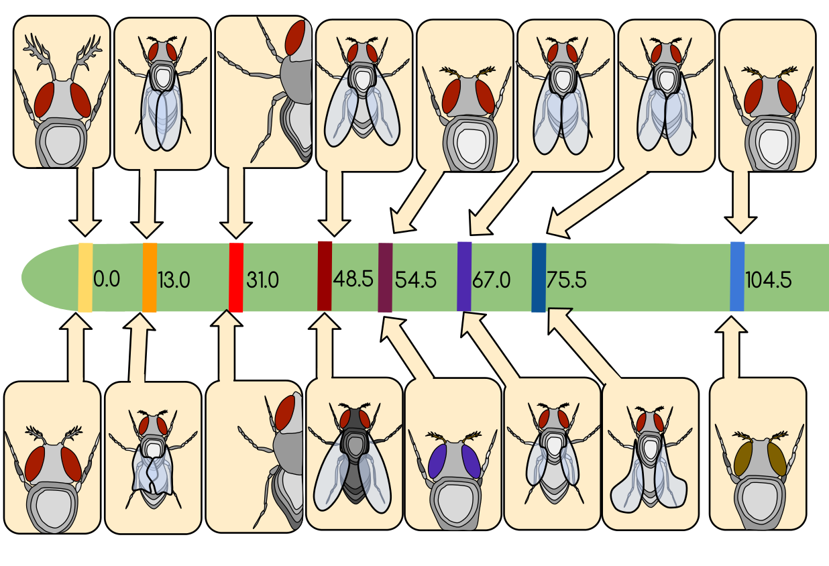
A very brief history of genetics & genomics
1900 - Rediscovery of Mendel’s work (1860s)
1903 - Chromosomes are hereditary units
1913 - Chromosomes are linear arrays of genes
1941 - Beadle & Tatum: the one-gene-one-enzyme hypothesis
1944 - DNA is the genetic material
1951 - First protein sequenced
1953 - DNA is a double helix
1961 - Jacob and Monod: the lac operon
1977 - DNA sequencing
1977 - Eukaryotic genes are spliced
1995 - First bacterial genomes sequenced
2000 - Next Generation Sequencing (NGS)
2001 - Draft of the human genome
2003 - RNA-seq
2006 - ChIP-seq
2012 - ENCODE, ATAC-seq
Classical genetics:
A “gene” is a unit of heredity
Wildtype
Chr2
Mutant
(Morgan's Drosophila genetic map, adapted from
Twaanders17, CC BY-SA 4.0, via Wikimedia Commons)

Slide 9
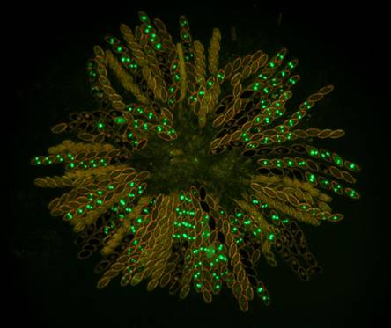
A very brief history of genetics & genomics
1900 - Rediscovery of Mendel’s work (1860s)
1903 - Chromosomes are hereditary units
1913 - Chromosomes are linear arrays of genes
1941 - Beadle & Tatum: the one-gene-one-enzyme hypothesis
1944 - DNA is the genetic material
1951 - First protein sequenced
1953 - DNA is a double helix
1961 - Jacob and Monod: the lac operon
1977 - DNA sequencing
1977 - Eukaryotic genes are spliced
1995 - First bacterial genomes sequenced
2000 - Next Generation Sequencing (NGS)
2001 - Draft of the human genome
2003 - RNA-seq
2006 - ChIP-seq
2012 - ENCODE, ATAC-seq
Classical genetics:
A “gene” is a unit of heredity
(+)
Early
molecular genetics:
A “gene” is a part of DNA that encodes for a protein
Neurospora (Namboori B. Raju, 2003)

Slide 10
A very brief history of genetics & genomics
1900 - Rediscovery of Mendel’s work (1860s)
1903 - Chromosomes are hereditary units
1913 - Chromosomes are linear arrays of genes
1941 - Beadle & Tatum: the one-gene-one-enzyme hypothesis
1944 - DNA is the genetic material
1951 - First protein sequenced
1953 - DNA is a double helix
1961 - Jacob and Monod: the lac operon
1977 - DNA sequencing
1977 - Eukaryotic genes are spliced
1995 - First bacterial genomes sequenced
2000 - Next Generation Sequencing (NGS)
2001 - Draft of the human genome
2003 - RNA-seq
2006 - ChIP-seq
2012 - ENCODE, ATAC-seq
Classical genetics:
A “gene” is a unit of heredity
Early
molecular genetics:
A “gene” is a part of DNA that encodes for a protein
“structural” genes encode for proteins
“regulatory” genes → regulate the structural genes

Slide 11
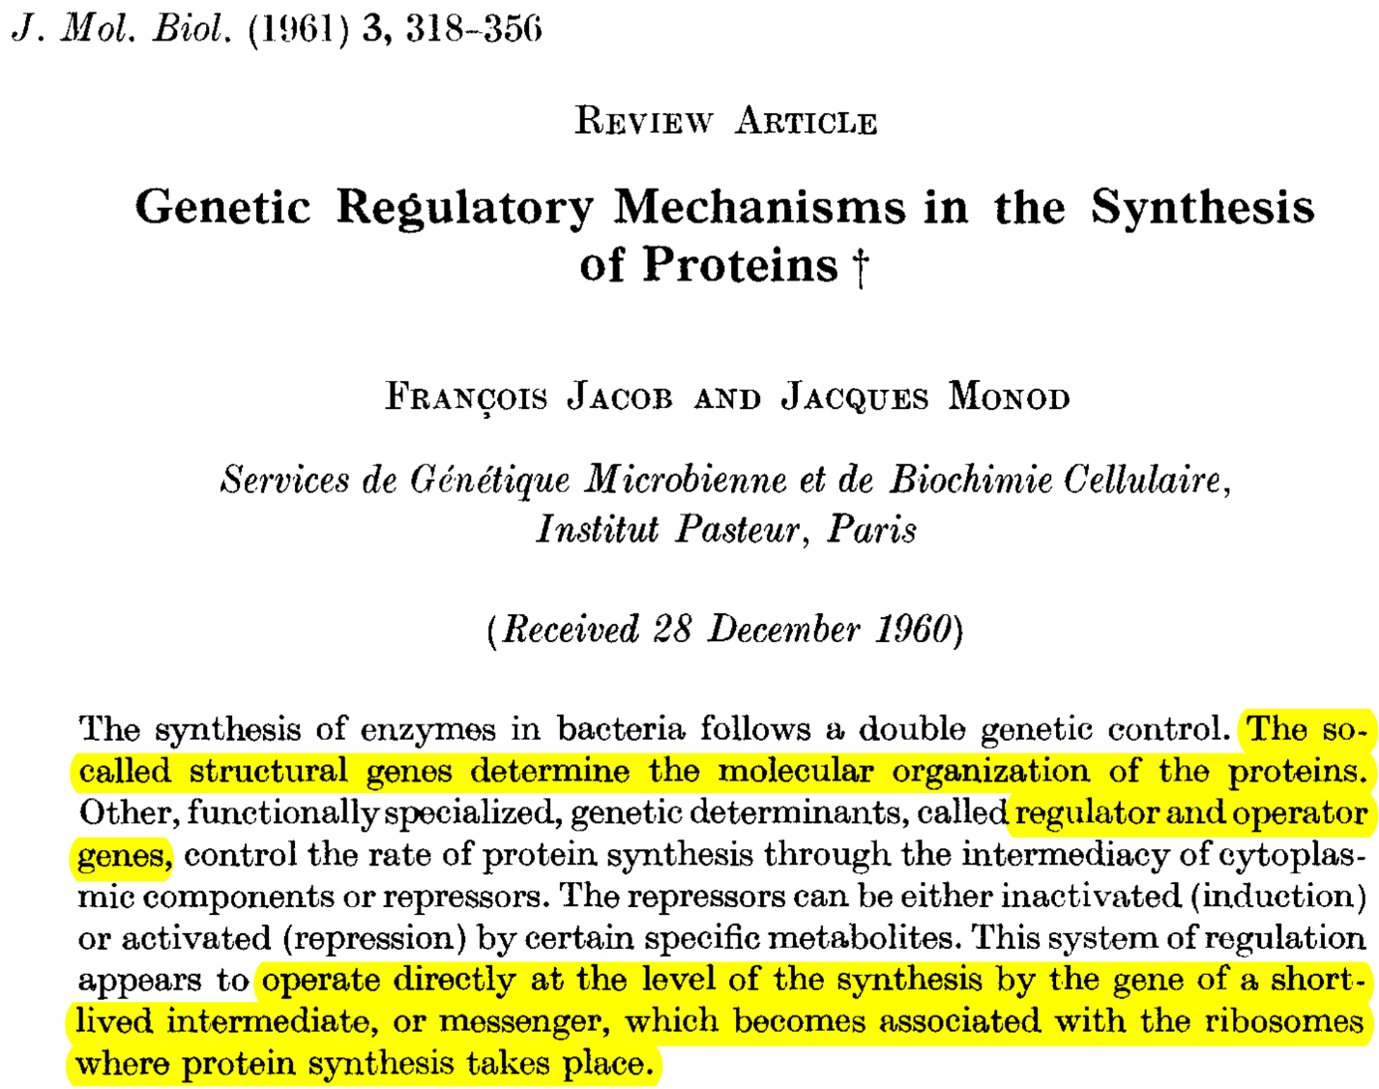

Slide 12
A very brief history of genetics & genomics
1900 - Rediscovery of Mendel’s work (1860s)
1903 - Chromosomes are hereditary units
1913 - Chromosomes are linear arrays of genes
1941 - Beadle & Tatum: the one-gene-one-enzyme hypothesis
1944 - DNA is the genetic material
1951 - First protein sequenced
1953 - DNA is a double helix
1961 - Jacob and Monod: the lac operon
1977 - DNA sequencing
1977 - Eukaryotic genes are spliced
1995 - First bacterial genomes sequenced
2000 - Next Generation Sequencing (NGS)
2001 - Draft of the human genome
2003 - RNA-seq
2006 - ChIP-seq
2012 - ENCODE, ATAC-seq
Classical genetics:
A “gene” is a unit of heredity
Early
molecular genetics:
A “gene” is a part of DNA that encodes for a protein
“structural” genes encode for proteins
“regulatory” genes → regulate the structural genes

Slide 13
A very brief history of genetics & genomics
1900 - Rediscovery of Mendel’s work (1860s)
1903 - Chromosomes are hereditary units
1913 - Chromosomes are linear arrays of genes
1941 - Beadle & Tatum: the one-gene-one-enzyme hypothesis
1944 - DNA is the genetic material
1951 - First protein sequenced
1953 - DNA is a double helix
1961 - Jacob and Monod: the lac operon
1977 - DNA sequencing
1977 - Eukaryotic genes are spliced
1995 - First bacterial genomes sequenced
2000 - Next Generation Sequencing (NGS)
2001 - Draft of the human genome
2003 - RNA-seq
2006 - ChIP-seq
2012 - ENCODE, ATAC-seq
Classical genetics:
A “gene” is a unit of heredity
Early
molecular genetics:
A “gene” is a part of DNA that encodes for a protein
“structural” genes encode for proteins
“regulatory” genes → regulate the structural genes
Genetic elements
Regulatory elements
Transcribed regions
Coding
Non-coding

Slide 14

Ignoble Nano-lectures:
A 24sec technical summary
A 7-words summary everyone can understand

Slide 15

So what’s a gene today?
"The gene is a union of genomic sequences encoding a coherent set of potentially overlapping functional products"
(Gerstein et al., 2007)
“On this view, genes represent a higher-order framework around which individual transcripts coalesce, creating a poly-functional entity that assumes different forms under different cellular states, guided by differential utilization of regulatory DNA."
(Stamatoyannopoulos, 2012)

Slide 16
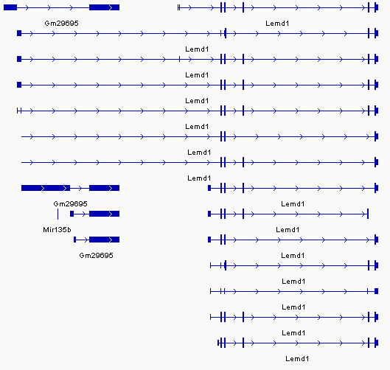
Transcripts tend to be grouped into genes depending on partially overlapping exonic sequences

Slide 17
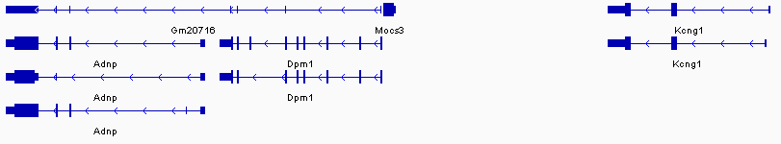
But of course that’s not a universal rule…

Slide 18
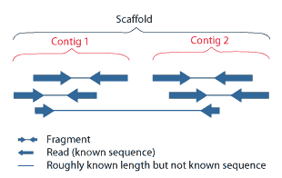
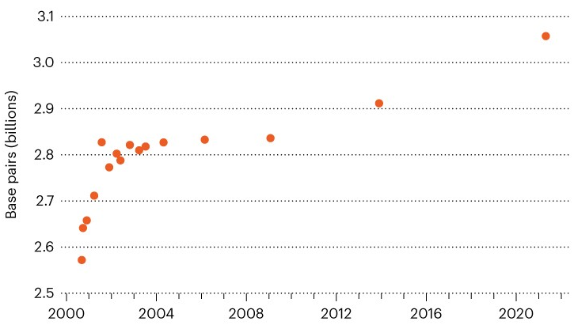
Reference genomes and gene annotations
The reference genome refers to the sequence of the genome of a species.
For mainstream organisms (e.g. human/mouse), there is one standardized genome (from the Genome Reference Consortium) which everyone uses, but different build versions of that genome, e.g.:
Human:
GRCh38/hg38 (released in 2013)
GRCh37/hg19 (released in 2009)
...
Mouse:
GRCm39/mm39 (released in 2020)
GRCm38/mm10 (released in 2011)
GRCm37/mm9 (released in 2007)
...
…CAGTCAAGGGTTTnnnnnTGACATACCT…
(Reardon, Nature News 2021)

Slide 19
Reference genomes and gene annotations
The reference genome refers to the sequence of the genome of a species.
For mainstream organisms (e.g. human/mouse), there is one standardized genome (from the Genome Reference Consortium) which everyone uses, but different build versions of that genome, e.g.:
Within each genome build, there are also patches:
GRCh38.p13 (released in 2019)
GRCh38.p12 (released in 2017)
…
Human:
GRCh38/hg38 (released in 2013)
GRCh37/hg19 (released in 2009)
...
Mouse:
GRCm39/mm39 (released in 2020)
GRCm38/mm10 (released in 2011)
GRCm37/mm9 (released in 2007)
...
Coordinates are stable within a build, but not across builds

Slide 20

Reference genomes and gene annotations
The reference genome refers to the sequence of the genome of a species.
For mainstream organisms (e.g. human/mouse), there is one standardized genome (from the Genome Reference Consortium) which everyone uses, but different build versions of that genome, e.g.:
Annotations refer to the catalogues of regulatory elements, genes and transcripts associated to a genome.
There are two main sources for gene annotations (aka “gene builds”) :
Ensembl NCBI/Refseq
example transcript:
ENST000012343.2
ENST000012343.1
ENST000012343.1
Human:
GRCh38/hg38 (released in 2013)
GRCh37/hg19 (released in 2009)
...
Mouse:
GRCm39/mm39 (released in 2020)
GRCm38/mm10 (released in 2011)
GRCm37/mm9 (released in 2007)
...
104 (may 2021)
103 (nov 2020)
102 (april 2020)
…

Slide 21
Accessing ensembl annotations
http://ftp.ensembl.org/pub/
contains various types of data, most importantly:
.fasta files: sequences
(e.g. DNA or cDNA)
.gtf/.gff files: gene models
(i.e. exon coordinates and inclusion into transcripts)
AnnotationHub
Standardized access to a large variety of annotations
including genomes, gene annotations (e.g. EnsDb objects) and more
Your query
Your computer
AnnotationHub
package
AnnotationHub
server
cache

Slide 22
Further information
See the documentation of the ensembldb package for manipulating EnsDb objects
See the documentation of the GenomicRanges package for manipulating GRanges objects (and their derivatives)

Slide 23
Assignment for this week
Using AnnotationHub, find and download the following annotations data:
The mouse (Mus Musculus) EnsDb object, version 102, genome build GRCm38
The mouse genome sequence ( dna_sm ) in TwoBit/2bit format for GRCm38
The drosophila melanogaster genome sequence ( dna_sm ) in TwoBit/2bit format for BDGP6
Using the mouse EnsDb, find the following:
How many different ensembl gene IDs and gene symbols are there for protein-coding genes?
Plot the distribution of the (spliced) length of protein-coding transcripts
(tip: this will require you to extract exons of protein-coding transcripts from the database, and split them by transcript, before summing the width of the exons of each transcript)
Name your markdown file ‘assignment.Rmd’, render it, and put it (along with the produced html) in the week02 folder of your repository, and push!

