Slide 1
Reatha
[gaelic: current, up-to date]
Idea,
Features,
Use-Cases,
Specification Draft,
Author: Valentin Heinitz
Date: 2013-02-23
Contact: http://heinitz-it.de

Slide 2
Idea
Basic idea: Remote monitoring of any device, e.g. refrigerators, production lines, alarming systems, home automation systems, labor equipment, servers, etc.
Webserver is used as a proxy between the monitored device and monitoring client.
Internet
Webserver
Http (control-flow)
Local Network
Http (data-flow)
Local Network
Monitored
Device
Http (control-flow)
Http (data-flow)
Monitoring
Client

Slide 3
Architecture
Basic abstractions:
Domain – Similar to subdomain of a website. Logical separation of one company/project/device having it's own users, devices, look&feel
Admin – user with privilegs for managing domains,
User – User able monitor devices, configure notifications, etc. within one domain
Device – Logical configuration- and data area for one real device located anywhere in the world.
DataItem – Data structure for one process-variable (Current value, Timestamp, Min/Max, etc.)
View – UI for monitoring/managing Device by user
Domain
Admin
Device
User
contains
manages/monitores
device via
DataItem
View

Slide 4
Login
User:
Password:
Login>>
Register>> | Lost Password?>>
Reatha :: Copyright 2013 :: Impressum
Login UI is the same for all domains. After logging in, the user should see only domain-views for which she has privilegs.

Slide 5
Registering
User:
Password:
E-Mail:
Domain:
Submit>>
Reatha :: Copyright 2013 :: Impressum
Users applying for registration should know the domain, they are assigned to and provide it to the registration form.

Slide 6
Admin Login
Domains | <MenuItem> | <MenuItem>
Domain1
Project/customer description
Domain2
Project/customer description
Domain3
Project/customer description
-
+
Admin manages domains and domain-admins. Admin has no privilegs for managing devices or domain-users

Slide 7
Domain-Admin Login
Device list
Devices | Users | <MenuItem>
Device 1
Device description
Device 2
Device description
Device 3
Device description
-
+
Domain-Admin manages devices and assigns users to devices

Slide 8
Domain-Admin Login
Device Configuration
Devices | Users | <MenuItem>
Device 1:
Description:
Location:
Users:
-
+
Domain-Admin manages devices and assigns users to devices

Slide 9
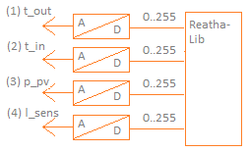
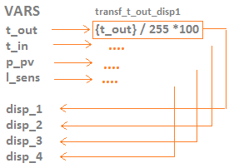
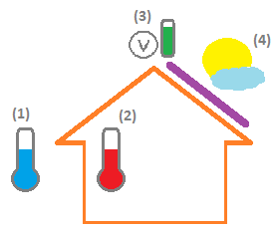
Data and Views
Variables and Transformations
Let's take as example a home automation system. One subset of the variables in such a system could reflect tempeature and power related data tapped from sensors. Unfortunatelly, the client doesn't know, how the data should be displayed. So, „raw“ value from A/D conversion are sent to Reatha server as variables t_out, t_in (for inside/outside temperatures), p_pv (power of photovoltaics), l_sens (light sensor).
A transformation makes some operation on a given variable and stores the result in another variable. For instance scales the value to max scale of 100(%).

Slide 10
Data and Views
Rules for Transformations
Transformations scale, map or make any other conversion on the device-variables for making them suitable to use in views
Var_in
Transformation1
Var_out_1
...
Transformation2
Var_out_N
Transformation may be triggered by any variable delivered from device
One device-variable may trigger many transformations
The result of transformation may be stored in any variable, but this change f out-variable shouldn't trigger further transformation
Example:
temp[0..255]=100
({temp}/255)*50 - 10
Vtemp=9.6
Mapping A/D value to scale -10°..40°
{temp} < 50 ? 1 :
{temp} < 200 ? 2 : 3
2
Not linear mapping to
1 (below 0°),
2 (0°-30°)
3 (above 30°)
The output value bay be used e.g.
for switching an icon

Slide 11
Data and Views
Rules for Transformations (continued)
Var_in_tr
Transformation
Var_out_1
Var_in
Transformation is triggered by only one variable but may use any orbitrary variables in term.
Example:
temp_in
{temp_in}/{temp_out}
var_whatever
temp_out

Slide 12
Data and Views
View-Rules
A view defines how the device-data or a subset of device-data is displayed to the user.
One device may have many views
The views have names, which may be used current view-placeholders
The views are chunks of html having placeholders. The placeholders are replaced by appropriate values, before the view is rendered in browser.
The user gets “main“ view at the beginning. If no view is defined, the user can't go to device's view from device-list. The device is only displayed as devices-list entry in this case.
Device
View:main
View:view2
...
View:viewN

Slide 13
Data and Views
View-Rules - Example
Attention, this example shows pseudo HTML-code, especially concerning positioning.
View:main
<div class=“background“ img=“{:domain}/house.png“>
<div class=“termometer“ x=“0“ y=“200“ value=“{disp1}“ />
<div class=“termometer“ x=“100“ y=“200“ value=“{disp2}“ />
<div class=“powerview“ x=“150“ y=“0“ value=“{disp3}“ />
<div class=“sunicon“ x=“200“ y=“20“ value=“{disp4}“ />
</div>
<a href=“{::alarm}“ />ALARM&gt&gt;</a>
The example shows, how a view may be defined.
The names in {} are placeholders, which should be replaced by appropriate values:
{:<name>} - placeholder for domain path. May be used to reference images
{::<name>} - placeholder for views. May be used to change view.
{<name>} - placeholder for variables
ALARM>>

