Slide 1
Biological Data CSV
Volker Hoffmann (volker@cheleb.net)

Slide 2
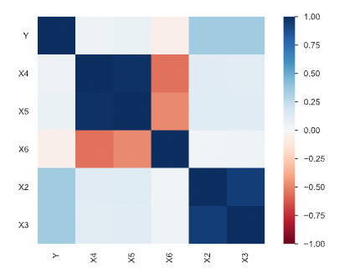
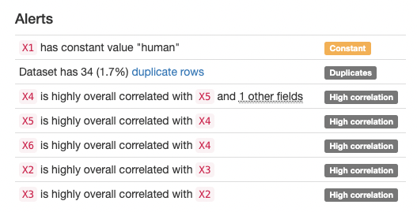
Data 1/2
Drop One?
PCA?
Drop
Drop
Drop One?

Slide 3
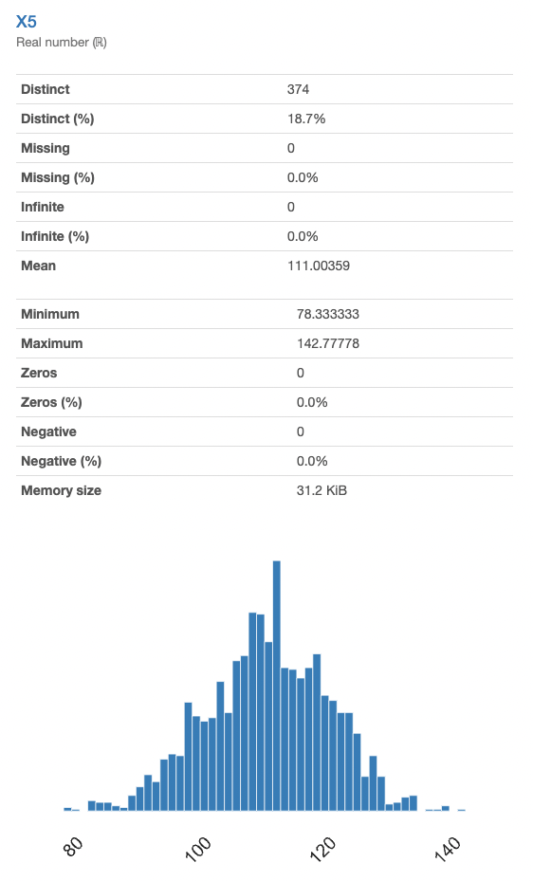
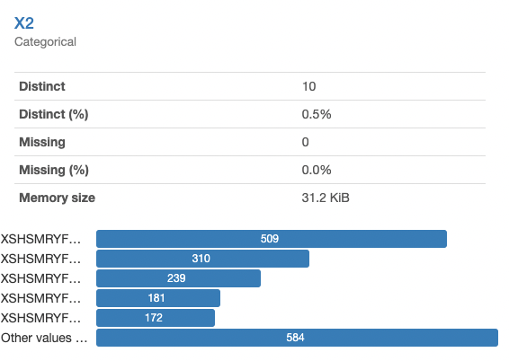
Data 2/2
Encode as One-Hot / Label
(Same for X3)
“Dummy Variable Trap”!
🦄 Np.rand.randn * 20 + 110 → ?
(X4, X6 also look like this)

Slide 4
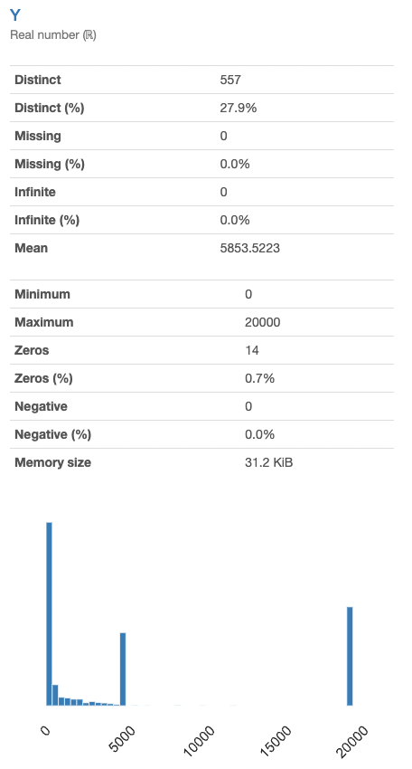
Regression 1/3

Slide 5
Regression 1/3
Probably tricky… (look at histogram!)
3 Models
XGBoost
SVM
Ridge Regression (LinReg + Regularization)
Rescaled Features to ~[0,1] (SVR/LinReg Care)
5-Fold Cross-Validation
(Negative) Mean Squared Error

Slide 6
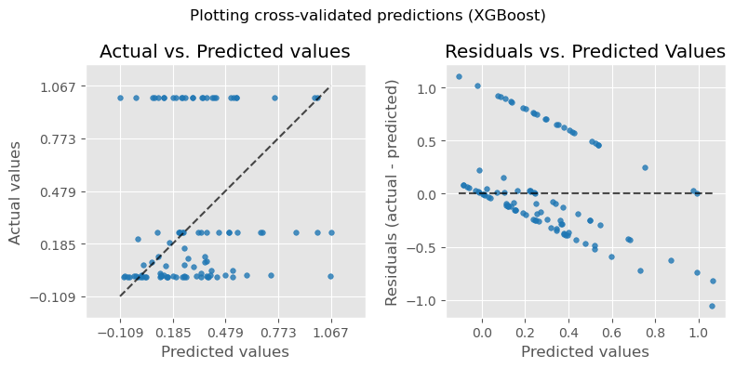
Regression 2/3

Slide 7
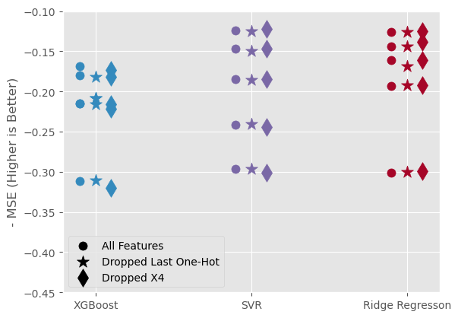
Regression 3/3

Slide 8
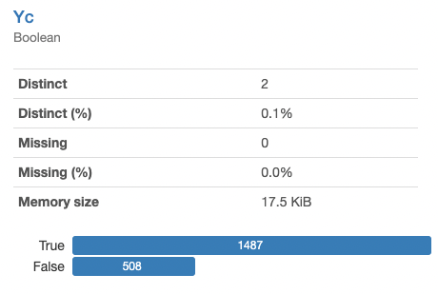
Classification 1/3

Slide 9
Classification 1/3
Probably easier
Slightly imbalanced
Precision-Recall (instead of ROC Curve)
3 Models
XGBoost
SVC
LogReg
5-Fold Stratified CV

Slide 10
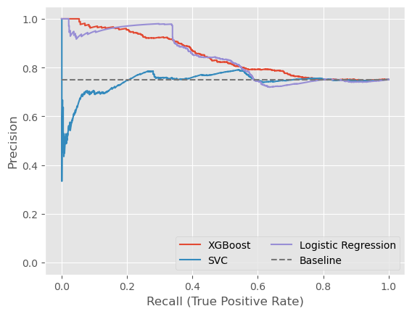
Classification
Predict Y=True (75%)

Slide 11
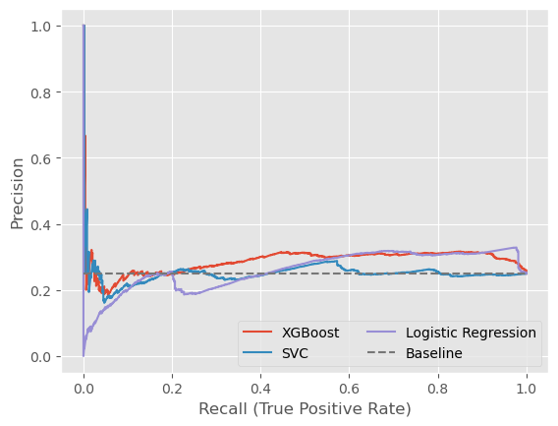
Classification
Predict Y=False (25%)
Minority Most Interesting

Slide 12
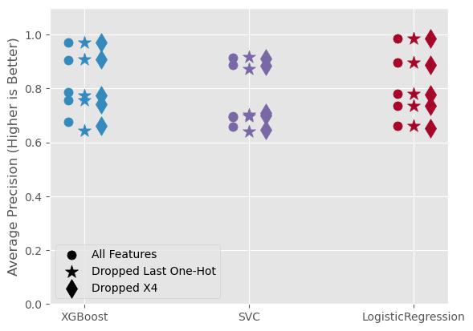
Classification
Predict Y=True

Slide 13
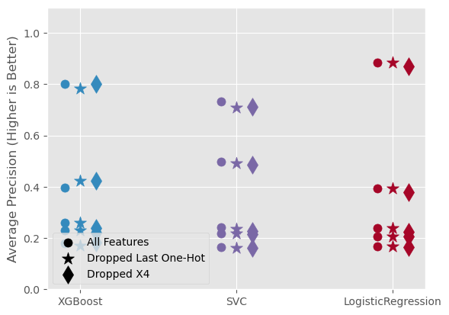
Classification
Predict Y=False

Slide 14
Conclusion 1/2
Classification
LogReg or XGBoost do best (except at low thresholds)
XGBoost is the only one that stays above the baseline (“coin-toss”)
SVC isn’t doing very well
Regression
Is really hard (target distribution is step-functiony), cf. horizontal stripes
Overall, I’d go with XGBoost
It’s also “explainable”, so yay

Slide 15
Conclusion 2/2
X4 seems redundant
Models don’t really change with/without
Dropping one column from the one-hot encoded doesn’t matter
Models don’t change much with/without

Slide 16
What Now?
Multi-Class Prediction?
More Preprocessing
PCA? TDA?
Deal with noisy features? (X4, X5, X6)
→ Fit Gaussian and take delta to be left with something interesting
→ Or something more sophisticated (whitening / decorrelation)
Try dropping X6?
Drop one of one-hot? (Correlated)
Pipeline in Sklearn
Explainability

