Slide 1

Time Use During the Pandemic
Differences from the Great Recession and Gender Gaps
Himani Verma

Slide 2
Introduction
Pandemic disrupted lives and changed lifestyles
Social distancing policies restricted people to their homes
Unemployment rate climbed 14.8 percent
How did people reallocate time that they didn’t work across other categories?
Notes:
The 2020 pandemic disrupted lives of people around the globe by introducing practices of social distancing and work categorization (essential vs non-essential), which confined individuals to limited spaces of their homes. The unemployment rate climbed to 14.8 percent in April 2020, remained over 10 percent until July 2020, and hovered around 6 percent till April 2021 (Bureau of Labor Statistics (2020-2021)). Job losses and stay at home measures altered the overall lifestyle of people. How did people who lost their jobs and/or stayed at home allocate their time to various daily activities? How did it differ from another notable recession of the century? Were there any differences in time allocation across genders? These are few of the questions that my research seeks to explore and provide evidence for.

Slide 3
Literature Review
Time use studies:
Studies on allocation of time to different activities during the Great Recession: Aguiar et al. (2013)
Pandemic period literature:
Women’s employment in Pandemic recessions: Alon et al. (2020, 2021)
Women with children affected due to school and daycare closures: Albanesi and Kim (2021)
Notes:
The usage of time use survey data to study individual responses to business cycles has been prevalent in the literature. Aguiar et al. (2013) study the allocation of the foregone market work hours during the Great Recession of 2008 using ATUS data from 2003 to 2010. Approximately 50 percent of these foregone work hours was absorbed by leisure, which labels activities like time spent watching TV and sleeping, followed by approximately 30 percent for home production, which includes household chores and shopping, as well as increased time allocation across categories such as childcare, education, and health. Burda and Hamermesh (2009) use pre-recessionary data from 2003-2006 and find that the unemployed reallocate most of their time toward leisure and personal maintenance rather than household production. The evidence is furthered in Krueger and Mueller (2012), which uses time use data from multiple international sources across 14 countries between an expanded timeline of 1991-2006, and conducts research to estimate job search intensity among unemployed individuals, which is found to be significantly driven by wage dispersions.
Recent literature analyzing the pandemic recession has concentrated on the disproportionate job loss of women in the labor market. Alon et al. (2020) discuss the loss of high contact service industries which had greater proportions of women employees. Albanesi and Kim (2021) extend upon that analysis and report that both inflexible and flexible, highcontact occupations, the ones which can be seen as most adversely affected by the pandemic, were primarily female dominated.

Slide 4
Data
BLS American Time Use Survey: 2003-2020
Category definitions as in Aguiar et al. (2013)
Market work
Job Search
Childcare
Non-market work
Leisure
Other
Notes:
For my thesis, I use the American Time Use Survey: Microdata Files (2003-2020), abbreviated as ATUS, to analyze the impact of the pandemic on time allocation of individuals across various categories. This paper is an extension of the paper by Aguiar et al. (2013) which focuses on analysis related with time allocation of the foregone market work hours during the Great Recession. I employ the same definitions of the seven categories as the authors discuss in the paper and use their descriptive statistics for years 2003-2010 for comparison.

Slide 5
Research Question
How do the lifestyle differences compare to the Great Recession?
The Pandemic Recession disproportionately affected women
How did the two gender groups substitute market work to other categories?
Notes:
First, I am interested in studying the differences between the Great Recession and the pandemic recession from a time use perspective. This is to distinguish between the lifestyle implications of the two recessions and discuss how the pandemic recession is different than other typical recessions. Second, I want to extend this analysis to research into the variation in time allocation for men and women. Since women were disproportionately affected in the labor market during the pandemic recession, I am interested in estimating the difference in their time use against men, as well as other subgroups – single, married, and mothers with young children.
I discuss the implications of my results for business cycle models studying substitution behavior among gender groups and non-separable preferences of people between leisure and market work.

Slide 6
Importance
Business cycle models studying:
Non-separable preferences of people between leisure and market work
Substitution behavior among gender groups

Slide 7
Descriptive Statistics

Slide 9
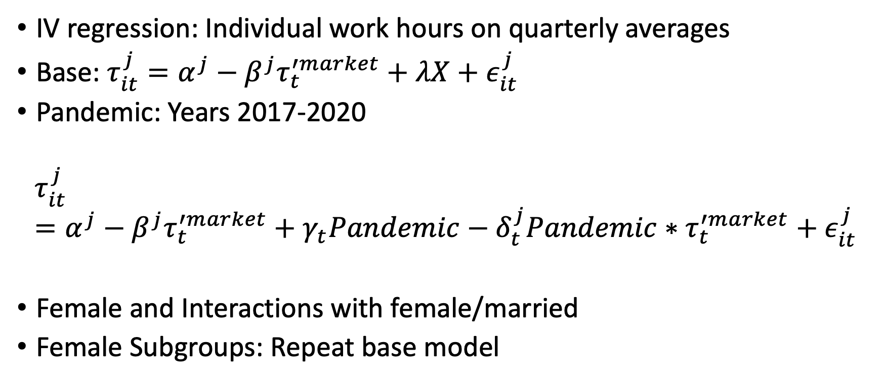
Empirical Model
IV regression: Individual work hours on quarterly averages
Base: $τ_{it}^{j}=α^{j}−β^{j}τ_{t}^{′market}+λX+ε_{it}^{j}$
Pandemic: Years 2017-2020
$$τ_{it}^{j}=α^{j}−β^{j}τ_{t}^{′market}+γ_{t}Pandemic−δ_{t}^{j}Pandemic∗τ_{t}^{′market}+ε_{it}^{j}$$
Female and Interactions with female/married
Female Subgroups: Repeat base model
Notes:
I use an instrumental variables approach to estimate the reallocation of the foregone market work hours across different categories. I instrument individual market work hours by the quarterly average of market hours. By isolating the component of average quarterly market hours correlated with individual market hours, I address measurement error issues related with ATUS’ data collection during the pandemic.

Slide 10
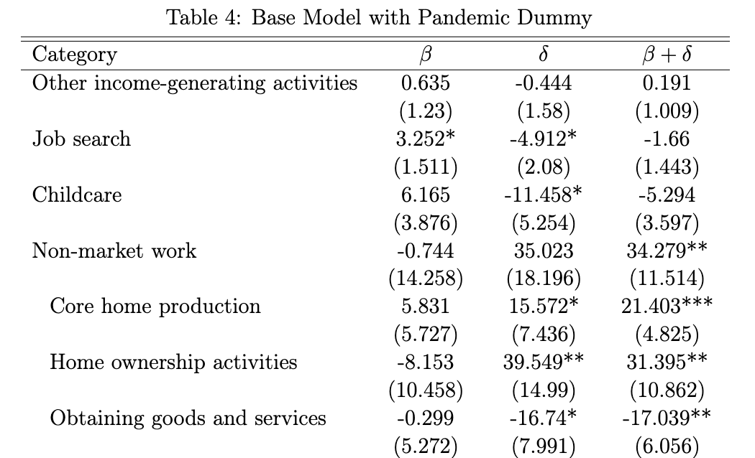
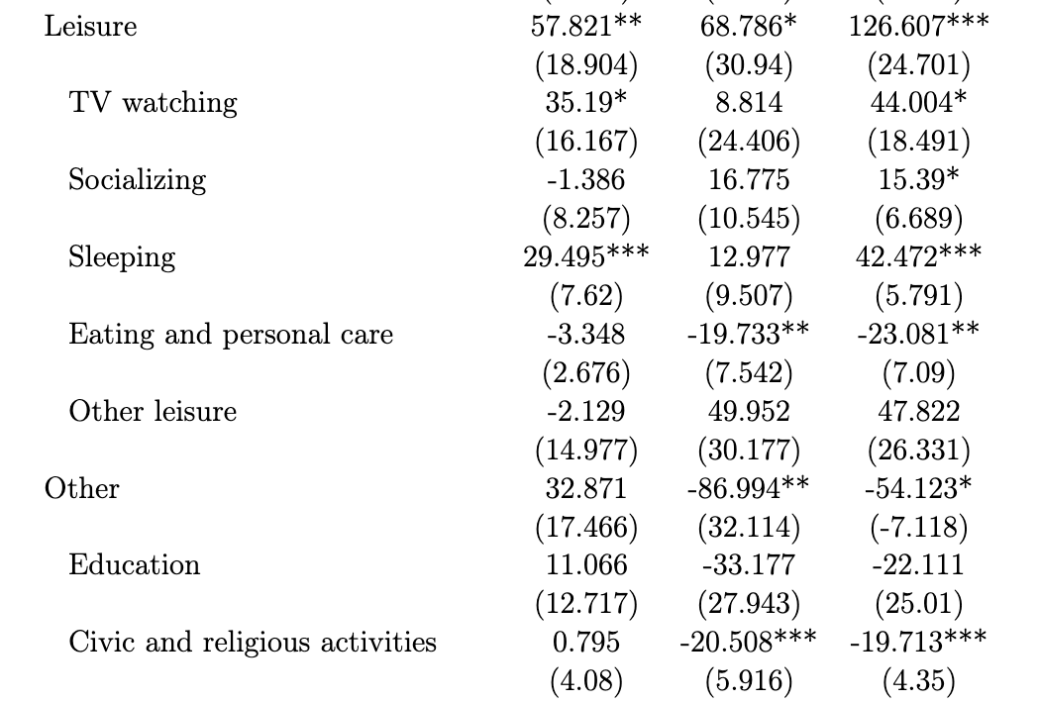
Results: Comparison w/ GR

Slide 11
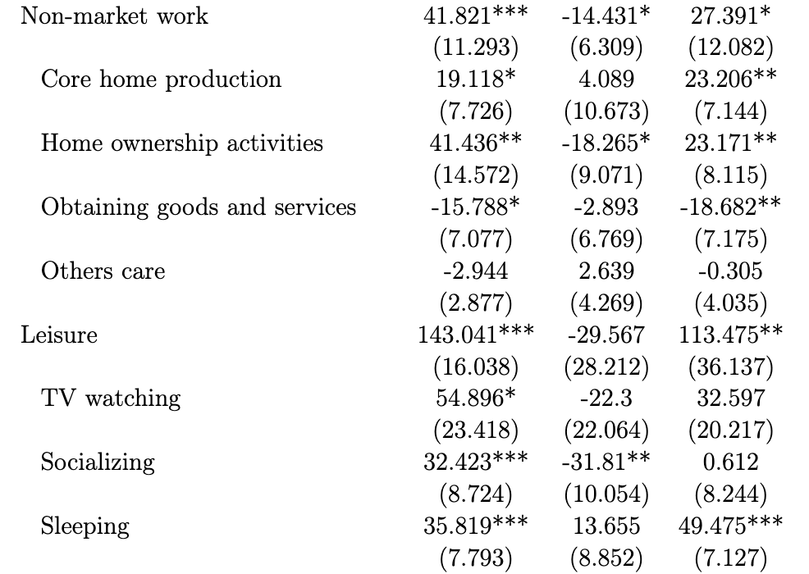
Results: Gender Gaps
Men spent more time on home ownership
Among leisure, TV watching hours for men, while women substituted more hours to sleeping
Women devoted more time to education than men

Slide 12
Results: Female Subgroups
Single vs Married women:
Married women spent less time on job-search (-1.387*)
Single women substituted about 11.34 percent of their foregone work hours to childcare
Married women spent -15.626 hours less
Increase in childcare is offset by decrease in non-market work activities and increase in sleeping

Slide 13
Results: Female Subgroups
Single vs Married women with young children:
Single women substituted about 16.38 percent of their foregone work hours to childcare
No significant changes for married women
Married women spent more time on non-market work than leisure

Slide 14
Robustness Checks
Intensive Margins
The comparisons across the changes in responsiveness of market work hours when conditioned on employment status show that the reallocation of market work time is stable across different labor market states across both the recession periods as well as during the pandemic period

Slide 15
Conclusion
Substitution of foregone market hours mostly to leisure, especially watching TV and sleeping
Non-market work activities also increased
Decrease in hours spent on outdoor activities, like shopping and civic and religious activities
Females: childcare results are significant for single women, especially with young children

Slide 16
Further Research
Data was restricted to 7.5 months of data for the pandemic period – 2021 results can reveal stronger patterns
Controlling for COVID specific variables – family infection rates, stimulus payments, etc.

Slide 17
Thank you!
Himani Verma (himaniverma@utexas.edu)
The University of Texas at Austin

