Slide 1
AI & ML Conclave 2026 — AXIOM TRACE
Team Name: Highest in the Room
Institution Name: KPR Institute of Engineering and Technology
Department: ECE & CSE
Theme: T2 — Personalized Educational AI
Sub-Theme: T2-2 — Knowledge-Graph-Guided RAG Transformer for Personalized Student Knowledge-Tracing
Team Members: Maadhav V H, Sachin A S

Slide 2
INTRODUCTION
• Students learn from disconnected notes, PDFs, websites, and assessments, but conventional assistants do not connect this evidence to individual knowledge gaps.
• Domain: Educational AI, personalized learning, Bayesian Knowledge Tracing, knowledge graphs, and explainable Retrieval-Augmented Generation.
• Axiom Trace is a local-first learning assistant that tracks concept mastery and retrieves evidence through the prerequisite paths that matter most to each student.
AI Conclave - 2026
2

Slide 3
PROBLEM DEFINITION & OBJECTIVE
Problem
• Conventional RAG retrieves semantically similar text but ignores prerequisite relationships and student mastery.
• Existing knowledge-tracing systems often estimate performance without grounding explanations in the student’s own learning material.
Objectives
• Convert notes, PDFs, and attention-qualified browser reading into a unified evidence base.
• Maintain a prerequisite graph and update P(known) after every quiz attempt.
• Expand retrieval through weak prerequisites and dependents, then return cited answers with visible retrieval reasons.
Success Criteria
• Reproducible ingestion without duplicate captures.
• Personalized gap detection and study recommendations.
• Every generated answer exposes its citations, graph path, and evidence-selection logic.
AI Conclave - 2026
3

Slide 4
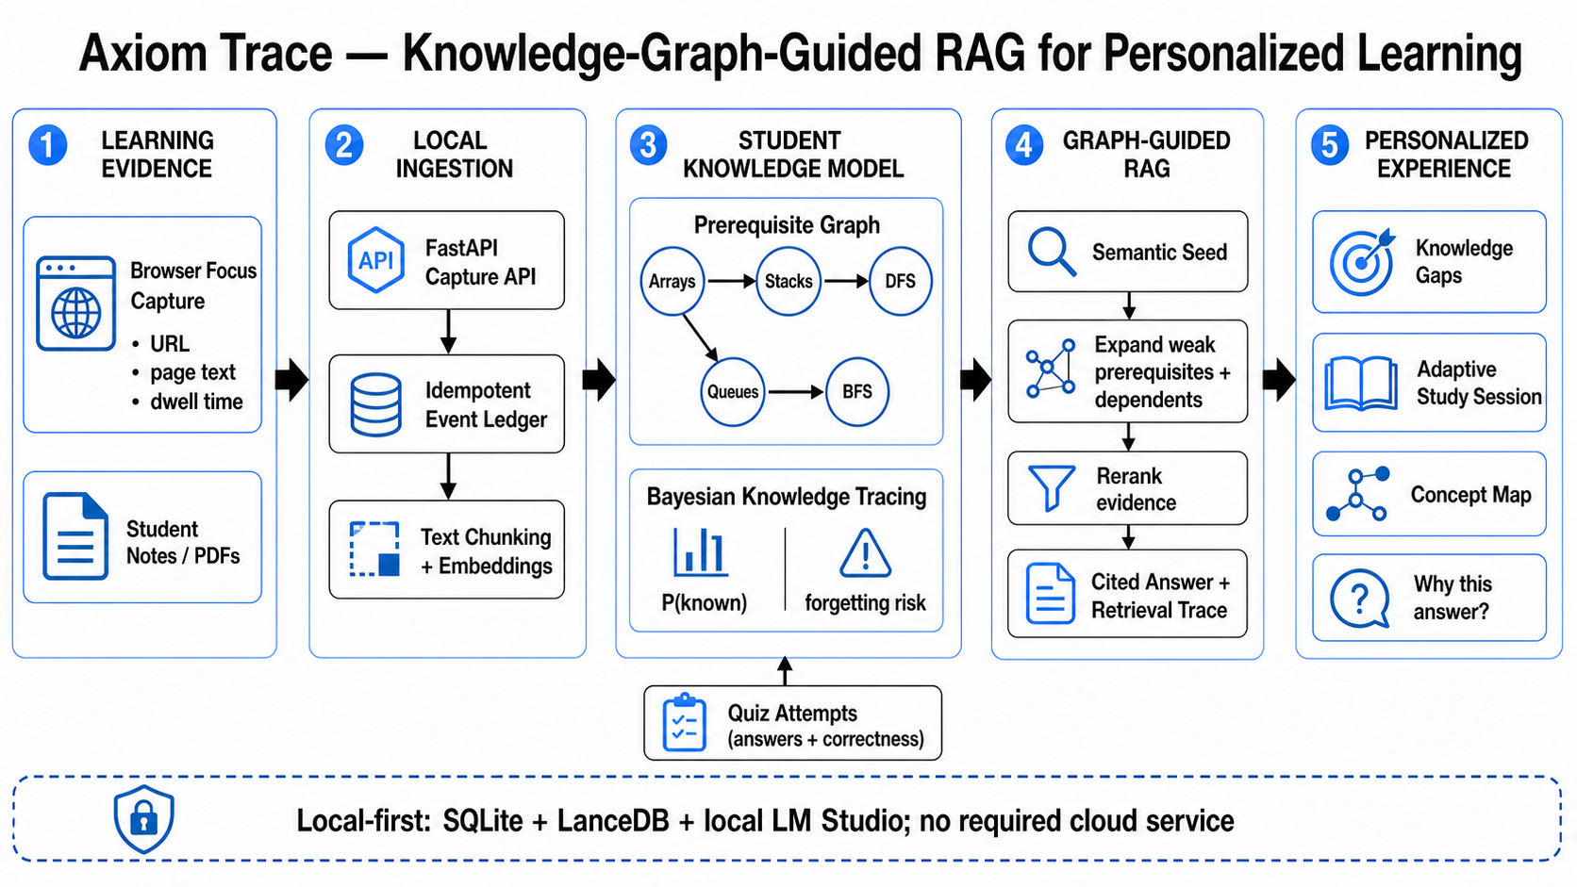
PROPOSED ARCHITECTURE
Quiz attempts update P(known). The resulting mastery state changes both retrieved evidence and the learner’s next recommended action.
AI Conclave - 2026
4
Notes:
[Sources]
- Embedded project architecture image from the supplied template and C:/Users/maadh/Desktop/AxiomTrace/docs/assets/axiom-trace-system-architecture.png; accessed 2026-08-16
[/Sources]

Slide 5
DATASET
Data Sources
• Student notes and documents: TXT, Markdown, and PDF.
• Attention-qualified browser events: URL, page title, visible text, dwell time, capture timestamp, and metadata.
• Deterministic demonstration dataset: 3 evidence sources, 8 computer-science concepts, and 8 prerequisite relationships.
Data Split
• No train/validation/test split is required because Axiom Trace uses pretrained transformer models without fine-tuning.
• Functional behavior is evaluated through deterministic integration tests and a repeatable seeded scenario.
Preprocessing
• Visible-text extraction, validation, sanitization, size limits, and idempotent event handling.
• Canonical item creation, text chunking, 384-dimensional normalized embeddings, and concept-to-source binding.
AI Conclave -2026
5

Slide 6
MODULES
1. Learning Evidence Adapter
Captures focused browser reading and accepts student notes and documents.
2. Canonical Ingestion Layer
Validates, deduplicates, chunks, embeds, and stores all evidence through one pipeline.
3. Student Knowledge Model
Maintains concepts, prerequisite edges, quiz history, P(known), confidence, and forgetting risk.
4. Graph-Guided Retriever
Expands the active concept into weak prerequisites and dependents before merging semantic candidates.
5. Transformer Reranker and Generator
Reranks the bounded evidence pool and produces a grounded answer using the selected context.
6. Adaptive Learning Interface
Displays knowledge gaps, concept maps, study sessions, evidence, citations, and “Why this answer?”
Module Connection
Learning evidence updates the knowledge base; quiz attempts update mastery; mastery guides retrieval and the next recommended learning action.
AI Conclave - 2026
6

Slide 7
IMPLEMENTATION SETUP
Programming Stack
• Backend: Python 3.12, FastAPI, SQLite, LanceDB, Sentence Transformers, and an OpenAI-compatible LM Studio API.
• Frontend: Next.js 16, React 19, TypeScript, Tailwind CSS, Mermaid, and KaTeX.
• Capture Integration: Manifest V3 browser extension with a persistent retry queue and idempotent acknowledgements.
Models
• Embeddings: sentence-transformers/all-MiniLM-L6-v2.
• Reranking: Qwen3-Reranker-0.6B through LM Studio.
• Answer generation: Qwen3-4B through a local OpenAI-compatible endpoint.
Environment and Tools
• Designed to run locally on a Windows laptop; GPU acceleration is optional.
• No required cloud service or external database.
• Development tools: uv, pnpm, Git, GitHub, pytest, ESLint, and TypeScript.
AI Conclave - 2026
7

Slide 8
HYPERPARAMETERS
Graph-Guided Retrieval
• Maximum candidate pool: 24 chunks.
• Final context: Top 8 reranked chunks.
• Graph expansion: up to 4 weakest prerequisites and 4 weakest dependents.
• Evidence per graph node: maximum 3 chunks.
Transformer Configuration
• Embedding dimension: 384 with normalized embeddings.
• Reranker temperature: 0.0.
• Reranker output: maximum 4 tokens with 4 parallel requests.
• Maximum reranker document length: 6,000 characters.
Bayesian Knowledge Tracing
• Initial knowledge probability: 0.25.
• Learning probability: 0.15.
• Slip probability: 0.10.
• Guess probability: 0.25.
• Knowledge-gap threshold: 0.60.
• Mastery threshold: 0.85.
• Initial memory half-life: 1 day; correct review ×2, incorrect review ×0.4.
AI Conclave - 2026
8

Slide 9
RESULTS & ANALYSIS
252 backend tests passed; frontend lint, type checks and production build pass.
0 duplicate records in tested replay scenarios.
Web and API health checks return HTTP 200.
The seeded demo reproduces 3 evidence sources, 8 concepts and 8 prerequisite edges.
Mastery updates alter both retrieval context and next-study recommendations.
Current evidence validates functional correctness; latency, retrieval quality and learning gains remain formal evaluation work.
AI Conclave - 2026
9
Notes:
[Sources]
- C:/Users/maadh/Desktop/AxiomTrace (local verification run and seeded demo; accessed 2026-08-16)
[/Sources]

