Slide 1
AI / ML PROJECT PRESENTATION
AXIOM TRACE
Knowledge-Graph-Guided RAG for Personalized Student Knowledge-Tracing
Team: Highest in the Room
Members: Maadhav V H, Sachin A S
College / Department: KPRIET – ECE, CSE

Slide 2
1
PROBLEM STATEMENT
Students have information everywhere—but no system connects it to what they actually know.
WHY THIS MATTERS
Notes, PDFs, webpages and assessments stay disconnected.
• Generic RAG retrieves similar text but ignores prerequisite gaps.
• Progress tools track activity, not concept mastery.
• Explanations rarely show why evidence was selected.
Axiom Trace links evidence, a prerequisite graph and P(known) to guide the next step.
4.46 Cr
Students enrolled in Indian higher education, 2022–23 (provisional).
Source: Ministry of Education, AISHE.
AI / ML PROJECT PRESENTATION
2
Notes:
[Sources]
- https://www.pib.gov.in/PressReleasePage.aspx?PRID=2219936&lang=1&reg=1 (Ministry of Education AISHE 2022–23 provisional enrolment; accessed 2026-08-16)
[/Sources]

Slide 3
2
OBJECTIVE & PROPOSED SOLUTION
Axiom Trace turns a student’s own learning evidence into mastery-aware, cited guidance.
1
2
3
Primary Goal
Key Capability
Success Metric
Connect reading, assessment and revision in one personalized learning loop.
Expand retrieval through weak prerequisites and dependents before transformer reranking.
Duplicate-safe capture, mastery updates, ordered evidence and visible retrieval reasons.
AI / ML PROJECT PRESENTATION
3

Slide 4
3
EXISTING SOLUTIONS & OUR APPROACH
Axiom Trace closes gaps left by similarity-only retrieval and static study tools.
Generic AI / RAG
LMS / Flashcards
Axiom Trace
Accuracy / Performance
Semantic relevance
Manual progress
Mastery + graph
Key limitation
No learner model
Evidence disconnected
Formal efficacy pending
Our improvement
—
—
Cited adaptive loop
Unlike similarity-only tools, Axiom Trace selects evidence using prerequisite structure, mastery and source provenance.
AI / ML PROJECT PRESENTATION
4

Slide 5
4
DATASET & METHODOLOGY
One evidence pipeline powers graph retrieval, knowledge tracing and adaptive study.
1
2
3
Data Collection
Preprocessing
Modeling Pipeline
Notes, PDFs and focused browser reading.
Demo: 3 sources, 8 concepts and 8 prerequisite edges.
Validate, deduplicate and chunk text; create normalized 384-D embeddings; bind chunks to concepts.
Graph expansion → candidate union → Qwen reranking → cited generation → BKT mastery update.
AI / ML PROJECT PRESENTATION
5
Notes:
[Sources]
- C:/Users/maadh/Desktop/AxiomTrace (repository implementation and seeded demo data; accessed 2026-08-16)
[/Sources]

Slide 6
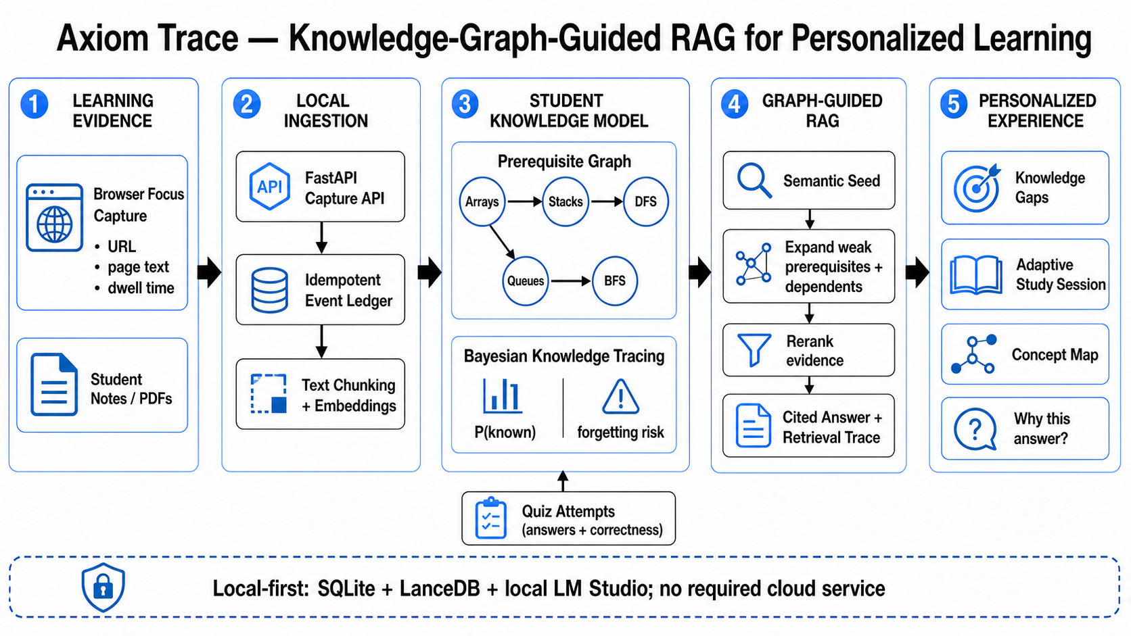
5
MODEL / SYSTEM ARCHITECTURE
The retrieval path changes as the learner’s mastery changes.
Pretrained transformer embeddings and local generation
Bayesian Knowledge Tracing estimates P(known)
Up to 4 weak prerequisites + 4 dependents
24 candidates; top 8 after reranking
Order: prerequisite → target → dependent
AI / ML PROJECT PRESENTATION
6
Notes:
[Sources]
- C:/Users/maadh/Desktop/AxiomTrace/docs/assets/axiom-trace-system-architecture.png (project architecture diagram; accessed 2026-08-16)
- C:/Users/maadh/Desktop/AxiomTrace (repository implementation and configuration; accessed 2026-08-16)
[/Sources]

Slide 7
6
IMPLEMENTATION & TECH STACK
A complete local-first stack, from evidence capture to adaptive learning.
Languages & Frameworks
Libraries & APIs
Python 3.12, FastAPI, Next.js 16, React 19, TypeScript and Kotlin.
SQLite, LanceDB, Sentence Transformers, Qwen reranker, Mermaid and KaTeX.
Infrastructure & Tools
Interface / Demo
Windows-local deployment with uv, pnpm, LM Studio, Git, pytest and ESLint.
Responsive web app, REST API, browser extension and optional Android client.
AI / ML PROJECT PRESENTATION
7

Slide 8
7
RESULTS & EVALUATION
Testing verifies behaviour and reproducibility—not unmeasured learning gains.
252
0
200 / 200
8 / 8 / 3
Backend tests passed
Duplicate records in tested replays
Web / API health status
Concepts / edges / evidence sources
Frontend lint, TypeScript, production build and browser-extension checks also pass. Educational efficacy and latency benchmarking remain future work.
AI / ML PROJECT PRESENTATION
8
Notes:
[Sources]
- C:/Users/maadh/Desktop/AxiomTrace (local verification run: backend tests, frontend checks, extension tests and launcher health checks; accessed 2026-08-16)
[/Sources]

Slide 9
8
APPLICATIONS & FUTURE SCOPE
The same foundation supports individual study today and institutional evaluation next.
REAL-WORLD USE
CURRENT LIMITATION
FUTURE SCOPE
Exam preparation
Course revision
Prerequisite recovery
Evidence-grounded tutoring
Single-user local deployment
No large-cohort efficacy study
Hardware-dependent model performance
Instructor-labelled evaluation
Multi-user dashboards
Learning-gain studies
Latency and retrieval ablations
AI / ML PROJECT PRESENTATION
9

Slide 10
CONCLUSION & TEAM
Axiom Trace makes RAG personal by connecting evidence, prerequisites, mastery and the next learning action.
MV
SA
AT
Maadhav V H
Sachin A S
Axiom Trace
PROJECT REPOSITORY / DEMO LINK
Repository and live demo available
Thank you!
Highest in the Room · KPRIET · ECE / CSE

