Slide 1

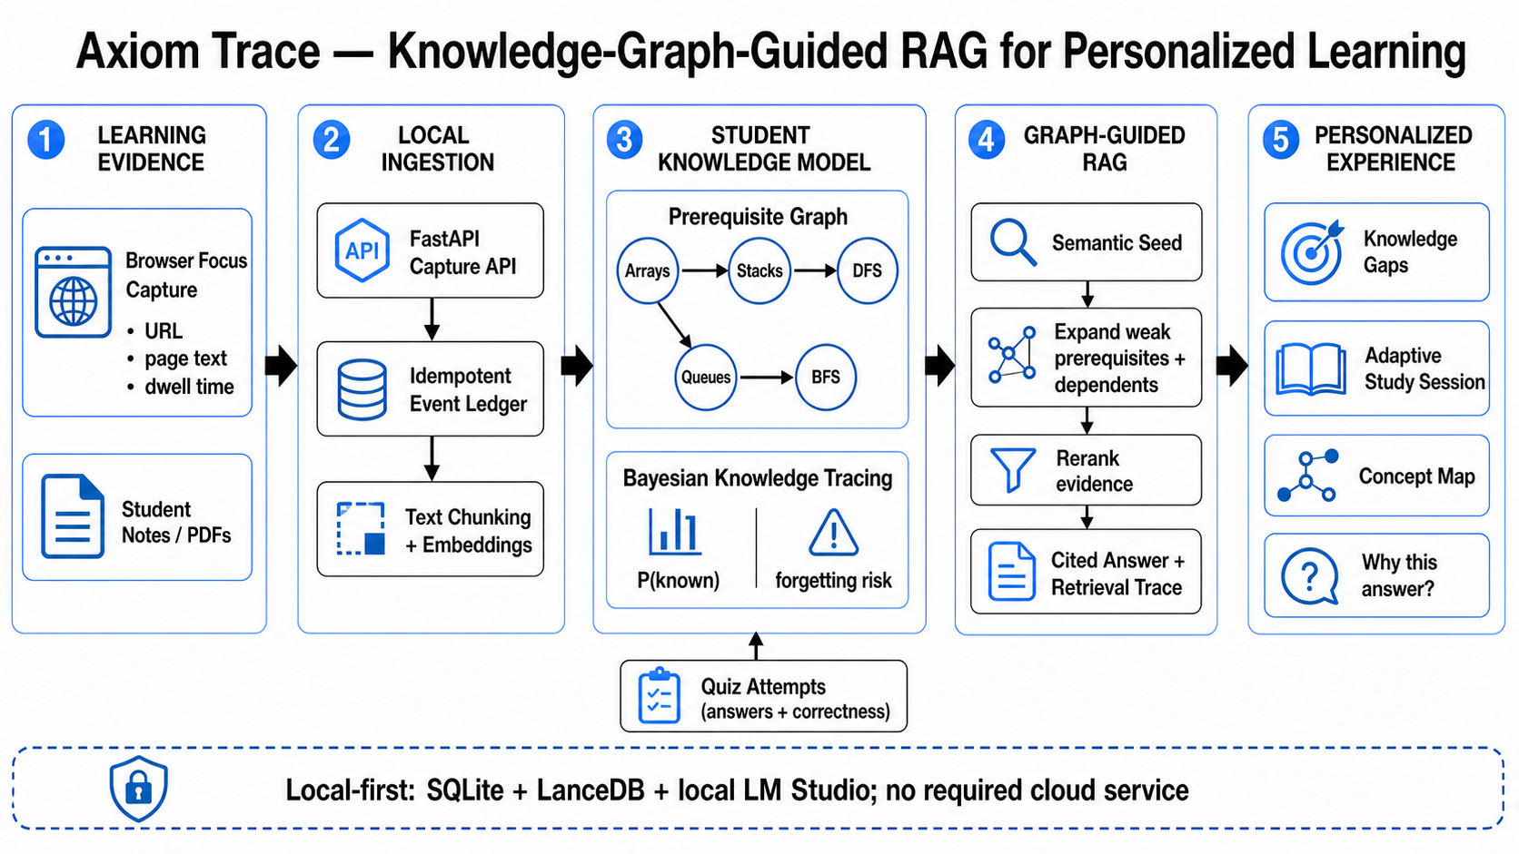
AXIOM TRACE
Highest in the Room | Team Members: Maadhav V H, Sachin A S
ABSTRACT
Axiom Trace is a local-first personalized learning system that combines a prerequisite knowledge graph, Bayesian Knowledge Tracing and retrieval-augmented generation. It converts notes, PDFs, browsing evidence and quiz attempts into a continuously updated student model, then returns cited answers, visible retrieval traces and next-study recommendations without requiring a cloud service.
OBJECTIVE
PROPOSED APPROACH
Build a private learning memory from notes, PDFs and browsing.
Track mastery and prerequisite gaps from quiz evidence.
Return cited answers and next-study actions.
Deduplicate and index evidence in SQLite + LanceDB.
Update a prerequisite graph and Bayesian P(known).
Expand graph neighbors, rerank evidence and generate cited guidance.
METHODOLOGY
RESULT
252 backend tests passed
Frontend checks + build passed
0 replay duplicates
Web/API health: HTTP 200
Demo: 3 sources · 8 concepts · 8 edges
CONCLUSION
REFERENCES (OPTIONAL)
Closes the loop between what a student reads, knows and should study next.
Functional correctness is verified; latency, retrieval quality and learning gains remain formal evaluation work.
[1] A. T. Corbett and J. R. Anderson, “Knowledge Tracing,” UMUAI, 1995.
[2] P. Lewis et al., “Retrieval-Augmented Generation,” NeurIPS, 2020.
Int AI Conclave-2026
Notes:
[Sources]
- C:/Users/maadh/Desktop/AxiomTrace (local verification and seeded demo; accessed 2026-08-16)
- C:/Users/maadh/Desktop/AxiomTrace/docs/assets/axiom-trace-system-architecture.png (architecture visual; accessed 2026-08-16)
- A. T. Corbett and J. R. Anderson, Knowledge Tracing, User Modeling and User-Adapted Interaction, 1995
- P. Lewis et al., Retrieval-Augmented Generation for Knowledge-Intensive NLP Tasks, NeurIPS, 2020
[/Sources]

