Slide 1
Smart Rehabilitation Glove
Graduation Project 2026
Menoufia University
Supervised By: Dr. Essam Nabil

Slide 2
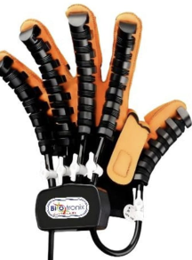
Abstract
An Integrated Therapeutic System.
A smart wearable rehabilitation glove for patients with neurological impairments.
TENS Module: Transcutaneous Electrical Nerve Stimulation.
Vibration Therapy Module: ERM haptic actuators.
Force Measurement Module: FSR sensors mapped to 0-100% grip.

Slide 3
Problem Statement
Core Challenges of Hand Rehabilitation:
- Limited Range of Motion
- Muscle Atrophy & Weakness
- Sensory Deficits
- Impaired Coordination
- Chronic Pain
Our Smart Solution: An integrated wearable glove.

Slide 4
Historical Background
Evolution of Hand Rehabilitation:
- Ancient Era: Primitive splinting
- 18th-19th Century: Surgical Pioneers
- World Wars: Wartime Innovation & FES
- 1950s-1977: Formal Specialty
- Today 2026: Smart Wearables

Slide 5
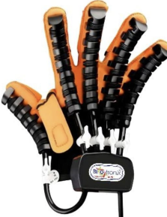
Objectives (1/2)
What We Aim to Achieve:
1. Restoring Range of Motion (ROM)
2. Increasing Strength & Dexterity
3. Non-Invasive Pain Management

Slide 6
Objectives (2/2)
Beyond Basic Recovery:
4. Enhancing Activities of Daily Living
5. Improving Coordination & Proprioception
Customized Plans for targeted therapy.
Scar Management techniques.

Slide 7
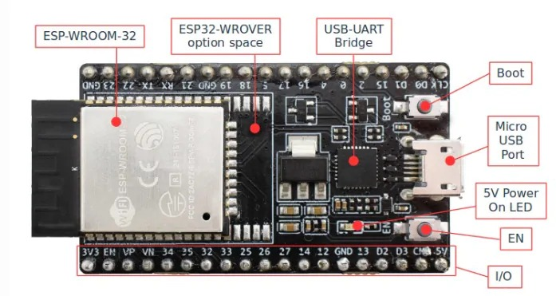
System Architecture
4-Layer Design Philosophy:
1. Input & Sensing Layer: Flex + FSR sensors
2. Processing & Control: ESP32 dual-core
3. Actuation & Power: Solenoid valves + MOSFET
4. Feedback & Interface: LCD display

Slide 8
Materials & Methods: Core Components
Control, Power & Actuation:
- ESP32 Microcontroller
- Pneumatic Glove
- LCD Display Screen
- MOSFET Module
- Power Supply Adaptor
- Voltage Regulator (LM2596)

Slide 9
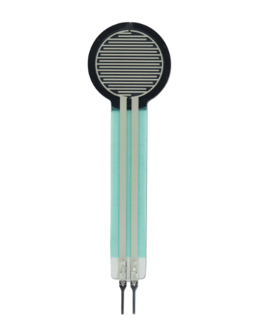
Materials & Methods: Sensors & Therapy
Sensing, Feedback & Therapy:
- TENS Cable & Electrodes
- Vibration Motor (ERM)
- Force Sensor (FSR)
- Solenoid Valves
- Voltage Regulator 7805
- Air Pressure Sensor HX710B

Slide 10
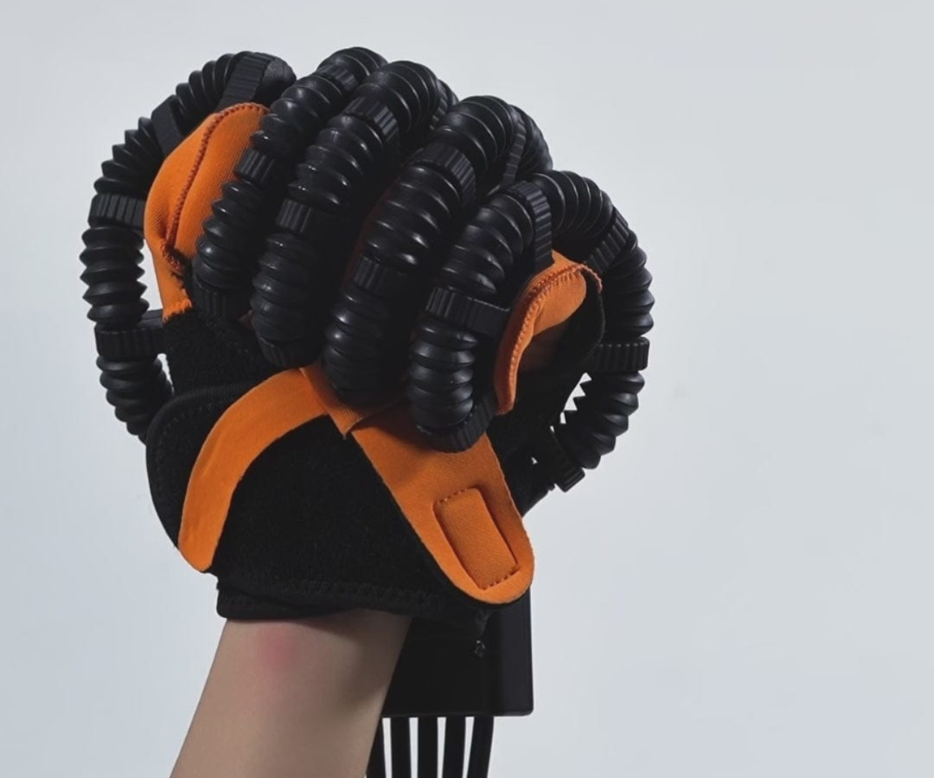
Development Methodology (1/2)
6-Phase Top-Down Approach:
1. Analysis & Requirements
2. Theoretical Design
3. Modular Assembly & Unit Testing

Slide 11
Development Methodology (2/2)
Integration & Calibration:
4. Full System Integration
5. Functional Verification
6. Calibration & Final Tuning
Developed with Arduino IDE (C++) and CAD software.

Slide 12
Testing & Validation
Rigorous 3-Stage Test Strategy:
- ST1: Component-Level Testing (Unit)
- ST2: Sub-System Integration Testing
- ST3: System-Level Validation (End-to-End)
Measured Performance:
FSR -> Valve Latency < 150ms
Pressure Accuracy +/- 1 kPa
Display Refresh Rate ~20 Hz

Slide 13
Conclusions
Achievements & Future Work:
- Pneumatic-assisted ROM restoration verified
- 0-100% grip strength scale implemented
- TENS pain management integrated
- All 9 requirement areas passed tests
Future Work:
Mobile App / PC Dashboard, Wireless Monitoring, Clinical Trials

Slide 14
The Team
Supervised by: Dr. Essam Nabil
Head of Dept: Dr. Ghada El-Banby
Menoufia University
Team of 15 members.
Thank you for your support!

