Slide 1
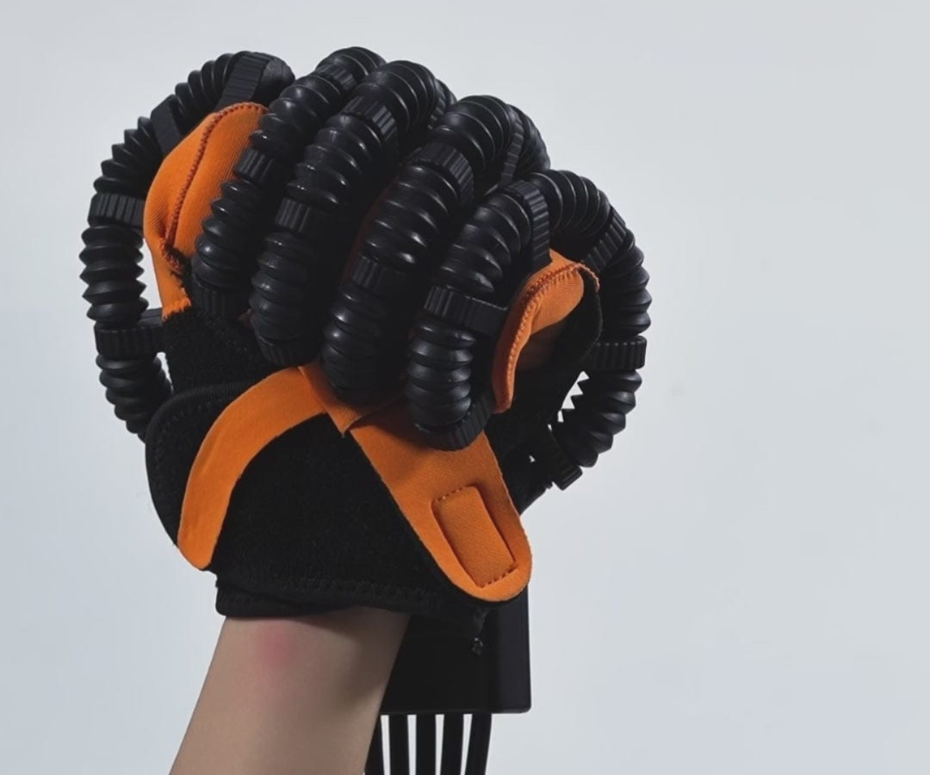
Smart Rehabilitation Glove
A wearable mechatronic device combining TENS therapy, vibration feedback, and real-time force sensing. Graduation Project 2026 Menoufia University Supervised By: Dr. Essam Nabil

Slide 2
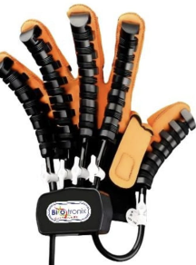
Abstract: An Integrated System
Overview
A smart wearable rehabilitation glove for patients with neurological impairments.
TENS Module
Transcutaneous Electrical Nerve Stimulation for pain modulation.
Vibration Therapy
ERM haptic actuators providing sensory stimulation.
Force Measurement
FSR sensors mapped to 0-100% grip percentage.

Slide 3
Problem Statement
Limited Range of Motion
Fractures and arthritis restrict joint mobility.
Muscle Atrophy & Weakness
Prolonged immobilization leads to muscle wasting.
Sensory Deficits
Nerve damage alters tactile feedback.
Chronic Pain
Persistent pain acts as a major barrier.
Our Solution
An integrated wearable glove combining multiple therapies.

Slide 4
Historical Background
Ancient Era
Primitive splinting and exercises.
18th-19th Century
Surgical pioneers correcting hand deformities.
World Wars
Severe trauma catalyzed advances like FES.
1950s-1977
Hand rehabilitation emerged as a formal specialty.
Today 2026
Smart Rehabilitation Gloves with real-time feedback.

Slide 5
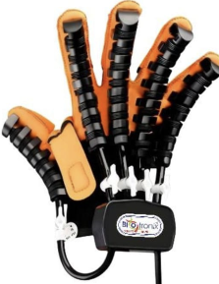
Objectives (1/2)
Restoring Range of Motion (ROM)
Pneumatic-assisted exercises.
Increasing Strength & Dexterity
Strengthening muscles for fine motor tasks.
Non-Invasive Pain Management
TENS therapy as a safer alternative to drugs.

Slide 6
Objectives (2/2)
Enhancing Activities of Daily Living
Empowering independent performance.
Improving Coordination & Proprioception
Neuromuscular coordination.
Customized Plans
Individualized protocols tailored to each patient.
Scar Management
Targeted techniques to minimize post-surgical scar tissue.

Slide 7
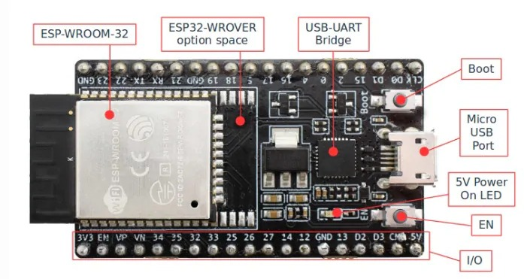
System Architecture
Input & Sensing Layer
Flex sensors + FSR sensors with 12-bit ADC.
Processing & Control Layer
ESP32 dual-core handles logic and PWM.
Actuation & Power Layer
Solenoid valves + MOSFET + Buck converter.
Feedback & Interface Layer
LCD display showing real-time metrics.

Slide 8
Core Components
ESP32 Microcontroller
Dual-core LX6 processor.
Pneumatic Glove
Inflatable air actuators along each finger.
LCD Display Screen
Shows real-time system data and diagnostics.
MOSFET Module
High-speed switch for valves and motors.
Power Supply Adaptor
Converts 220V AC to DC.
Power Module (LM2596)
Step-down converter for stable voltages.

Slide 9
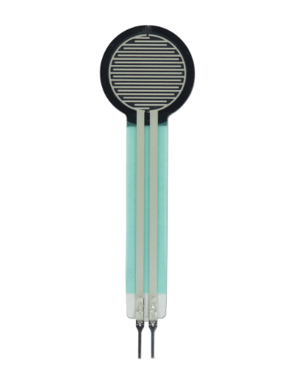
Sensors & Therapy Components
TENS Cable & Electrodes
Transmits electrical impulses.
Vibration Motor (ERM)
Provides tactile feedback.
Force Sensor (FSR)
Thin flexible sensor measuring grip pressure.
Solenoid Valves
Electromechanical air valves.
Voltage Regulator 7805
Stable fixed +5V DC output.
Air Pressure Sensor HX710B
24-bit ADC chip for closed-loop control.

Slide 10
Development Methodology (1/2)
1. Analysis & Requirements
Defined functional & non-functional requirements.
2. Theoretical Design
System decomposed into 4 layers.
3. Modular Assembly & Unit Testing
Independent component testing.

Slide 11
Development Methodology (2/2)
4. Full System Integration
Unified firmware managing all tasks.
5. Functional Verification
Tested under real-world clinical conditions.
6. Calibration & Final Tuning
Sensor offset adjusted and valves fine-tuned.

Slide 12
Testing & Validation
ST1 Component-Level Testing (Unit)
13 components tested individually.
ST2 Sub-System Integration Testing
Group interactions verified.
ST3 System-Level Validation
Complete clinical scenario looped.
Performance
FSR latency < 150ms, Accuracy +/- 1 kPa.

Slide 13
Conclusions & Future Work
Achievements
Pneumatic-assisted ROM restoration verified.
Tracking
0-100% grip strength scale for quantitative tracking.
Safety
Real-time display with auto pressure shutoff.
Future Enhancements
Mobile App, Wireless Monitoring.
Clinical Trials
Validate therapeutic efficacy across larger groups.

Slide 14
Work Team
Supervision
Dr. Essam Nabil & Dr. Ghada El-Banby.
Institution
Menoufia University.
Team Members
15 dedicated engineers.
Special Thanks
For the invaluable support and dedication.

