Slide 1
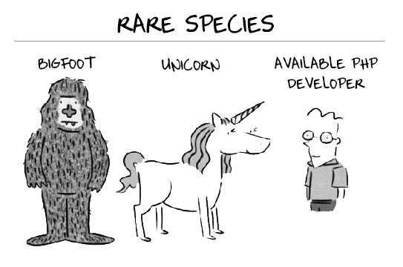
John Abbott IPD-8 “PHP” course group project

Slide 2
Ticket online reservation service
John Abbott IPD8 “PHP” course group project
Nazar Holyanskyy & Valeriy Hohin

Slide 3
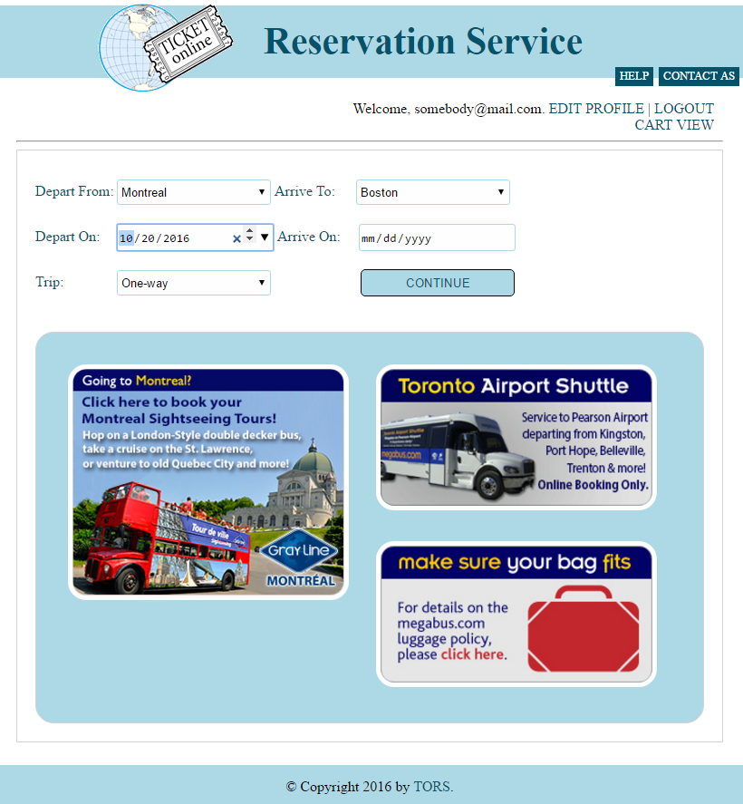
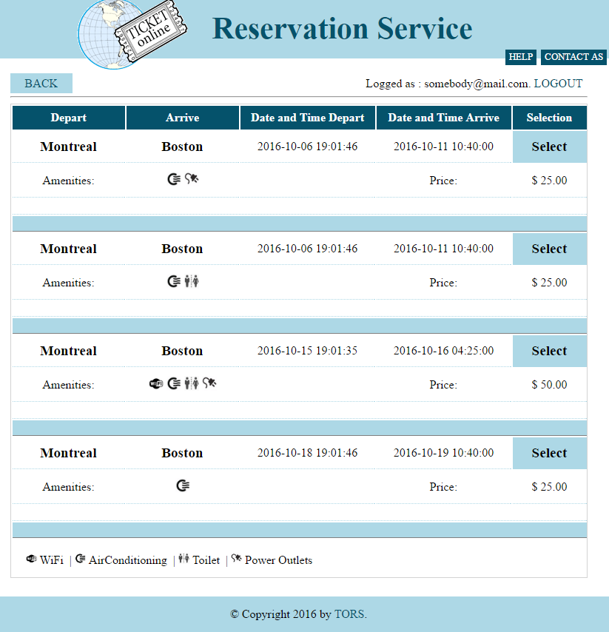
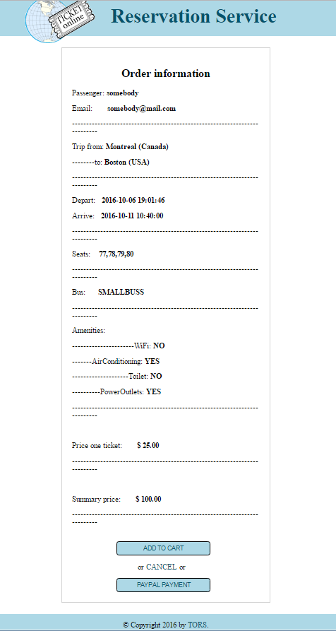
Ticket Online Reservation Service is used for Searching, booking and purchasing BUS tickets for registered users.
The idea was to implement the flow similar to such web-sites as expedia, megabus canada
Choose the trip
Create booking (select bus, seats, etc.) and sign in (if not)
Make payment and get final confirmation

Slide 4
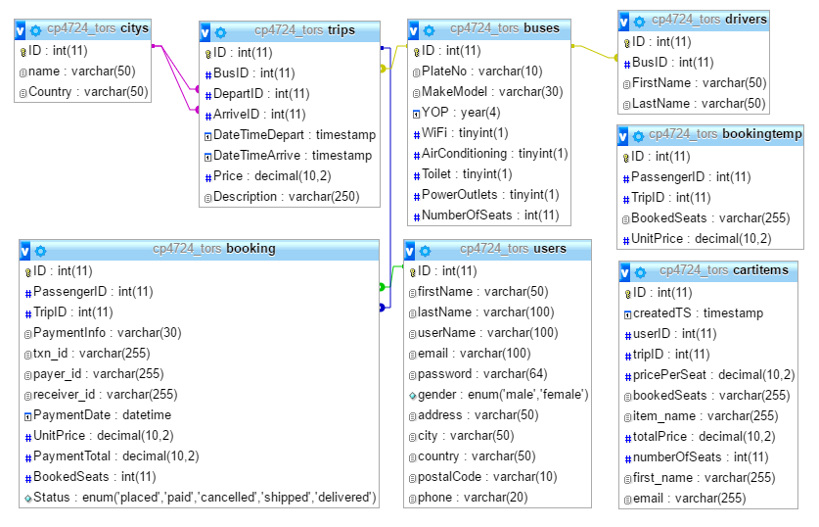
BACKGROUND
Database structure

Slide 5
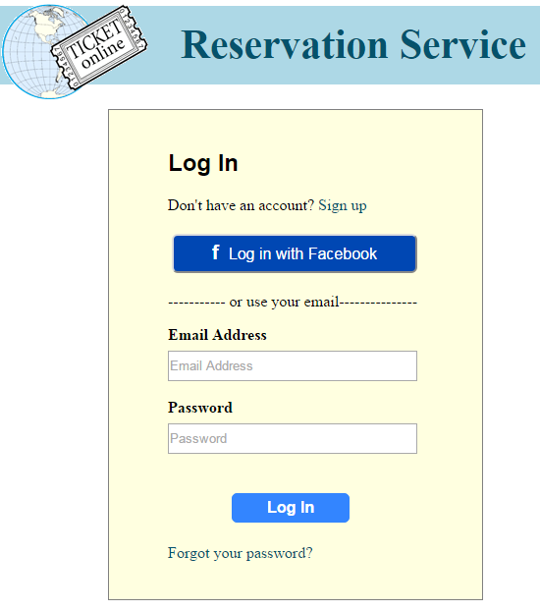
SOLUTION OVERVIEW
Log In(Facebook)/ Register/ Password Reset/ Edit Profile
Log In using Facebook account (no overlap in Database)
Password reset using token
Edit profile for current user (via unique ID)

Slide 6
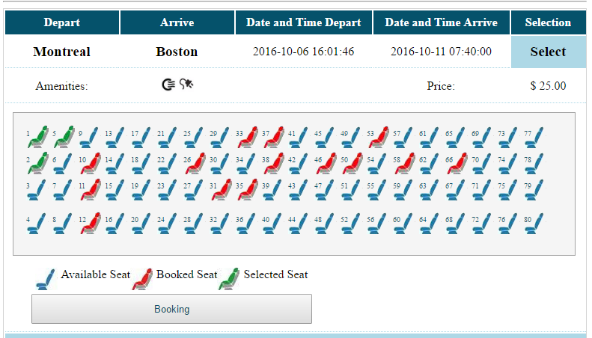
SOLUTION OVERVIEW
Select bus/seats/order details and reflecting in DB
Select bus option (time and
amenities) for selected trip
Select available seats with
proper reflection in DB

Slide 7
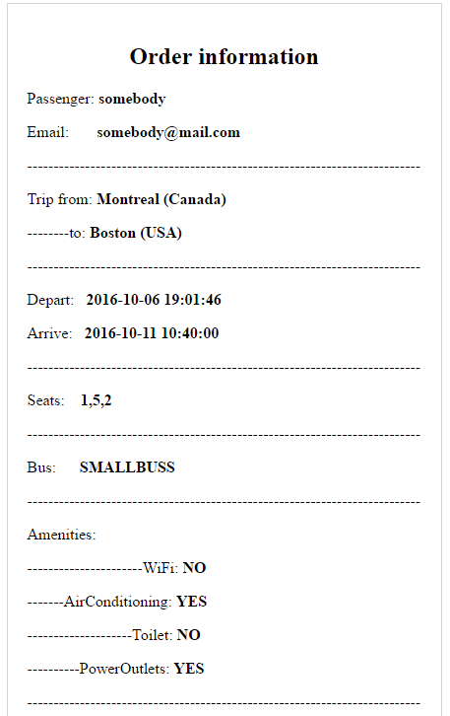
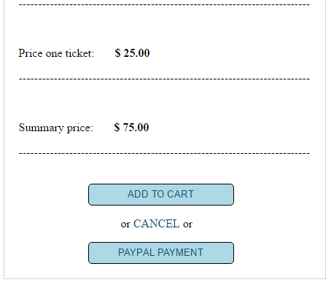
SOLUTION OVERVIEW
Booking information

Slide 8
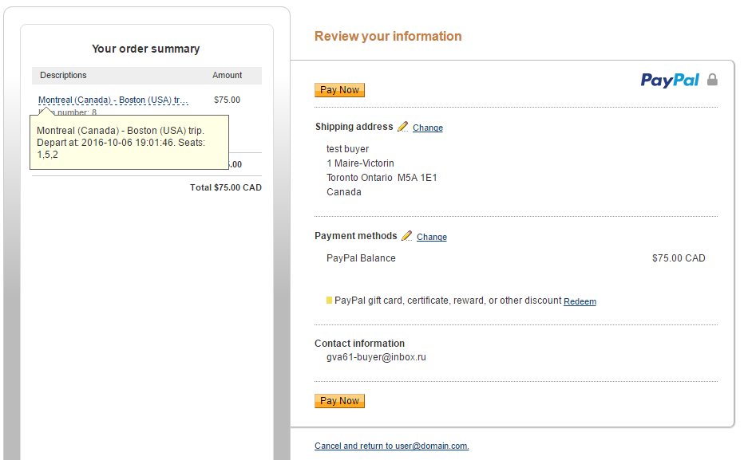
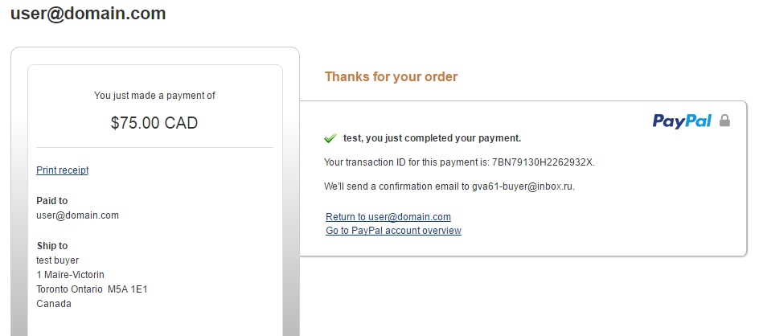
SOLUTION OVERVIEW
Payment
PayPal payment
PayPal confirmation

Slide 9
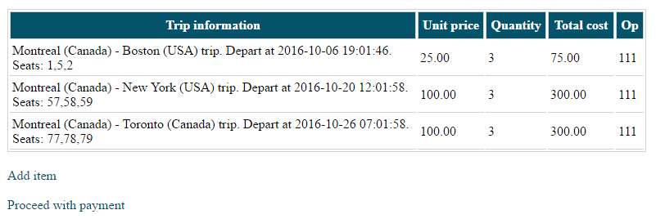
SOLUTION OVERVIEW
Cart page

Slide 10
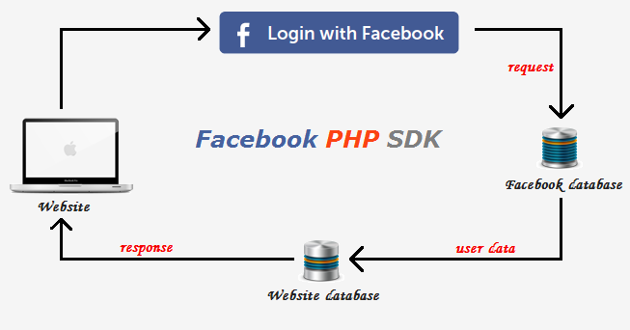
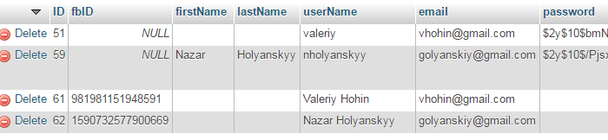
CHALLENGES AND SOLUTIONS
Facebook API
Connect to Facebook API:
User/ FB user sessions (same user – fbID field in DB)
Call back
No data overlap in Users table
Storing data in Database
External API realization takes time (up to few days)

Slide 11
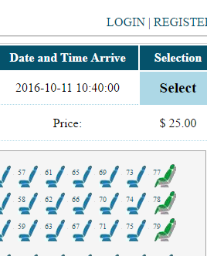
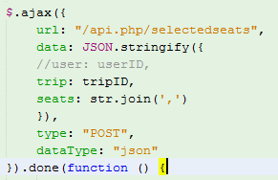



CHALLENGES AND SOLUTIONS
api.php:
Login:
Login_success:
…………………………………………………
PayPal response

Slide 12
CHALLENGES AND SOLUTIONS
Database Structure/ JS / API
Proper Database Structure and Tables link
(FK -> Unique key -> Relations view)
SQL queries (JOINs, multiple fields/tables)
JQuery function()
JSON/ AJAX

Slide 13
CHALLENGES AND SOLUTIONS
Debugging/ html.twig / multiple URL’s
Debug via log
When to put twig file
GET/POST/MAP (/URL: )
CRON SCHEDULAR CLEAN-UP

Slide 14

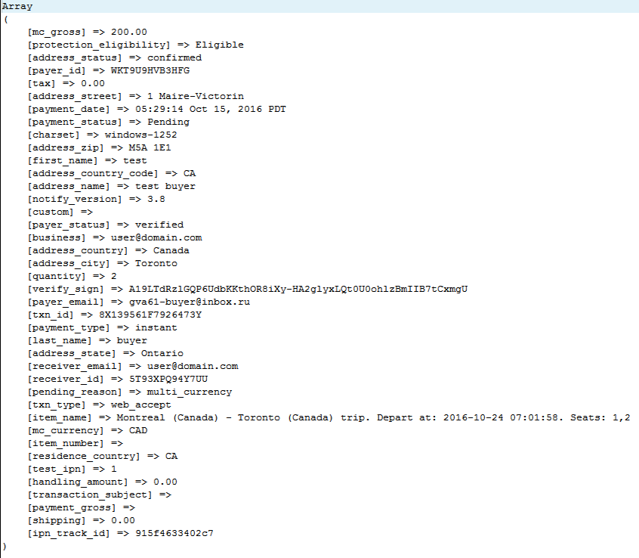
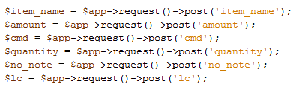
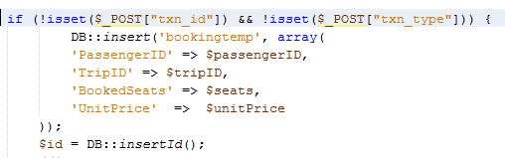

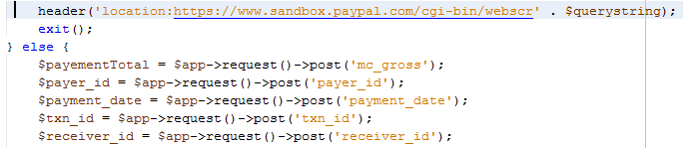
WHAT WE LEARNED
Code-Behind to PayPal
…
…
…
…

Slide 15
WHAT WE LEARNED
Served-side <-----> Client-side Interaction
External API’s and it’s implementation
Proper database structure – successful key
Jquery /AJAX/ API
Working with Frameworks (Slim/MeekroDB)
Project setups (hosting server/ http connection)

Slide 16
Ticket Online Reservation Service
FUTURE WORK
IMPLEMENT bilingual option
Administration
Мultiple PayPal payments

Slide 17
Ticket Online Reservation Service
SUMMARY
With what RESULT:
Valuable experience
Team spirit and respect
What was DONE:
Group Project using server-and client-side scripts, MySQL, frameworks and API’s
System setups
Team collaboration and support, especially btw junior and senior dev

Slide 18
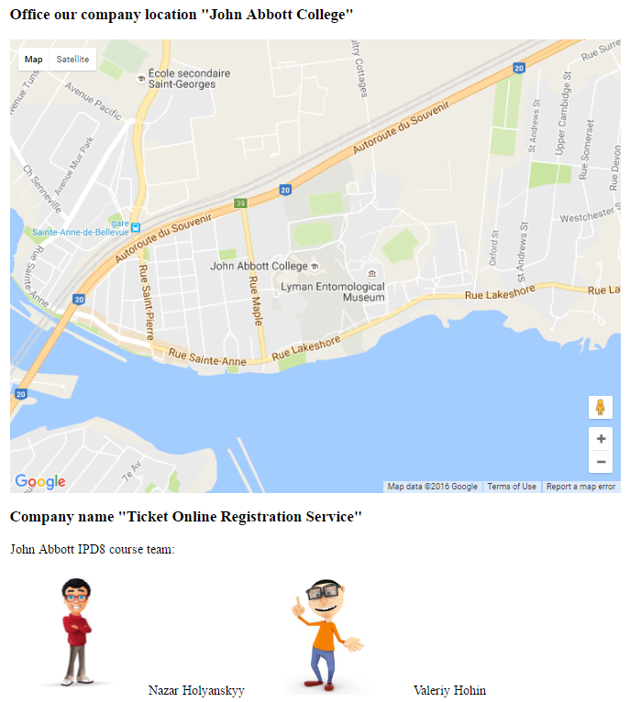
Thank you for your time and interest…

Slide 19
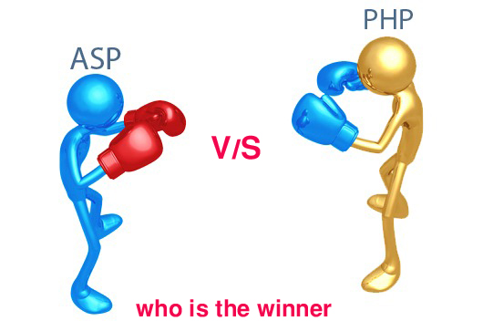
Who is NEXT????
LET’S GET READY TO RUMBLE!!! … and the WINNER IS …

Slide 20
