Slide 1
view_zenith = [0.0] view_azimuth = [0.0]
# Solar parameters solar_azimuth = [0.0] solar_zenith = [10]
reff_range = np.linspace(6.0, 18.5, 20) lwc_range = np.linspace(1e-2, 0.85, 20) # Run and save the results lwc_true = [0.356] reff_true = [12.34]

Slide 2
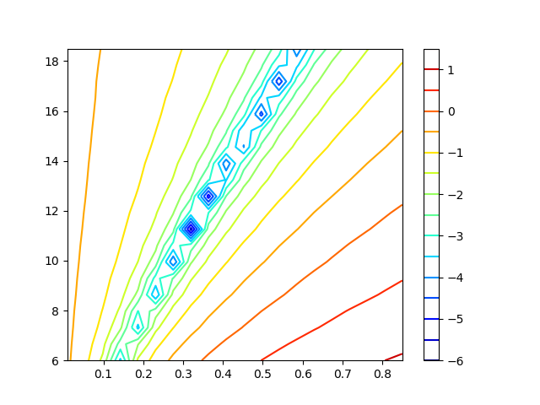
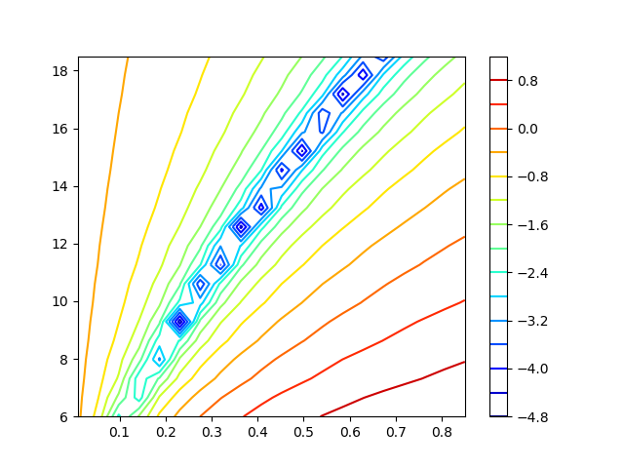
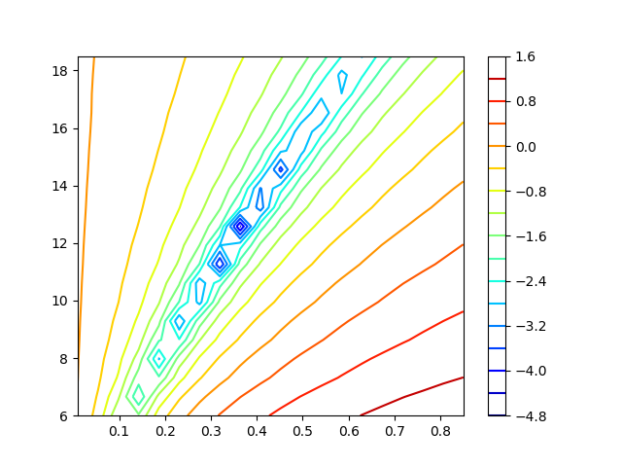
I loss 672nm (log)
I loss 1600nm (log)
True
True
Reff [micron]
Reff [micron]
Lwc [g/kg]
Lwc [g/kg]
I loss 672nm+1600nm (log)
20 options of Reff
20 options of lwc
True
Reff [micron]
Lwc [g/kg]

Slide 3
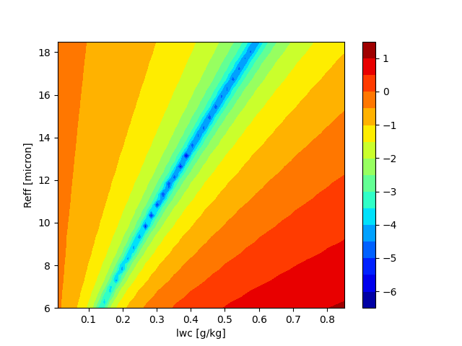
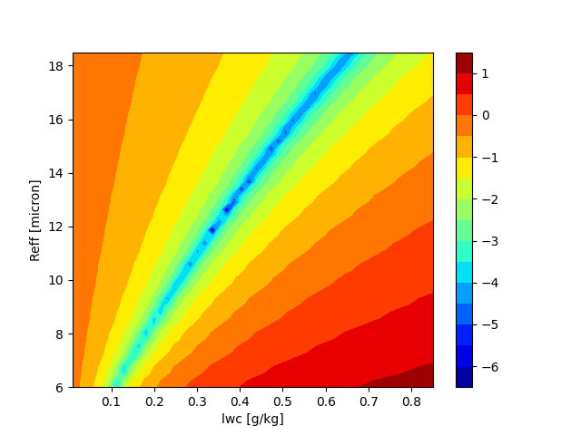
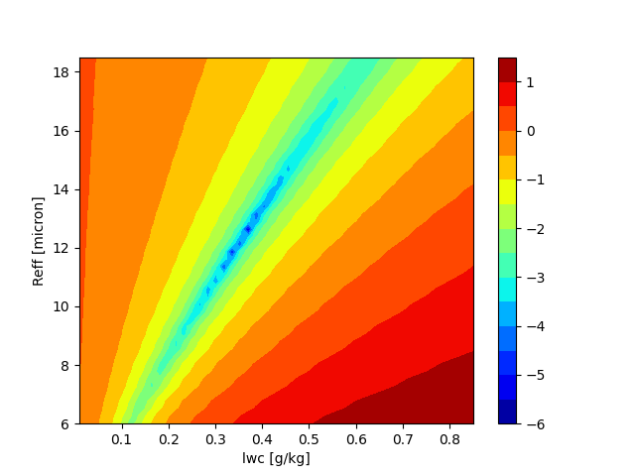
I loss 672nm (log)
I loss 1600nm (log)
True
True
I loss 672nm+1600nm (log)
50 options of Reff
50 options of lwc
True

Slide 4
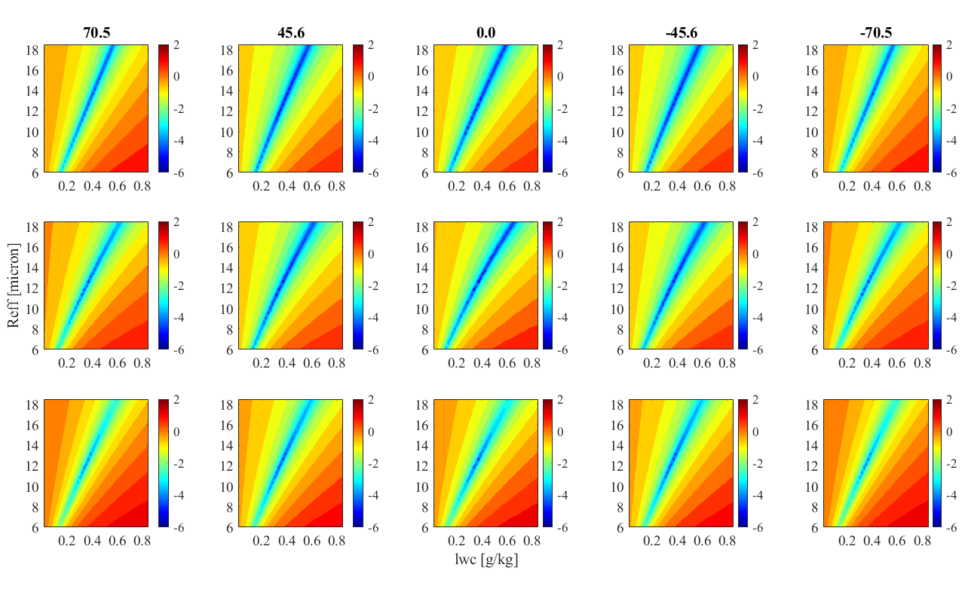
Single viewing angle
672nm
1600nm
Both

Slide 5
5 viewing angles- string of pearls
True
True
True

Slide 6
5 viewing angles-circle
True
True
True

Slide 7
SWIR vs VIS (not on same platform)
Solar zenith 25°
Angles [60,30,15,-15,-60]

Slide 8
Choice by order
Angles
[60,30,15,0,-15,-60]

Slide 9
Single SWIR
Solar zenith 25°
Solar zenith 0°

Slide 10
SWIR in specific angles

Slide 11
SWIR with VIS (on same platform)
Solar zenith 25°
Solar zenith 0°
Angles
[60,30,15,0,-15,-60]
Removing by order
Angles
[60,30,25,15,0]

Slide 12
Single SWIR with VIS
Solar zenith 25°
Solar zenith 0°

