Slide 1
Project: Ant ’s Nest Building
Students: Phong Vo, Giang Tran

Slide 2
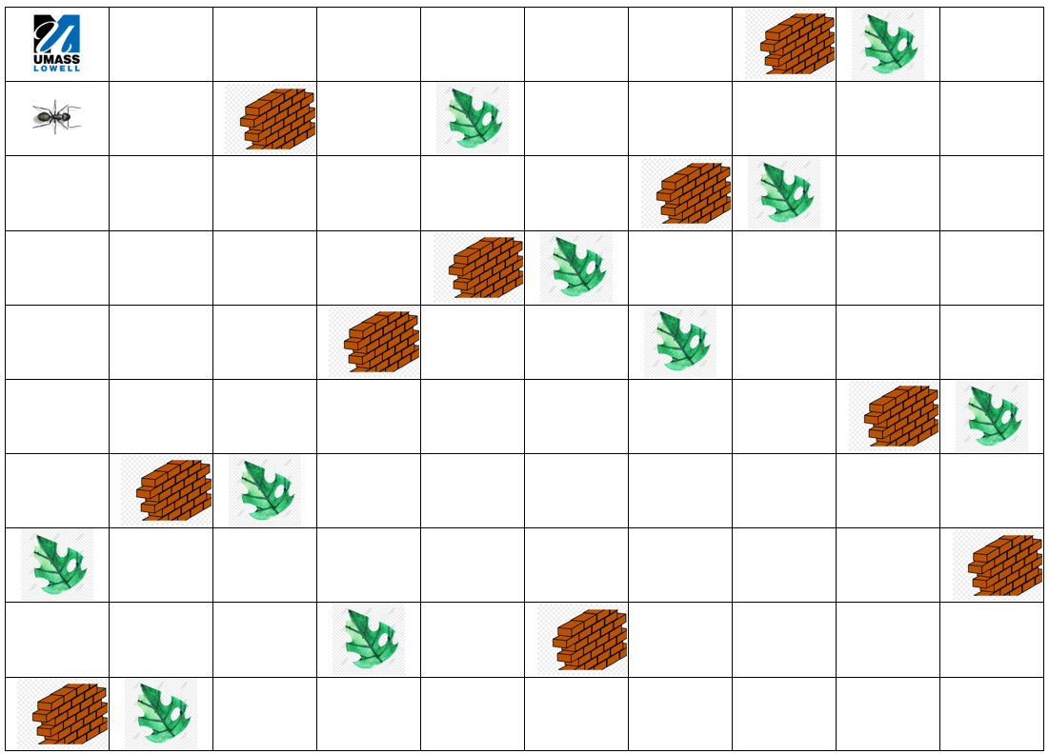

Slide 3
Developed with A* algorithm.
The purpose of the program is to optimize the path of the ant to be least walks as it can.
The material for building up the nest are the ten (10) leaves which are laying around the map. Every leaf might be blocking by ten (10) bricks.
The ant must wisely reach out the leaves without hitting the walls.
Once it gets a leaf, it brings it back to the nest and then continues heading to the other remaining leaves.
The loop of collecting the leaves is finished once all of ten leaves are gathered.

