Slide 1
AuraDB Knowledge Graph Creation
Viliam Horák

Slide 2
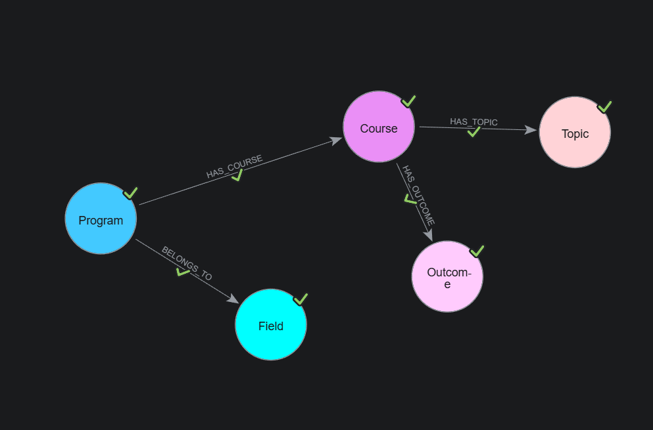
The graph database schema in the Data Importer tool displays the defined nodes and relationships. Green markers confirm the successful and complete import of data into the system.

Slide 3
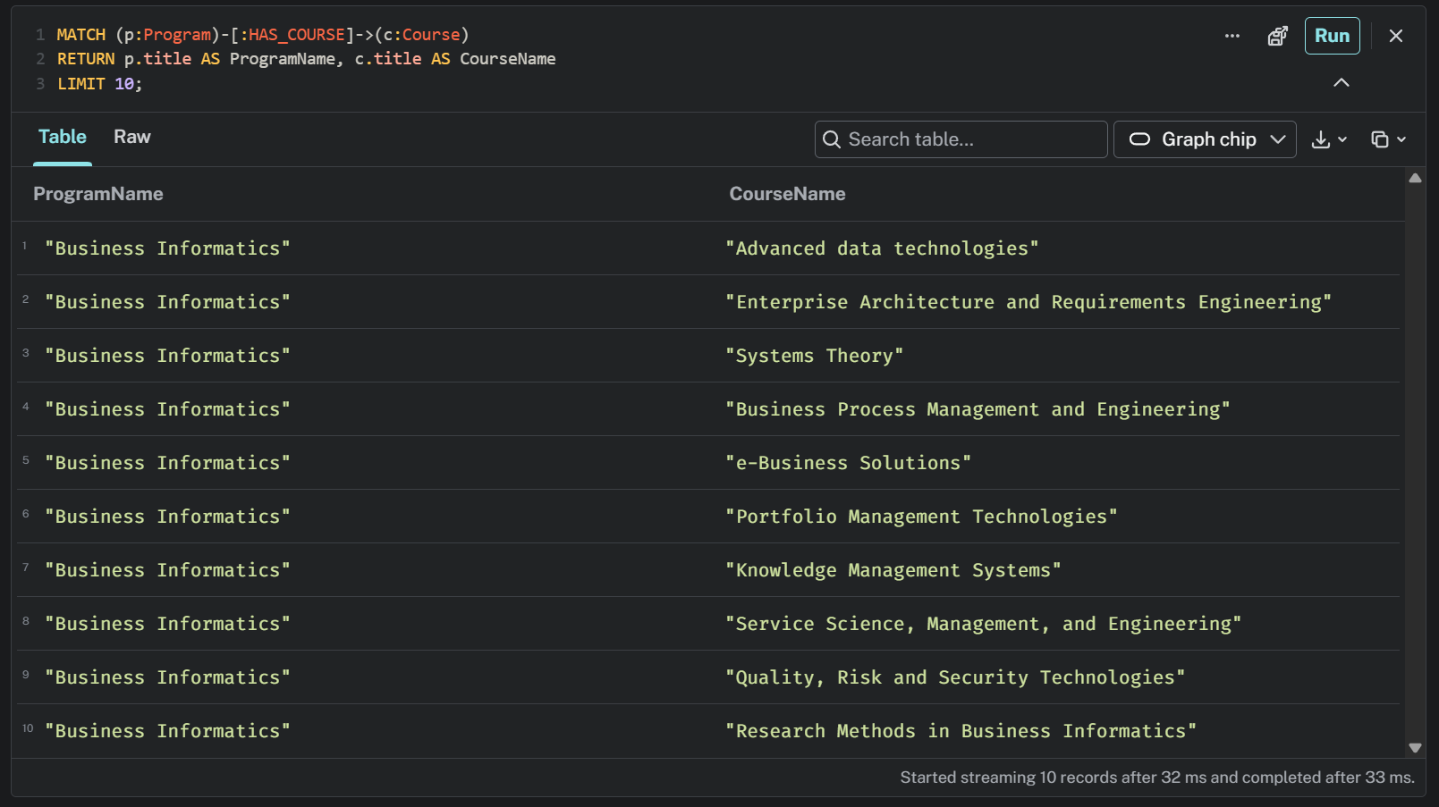
The tabular query result displays the first 10 courses for the Business Informatics study program. The data is obtained by linking nodes via the HAS_COURSE relationship.

Slide 4
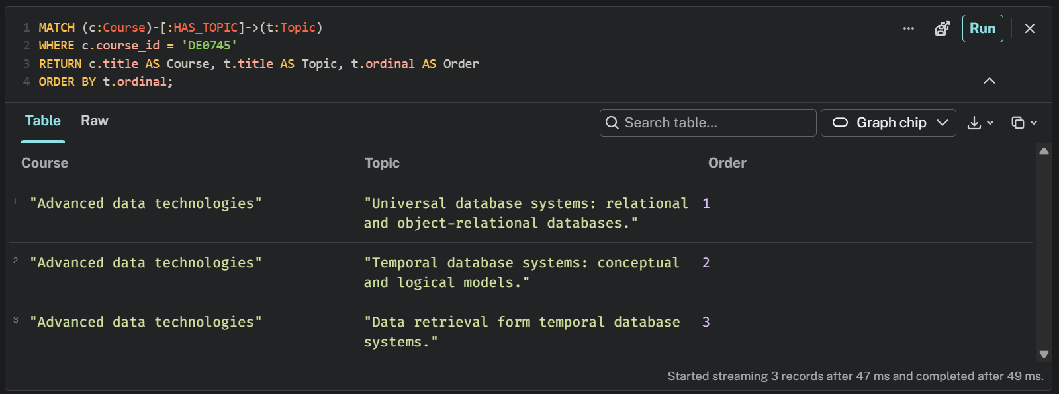
The table lists specific topics for the Advanced Data Technologies course. The results are arranged chronologically according to their designated order.

Slide 5
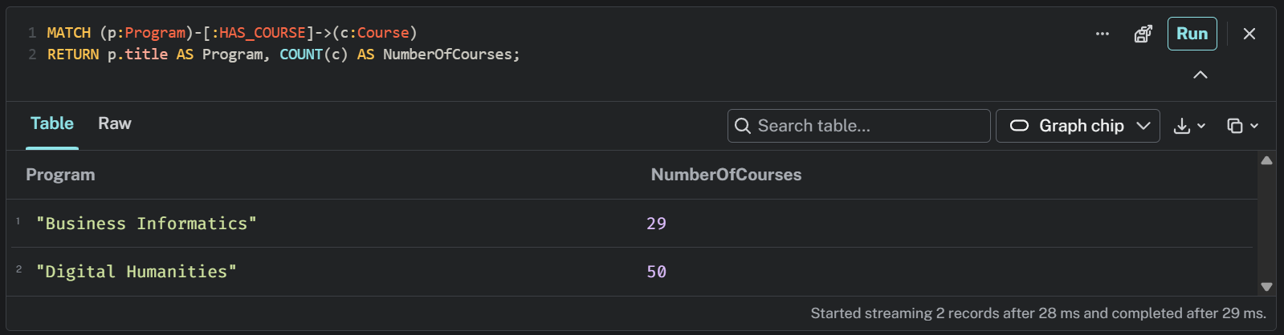
An aggregate query calculated the total number of courses in the individual study programs. The result shows 29 courses for the Business Informatics program and 50 for Digital Humanities.

Slide 6
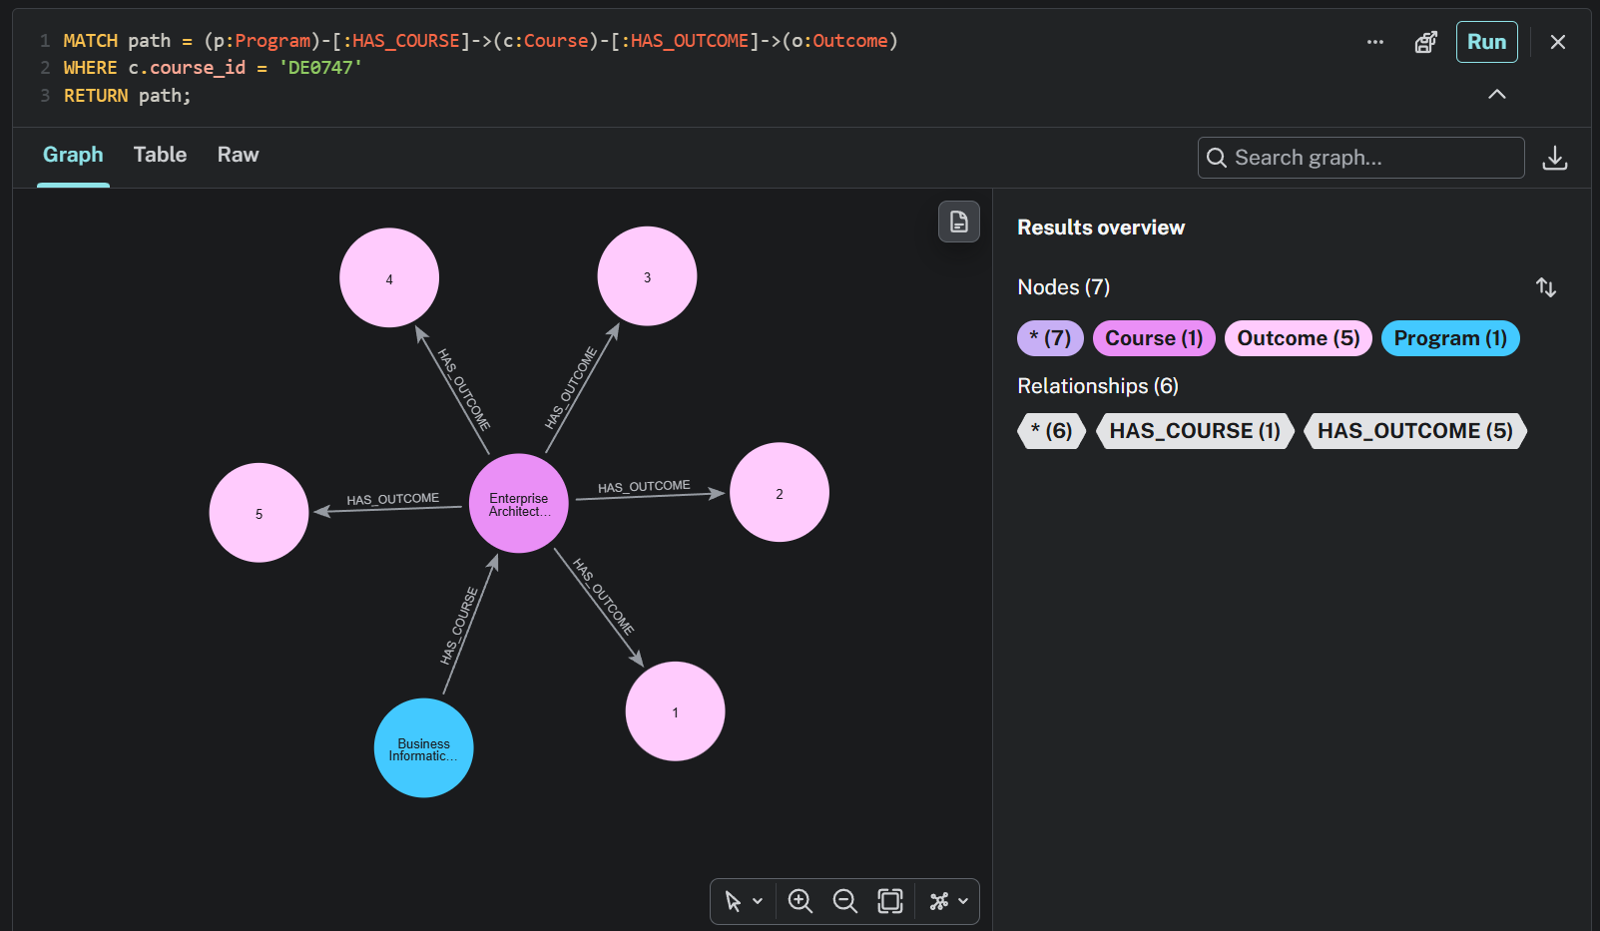
A visual graph representation of the connections for the Enterprise Architecture course. It displays the course node itself, linked to its study program and five learning outcomes.

