Slide 1
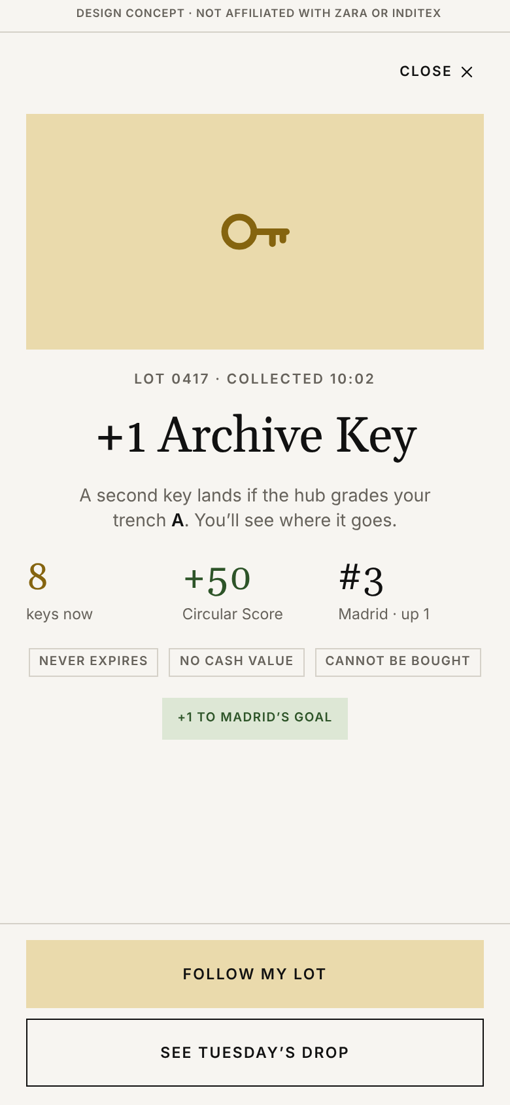
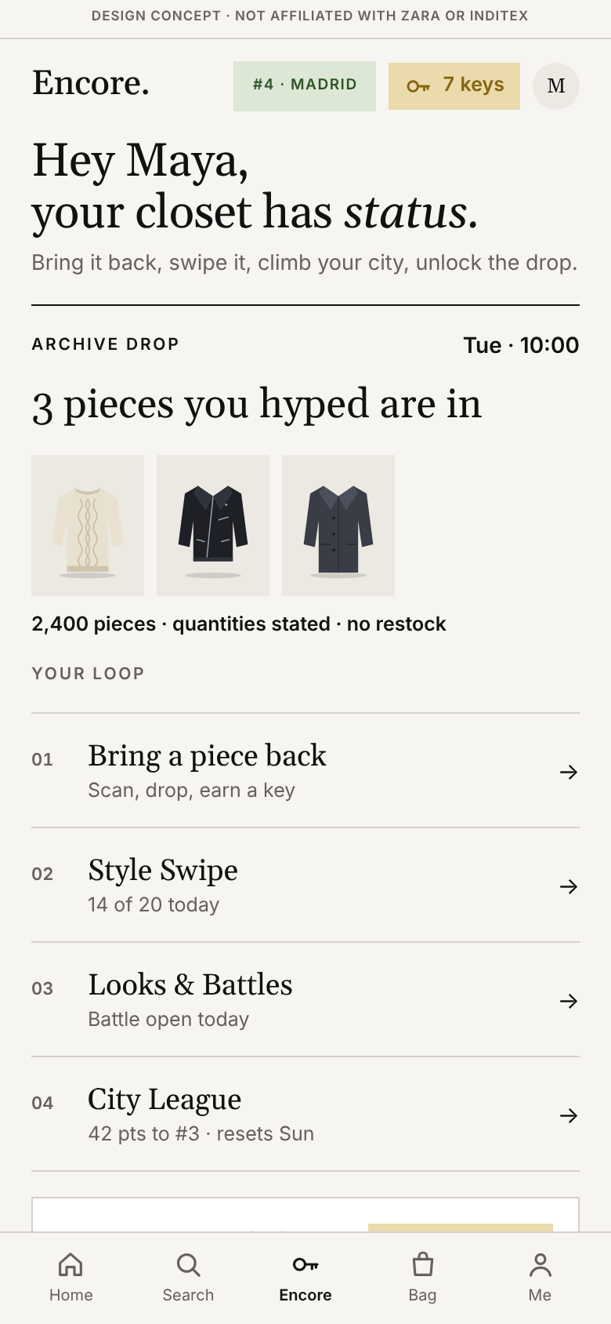
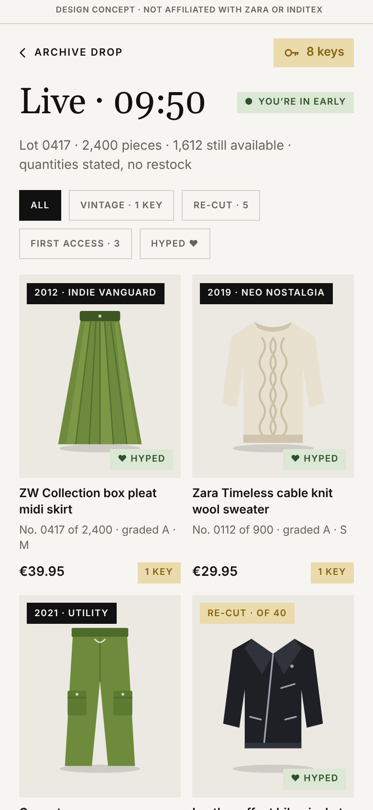
BIC × ZARA CASE COMPETITION · ROUND 1 · FALL 2026
Encore.
Bring it back. Swipe it. Unlock the drop.
Zara’s second life, run as the main event. Encore Bins turn returned garments into Archive Keys; Style Swipe, closets and city leagues turn circular actions into status; Archive Drops turn keys into the pieces everyone else will find sold out. Built inside the Zara app, on rails Zara already owns.
100,000
€0
<10 min
Zara items listed on Vinted every day
what Zara’s bin pays for a garment today
for Galliano Re{form} accessories to sell out
HOME
A KEY LANDS
TUESDAY’S DROP
Team captain Victor Hsu
Team members Juliet Dong, Sophie Hsu, Kaitlyn Lavichant
Student concept. Screens are from the team’s working prototype with placeholder garment art; not affiliated with or endorsed by Zara or Inditex.

Slide 2
01 · THE BEHAVIOR WE WANT TO CHANGE
Secondhand Zara has no status, no date and no drop, so buying new always wins
The moment we target is the closet clean-out: an 18 to 25-year-old decides a Zara piece is done. Today it is listed on Vinted with 61.8 million other Zara items, dropped in a bin that pays €0, or left in the closet. Supply is not the problem; status is. A new drop has a date, an edit, visible scarcity and status for owning it, and secondhand Zara has none of them. Encore gives a returned garment all four and makes bringing it back the only way into the drops Zara’s customers already queue for.
THE STATUS GAP: WHAT A DROP HAS AND SECONDHAND LACKS
WHY PEOPLE SKIP SECONDHAND (YOUGOV, OCT 2026)
THE NUMBERS BEHIND THE GAP
WHAT MAKES A PIECE WANTED
NEW DROP
SECONDHAND
ENCORE
61.8M
17,015 t
A date and an edit
✓
×
✓
Hygiene
48%
A drop moment
✓
×
✓
Condition
45%
Zara items on Vinted, against 590 monthly searches for “secondhand Zara”
came back to Zara bins in 2022 with “no economic benefit”
Scarcity you can see
✓
×
✓
Status for owning it
✓
×
✓
Fit
38%
32%
0
Trusted condition and fit
✓
×
✓
A reason to bring it back
×
×
✓
Limited styles
22%
of clothes bought are never worn; 57% feel pressure to keep up (Oxfam 2026)
loyalty programs at Zara; Bershka’s club has 40M members
WHY NOW
WHO WE DESIGN FOR
ZARA IS GROWING, NOT FIXING
19 Jul 2026
EU ban on destroying unsold apparel applies
Maya, 24, Madrid (illustrative). 14 Zara pieces, 5 unworn for a year, 0 reasons to bring one back. She queued online for the Galliano drop and missed it. She thrifts on Depop for one-of-a-kind finds and posts fits, but has never resold a Zara piece because nothing makes it worth the effort.
€19.8bn
58.7%
27 Sep 2026
Green-claims directive: facts only, no vague “sustainable”
H1 2026 sales, +9.2% at constant currency; Q3 opened +9%
gross margin; Zara concepts about 70% of the group
17 Apr 2028
Textile EPR schemes due, fees must penalise fast fashion
Team survey, Nov 2026, n = [ ]: [Y]% would bring a piece back for drop access · [Z]% would pay more for a dated, numbered Zara piece than the same piece on Vinted.
Zara app peaked at 11.1M active users in Europe: the channel already exists.
Key takeaway Demand for a worn garment cannot be bought with discounts; it is earned with status. H&M’s take-back vouchers were called “an invitation to buy more” and 76% of tracked items were destroyed, exported or warehoused. Encore pays for returns in the one currency Zara’s customers already compete for: access to the drop. The format works at Zara: Galliano Re{form} accessories sold out in under ten minutes on 1 October, about €100M of sales from 157 pieces (Jefferies).
Sources FashionUnited (2024, 2026) · Marie Claire (2022) · Zara help center (2026) · Inditex SNFI 2022, FY2025, H1 2026 · Sensor Tower (2026) · YouGov (Oct 2026) · Oxfam (2026) · European Commission and Parliament (2026) · Changing Markets (2023) · Sina Finance; Jefferies via Benzinga (Oct 2026)
Encore · student design concept · 2

Slide 3
02 · WHAT WE LEARNED FROM EXISTING SOLUTIONS
Depop made secondhand social; deposits, leagues and earned drops make it a habit
Depop has 7 million active buyers and 3 million sellers, nearly 90% of buyers under 34, and eBay paid about $1.2bn for it in July 2026. It feels like a social feed, not a store: people follow closets, curate a vibe, sell their own pieces and ask each other about fit. 75% of its Gen Z users buy secondhand to reduce consumption, 55% for one-of-a-kind pieces and 45% to keep up with trends. What it lacks is a brand behind the garment. Encore takes Depop’s social layer and adds what only Zara can: the label, the store, the drop.
WHY GEN Z LIVES ON DEPOP, AND WHAT ENCORE BORROWS
PRECEDENTS: WHAT GETS GOODS BACK AND PEOPLE HOOKED
01
Social-first feed
ENCORE Looks feed and closet pages with followers; hearts earn points.
PRECEDENT
NUMBER
LESSON ENCORE KEEPS
Likes, follows and curated closets feel like Instagram, not a catalogue grid.
Germany deposit return
98%
of containers return for €0.25 via 135,000 return points: make the return point obvious
Trove in-store trade-in
31%
of credits redeemed same day; Clare V.: 35% of resale buyers new to brand
02
Vibe over transaction
ENCORE Pieces sold in era edits: “Zara 2012 · Indie Vanguard · No. 0417”.
Nike SNKRS Exclusive Access
earned
access won by engagement, bots banned: access is worth more than money
People buy an aesthetic: Y2K, 90s, “Indie Vanguard”. Identity, not utility.
H&M vouchers (counter-example)
76%
of take-back items destroyed or exported: vouchers drive new buying
Rewards meta-analysis, 128 studies
-0.36 / +0.33
tangible rewards cut motivation; status and feedback raise it
03
Micro-entrepreneurship
ENCORE Sell from your closet on Zara Pre-Owned (+40 pts); Encore Curators.
Duolingo leaderboards
+17%
learning time; engaged users tripled: weekly leagues work
Anyone can flip finds and become “Depop famous” with a following.
Starbucks Rewards tiers
~60%
of US company revenue from 36M members climbing tiers by frequency
Spotify Wrapped 2025
500M
shares in days: a season recap people post
Peer-to-peer trust
Beli pairwise ranking
120M
rankings of 2M places: taste is a game people play daily
04
ENCORE “Ask about fit” and fit notes from owners in your size (+5 pts).
Galliano Re{form} at Zara
<10 min
to sell out; about €100M from 157 pieces: Zara drops already work
Buyers chat with sellers about size and styling.
Supreme on StockX, H1 2026
11% → 41%
resale premium: a drop you had to earn trades above retail
Limited quantity vs limited time
quantity
beats time for symbolic brands: state units, never count down
05
Buying with a conscience
ENCORE City goal: every return counts toward what Zara does for the city.
Standalone swipe apps
0 of 3
survived (Mallzee, Grabble, The Yes): build inside the Zara app
75% buy secondhand to reduce consumption (Depop x Bain).
FIVE DESIGN RULES WE TOOK AWAY
01
Earned, never bought
02
Status, never discounts
03
Quantities, never timers
04
Inside the Zara app
05
Community first, then rank
Sources Retail Gazette (Jul 2026) · Depop x Bain (May 2021) · Depop trend reports (2024-2026) · TOMRA (2026) · Trove (2024) · Complex; Hypebeast (2021, 2023) · Changing Markets (2023) · Deci, Koestner and Ryan (2001) · Lenny’s Newsletter (2023) · Starbucks (2026) · TechCrunch (Dec 2025) · Boston Globe (Aug 2026) · Sina Finance; Benzinga (Oct 2026) · StockX via FashionUnited (Aug 2026) · Aggarwal, Jun and Huh (2011) · Retail Dive; DIGIT (2017, 2018)
Encore · student design concept · 3

Slide 4
03 · OUR IDEA, PART 1: EARN IT IN STORE, SPEND IT ON THE DROP
Encore Bins turn every Zara label into a key money can’t buy; keys open the drop
Phase 1 bridges store and app: scan the care label, drop the garment in the Encore Bin by the returns counter, and an Archive Key lands once the bin’s reader and scale confirm it. Phase 3 is the reward: every Tuesday at 10:00 keys open three quantity-limited lanes. Keys are never sold, never expire and never discount new product; the key opens the door, money buys the piece. It all rides soft-tag RFID in every store, the NaviLens code on care labels, the Tuesday delivery and Cáritas Moda re-, which already collects 50.9M kg a year.
PHASE 1 · ENCORE BINS: FOUR STEPS, ABOUT A MINUTE
01
At the label
02
At the bin
03
In the app
04
At the DC
Scan the care label in Store Mode. The reference code returns photo, name and composition, the lookup Pre-Owned already uses. Any Zara piece, any condition, no receipt.
Drop it in the Encore Bin. It weighs the piece; a UHF reader confirms recent RFID labels in ~1 s; older pieces by scan plus weight.
The key lands: 1 per garment, 2 if graded A. A lot number shows where it goes. Capped at 10 keys a month.
Follow the lot: Verified on Pre-Owned, vintage lane, re-cut, or fiber. Owners are told when it sells.
ZARA No new hardware: RFID in 90%+ of products; NaviLens on all labels by SS27.
ZARA Zebra FX9600 reader, scale, chute: ~€3,000 a bin, ~€6.3M for 2,089 stores.
ZARA Keys cost nothing: an access right, opt-in under GDPR.
ZARA Rides the twice-weekly return run; Cáritas keeps every reusable piece.
PHASE 3 · ARCHIVE DROPS: THREE LANES EVERY TUESDAY AT 10:00
Vintage by era
1 KEY
Re-cut editions
5 KEYS
First access
3 KEYS
Graded, cleaned Zara by trend and year. Grade A at the original price, grade B at 70%; never marked down.
Hand re-cut in the Arteixo cluster from garments graded unwearable; numbered editions of 20 to 200 at Atelier prices.
The most wanted new pieces, 24 h before the public, at the same price. Sells out anyway, so it costs Zara nothing.
PROOF Depop: “Indie Vanguard”, “Neo Nostalgia”; Pinterest “dream thrift finds” +550%; 62% of Zalando pre-owned sells in 7 days.
PROOF RE/DONE re-cut 200,000+ Levi’s; TNF Remade $50-400; Zara collab pieces resell at 2-4x.
PROOF 73% of Gen Z and Millennials prefer experience rewards like early access (LoyaltyLion).
IN STORE Scan, drop, the key lands.
TUESDAY Three lanes, quantities stated.
Rules of the key Earned only by bringing Zara garments back · no cash value, no expiry, no transfer · never a discount on new product · 10 a month cap and a condition spot check stop gaming · RFID only confirms, the label code identifies (Zara’s RFID can’t survive washing) · claims are facts: “pre-worn, graded A, lot 0417”, never “sustainable”.
Sources Inditex FY2025, H1 2026 · RFID News (Nov 2026) · Avery Dennison (2025, 2026) · Reason Why (Jul 2026) · Zara help center (2026) · Revista Cáritas (Mar 2026) · Zebra via BarcodePlanet (2026) · Depop (2024-2026) · Pinterest (2025) · Zalando (2026) · RE/DONE (2024) · Hypebeast (2020) · Glossy (Mar 2026) · LoyaltyLion (2025) · EUR-Lex Directive 2024/825
Encore · student design concept · 4

Slide 5
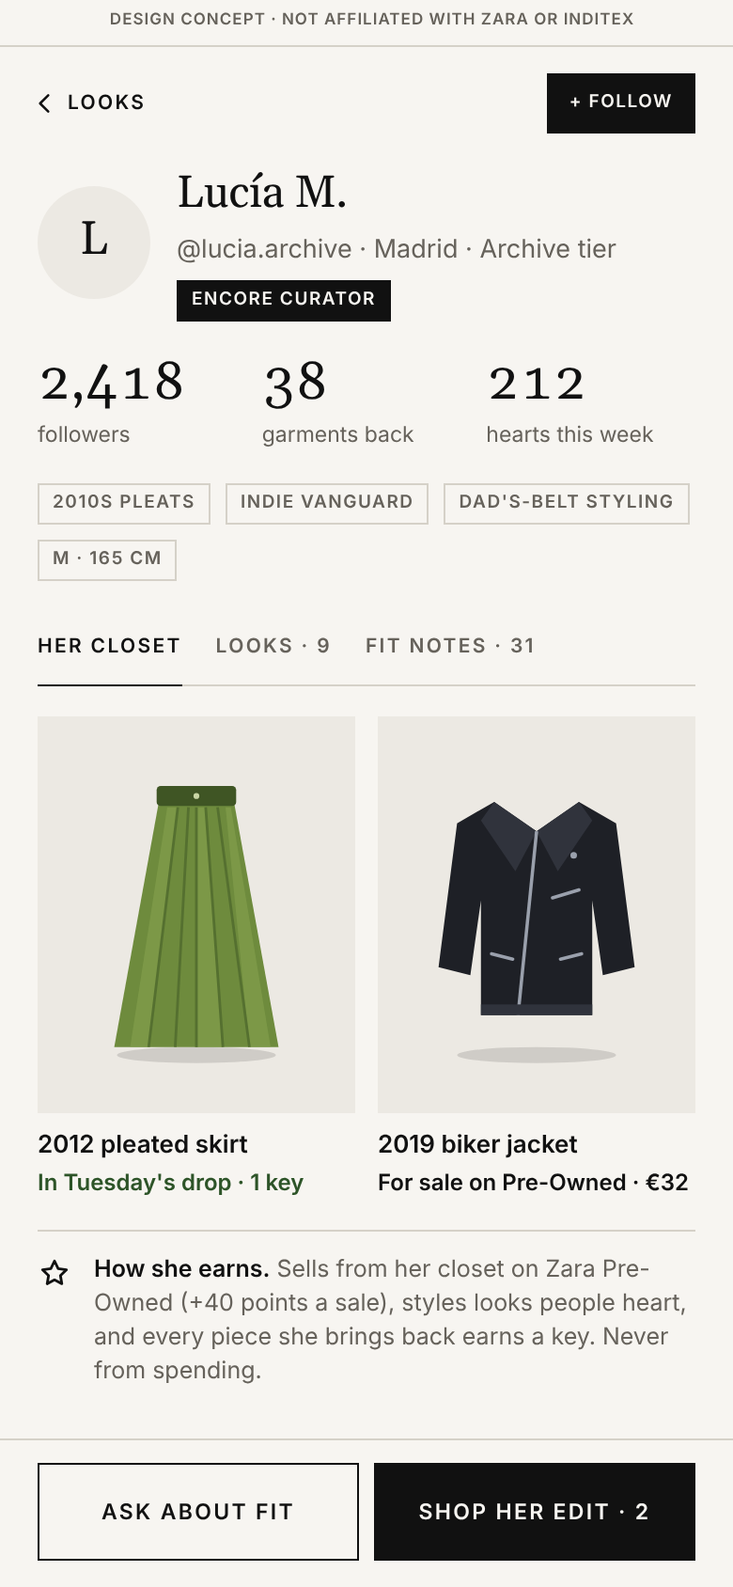
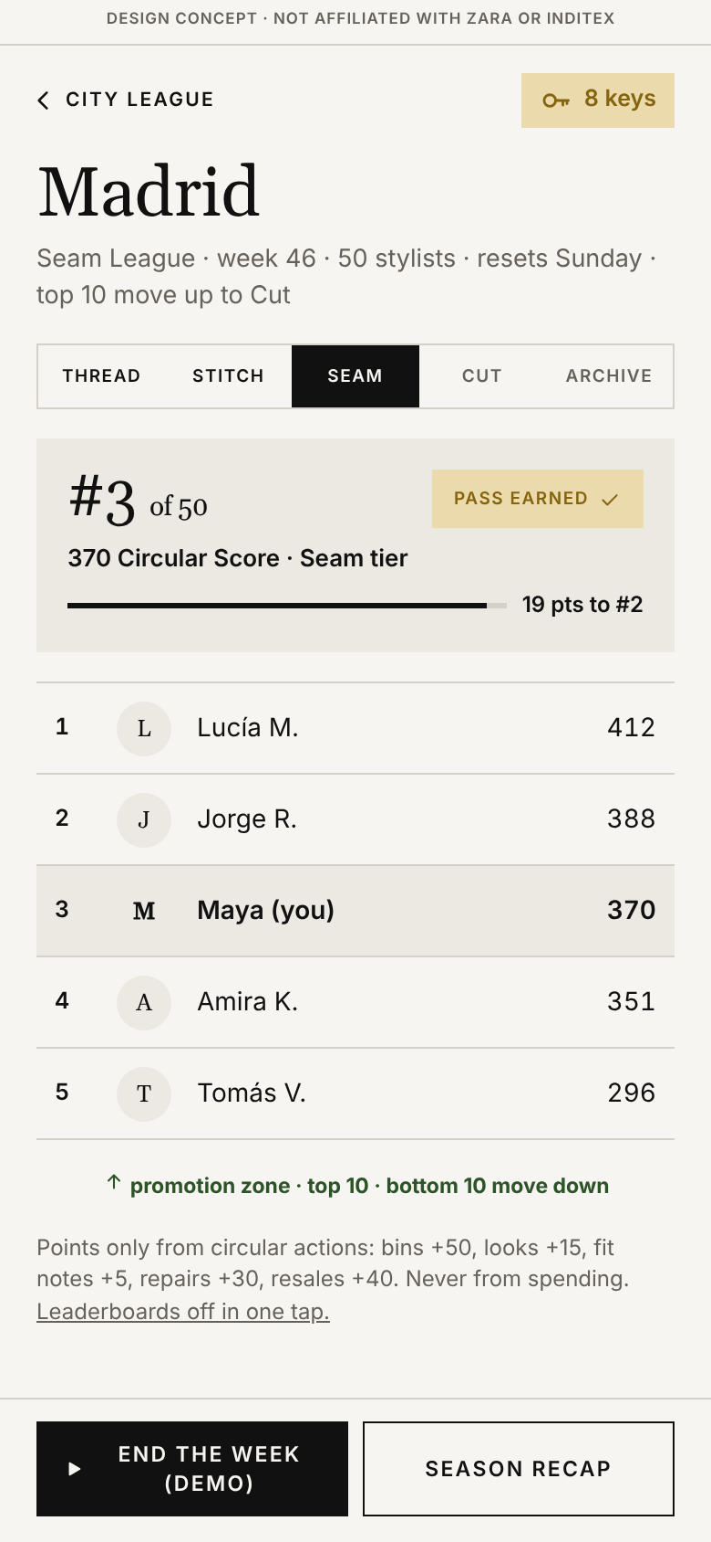
04 · OUR IDEA, PART 2: THE COMMUNITY THAT KEEPS PEOPLE COMING BACK
Closets, leagues and a city goal make bringing it back as social as Depop
Phase 2 keeps people in the Zara app between drops. A daily deck of 20 garments teaches the drop each user’s taste. Every user has a closet page others follow. Looks, fit notes, returns, repairs and Pre-Owned sales earn a Circular Score that ranks people in a weekly league of 50 in their city, and every return also counts toward one city goal that unlocks something Zara does for everyone. Nothing is earned by spending, nothing expires and nothing counts down.
THE DEPOP LAYER: CLOSETS AND CURATORS
CITY LEAGUES: FIVE TIERS, WEEKLY, SUNDAY RESET
Every user has a closet: followers, aesthetic tags, pieces they brought back and where those are now, pieces for sale on Zara Pre-Owned, looks and fit notes.
Follow, heart, “ask about fit”, shop someone’s edit. Encore Curators are the “Depop famous”: status from taste and returns, never spending.
Daily deck of 20: hype or pass; hyped pieces get first word on Tuesday and tell Arteixo what to make (early signals cut forecast error 30% → 9%, HBS).
TIER
HOW YOU GET THERE
WHAT IT UNLOCKS
Thread
Join; one circular action
Daily deck and the city feed
Stitch
A week in the top 20 of 50
Fit notes from owners in your size
Seam
Top 10 of Stitch, two weeks running
Skip-the-line pass: drops 10 min early
Cut
Top 10 of Seam + 2 garments back this season
+1 bonus key a month; Style Battle entry
CITY GOAL: EVERYONE’S RETURNS ADD UP
Archive
Top 5% of the city at season end
+2 keys a season, Insider badge, Encore night, first look at re-cuts
25k
Free repair weekend in every Zara in the city
CIRCULAR SCORE: POINTS ONLY FOR CIRCULAR ACTIONS
50k
5,000 paid training hours at Cáritas Moda re-
ACTION
POINTS
CAP
WHY
75k
City votes a re-cut edition; proceeds to Cáritas
100k
10,000 trees with the city’s parks + Encore night
Bring a garment back
+50, 1 key (2 if A)
10 keys/mo
only way to earn keys
Cities race on share of goal (Madrid 61%, Barcelona 54%, London 48%, illustrative). Stated as actions with numbers, never as offsets.
Post a look in secondhand
+15, +5 / 10 hearts
50 a post
photos: top trust signal (52%)
Fit note on a piece you own
+5
25 a week
fit: 3rd barrier (38%)
CLOSETS Follow, ask about fit.
LEAGUE 50 people, weekly.
WHAT KEEPS IT OUT OF SHEIN TERRITORY
Repair / Pre-Owned sale
+30 / +40
none
displace new buys most (WRAP)
No spend points, no expiry, no streaks: the leaked Digital Fairness Act draft (9 Nov 2026) lets users switch off streak rewards, fines up to 6% of turnover.
No countdowns, no “only 3 left”, no nagging: the practices in BEUC’s 2025 Shein complaint; the Commission opened an addictive-design case on 17 Feb 2026 and fined Temu €200M under the DSA.
Consent first: photos opt in, city declared not tracked, 16+, human plus AI moderation, one tap turns leagues off and keeps every key.
Finish the daily deck
+5
35 a week
taste data; no streaks
Buy anything
0
none
status is never bought
+17%
60%
500M
Duolingo learning time with leagues
of Starbucks US revenue from tiered members
Spotify Wrapped shares: Encore Wrapped each season
Sources Retail Gazette (Jul 2026) · Depop x Bain (2021) · HBS Working Knowledge · Lenny’s Newsletter, Mazal (2023) · Starbucks Q4 FY26 · TechCrunch (Dec 2025) · Bazaarvoice (Mar 2025) · YouGov (Oct 2026) · WRAP (Feb 2025) · Drèze and Nunes (2009) · Sailer and Homner (2020) · Euronews (Feb, Nov 2026) · BEUC (Jun 2025) · TechPolicy Press (May 2026) · Revista Cáritas (Mar 2026)
Encore · student design concept · 5

Slide 6
05 · HOW WE WOULD TEST IT
A 20-store, 16-week pilot scored on eight metrics, with the decision rule written first
10 test and 10 control stores in Madrid and London, both Pre-Owned markets. Encore Bins at the returns counter; Style Swipe, closets, the City League and the city goal behind a feature flag in the existing app; one Archive Drop every Tuesday from week 5. Cáritas Moda re- grades and cleans as consignee, so Zara owns no used stock; one partner atelier makes a 200-piece re-cut edition. Every metric comes from systems Zara already runs, so the numbers, not the debate, decide the rollout.
Weeks 1-2 Bins installed, flag on
Weeks 3-4 Keys, closets, leagues live
Week 5 First Tuesday drop
Week 9 Mid-point read
Week 16 Decision rule applied
PILOT DESIGN AND COST (ASSUMPTIONS UNTIL THE PILOT REPORTS)
EIGHT METRICS, EACH WITH A PUBLISHED BENCHMARK AND A PILOT BAR
LINE
BASIS
COST
METRIC
DEFINITION
BENCHMARK (SOURCE)
PILOT BAR
Encore Bins, 10 stores
Reader, antenna, scale, chute, fit-out ~€3,000 each
€30,000
Drop-off to key use
Keys used for a drop within 30 days
Over half of Clare V. trade-in credit spent same day (Trove)
40% in 30 days
App features behind a flag
Swipe, closets, Circular Score, leagues, city goal, keys ledger, drop page
€300,000
Incremental spend
Key holders vs matched control, 90 days
Members +10%, redeemers +25% (McKinsey)
+10% vs control
Grading and cleaning
6,000 pieces, Cáritas as consignee at €3-6 a piece
€27,000
Community stickiness
DAU/MAU of league and closet cohort; D30
20% good, 25% excellent (Phiture); Duolingo ~40%
20%; D30 10%
Bin throughput and grade
Garments per bin per week; share A or B
Patagonia 80% resellable; H&M 60% to reuse
150/wk; 60%
Re-cut edition
200 pieces, partner atelier ~€40 each, Atelier prices
€8,000
Drop sell-through
Units sold in 14 days, no markdown
62% of Zalando pre-owned in 7 days
70%
Drops, signage, training
Existing Tuesday deliveries; 30-min counter module
€35,000
New-to-brand share
Drop buyers with no Zara buy in 12 months
35% of Clare V. resale buyers new (Trove)
20%
Total pilot
16 weeks, 20 stores
~€400,000
Virgin material displaced
Resold x weight x 64.6%, plus fiber reused
Resale displaces 64.6%, repair 82.2% (WRAP)
per lot, not 1:1
Full scale Bins in all 2,089 Zara stores ~€6.3M once; app layer ~€2-3M to build, €1M a year to run (team estimates). Keys cost nothing. At a 58.7% gross margin it pays for itself if 2M key holders lift spend 2%, against McKinsey’s +10% for active loyalty members and +25% for redeemers.
Time to earn
Median days, first scan to first drop
49.1% say rewards take too long (Antavo)
under 14 days
Decision rule, written before the pilot Scale to Spain, the UK and France if after 16 weeks: (1) bins take 150+ garments a week, 60%+ resellable; (2) 40%+ of keys used within 30 days; (3) drops sell 70%+ at full price in 14 days; (4) key holders spend 10%+ more than control, with new-purchase frequency not rising faster than circular actions. Two of four earns a second season; fewer folds bins into the Cáritas flow.
Risks and the answer Unwashable RFID: the label code identifies. “Little archive”: the archive is customers’ closets, 61.8M pieces on Vinted. Shein backlash: no spend rewards, expiry or timers. Cannibalization: nothing discounted; first access is to pieces that sell out anyway. Charity displacement: Cáritas keeps every reusable garment. Claims law: facts and lot numbers.
Sources McKinsey (2021) · Trove (2024) · ThredUp (2025, 2026) · Antavo (2026) · Duolingo (Feb 2026) · Phiture (2026) · Patagonia via Trellis (Oct 2026) · H&M Group (2026) · Zalando (2026) · WRAP (Feb 2025) · Zebra via BarcodePlanet (2026) · Inditex FY2025 and H1 2026 · team cost model, all inputs labeled as assumptions
Encore · student design concept · 6

Slide 7
SOURCES
Works cited
Every number on slides 1 to 6 traces to a source below. Figures marked as estimates are team assumptions and will be replaced by pilot data; phone screens are from the team’s working prototype with placeholder garment art. Only public sources, the team’s own survey and the team’s own observations as customers were used; nothing from a company employee, recycler, atelier or contact appears in this deck.
adidas (Mar 2026). Annual Report 2025: adiClub points unlock raffles and exclusive benefits.
Aggarwal, P., Jun, S.Y. and Huh, J.H. (2011). Scarcity messages. Journal of Advertising 40(3): limited quantity beats limited time.
Antavo (Feb 2026). Global Customer Loyalty Report 2026: 49.1% say rewards take too long to earn.
Avery Dennison (2025, 2026). Zara RFID labels cannot be washed after application; Durable PFL rated 10 to 12 washes.
Bazaarvoice (Mar 2025). Shopper Preference Report: 52% say real customer reviews decide the purchase; short-form video most trusted (46%).
Benzinga and Bezzia (Oct 2026). Jefferies on Galliano Re{form}: numerous sold-out items online, about €100M; 157 pieces.
BEUC (Jun 2025). Complaint against Shein by 25 groups in 21 countries: timers, low-stock messages, nagging.
Boston Globe (Aug 2026). Beli: over 120 million pairwise restaurant rankings, 2 million establishments.
Changing Markets (2023). Take-back Trickery: 76% of tracked items destroyed, exported or warehoused.
China Daily (Apr 2026). Pop Mart FY2025: revenue RMB 37.1bn (+185%); Labubu RMB 14.2bn (+366%); shares fell on single-IP risk.
Complex; Hypebeast (2021; May 2023; 2020). SNKRS Exclusive Access earned by engagement; 12bn bot entries a month; The North Face Remade $50 to $400.
Deci, E., Koestner, R. and Ryan, R. (2001). Meta-analysis of 128 experiments: tangible rewards d = -0.36, informational rewards +0.33.
Depop (Dec 2024; Dec 2025; 2026). Trend reports: Indie Vanguard (2025), Neo Nostalgia (2026); Top Seller program: earned status, never bought.
Depop and Bain & Company (May 2021). Survey of 2,000+ Gen Z Depop users: 75% buy secondhand to reduce consumption, 55% for one-of-a-kind pieces, 45% to keep up with trends, 35% because it is cool.
Drèze, X. and Nunes, J. (2009). Feeling Superior, Journal of Consumer Research: a tier’s status rises when a tier exists below it.
Duolingo (Feb, Nov 2026). Q4 2025: DAU 52.7M, MAU 133.1M; Q3 2026: DAU +29%. Lenny’s Newsletter, J. Mazal (Feb 2023): leaderboards +17% learning time, engaged users tripled.
Euronews (Feb 2026; Nov 2026). Commission opens DSA case against Shein over addictive design; Digital Fairness Act leaked draft: switch off streak rewards, fines up to 6%.
European Commission and Parliament (2026). DG ENV: destruction ban in application from 19 Jul 2026. OEIL: Directive (EU) 2025/1892, textile EPR schemes by 17 Apr 2028. EUR-Lex: Directive 2024/825 from 27 Sep 2026.
FashionUnited (Jun 2024; Jul 2026; Aug 2026; Sep 2026). 61.8M Zara items on Vinted; AGM: RFID in over 90% of products, MMBRS 40M; StockX H1 2026: Supreme premium 11% to 41%, Palace 9% to 81%; Galliano launch 1 Oct.
Glossy (Mar 2026; Aug 2026; Oct 2026). Zara collab pieces resell at 2 to 4x; Sephora: 46M+ members, 30% did Beauty Insider Challenges; Launchmetrics: Galliano $8.3M MIV, 62% archival authority, premium strategy 2x MIV.
H&M Group (Mar 2026). Annual report 2025: 60% of collected garments to reuse.
HBS Working Knowledge (2000). Early demand signals cut forecast error from 30% to 9%; Zara cited.
Inditex (Mar 2026; Sep 2026 via MarketScreener and TheIndustry.fashion). FY2025: sales €39.9bn, gross margin 58.3%, online 26.8%, Zara 2,089 stores, 88% lower-impact and 47% recycled fibers, Try-On; H1 2026: sales €19.8bn (+9.2% cc), gross margin 58.7%, Q3 +9%, soft-tag RFID in all stores. SNFI 2022: 17,015 t collected.
LoyaltyLion via TheIndustry.fashion (Jul 2025). 73% of Gen Z and Millennials motivated by experience rewards; 70% of Gen Z would pay to join.
Marie Claire (Dec 2022). 670,616 Zara resale listings against 590 monthly searches.
McKinsey (Oct 2021). Next in loyalty: active members +10%, redeemers +25%. Retail Brew (Apr 2026): 58% of secondhand-first buyers later buy new.
Oxfam (Sep 2026). State of Style 2026: 57% feel pressure to keep up; items worn under 5 days; 32% unworn.
Phiture (Mar 2026). App benchmarks: DAU over MAU 20% good, 25% excellent; shopping apps D30 about 5 to 6%.
Pinterest (Aug 2025; Dec 2025). Fall trend report: dream thrift finds +550%, vintage fall aesthetic +1,074%; Predicts 2026: 80s luxury +225%, 67% of trends driven by Gen Z.
RE/DONE; Fashion Dive (2024; Apr 2025). 200,000+ pairs of vintage Levi’s re-cut by hand; Urban Outfitters Vintage & ReMade $45 to $270.
Reason Why (Jul 2026). NaviLens code on Inditex internal care labels, all products by SS2027.
Recover (Jan 2025). Verified LCA: 93% less CO2 per kg than conventional cotton.
Retail Dive; DIGIT; FashionUnited (2017, 2018, 2022). Mallzee 1M downloads, 300M ratings; Grabble shut 2018; Pinterest acquires The Yes.
Retail Gazette (Jul 2026). Depop: 7M active buyers, nearly 90% under 34, 3M+ active sellers; eBay acquisition for about $1.2bn completed 30 Jul 2026.
Revista Cáritas (Mar 2026). Moda re- 2025: 50.9M kg collected, 9,172 containers, 191 shops; Santiago sorting plant with Inditex and the Xunta.
RFID News (Nov 2026). Zara soft-tag RFID; passive UHF; a pile read in about a second; self-checkout up to 90% of transactions.
Sailer, M. and Homner, L. (2020). Meta-analysis of gamification: competition combined with collaboration moves behaviour most.
Sensor Tower (Jan 2026). Zara app in Europe: 11.1M active users at peak, 738K weekly downloads.
Sina Finance (Oct 2026). Galliano Re{form} on the Zara app in China: accessories sold out in under ten minutes; most of the line followed.
Starbucks (Jan 2026; Oct 2026). Rewards drives nearly 60% of US company-operated revenue; 36M active members climb tiers “first and foremost by frequency”.
Strava (Dec 2025). Year in Sport 2025: 180M users, 1M clubs, new clubs nearly 4x; Gen Z 75% more likely than Gen X to cite an event as motivation.
Team survey (Nov 2026). n = [ ], ages 18 to 30, Harvard campus networks. Results reported with sample size.
TechCrunch (Dec 2025). Spotify Wrapped 2025: 200M users in 24 hours, 500M+ shares.
TechPolicy Press (May 2026). Commission fines Temu €200M under the DSA.
TheIndustry.fashion (Sep 2025). eBay Authenticity Guarantee: 1M items in a quarter; “vintage” searched 1,000+ times a minute.
ThredUp (Mar 2025, Apr 2026). 49%/60% would buy more secondhand if trends findable; 47% more likely to buy with trade-in credit.
TOMRA (Jun 2026). Germany deposit return: 98% return rate, €0.25, about 135,000 return points.
Treet; Trove; Trellis (2026; 2024; Oct 2026). Credit takers spend 270% above credit; 700+ stores, 31% same-day, Clare V. 35% new; Patagonia Worn Wear 230,000 processed, 80% resellable.
Ulta Beauty (Mar 2026). 46.7M active members (+5%); loyalty base cited for needing no elevated promotions in 2026.
WRAP (Feb 2025). Displacement rates: resale 64.6%, repair 82.2%.
YouGov (Oct 2026). US secondhand concerns: hygiene 48%, condition 45%, fit 38%, limited styles 22%.
Zalando; Zara; Zebra (Jul 2026; 2026). 62% of pre-owned sells within 7 days; Zara help center: collection program, Pre-Owned auto-fill; Zebra FX9600 $1,336, antenna $247.
Encore · student design concept · 7

