Slide 1
Lazy Validation of Experience Graphs
Victor Hwang
Speaking Qualifier
Committee:
Maxim Likhachev (chair)
Siddhartha Srinivasa
Michael Shomin

Slide 2
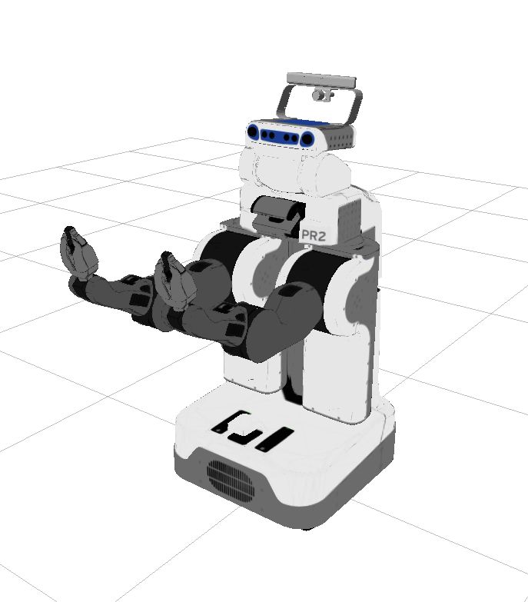
The Motion Planning Problem
High dimensional problems are harder to solve

Slide 3
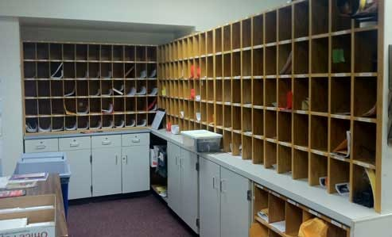
Robots should use prior experience to accelerate planning, even in changing environments

Slide 4
Lazy validation of Experience graphs is a method to efficiently plan with prior experiences in changing environments

Slide 5
Related work
E-Graphs background
Lazy validation
Results

Slide 6
Related Work
Sampling based planners
RRTConnect (Kuffner, et al., 2000)
Probabilistic Roadmap (Kavraki, et al., 1996)
Trajectory Optimization
CHOMP (Zucker, et al., 2009)
Search-based methods
Weighted A* (Pohl, 1970)
Experience Graphs (Phillips, et al., 2012)

Slide 7
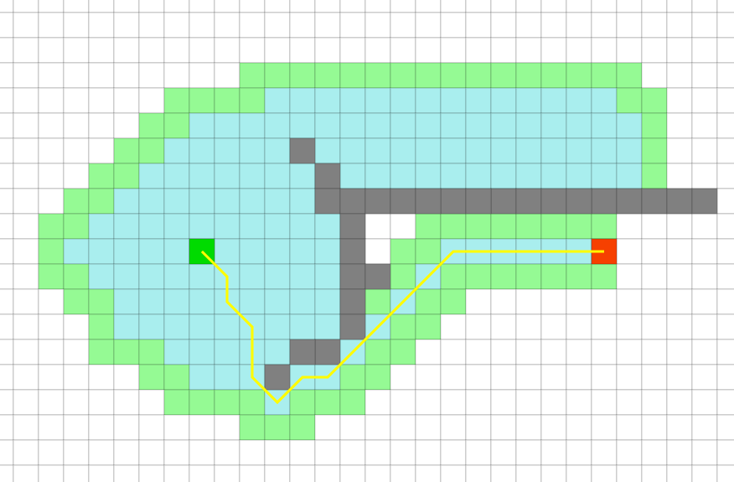
A* Search
Construct a graph that represents the planning problem, search with A*
Quality of the search-focusing heuristic function is extremely important

Slide 8
A* Search
Construct a graph that represents the planning problem, search with A*
Quality of the search-focusing heuristic function is extremely important

Slide 9
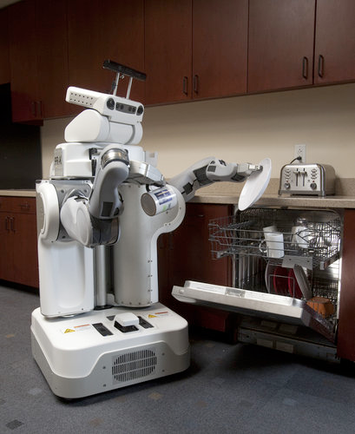
Experience Graphs
Augments A* search with past experiences to improve performance for similar tasks

Slide 10
Experience Graphs
Store states and edges of prior planning episodes in a subgraph of the original graph
Create a heuristic that guides the search towards states on the E-Graph

Slide 11
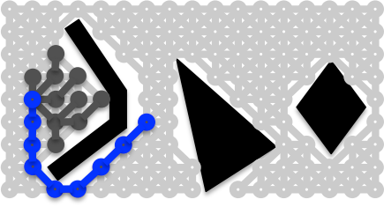
E-Graphs
A new planning scenario

Slide 12
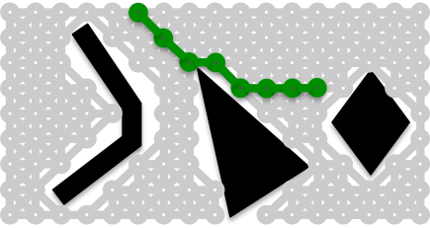
E-Graphs
A second query

Slide 13
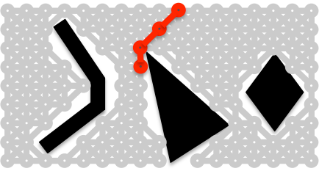
E-Graphs
…a third query

Slide 14
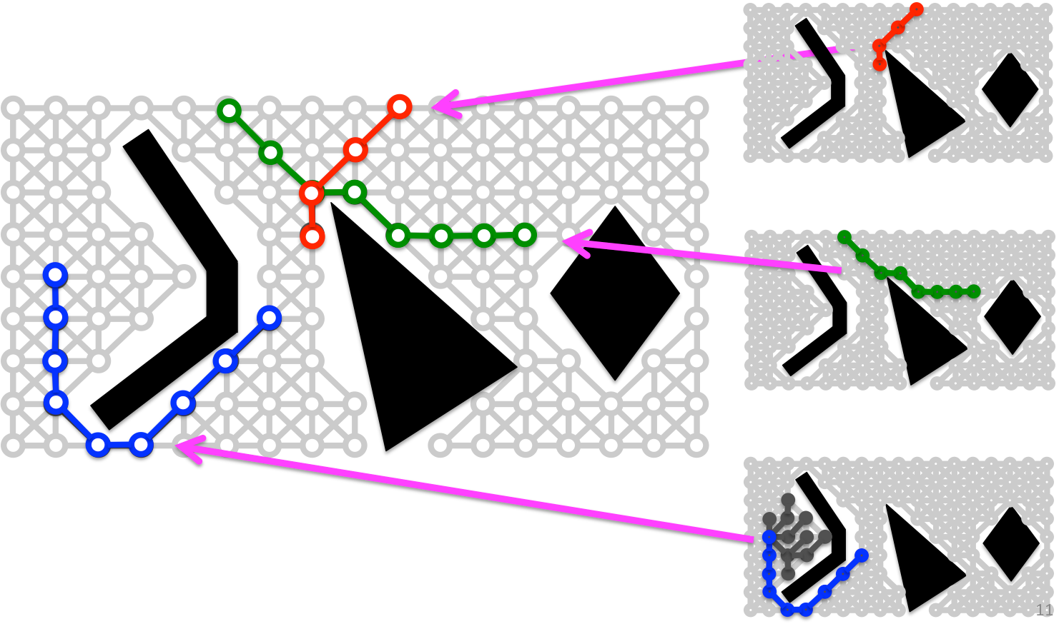
E-Graphs
Merge all three queries

Slide 15
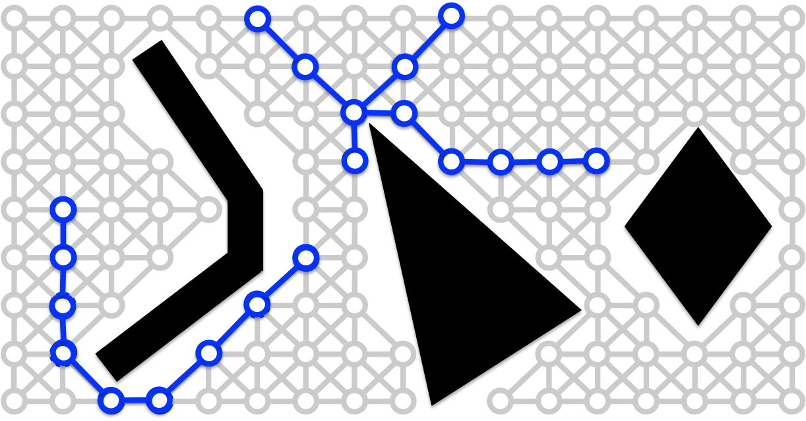
E-Graphs
The complete E-Graph after we merge all three trajectories

Slide 16
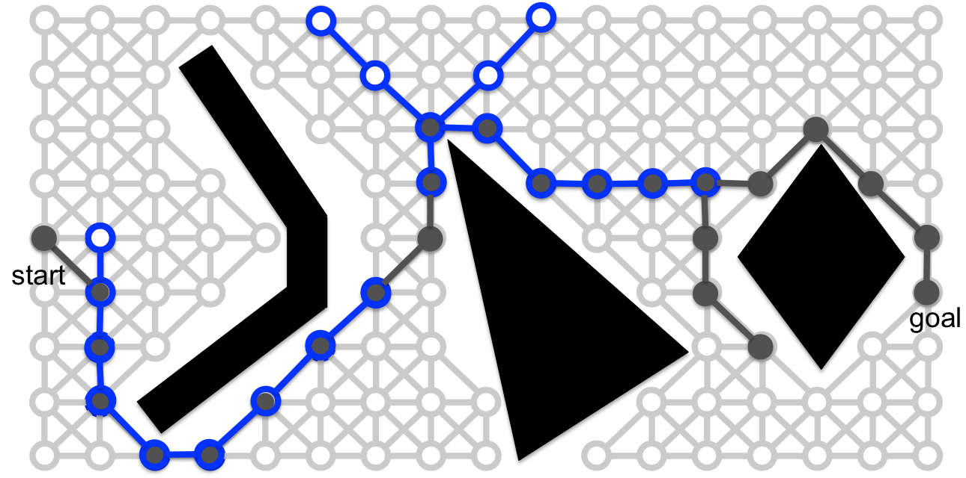
E-Graphs
Using E-Graph now expands fewer states
Completeness & bounds on sub-optimality

Slide 17

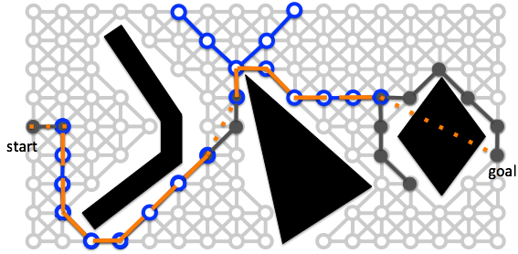
E-Graph Heuristic
Phillips, et al., 2012

Slide 18


E-Graph Heuristic
Heuristic(s)
ε * Heuristic cost
E-Graph cost
Phillips, et al., 2012

Slide 19
The E-Graph framework uses a heuristic to guide a search towards previously planned paths

Slide 20
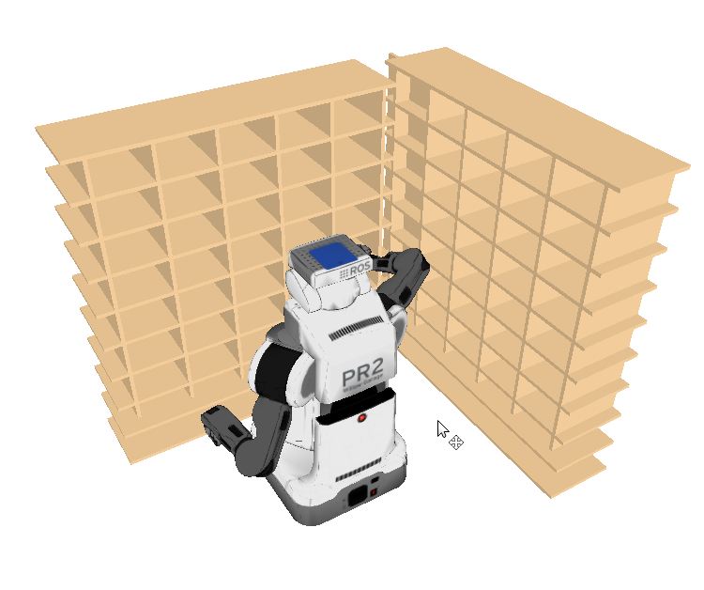
With enough experience, planning between two points is fast
Single arm manipulation (7D) in a
mailroom environment

Slide 21
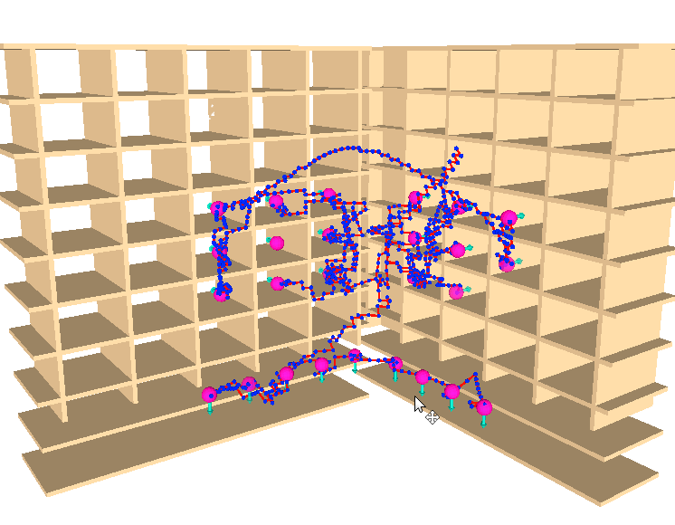

Slide 22
How is this framework affected by small changes in the environment?

Slide 23
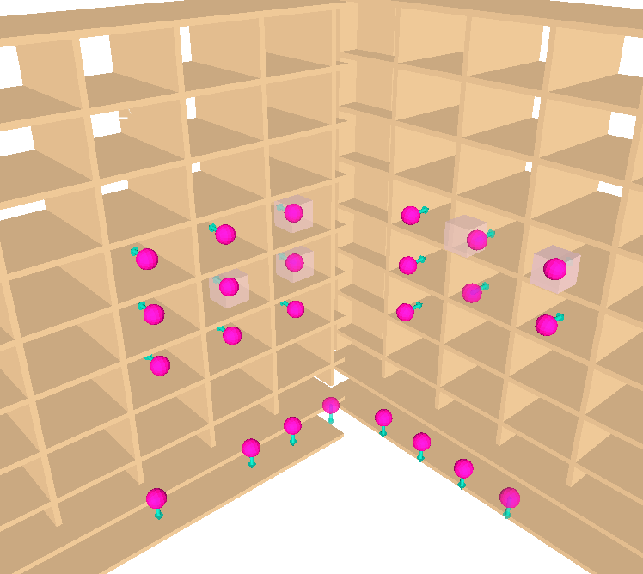

Slide 24
With small changes in the environment, we need to ensure our experience is valid
We could fully validate the E-Graph for every planning request, but this is slow

Slide 25
Lazy validation: Only validate E-Graph edges that lie along a solution path (rather than the entire E-Graph)

Slide 26
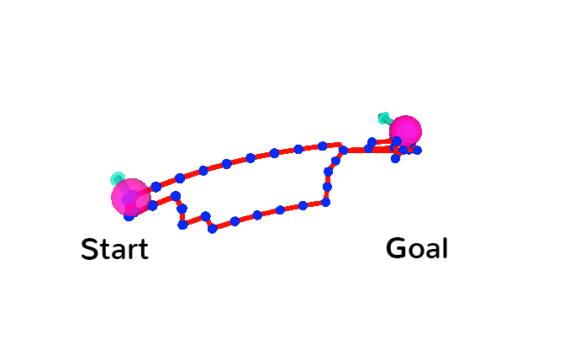
Initial E-Graph

Slide 27
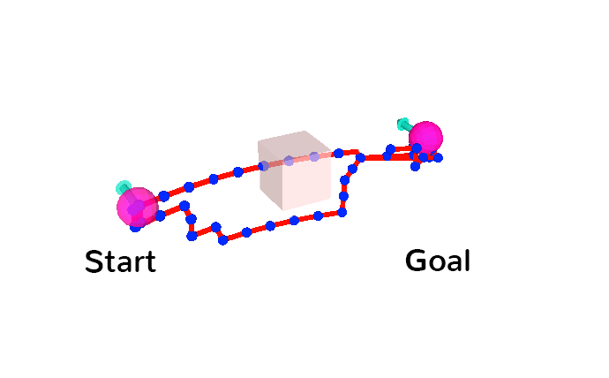
Environment changes

Slide 28
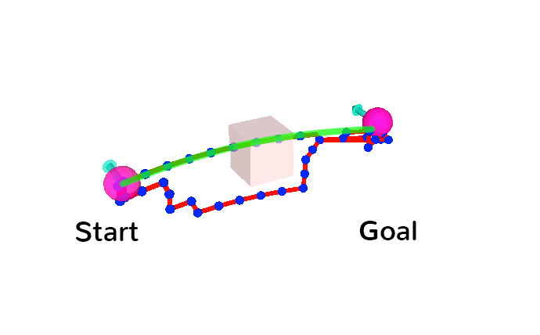
Generate a plan

Slide 29
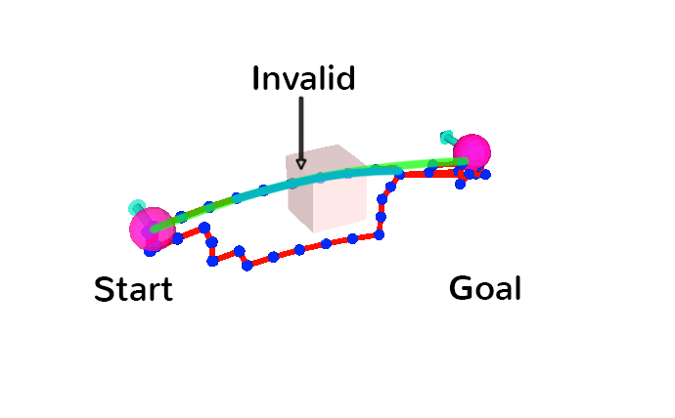
Validate the E-Graph Edges

Slide 30
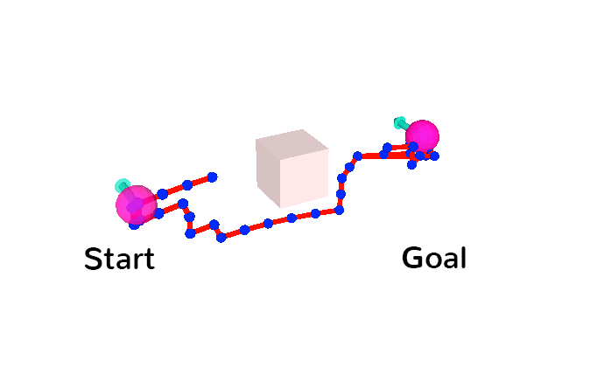
Update E-Graph edges

Slide 31
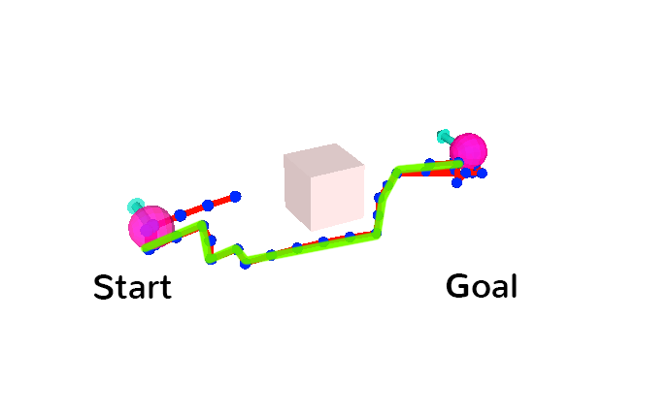
Replan

Slide 32
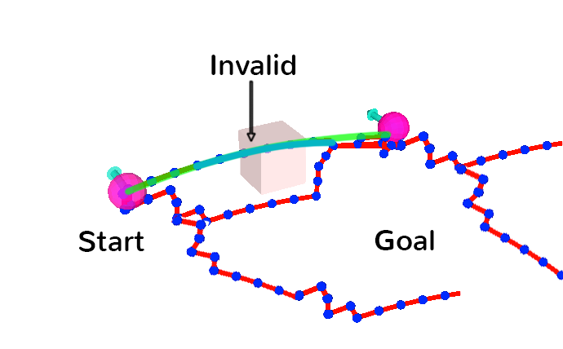

Slide 33
Lazy validation of paths:
Generate a plan
Validate the E-Graph edges in the plan
If invalid, update the corresponding edges in E-Graph
Replan and feedback path

Slide 34
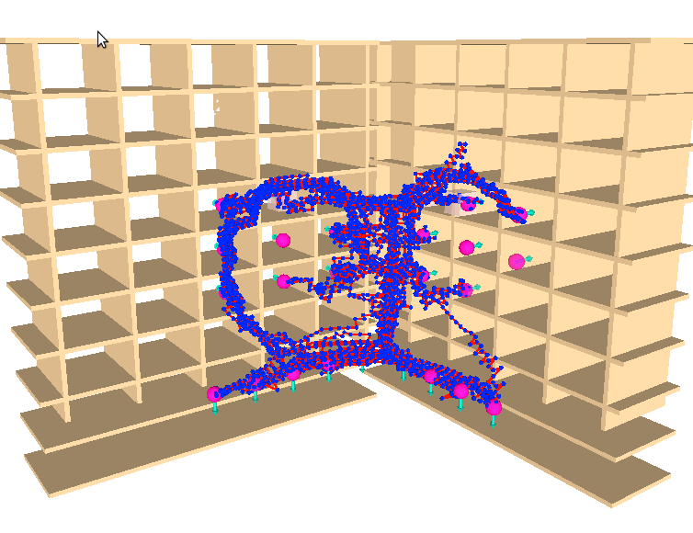
With lazy validation, we avoid validating an E-Graph with ~2000 vertices
Because the E-Graph is dense, replans are fast (0.1 sec)

Slide 35
Experimental Setup
Cubby scenario
200 trials between 18 cubby hole locations to build E-Graph
50 trials with 4 obstacles randomly placed in cubbyholes

Slide 36
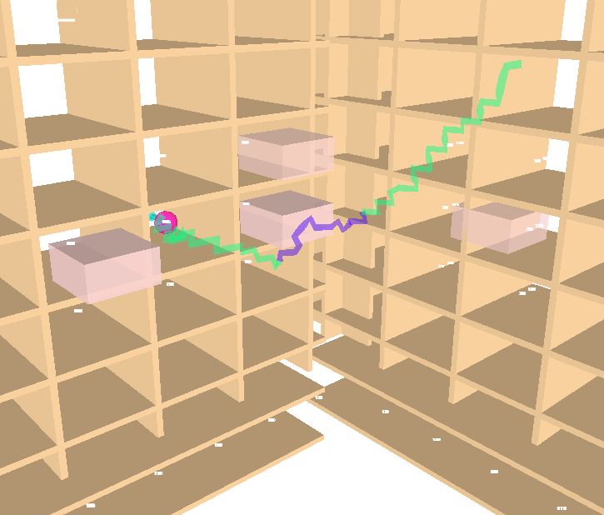

Slide 37
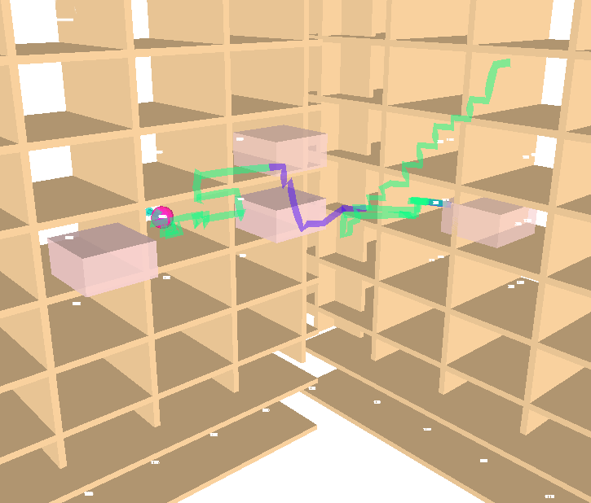

Slide 38
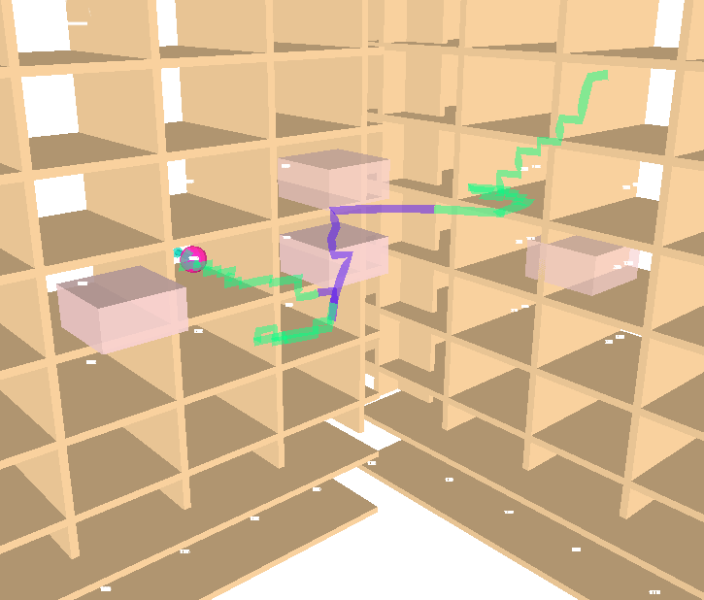

Slide 39
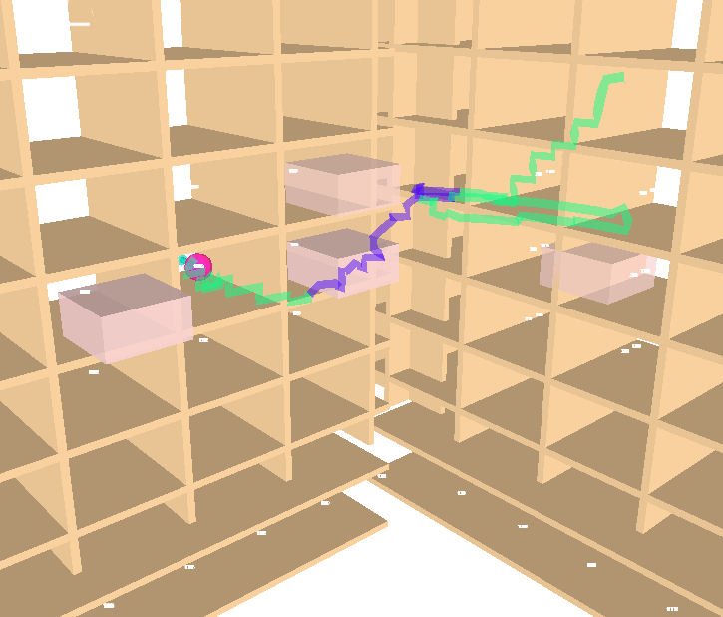

Slide 40
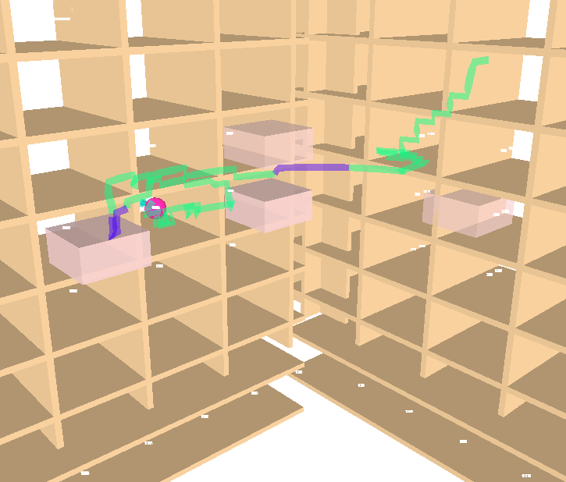

Slide 41


Slide 42


Slide 43
Collision Check Comparison
 | Median CC/request | Average CC/request | Avg # Replans
Lazy Validation | 5181 | 18680 | 3
Full Validation | 36543 | 36769 | -

Slide 44
Time Comparison
 | Planning Time Ratio | Path Quality (EE)
Lazy Validation | 1 | 3.34
Full Validation | 1.6 | 3.78
RRT | 3.6 | 3.57
PRM | - | -

Slide 45
Future Work
Reduce number of replans with better obstacle modeling
Improve replan time in different domains

Slide 46
Conclusion: something.
Lazy validation enables efficient use of large E-Graphs in a changing environment
Allows us to reuse experience to speed up planning

Slide 47
Questions?

Slide 48
give credit to sidd slide 5
say theorems about egraphs
movie
post processing
plot about collision cost
mib2 mail room
egraph shortcutting
on the fly collision checking
feedback egraph in procedure
chomp citation ratliff, lazy prm
trajectory libraries in RW
slide titles

