Slide 1



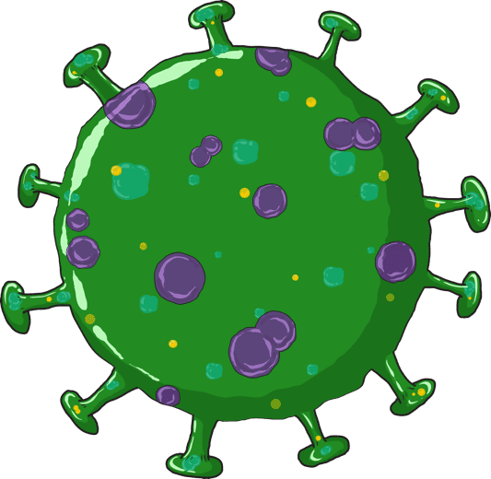

COVID-19
Response and Containment Measures
Training of ANM, ASHA, AWW

Slide 2
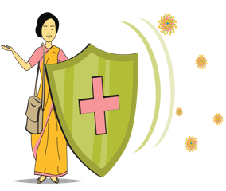
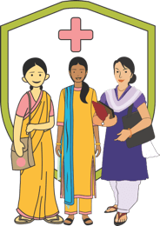

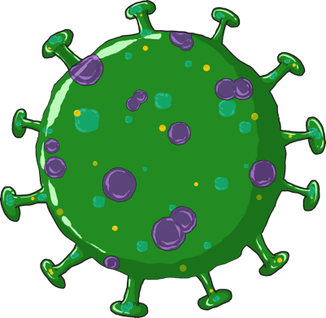
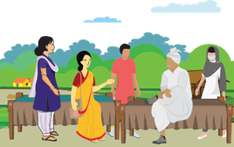


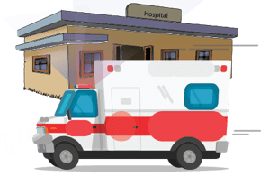
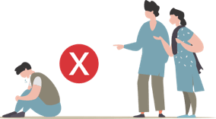
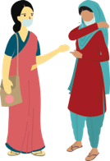



WHAT ARE WE GOING TO LEARN?
1
COVID-19
6
Personal Safety
Frontline workers will work to reach out the message to thousands of directly or indirectly affected community members. However they also need to take care of their own personal safety
ROLE OF THE FLW
This session talks about the role that each of the frontline worker plays and what she needs to understand about COVID-19
2
5
supportive public health services: community & HH
What is the role that community networks play in addressing COVID in the community, what are the services required: home care , home quarantine in urban and rural areas
INFORMATION TO THE COMMUNITY
This section talks about the information and knowledge that the FLW will give to the community on Handwashing, Cough hygiene, Social distancing and HRG
3
4
COMMUNITY SURVEILLANCE
Session discusses the contact tracing protocol, how to identify the contact, what are the guidelines for supporting people who are suspected, symptomatic or asymptomatic cases
STIGMA & DISCRMINATION
This session deals with the myths and misconceptions around Coronavirus and many fears that result in stigmatising behaviours at various level. What is the role of the FLW and what can she do
02
Notes:
1. What role will she play in helping to deal with COVID-19. 2. What is the information that community needs to keep themselves safe and how does the FLW give this information to the community. 3. What is community surveillance and how to conduct community surveillance, who is a person who shows the signs and symptoms and who is one who is infected but does not show the signs of infection. 4. What is Stigma and why is there stigma and how to help 5. How to help people during home quarantine, what care should family members take. 6. Personal safety of FLWs

Slide 3
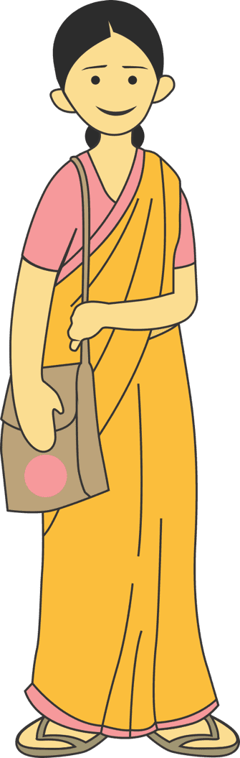
SESSION 1
Communication for Response and Containment Measures
03

Slide 4
ROLE OF ANM, ASHA & AWW
HEALTH - ANM UNDER GUIDANCE OF DSO/MO
HEALTH-ASHA, CHV(IN URBAN AREAS) AND
ICDS –AWW, UNDER GUIDANCE OF ASHA FACILITATOR & CDPO
Provide information
(a) Preventive and control measures including social
distancing during the phases of the COVID outbreak
(b) Addressing myths and misconceptions;
Support DSO on
(a) Contact tracing as per SOPs
(b) Link public health (home quarantine, home care, and supportive services for HRG and probable cases) in urban and rural areas &
(c) Psychosocial care and discrimination stigma and discrimination.
Reporting and feedback across different phases of COVID-19 pandemic (no cases, imported/sporadic cases, clusters and community wide transmission)
Personal Safety and Precautions
Supervision of effective usage COVID-19 IEC materials
Community awareness through inter-personal communication
(a) Uptake of preventive and control measures including social distancing
(b) Addressing myths and misconceptions;
Support ANM/Supervisor in house to house surveillance including
(a) Identification of HRG and probable cases
(b) Ensure uptake of medical services in urban and rural areas and
(c) Psychosocial care, stigma and discrimination
Reporting and feedback across different phases of COVID-19 pandemic (no cases, imported/sporadic cases, clusters and community wide transmission)
Personal Safety and Precautions
Use of COVID 19 IEC materials
04

Slide 5

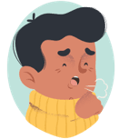

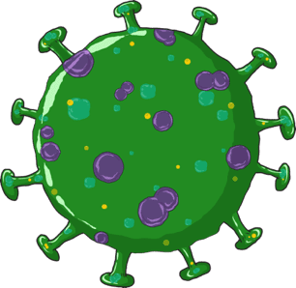
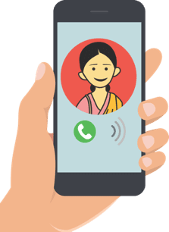
LET US UNDERSTAND ABOUT COVID-19
WHAT ARE THE
COMMON SYMPTOMS
OF COVID-19
The symptoms of covid-19
Are fever, cough, and
Difficulty in breathing
COVID-19 is
Coronavirus Disease-2019
If you have these and you are a contact of
A Laboratory confirmed positive case immediately Call the state helpline
number or ministry of Health & family
welfare, government of India 24x7 helpline
011-2397 8046, 1075 Or your ASHA/ANM.
It is caused by a
Coronavirus
named as SARS-CoV-2
05
Notes:
The name of the disease is COVID-19. THIS IS CORONA VIRUS DISEASE – discovered in 2019. The name of the organism that causes the disease is SARS-CoV-2. This stands for Severe (because it is serious) Acute Respiratory Syndrome- Coronavirus (the name of the family of viruses) 2. Coronaviruses cause several similar diseases including SARS, HINI (Swine flu) and the common cold and Influenza.
Symptoms of COVID-19 are fever, cough and difficulty in breathing
If a person sees these symptoms, the person must immediately contact the government helpline numbers given in this slide.
If you know that the person with whom you have been in contact has been identified as positive for COVID-19, then the person must contact on the helpline numbers immediately.

Slide 6
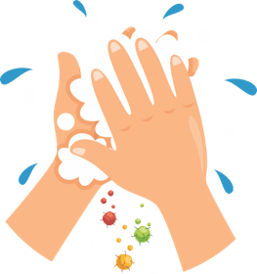
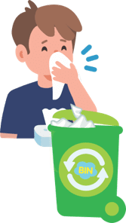
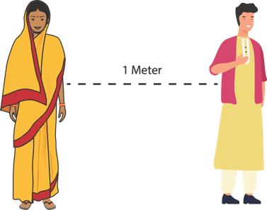

SESSION 2
PREVENTION: SAFE PRACTICES IN THE COMMUNITY
HAND
HYGIENE
RESPIRATORY
HYGIENE
SOCIAL
DISTANCING
HIGH RISK
GROUP
06

Slide 7
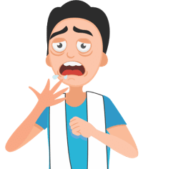



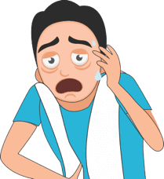


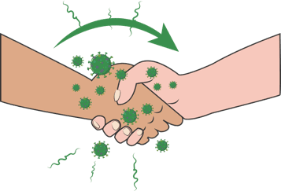

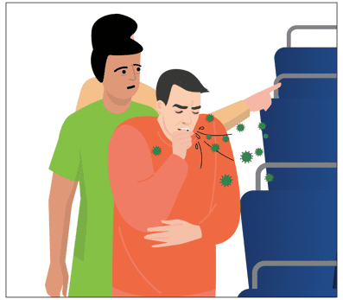
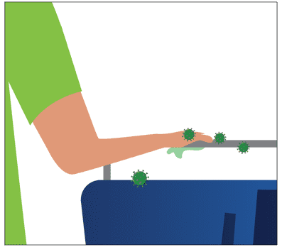
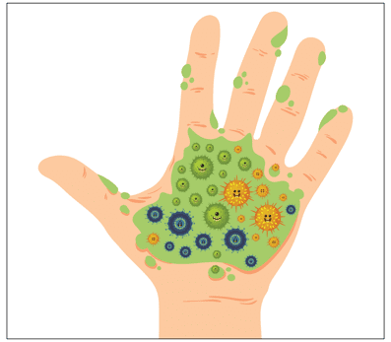
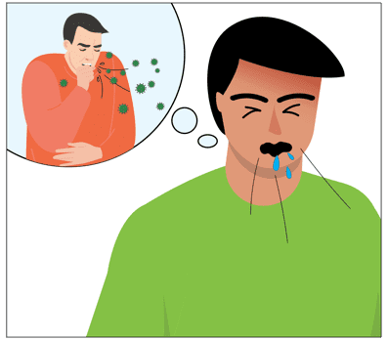
MODES OF TRANSMISSION
SNEEZE/ COUGH
BY INFECTED PERSON
INFECTED DROPLETS
INFECTED DROPLETS
GET ON YOUR HAND
AND WHEN TOUCH
ANY SURFACE OR PERSON
VIRUS
TRANSFERRED!!
SNEEZE/ COUGH
BY INFECTED PERSON
INFECTED DROPLETS
INFECTED DROPLETS
GET ON YOUR HAND
VIRUS
TRANSFERRED!!
07
Notes:
How do you get infected ?
The virus travels through the respiratory droplets of an infected person. When the person sneezes or coughs, the virus is deposited on the person’s hand if the hand covers the mouth, or droplets fall on a surface when the mouth/nose is not covered.
From the surface/hand, the virus will get transferred to an uninfected person’s hand and when that hand coms in touch with the nostril, eyes or mouth the virus gets inside the system.
We do not have the knowledge of how long this virus lives once it is out of the body. But keeping hands clean and not touching them to the face is the most important way of preventing this infection . We are going to learn about this.

Slide 8
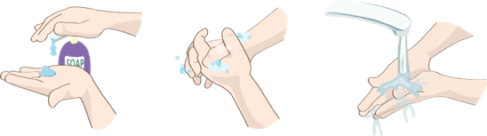
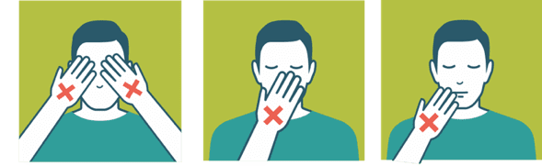
HAND HYGIENE
PREVENTION - WHAT TO DO?
Hand hygiene is a way of cleaning one's hands that substantially reduces potential pathogens (harmful germs) on the hands. Hand hygiene procedures include hand washing with soap and water for at least 40 secs or use of 70% alcohol-based hand rubs
Wash your hands often with soap and water for 40 seconds especially after you have been in a public place, or after blowing your nose, coughing, or sneezing.
Use a hand sanitiser (at least 70% alcohol based) if soap and water not available cover all surfaces of your hands and rub them together until they feel dry.
DO
touch your eyes, nose, and mouth with unwashed hands.
touch surfaces like door knobs and door bells, elevator buttons, handrails, support handles, chair backs, ATM surfaces, mobiles, jeep handles etc
DO NOT
08
Notes:
We spoke about transmission in the earlier slide. Let us now look at how we can prevent this transmission.
Washing of hands with soap and water will kill the virus. Similarly sanitizing with 70% alcohol based sanitizer. We need to wash with soap for a particular time which is 40 secs. It takes that much time for the cell wall to be rubbed off. Similarly with Alcohol. If you do not rub your hand, the virus coat does not fall off and no harm comes to the virus
As we spoke earlier the infected droplets can get transferred via shaking hands with an infected person who may have the bacteria on his hands to an uninfected person or through touching of surfaces which may have the bacteria. That is why we need to have these hand hygiene practices.

Slide 9
PREVENTION: RESPIRATORY HYGIENE
Respiratory Hygiene is a combination of measures taken to stop the spread of germs through respiratory behaviours like coughing or sneezing
DO
DO NOT
DO USE a handkerchief or a tissue to cover your face while coughing or sneezing
DO THROW the used tissue immediately into a closed dustbin
DO COVER your sneeze into your bent upper arm in case you are not carrying a tissue or a kerchief.
DO WASH hands immediately after you have covered your sneeze or cough
DO NOT use other ways of covering your face like the pallu of the sari of the chunni or the gamcha
DO NOT spit in the open, always use a spittoon or wash basin for spitting
09
Notes:
And because we do not want the infected droplets to go out into the air and infect more people, we have to maintain what is called as respiratory hygiene at all times .
Never use the saree pallu or gamcha for sneezing into as you may use these for wiping your hands and the germs will get transferred from your hand to your nose, mouth or eyes.

Slide 10
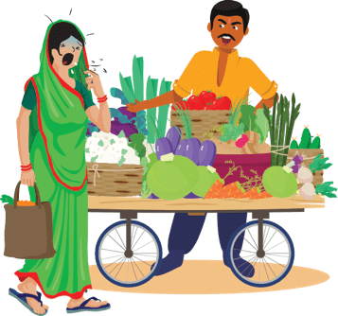
CASE STUDY
ANSWERS
It is good for people to move away and keep a distance. However, as a fellow customer anyone could give a polite advice to follow the correct respiratory hygiene.
It is wrong for the shopkeeper to have shouted at Smita. This is stigmatising behaviour. Though everyone is scared, being rude is not helpful. It will just keep people away from reporting a problem if they feel discriminated against. The shopkeeper can also keep his shop infection free by wiping the counters with a disinfectant regularly.
As a health worker my job will be:
Counsel Smita that she must cover her face with a handkerchief when coughing. Suggest her to get medication at the PHC
Counsel the shopkeeper that anyone can have a cough and it need not be coronavirus infection. However anyone can have the infection and therefore he can help by keeping a box of tissues and hand sanitizer on the counter or keep a washing station for people to wash their hand.
Counsel people on respiratory hygiene
Smita has gone out to buy vegetables. She has a sore throat and is often coughing without covering her face. You are in the shop when she comes and suddenly she has a fit of cough. Everyone instantly moves away from her and the shopkeeper says angrily “Don’t come into my shop if you are coughing.”
QUESTION 1: IF YOU WERE THERE AS A CUSTOMER; WHAT WOULD
YOU HAVE DONE?
QUESTION 2: If you were the shopkeeper, what would
you have done?
QUESTION 3: as a health worker what would you
advise/counsel?
10

Slide 11
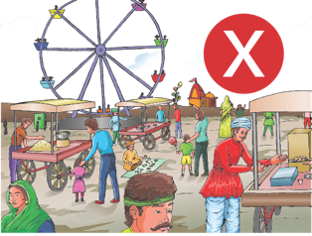
PREVENTION: SOCIAL DISTANCING
SOCIAL DISTANCING : deliberately increasing the physical space between people to avoid spreading illness. Staying at least ONE meter away from other people lessens your chances of catching COVID-19.
Stay at home unless absolutely necessary
Keep a distance of at least one meter between yourself and another person
DO
DO
NOT
DO NOT Hold events wHere people have to gather (even if it is a corner meeting with three or four friends, or an evening chat on the chaupal)
DO NOT go to crowded places like markets, shopping, MELAS, parties
DO NOT use public transport
11
Notes:
Social Distancing is keeping a distance between you and other people so that you do not come in contact with their infected droplets in case they are carrying an infection. This does not mean that every person you come across is infected. But it is necessary being careful.
Social distancing also means that you avoid crowded, you do not organize events where people have to get together. All these are ways by which a virus can travel from one person to another. Be aware that the virus cannot live for long when it is out of the human body. It will require to find a human body to grow and survive. If it does not, it will die. When people have been around, used places, touched things, the virus can get transmitted from one person to another. That is why it is necessary to decrease human to human contact in this period.

Slide 12
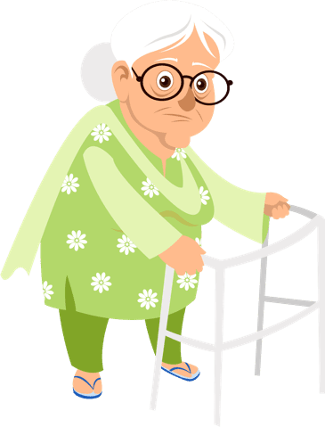
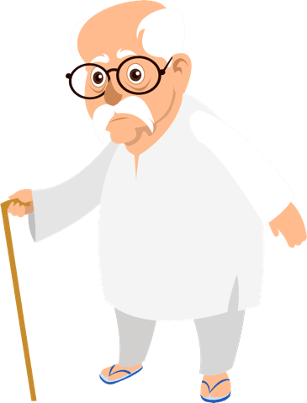

PREVENTION: HIGH RISK GROUP
High Risk Groups are people who are at A higher risk from severe illness if they get COVID-19. This includes:
people who have underlying medical conditions like:
Heart disease
Diabetes
Lung disease
Kidney disease
On cancer
medication
PREGNANT WOMEN
(AS WE DO NOT KNOW THE IMPACT OF THE DISEASE ON PREGNANCY AS OF YET, IT IS BETTER TO TAKE CARE)
older adults
12
Notes:
Though the infection can happen to anyone, the infection becomes severe when it happens in old people or people who already have an illness. This is because the immune systems of such people is weak and cannot defend the body when it is attacked by disease causing organisms. Now you will understand the importance of immunizations which prepare our bodies for attacks from viruses and bacteria.

Slide 13

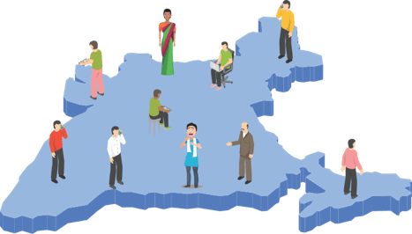
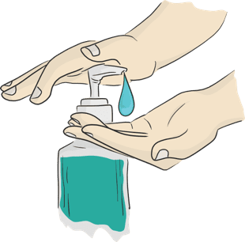

SESSION 3
COMMUNITY SURVEILLANCE
TYPES OF
CONTACTS
COMMUNITY SURVEILLANCE SoP
ADVISORY
COMMUNICATION
13

Slide 14
DEFINITIONS – Suspect/Probable infected person
A person with acute respiratory illness (fever and at least one sign/symptom of respiratory disease (eg. Cough, shortness of breath) AND
A history of travel to or residence in a country/area or territory reporting local transmission of COVID-19 disease during the 14 days prior to symptom onset OR
A person with any acute respiratory illness AND having being in contact with a confirmed COVID-19 case in the last 14 days prior to onset of symptoms OR
A person with severe acute respiratory infection {fever and at least one sign/symptom of respiratory disease (eg., Cough, shortness of breath)} AND requiring hospitalisation AND with no other etiology that fully explains the clinical presentation OR
A case for whom testing for COVID-19 is inconclusive.
DEFINITIONS - who is a contact
A contact is a person who is involved in any of the following:
• Providing direct care without proper personal protective equipment (PPE) for COVID-19 patients
• Staying in the same close environment of a COVID-19 patient (including workplace, classroom, household, gatherings).
• Traveling together in close proximity (less than 1 m) with a symptomatic person who later tested positive for COVID-19.
14
Notes:
In this slide we have two simple definitions, though they may look very complicated here. It tells you who is a suspect? 1.
Let us remember that the suspect needs to have any one of the 5 things:
Any kind of fever, cough or a difficulty in breathing.
If the person has traveled from any place or area which has been an outbreak area for COVID in the last 14 days
If the person has been in close contact of another person who is positive for COVID
A person who has tested but has not got the results
A person who may not have the symptoms but the lab reports come as positive.
Now a Contact is:
Someone who is providing direct care to a person who is confirmed to be positive for COVID
Someone who has stayed together with a person who has been tested as positive for COVID
Someone who has travelled together for more than 6 hours in close space with a person who later becomes positive for COVID

Slide 15
TYPES OF CONTACTS
High Risk
Touched body fluids of the patient (Respiratory tract secretions, blood, vomit, saliva, urine, feaces)
Had direct physical contact with the body of the patient, shook hands, hugged or took care of.
Touched or cleaned the linen, clothes, or dishes of the patient.
Lived in the same household as the patient.
Anyone in close proximity (less than one meter) of the confirmed case without precautions.
Passenger traveling in close proximity (less than one meter) for more than 6 hours with a symptomatic person who later tested positive for COVID-19.
Low Risk
Shared the same space (Same class for school/worked in same room/similar and not having a high risk exposure to confirmed or suspect case of COVID-19).
Travelled in same environment (bus/train/flight/any mode of transit) but not having a high-risk exposure.
15
Notes:
The types of contacts can then be further divided into contact who are at a high risk and those who are at low risk
The high risk are those who have directly been in touch with the patient or any body fluids or the patient while taking care during home quarantine, traveled with a patient, been in the same room/house and shared utensils, etc with the patient.
A low risk contact is someone who would have been in the same place but well outside the range of one meter, may have travelled in the same bus or train or flight but three seat difference with the person who tested positive.

Slide 16
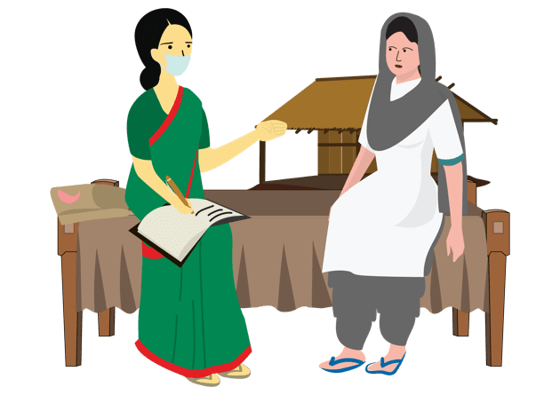
COMMUNITY BASED SURVEILLANCE
SURVEILLANCE done by visiting the local residence of the contact(s) by Health Personnel Telephone may be used in certain circumstances or for follow-up.
Introduce yourself, explain purpose of SURVEILLANCE, collect data in prescribed format.
Contacts of confirmed cases traced and monitored for at least 28 days after the last exposure to the case patient for evidence of COVID-19 symptoms as per case definition.
Information about contacts can be obtained from: Patient, his/her family members,
persons at patient’s workplace or school associates, or others with
knowledge about the patient’s recent activities and travels.
ARI Surveillance in the Containment zone
16
Notes:
This slide tells you the simple process for surveillance. You will be given the Surveillance form by your immediate supervisor and the areas where you need to conduct the surveillance. Using this format you must visit the households, introduce your self and the purpose of your visit and then ask the questions from the format.
While completing the format, you must take care of the following:
Communication: Always introduce your self and the purpose, be ready to answer the questions they may have
Preparation: Carry your own pens, pads, books. Also carry sanitizers and masks. Always wear your mask when you are doing surveillance. Do not take the mask off and let it hang from your neck and then put it back again. Do not touch the mask several times
Who should we collect information about? People who have been identified as contacts. We must monitor them for fever, cough, breathing difficulty for at least 28 days.
We have to give the contacts information about home quarantine and what care should be taken during home quarantine
We must also take details of contacts of contacts (people who the person has interacted with in the last 28 days).
Write out all your information clearly on the format. Do not leave the work to later as you will need addresses, names and telephone numbers in order to trace contacts when needed.
Make sure that you maintain a distance of one meter between yourself and the person you are interviewing.
Do not sit in crowed rooms. If possible sit in the open.
Make sure you sanitize your hands every time by washing with soap and water for 40 secs or using a 70% alcohol based sanitizer.

Slide 17
ADVISORY FOR CONTACTS
ASYMPTOMATIC
IF SYMPTOMATIC
Home quarantine for at least 28 days after the last exposure with the case.
Initiate self-health monitoring for development of fever or cough and maintain a list of contacts on daily basis.
Active monitoring (eg. Daily visits or telephone calls) for 28 days after the last exposure shall be done by ANM/ASHA/identified person
Direct and high-risk contacts of a confirmed case should be tested once between day 5 and day 14 of coming inn his/her contact
If symptoms develop (fever, cough, difficulty in breathing), use mask, self-isolate and immediately inform ANM / ASHA/ the identified local health official by telephone
17
Notes:
The contacts will be of two types.
1. Those who do not show any symptoms of fever, cough or breathing difficulty. You have to give advise of home quarantine, self-isolation and active monitoring to both the caregiver and the person.
2. In case the contact shows symptoms of fever, cough and breathing difficulty then the advise to be given is a) immediate isolation, b) use of mask and c) contacting the nearest health facility and reporting .

Slide 18
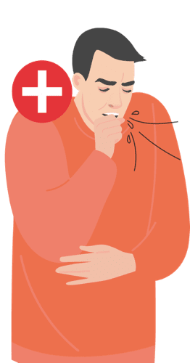
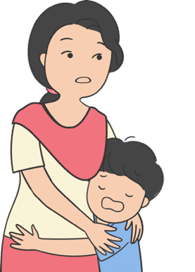
CASE SCENARIO
ANSWERS
Sunil is a young man of 30 years. He works in mumbai as a teacher in a small school and has returned back home for holi. Sunil has been confirmed with COVID-19 and now his family is worried.
Ensure that all members in the family have been given the advise to follow
Follow up if any help needed
Organise for the families to have support when they are on quarantine for getting their daily supplies like groceries or vegetables.
Check on hand hygiene and respiratory hygiene understanding
Check if all clothes and household materials used by confirmed family member have been disinfected.
Talk to the family often even if only on the mobile and encourage other friends of the family to talk on the phone. This is to help them manage the feeling of being isolated.
QUESTION: What will you do?
18

Slide 19
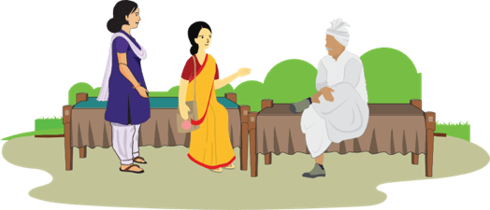
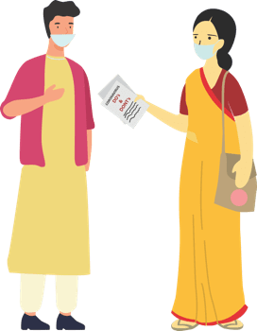
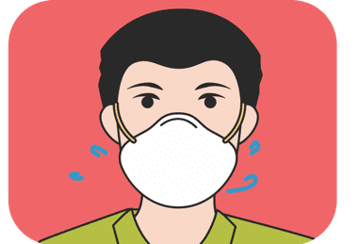
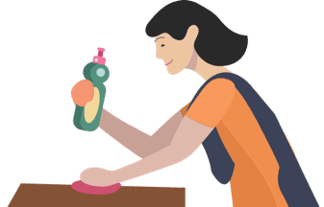
SESSION 4
SUPPORTIVE PUBLIC HEALTH SERVICES: COMMUNITY HOUSEHOLDS
CREATE
SUPPORTIVE
ENVIRONMENT
HOME
QUARANTINE-
FAMILY MEMBERS
HOME
QUARANTINE -SELF
HOME CARE
19

Slide 20
Response and containment– Create a Supportive environment
Talk to and
involve Influencers
Fight discrimination
PLAN COMMUNITY
SUPPORT FOR HIGH RISK
COORDINATE WITH
THE EXISTING COMMUNITY
NETWORKS FOR SUPPORT
HELP DEVELOP HOUSEHOLD
EMERGENCY CONTACT LIST
Make a list of local influencers (Gram Pradhan, Religious Leaders, Teachers, any other)
Explain & discuss the situation and protocols/orders/notifications to be followed and seek their support in giving key messages.
Support assigning roles for community networks
Make a list of high risk groups in the village
Identify people they meet or talk to; share preventive measures with these people and request them to keep communicating these measures to the high risk people
Take care of older people or people with co - morbidities like hypertension, diabetes, lung or kidney disease.
Take care of children whose parents may be in quarantine for issues of education and/or care.
Coordinate with the existing groups like SHGs, Youth networks, VHSNC etc on the roles assigned for emergency planning, distribution of services like food/grocery delivery for quarantined households, midday meals medicine etc.
Share contact details of ANM, ASHA, Ambulance, and other medical support with them
Share coordinating details of Child protection committees for addressing issues of trauma and violence in children.
Ensure each household has a current list of emergency contacts for family, friends, neighbours, essential services contact numbers like food, medicines, medical help .
20

Slide 21
CASE STUDY
ROLE OF AN INFLUENCER
QUESTION 1: Is this the right thing to do?
Babulal has been renting out his tractor for the last several years and many people know him in the community. Recently people have stopped taking babaulal’s tractors on rent and you come to know that this is because Babulal has been having symptoms of cold and flu. When you speak with Babulal he tells you that when he is walking people cross over on the other side of the street and do not even talk to him or his family members, including his children even on the phone. He has decided to go to his city house so he does not have to bear this behaviour
QUESTION 2: What will you do as the local health worker?
Check who can help in influencing the local landowners.
Use the key influencers in giving the communication on what is covid and what are the symptoms.
Talk to the DHO/MO for discussing the SYMPTOMS OF COVID with Babulal and if he is a contact what advisory should be given to him
21

Slide 22
HOME QUARANTINE: STAY SAFE FOR PROBABLE INFECTED PERSON
RESTRICTED MOVEMENT FOR COVID-19 SUSPECTS
KEEP DISTANCE
AVOID VISITORS IN THE HOUSE
Stay in a well ventilated specific room and away from other people in your home. Restrict movement
If available, use a separate bathroom
BECAUSE IF INFECTED YOU CAN SPREAD INFECTION TO OTHERS
SEEK HEALTH CARE AND NOTIFY
AVOID GOING TO PUBLIC AREAS
If suffering from cough or fever or breathing difficulty and suspecting contact, wear a mask, and notify nearest health facility / ASHA/ANM immediately.
Do not go to work, school, or public areas like markets, cinemas etc.
Avoid using public transport
WEAR A MASK
Wear a mask correctly when you are around other people and whenever you enter a healthcare provider’s clinic
22

Slide 23
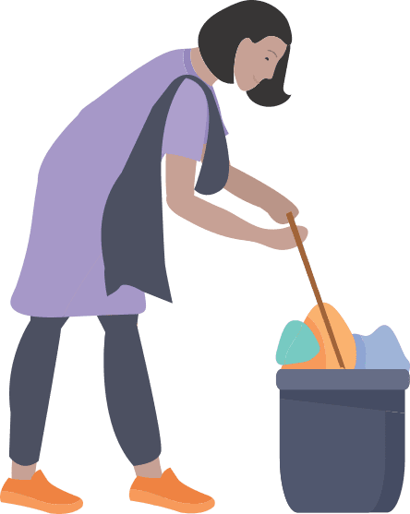
HOME CARE: KEEP ENVIRONMENT SAFE
PRECAUTIONS TO BE TAKEN BY THE HOUSEHOLD WHERE THERE IS A SUSPECTED CASE
Support: Assigned family member to take care of infected person helping them follow doctor’s instructions for medication(s) and care.
Wash hands: with soap and water for at least 40 seconds or, if soap and water are not available, clean your hands with an alcohol-based hand sanitizer that contains at least 70% alcohol. Wash often and especially after touching
Clean and Disinfect: all “high-touch” surfaces, such as tabletops, doorknobs, bathroom fixtures, toilets, phones, every day. Also, wipe any surfaces that may have blood, stool, or body fluids on them. using bleaching powder solution (4 TSP of household bleach in 4 cups of water)
Wash laundry thoroughly and Avoid shaking soiled linen
Immediately remove and wash clothes or bedding that have blood, stool, or body fluids on them. Keep away from body.
Wash and disinfect linen in warm water and soap, dry in sun
Washing machine: use disinfectant, soap, warm water, dry in sun
linen can be soaked in hot water and soap in a large drum, using a stick to stir, avoiding splashing (soak linen in 1% chlorine for approximately 30 minutes. Finally, rinse with clean water and let linen dry fully in the sunlight.
Place all used disposable gloves, facemasks, and other contaminated items in a lined container before disposing of them with other household waste.
NOTE: infected person may be ambulatory or bed-ridden
23

Slide 24
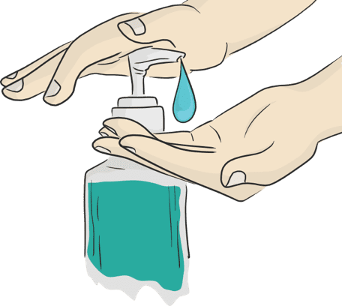

HOME QUARANTINE: STAY SAFE FOR FAMILY MEMBERS
Household members should stay in another room or be separated from the patient as much as possible.
Household members should use a separate bedroom and bathroom, if available.
Avoid sharing household items e.g. dishes, drinking glasses, cups, eating utensils, towels, bedding, or other items with other people at home.
Wash hand as often thoroughly with soap and water (40 secs) or with 70% alcohol-based hand sanitiser
When IN Contact with the person who is quarantined, the family members should Wear a three layered mask at all the times. Disposable masks are never to be reused.
Used mask should be considered as potentially infected. Dispose mask by soaking in home bleach solution and then throwing in a dustbin.
Do NOT let small children play with the masks.
24

Slide 25
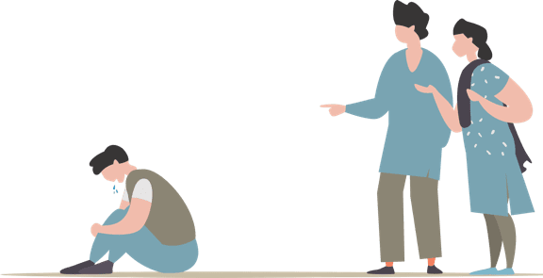
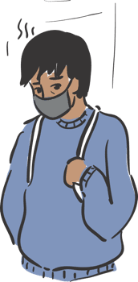
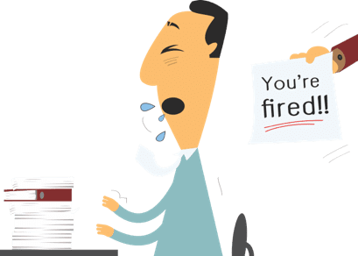
SESSION 5
STIGMA AND DISCRIMINATION
WHAT IS
STIGMA?
WHY IS THERE
STIGMA?
WHAT DOES
STIGMA DO?
WHAT CAN
FLW DO?
25

Slide 26
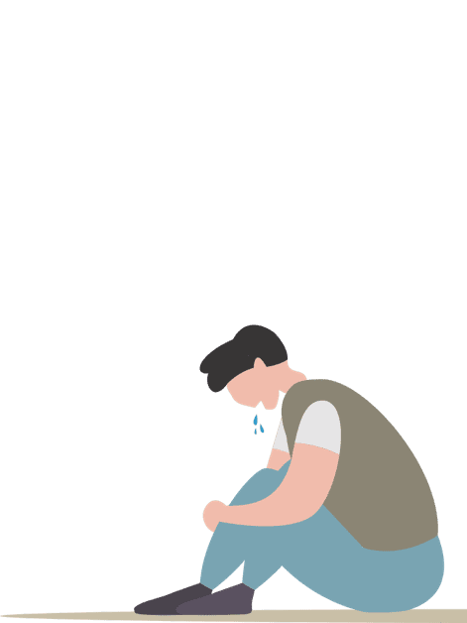
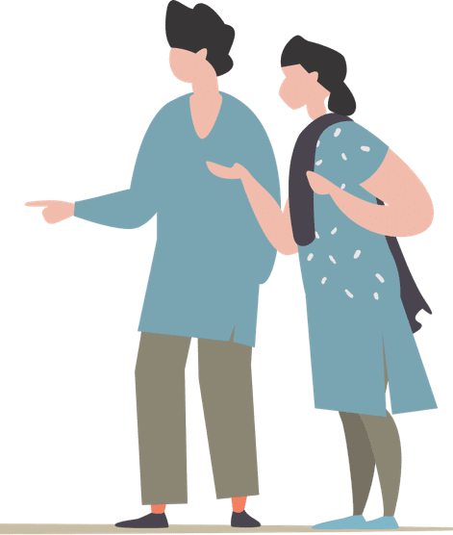
WHAT IS STIGMA?
In any Epidemic, it is common for individuals to feel
stressed and worried because they fear:
Falling ill and dying
Avoiding approaching health facilities due to fear of becoming infected while in care
Fear of losing livelihoods, not being able to work during isolation, and of being dismissed from work
Fear of being socially excluded/placed in quarantine because of being associated with the disease
Feeling powerless in protecting loved ones and fear of losing loved ones because of the virus or being separated during quarantine
Feelings of helplessness, boredom, loneliness and depression due to being isolated and not working towards caring for a dependent
Stress is caused due to the above fears and being treated as an outcaste or blamed for spreading the disease
26

Slide 27
WHY IS THERE STIGMA?
The level of stigma associated with COVID-19 is based on three main factors:
COVID-19 is a new disease about which many things are still being discovered.
When something is unknown people are worried which leads to fear
Rumours or fake news give wrong information and spreads the fear.
27

Slide 28

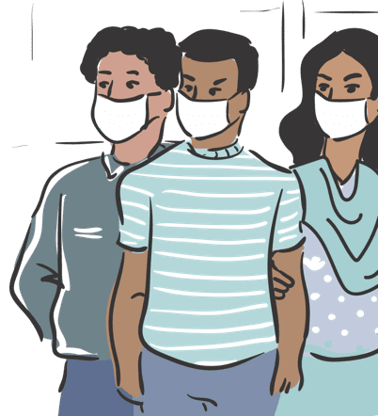
RECOGNISING STIGMA?
You are in the grocery shop. There are several people who are wearing a mask. You see Babulal the store owner going red in his face as he tries to suppress a cough.
Sukhram has come back from Pune where he works as a taxi driver. They stay in a joint family and you have taken his contact history as advised by your Supervisor. You come to know that Sukhram’s family members have asked him to leave the house
Beauty works in Delhi as a house maid. Recently she has come back and you have been told that Beauty’s employers have asked her to leave as she had a cold.
Surali is a young girl of 11 years. She and her 8 year old brother are staying with an aunt as their parents have been asked to go in for isolation. Surali’s aunt keeps on complaining to you that the children are a big burden on the family’s resources.
WHAT WILL YOU FEEL LIKE IF YOU WERE
BABULAL, RANI, SUKHRAM, BEAUTY?
THE STIGMA
Babulal has Simple cough. But he is too scared to cough in front of people as he will loose the customers.
Sukhram needs family support to help him stay in isolation. If everyone takes proper precautions the infection need not spread.
Beauty has a seasonal cold but she has been asked to leave by her employers.
Surali and her brother are two small children who
need to be supported and this kind of incidence can
cause mental stress even in the future. CPC should
be approached for appropriate measures for helping
children in difficult situations
28

Slide 29

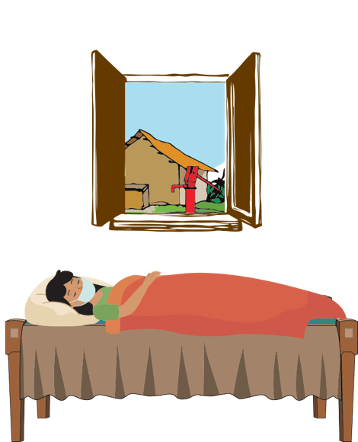
WHAT DOES STIGMA DO?
Discourages them &
may at times prevent
them from adopting
healthy behaviours
Makes people hide
their problems
Keeps people away
from accessing
health services and
seeking help
29

Slide 30

WHAT CAN THE FLW DO?
As a health worker, you can:
Sensitize people and help them to understand that it is a simple infection and 80% of the cases are mild cases.
COVID-19 can happen to anyone, speak to people, be available to listen to how they feel
Advise people to engage in relaxing activities like indoor games, reading, gardening, home-cleaning, etc.
Ask people to stay away from watching negative things on the TV and also fake news
Engage community influencers , Share correct information on COVID-19 with them. Brief them on specific support required by you. Guide WhatsApp groups to help in giving hope and positive news to help people handle stress.
Publicly, use terms like people who have COVID-19 instead of “COVID-19 cases” or “victims”. Similarly, use terms like people who may have COVID-19 instead of “suspected cases”
emphasize that most people do recover from COVID-19, amplify the good news about local people . Who have recovered from COVID-19? Who have supported a loved one through recovery?
Make special efforts to reach out to high risk groups including senior citizens and younger children.
30

Slide 31
Case from PIPLI: What Can FLW do?
Suresh was under home quarantine when his wife, developed labour pains and had to be taken to the hospital for delivery. The ASHA assured Suresh that his wife will be taken care of while he should remain isolated within the house as advised. The ASHA called her neighbour Seema and requested her to send food for Suresh. She reminded Seema to take the precautions while giving food. She then called the convener of local mothers’ group and a member of village health and nutrition committee (VHSNC) member and apprised both of them of the situation requesting them to arrange for Suresh’s food and home-care requirements. The VHSNC member requested village youth group members to do the needful for Suresh at-least for next 72 hours till his wife returns.
1. What are the positive actions taken by ASHA?
ASHA has proactively formed community support groups and planned in case of emergency
2. What should be done?
She informed her neighbour to give food
3. Which groups and /or people were involved by ASHA to provide supportive environment?
The neighbours, VHSNC (who in turn involved the Youth Groups) and Adolescent Girls groups
4. If you were in place of ASHA, what would you have done additionally?
31

Slide 32
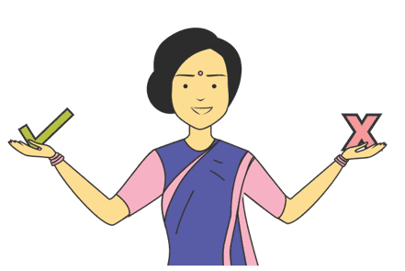
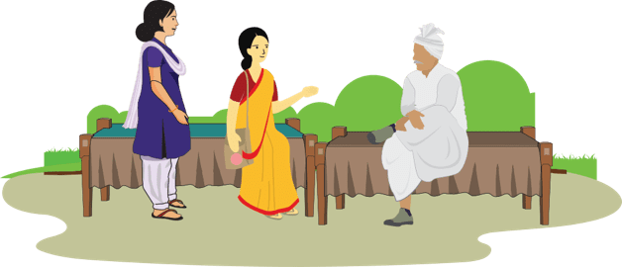
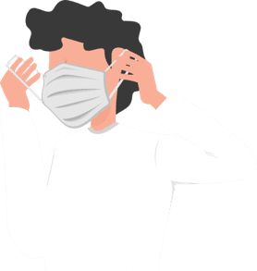
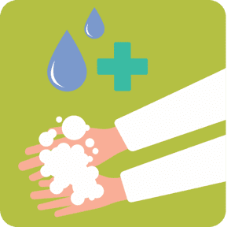
SESSION 6
COMMUNICATION, PERSONAL SAFETY FOR HEALTH/ICDS PERSONNEL
WHAT TO
COMMUNICATE
HOW TO
COMMUNICATE?
MASK
MANAGEMENT
PRECAUTIONS
32

Slide 33



what to communicate and communication platforms
HAND HYGIENE
share mobisodes
Display IEC materials at appropriate places
Use essential services (LIKE GARBAGE COLLECTION VANS, MILK SUPPLY, ETC.) for miking
Share whatsapp messages on groups
Use pocket book for giving key messages
RESPIRATORY
HYGIENE
Social Distancing
Home Care & Home Quarantine
MONITORING
SYMPTOMS
33
Notes:
We have seen each of these topics before. Let us recall the main points that we have learnt in each of these topics. Refer to your Pocket Reference book for what are the 5 points that you must remember in each of these. In this period of social distancing, the FLW must use appropriate platforms for giving out the messages. While some of the messages can be given to families when you are doing the contact tracing or monitoring, other messages can be given through WhatsApp groups or sharing of mobisodes with key groups, displaying IEC materials where people are allowed to go for buying essential services like grocery stores, milk, pharmacies etc and using miking on essential services like garbage collection, ambulances, or any other that is being used during the lock down /social distancing period. Police vans may be requested to play the miking messages when they are on beat duty

Slide 34
communication: how?
Always be polite. Anyone can get the infection, anywhere. Do not discriminate, shout, or use rude language.
Tell people about the purpose of your visit and what you will do with the answers you are seeking. Say that this is the support that the government is giving all citizens.
Gather accurate information from the patient: their name, date of birth, travel history, list of symptoms, record and communicate as per the surveillance format. Write the information clearly
Be aware that suspected and confirmed cases, and any visitors accompanying them, may be stressed or afraid. So, the most important thing you can do is to listen carefully to questions and concerns.
When you meet people, avoid touching or direct physical contact. This is true for passing on infection either way. Maintain distance of more than 1 meter when you interact.
It is better to sit in the open and speak with the family members if space and situation allows.
Ask questions and get very specific answers. When you are writing, make sure your writing is clear and complete information (addresses, names, contact numbers) is written legibly.
Check if people have understood your message by asking them to repeat what you have told.
If there are questions and you have the answers, you must share this with the community member. However if you do not have the answer, do not hesitate to say so. A lot is still unknown about COVID-19
34

Slide 35



mask management
Use a Mask Correctly:
Unfold pleats, facing down, place over nose, mouth and chin.
Fit nose piece over nose-bridge. tie strings upper string tied - top of head above ears lower string at the back of the neck.
Leave no gaps on either side of the mask, adjust to fit.
Do not pull the mask down or hang from the neck
Avoid touching the mask while in use.
Replace masks with a new clean, dry mask as soon as they become damp/humid, 6 -8 hours
Use a mask if and only when:
You develop FEVER, COUGH or difficulty in breathing
You visit a health care facility.
You are caring for an ill person
When contact tracing
Removing and Disposing the Mask
Do not re-use single-use masks
Do not touch other surfaces of the mask while removing.
To remove mask first untie the string below and then the string above and handle the mask using the upper strings. Other surfaces may be potentially contaminated
Remove the mask by using appropriate technique (i.e. do not touch the front but remove the lace from behind)
After removal or whenever you inadvertently touch a used mask, clean hands by using a 70% alcohol-based hand rub or soap and water for 40 secs.
Discard single-use masks after each use and dispose of them immediately upon removal
35

Slide 36




PRECAUTION AND SAFETY MEASURE FOR FLW
When moving around the community
Immediately on reaching home
Maintain distance of at least 1 meter from people when you are communicating
Use a three layered mask to cover your face. Make sure it is properly worn.(while contact tracing)
Avoid touching your face (eyes, nose, mouth) at all times
Wash your hands with soap and water frequently, or use alcohol based hand-rub
Avoid touching or direct physical contact
Carefully remove and dispose off your face mask by soaking in bleach solution and then throwing it in a covered dustbin. (See: MASK MANAGEMENT).
Wash your hands with soap and water or alcohol based hand-sanitiser before you touch anything else.
Wipe down what you have carried like your purse and mobile with home based disinfectant (4 tsps Of household bleach in 4 cups of water)
If you get any symptoms like fever, cough or Difficulty in breathing REPORT TO the nearest Government Facility or District Surveillance Officer immediately.
36

Slide 37



myths & Facts
Statement: With the summers coming up, the Coronavirus will be killed
FACT: COVID-19 has been detected in ALL AREAS, including areas with hot and humid weather. The best way to protect yourself against COVID-19 is by frequently washing your hands with soap and water, covering your coughs and sneezes and avoiding crowded places.
Statement: Having a bath with hot water will kill the virus
FACT: The virus lives inside the body where the temperature is maintained at 37ºC and is not affected by a hot water bath that you have.
Statement: Getting the pneumonia vaccine will protect you against the virus
FACT: While vaccines for Pneumonia will certainly protect you against other organisms that cause pneumonia, The vaccine for Novel Coronavirus is under development.
Statement: Spraying alcohol or disinfectant over your body can prevent infection
FACT: Spraying with alcohol or sanitiser on clothes and body will not prevent you from getting infection. Infection spreads when the virus enters the body through nose or mouth. Cleaning and wiping hands with alcohol is to prevent the germ from entering your system through infected hands when you touch your mouth or you eat food with infected hands.
Statement: Regularly rinsing the nose with saline will prevent the infection
FACT: Rinsing nose with saline has in few cases helped in containing common cold, but has no evidence to suggest it is effective against the Novel Coronavirus infection
37

Slide 38
myths & Facts
Statement: Coronavirus can be passed through chicken and meat
FACT: No! There is no such evidence of Coronavirus spreading through meat and poultry products. However it is always advised to have properly cooked meat and chicken.
Statement: A person with Coronavirus can recover fully and be no more infectious.
FACT: 80% of the people have recovered from the disease without needing special treatment. But information on the virus treatment is still being researched
Statement: Eating raw garlic, sesame seeds will protect you against the virus
FACT: Garlic is a healthy food that has other benefits but does not protect you against the Coronavirus.
Statement: The virus can die easily once it is out of the body
FACT: We do not know about this particular virus as of now. Similar viruses (SARS, MERS) survive from 8 to 24 hours depending on types of surfaces.
Statement: You can get COVID-19 through mosquito bites
FACT: The Coronavirus cannot be spread through the bite of a mosquito. It is spread thorough droplets spread when an infected person sneezes or coughs
38

Slide 39


LET'S EXPOSE THE VIRUS
correct information and behaviours is the way to defeat the infection. Let’s play the game to uncover the virus and tackle it through our information
Let’s play a recap game: In each square you will find a statement,
let’s hear your answer.
39

Slide 40

































let’s hear
your
answers.
40

Slide 41
SESSION 7
How to meet special communication needs in urban areas
ACTIVATING
SUPPORT
SAFE
PRACTICES
STIGMA AND DISCRIMINATION
41
Notes:
In this session we are covering the community support practice to be used in urban setting. Urban areas will pose different challenges which will have to be addressed

Slide 42
ACTIVATING SUPPORT
Community support should involve key stakeholders identified in the area and trained to given safe inputs and support
ADVISE COMMUNITY MEMBERS TO
Volunteer for supporting the Community help-desk set up by local municipality
Support the task of distributing masks in the community, ensuring that they are given to those who most require. Mask management to be taught while distribution
Community representative to ensure that community cleaning and disinfection drive to be taken up regularly by the Municipal corporation
Give information through local political and religious leaders involvement
Give information out through common essential services like garbage vans, milk supply van etc.
Free distribution of bleach/sodium hypochlorite solution and use of the disinfectant to be planned in the community
42

Slide 43
ACTIVATING SUPPORT
Remember urban areas are densely populated with limited health staff. You need to develop community support to keep everyone and yourself safe.
Identify the high risk groups in the community and help them to isolate themselves to protect them from getting infected
Be in touch with the government services to organise to get the mid-day meals delivered to the children’s homes.
Get key influencers who can help you with vigilance and tracking people who may possibly be infected and report it for referral.
Community level cadre to be trained to ensure compliance of protocols during lock down period
Community level structure to be identified to transform into quarantine facilities
43

Slide 44
PRACTICING SAFE BEHAVIOURS
Remember many daily wage / unorganized sector workers with severe economic hardship would go to work despite restrictions increasing their vulnerability
Reach out to specific group of people such as labourers, housemaids, shelter home migrants and daily wage workers and advise them to follow:
Frequent handwashing with soap and water for 40 seconds especially after coming from outside, before eating food and after going to toilet.
Change clothes and if possible wash oneself using soap after coming from outside. Avoid touching eyes, nose and mouth.
Avoid spitting in open places and use only a wash basin or spittoon
Maintain a distance of minimum 1 meter from others
Contact community help-desk/ health facility if they develop fever, cough or difficulty in breathing or need any information
44

Slide 45
Stigma and Discrimination
Remember urban areas are densely populated with limited health staff. You need to develop community support to keep everyone and yourself safe.
Many of the societies have stopped maids and other helpers from entering. While this is correct as this will keep people at home, the way of managing this distancing is stigmatizing
Words like “They will bring this disease to us” “The disease will spread because of them” etc are stigmatizing
Work with the local influencers and key decisionmakers of the area to sensitise people
Use the mass media clips to sensitise
Use government orders to show why housing societies should not discriminate against the working class like car cleaners, maids etc.
Resident Welfare Associations
45

