Slide 1
Kubernetes And GKE

Slide 2
What is Kubernetes?
Kubernetes is docker orchestration tool to manage the docker containers. When the application scale to large number of containers then there is a need to maintain the containers, provision containers , scaling up or down as per needs and manage the network between them. The main purpose of Kubernetes is to maintain the entire lifecycle of container from creation to deletion.
Kubernetes is required to handle the production loads automatically in response to application workload by balancing the containers. It provides CI/CD techniques by providing features like rolling updates with zero downtime.

Slide 3
Kubernetes Cluster Components
Node
Container Runtime
kubelet
K-proxy
Node
Container Runtime
kubelet
K-proxy
Node
Container Runtime
kubelet
K-proxy
c-c-m
c-m
Control pane
api
etcd
sched

Slide 4
Cluster Components
Cluster - A collection of multiple nodes, including at least one master node and several worker nodes.
Node - A physical or virtual machine.
Control Pane - A component that schedules and deploys application instances across Kubernetes nodes. The control plane communicates with nodes via the Kubernetes API server.
Kubelet - An agent process running on nodes. It is responsible for managing the state of each node, and it can perform several actions to maintain a desired state
Pods - A basic scheduling unit. Pods consist of one or more containers that are co-located on a host machine and can share resources.
Kube-proxy - kube-proxy is a network proxy that runs on each node in cluster.
Container Runtime - The container runtime is the software that is responsible for running containers.

Slide 5
GKE Overview
It is a managed service hosted on google infrastructure for deploying, scaling and maintaining the containerized applications. In GKE cluster the nodes are google compute engine instances.
Kubernetes on Google cloud
- Google cloud load balancing for compute VMs
Automatic upgrades of nodes by Google
Google Logging and monitoring
Node auto repair to maintain high availability
Types of Clusters
Standard Cluster – It provides the flexibility to control and manage the nodes as per needs and manually upgrade the nodes in case of updates. Can be zonal or regional cluster.
Autopilot Cluster – Google manages the nodes and one only focus on deploying the workloads on it. It is configured by default as regional cluster

Slide 6
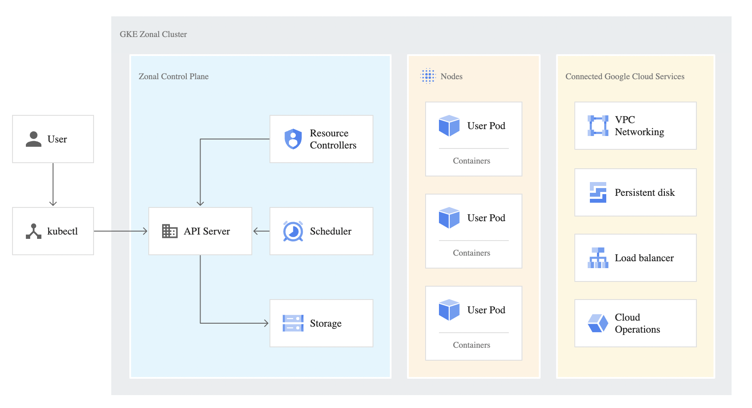
GKE Cluster Architecture
Reference – Google Cloud Official Documentation
https://cloud.google.com/kubernetes-engine/docs/concepts/cluster-architecture

