Slide 1
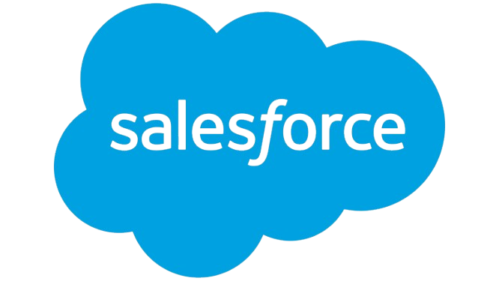
Infosy Summary Report
Prepared by Client Prep Agent

Slide 2
Executive Summary
• Infosys Limited is an Indian multinational technology company, founded in 1981 and headquartered in Bengaluru. It delivers business consulting, information technology, and outsourcing services globally. The company reported a latest revenue of 24, positioning itself as a comprehensive digital transformation partner across diverse industries.
Prepared by Client Prep Agent

Slide 3
Key Offerings & Business Segments
• Core Services: Business Consulting, Information Technology, and Outsourcing.
• Digital Experience: Includes Digital Marketing, Digital Commerce, Digital Interactions, Digital Workplace Services, and Infosys Metaverse Foundry.
• Data & AI: Focuses on Data Analytics and AI, Applied AI, Generative AI, and features the Infosys Topaz platform.
• Innovation & Engineering: Offers Blockchain, Engineering Services, and Internet of Things (IoT) solutions.
• Acceleration & Cloud: Provides Enterprise Agile DevOps, API Economy & Microservices, Application Modernization, Cloud services (Infosys Cobalt), and enterprise solutions for Oracle, SAP, Salesforce, and Microsoft platforms.
• Assurance & Security: Covers Cyber Security and Quality Engineering.
• Proprietary Platforms: Includes EdgeVerve, Infosys Finacle, Infosys Live Enterprise Suite, Infosys Cortex, and Infosys Meridian.
Prepared by Client Prep Agent

Slide 4
Strategic Direction & Initiatives
• Emphasizing the "Navigate Your Next" digital framework, focusing on digital core capabilities, digital operating models, and talent transformation.
• Promoting the concept of "Live Enterprise" for enhanced business resilience.
• Significant investment in Artificial Intelligence, including Applied AI, Generative AI, and the dedicated Infosys Topaz offering.
• Expansion into emerging technologies such as Blockchain, IoT, and the Metaverse Foundry.
• Commitment to sustainability through Infosys Sustainability Services and Energy Transition initiatives.
Prepared by Client Prep Agent

Slide 5
Market Positioning & Target Audience
• Infosys Limited positions itself as a leading provider of end-to-end digital and IT services, enabling enterprises to navigate their next stages of evolution. Its target audience spans a wide array of global industries, including Aerospace & Defense, Automotive, Financial Services, Healthcare, Retail, Public Sector, and High Technology.
Prepared by Client Prep Agent

Slide 6
Additional Notes
(No content provided)
Prepared by Client Prep Agent

