Slide 1
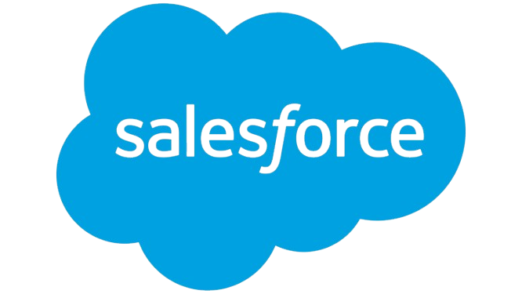
Infosys Summary Report
Prepared by Client Prep Agent

Slide 2
Executive Summary
• Infosys Limited, an Indian multinational technology company founded in 1981 and headquartered in Bengaluru, specializes in business consulting, information technology, and outsourcing services globally. With a trailing twelve-month revenue of $19.28 billion and a market capitalization of $6632.51 billion, Infosys holds a significant position in the IT services sector. The company focuses on driving digital transformation for clients, leveraging AI, cloud, and emerging technologies to enhance resilience and operational efficiency.
Prepared by Client Prep Agent

Slide 3
Key Offerings & Business Segments
• Consulting & IT Services: Business consulting, application development and maintenance, enterprise agile DevOps, quality engineering, infrastructure services.
• Digital Transformation: Digital marketing, commerce, interactions, workplace services, experience design, digital process automation, digital supply chain, and service experience transformation.
• Emerging Technologies: Data analytics and AI (including Infosys Topaz, Applied AI, and Generative AI), Cloud (Infosys Cobalt), Metaverse Foundry, Blockchain, Internet of Things (IoT), and Engineering services.
• Enterprise Solutions: Implementation and management services for platforms such as SAP, Oracle, Salesforce, and Microsoft Business Applications.
• Specialized Offerings: Cybersecurity, sustainability services, energy transition, and network transformation.
• Proprietary Platforms: EdgeVerve, Infosys Finacle (for financial services), and Infosys Live Enterprise Suite.
• Industry Verticals: Serving a broad range of sectors including Financial Services, Healthcare, Manufacturing, Retail, Communication Services, and Public Sector across over 25 distinct industries.
Prepared by Client Prep Agent

Slide 4
Strategic Direction & Initiatives
• "Navigate Your Next" Framework: Guiding clients through digital transformation by focusing on digital core capabilities, optimizing operating models, and enabling talent transformations.
• Live Enterprise Concept: Emphasizing business resilience and adaptability through integrated, real-time digital solutions.
• Advanced AI & Data: Strategic investment and development in data analytics, Applied AI, and Generative AI, notably through Infosys Topaz.
• Cloud-First Approach: Driving cloud adoption and modernization via the Infosys Cobalt portfolio of services and platforms.
• Sustainability & ESG: Expanding sustainability services and initiatives for clients, including energy transition solutions.
• Emerging Technology Incubation: Actively developing and deploying solutions in cutting-edge areas like the Metaverse.
Prepared by Client Prep Agent

Slide 5
Market Positioning & Target Audience
• Infosys is positioned as a leading global provider of comprehensive digital transformation and IT consulting services, recognized for its full-spectrum offerings. Its primary target audience consists of large enterprises and organizations worldwide across diverse industries, seeking to achieve digital resilience, operational excellence, and innovation through technology.
Prepared by Client Prep Agent

Slide 6
Additional Notes
(No content provided)
Prepared by Client Prep Agent

