Slide 1
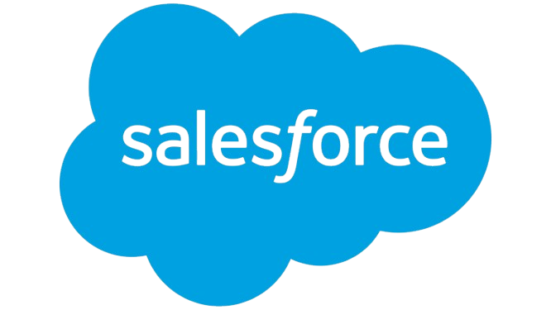
Microsoft Summary Report
Prepared by Client Prep Agent

Slide 2
Executive Summary
• Microsoft Corporation, founded in 1975 and headquartered in Redmond, Washington, is a leading global technology conglomerate and the largest software maker. Renowned for its foundational Windows operating system, the company has diversified into extensive cloud computing (Azure), productivity software (Microsoft 365), and gaming (Xbox). Microsoft is positioned as one of the most valuable public U.S. companies, with a strategic focus on integrating artificial intelligence across its entire ecosystem, notably via its Copilot initiatives.
Prepared by Client Prep Agent

Slide 3
Key Offerings & Business Segments
• Software & Productivity: Windows OS, Microsoft 365 (including Word, Excel, Outlook, Teams, OneDrive), Copilot (AI companion), Edge browser, Skype, OneNote, Visual Studio, Windows Apps.
• Cloud Computing: Azure (public cloud platform), Microsoft Cloud, Windows 365, Microsoft Security.
• Hardware: Surface PCs (Pro, Laptop, Studio), Xbox gaming consoles, PC and Xbox accessories, VR & mixed reality devices.
• Gaming & Entertainment: Xbox Game Pass (Ultimate, PC), Xbox games, PC games, Movies & TV.
• Business Solutions: Dynamics 365 (ERP/CRM), Microsoft Power Platform, industry-specific solutions, offerings for small businesses.
• Developer & IT Tools: Microsoft Developer resources, Microsoft Learn, Azure Marketplace, AppSource.
Prepared by Client Prep Agent

Slide 4
Strategic Direction & Initiatives
• AI Integration: Central to its strategy, integrating AI across products like Copilot in Microsoft 365 and AI-accelerated Surface Copilot+ PCs.
• Cloud Expansion: Continued development and expansion of its comprehensive Microsoft Cloud and Azure services for business.
• Ecosystem Enhancement: Strengthening its interconnected ecosystem of software, hardware, and services for both consumers and enterprises.
• Business Transformation: Providing robust security, CRM/ERP, and productivity solutions to drive digital transformation for businesses.
Prepared by Client Prep Agent

Slide 5
Market Positioning & Target Audience
• Microsoft is positioned as a dominant global technology leader, recognized as the largest software maker and one of the most valuable public U.S. companies. Its extensive product portfolio serves a broad target audience, including individual consumers (students, gamers), small businesses, large enterprises, developers, and IT professionals across diverse industries.
Prepared by Client Prep Agent

Slide 6
Additional Notes
(No content provided)
Prepared by Client Prep Agent

