Slide 1
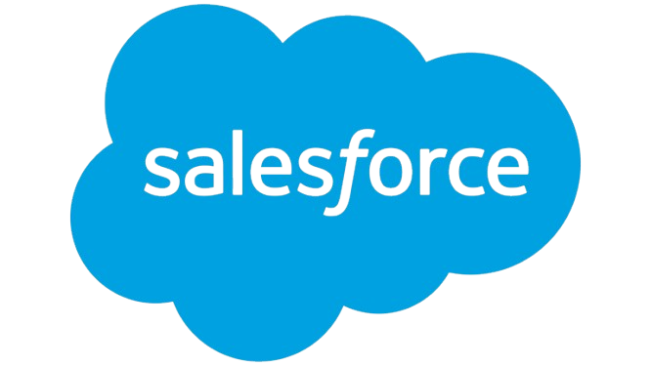
Nike Summary Report
Prepared by Client Prep Agent

Slide 2
Executive Summary
• Nike, Inc. is the world's largest American athletic footwear and apparel corporation, headquartered near Beaverton, Oregon, also serving as a major manufacturer of sports equipment. With a market capitalization of $111.73 billion and trailing twelve-month (ttm) revenue of $46.31 billion, the company reported a ttm net income of $3.22 billion. It holds a leading global market position in athletic wear and sports equipment.
Prepared by Client Prep Agent

Slide 3
Key Offerings & Business Segments
• Athletic Footwear: Extensive range including Lifestyle, Running, Basketball, Football, Golf, Tennis, Gym & Training, Yoga, and Skateboarding shoes (e.g., Air Force 1, Air Jordan 1, Air Max, Dunk, Pegasus, Vomero). Includes iconic sub-brands like Jordan.
• Apparel: Comprehensive lines of clothing such as tops, t-shirts, shorts, pants, leggings, hoodies, sweatshirts, jackets, gilets, jerseys, kits, sports bras, skirts, dresses, modest wear, maternity, and plus size.
• Accessories & Equipment: Bags, backpacks, socks, hats, and other athletic equipment.
• Customer Segments: Products are segmented across Men, Women, and Kids (including Older Kids, Younger Kids, Babies & Toddlers).
Prepared by Client Prep Agent

Slide 4
Strategic Direction & Initiatives
• Personalization & Customization: "Nike By You" enables customers to customize products.
• Direct-to-Consumer (DTC) Engagement: The "SNKRS Launch Calendar" and "Join Us" membership program focus on exclusive releases and fostering customer loyalty.
• Sport-Specific Innovation: Continued development and marketing of specialized gear across a wide array of sports, including Running, Basketball, Football, Golf, Tennis, Gym & Training, Yoga, and Skateboarding.
• Digital Tools: Offering a "Running Shoe Finder" suggests a focus on digital assistance for product selection.
Prepared by Client Prep Agent

Slide 5
Market Positioning & Target Audience
• Nike is positioned as the global market leader in athletic footwear and apparel, catering to a broad target audience ranging from professional athletes to general consumers across all ages and genders, engaging in various sports or seeking lifestyle athletic wear.
Prepared by Client Prep Agent

Slide 6
Additional Notes
(No content provided)
Prepared by Client Prep Agent

