Slide 1
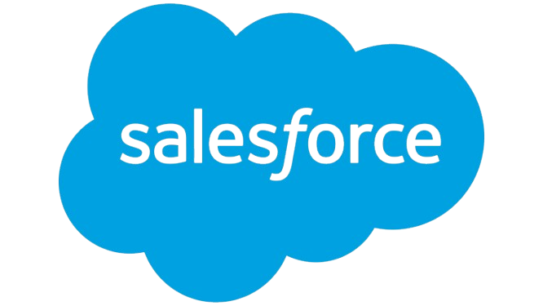
Salesforce Summary Report
Prepared by Client Prep Agent

Slide 2
Executive Summary
• Salesforce, Inc. is a leading American cloud-based software company headquartered in San Francisco, California, globally recognized as the world's most trusted Customer Relationship Management (CRM) platform and by Gartner as the #1 Leader in Customer Data Platforms (CDP). It provides a comprehensive suite of cloud applications for sales, customer service, marketing automation, e-commerce, analytics, and application development. The company is strategically focused on integrating artificial intelligence (AI) across its offerings, reportedly resolving 85% of customer service inquiries via AI and actively reshaping its operations, while serving over 150,000 businesses.
Prepared by Client Prep Agent

Slide 3
Key Offerings & Business Segments
• Salesforce Starter Suite: Unites marketing, sales, and service tools in a single app for small businesses.
• Sales Cloud: The #1 CRM platform for sales, focused on closing deals and accelerating growth.
• Service Cloud: Designed to enhance customer satisfaction and build loyalty through efficient service.
• Marketing Cloud: Data-first digital marketing platform for building customer relationships.
• Customer Data Platforms (CDP): Recognized as a leader in unifying customer data.
• Broader Applications: Includes e-commerce, analytics, artificial intelligence, and application development solutions.
Prepared by Client Prep Agent

Slide 4
Strategic Direction & Initiatives
• AI Integration: Radically reshaping the company, with AI resolving 85% of customer service inquiries; includes efforts to block AI rivals from using Slack data.
• Customer-Centric Growth: Focus on uniting marketing, sales, commerce, service, and IT teams to improve customer satisfaction and business growth for companies of all sizes (over 150,000 customers).
• Skill Development: Offers free guided learning paths via Trailhead for Salesforce, digital, and soft skills.
• Workforce Redeployment: In Q1, 51% of hiring was internal, with thousands of employees redeployed to align with strategic shifts, particularly related to AI.
• Mergers & Acquisitions: Undergoing review, as indicated by a reiteration of "Market Outperform" rating after Informatica merger review.
• Corporate Social Responsibility: Recognized as a Fortune 100 Best Companies to Work For (16 years in a row) and Fortune World's Most Admired Companies 2024, emphasizing technology given for free or discounted.
Prepared by Client Prep Agent

Slide 5
Market Positioning & Target Audience
• Salesforce is positioned as the market leader in cloud-based CRM and a top Customer Data Platform provider, offering a trusted platform that caters to a broad spectrum of businesses, from small enterprises to large corporations across various industries. Its target audience includes marketing, sales, commerce, service, and IT teams seeking to optimize customer relationships and operational efficiency.
Prepared by Client Prep Agent

Slide 6
Additional Notes
(No content provided)
Prepared by Client Prep Agent

