Slide 1





Crop Disease Detection and Severity Estimation using Machine Learning
School Of Information Technology,
Indira University, Pune.
M.SC.(COMPUTER APPLICATIONS) – SEMESTER-III (2026-2027)
AUTHORS
UNDER THE GUIDANCE OF
Vivek Kale (Roll No: 52)
Rahul Patil (Roll No: 36)
Pratap Suryavanshi (Roll No: 33)
Dr. Kavita Dhakad
Notes:
Course 25PSC306O Research Project-I. Introduce the team, the guide and the project title.

Slide 2
1. Introduction
BACKGROUND
Agricultural impact
Crop losses
Employs 42% of India's workforce & contributes 18.3% to national GDP.
Foliar diseases cause 20% to 40% yield loss globally (FAO 2023).
Traditional bottlenecks
Deep learning solution
Manual visual scouting is slow, subjective, and limited by agronomist shortages.
A multi-task CNN for simultaneous disease identification and severity quantification.
Notes:
Set the scene: agriculture is central to India's economy, disease losses are large, and manual scouting does not scale.

Slide 3
2. Review of Literature
PRIOR WORK
Evaluated benchmarks: AlexNet, VGG-16, ResNet-50 on single-disease tasks.
Systematic review of 25 research papers.
4 research gaps addressed
1
2
3
4
Single-task limitation: no severity stage quantification.
Cross-species misclassification due to unconstrained softmax.
No input validation or crop mismatch alerts.
Black-box opacity: no Explainable AI visual heatmaps.
Notes:
Each gap maps to one contribution of the project: severity head, species masking, mismatch filter and Grad-CAM.

Slide 4
3. Objectives of the Study
AIMS
Primary objectives
Secondary objectives
Design a lightweight Multi-Task Dual-Head EfficientNet-B0 (38 classes, 3 severity stages).
Achieve validation accuracy above 95%. Achieved: 99.69%.
Implement Species-Constrained Softmax Masking to eliminate cross-species errors.
Build a Confidence-Based Crop Mismatch Filter (45% threshold).
Integrate Grad-CAM visual attention heatmaps for explainable verification.
Notes:
Primary objectives concern the model and its accuracy; secondary objectives concern reliability and trust.

Slide 5
4. Hardware and Software Requirements
OPERATING ENVIRONMENT
Hardware
Software
Processor: Intel Core i5/i7 or Ryzen
RAM: 8–16 GB
GPU: NVIDIA RTX or Colab T4 (16 GB VRAM)
Storage: 50 GB
Python 3.10+, PyTorch 2.x, Torchvision
Albumentations, OpenCV, Matplotlib, Seaborn, Pandas, NumPy
Flask 3.0, Bootstrap 5, HTML5/CSS3/JavaScript
Windows 10/11 (64-bit) or Linux
Notes:
A GPU is needed only for training; inference runs on a normal CPU.

Slide 6
5. Significance of the Study
IMPACT
Food security
Smallholder farming
Rapid pathogen diagnosis prevents broad-acre crop failure.
An instant, pocket-sized clinical diagnostic tool.
Expert treatment engine
Environmental impact
Pairs each diagnosis with cultural, organic and chemical remediation from the database.
Halts indiscriminate pesticide overuse and lowers farming costs.
Notes:
Four beneficiaries: the food system, small farmers, extension advisers and the environment.

Slide 7
6. Research Requirements
DATA, TOOLS, METRICS
PlantVillage · 87,848
PlantDoc · 2,598
Studio-captured images: a controlled laboratory benchmark.
Outdoor farm photos: an unconstrained field benchmark with foliage shadows and dirt.
Tools
Metrics
PyTorch framework, Albumentations image augmentation, Flask web engine.
Weighted loss L_total = λ1·L_cls + λ2·L_sev, categorical accuracy 99.69%, latency 28.4–41.8 ms.
Notes:
The dual corpus lets the model learn clean features from PlantVillage and be tested on realistic field photos from PlantDoc.

Slide 8
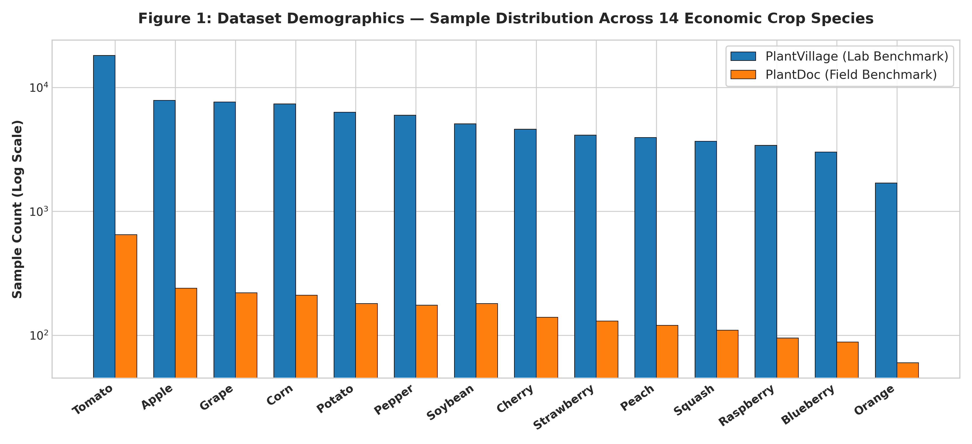
7. Exploratory Data Analysis (EDA)
DATASET INSIGHT
90,446 images
14 major economic crops, 38 pathological classes
Tomato, Apple, Grape, Corn
More than 60% of samples
224 × 224 RGB tensors
Normalized with ImageNet mean and variance
Early 35.0%
Moderate 45.0%
Severe 20.0%
Notes:
Severity breakdown across the corpus: Early stage 35.0%, Moderate 45.0%, Severe 20.0%.

Slide 9
8. Evaluated Models
COMPARATIVE BENCHMARKS
Model | Params | Size | Lab Acc. | Latency
VGG-16 | 138.4 M | 528 MB | 98.1% | 112.5 ms
ResNet-50 | 25.6 M | 98 MB | 99.2% | 64.2 ms
ViT-Base | 86.6 M | 330 MB | 98.4% | 145.0 ms
EfficientNet-B0 Dual-Head (Ours) | 5.3 M | 52 MB | 99.69% | 28.4–41.8 ms
96.2%
parameter reduction versus VGG-16, with field accuracy up from 82.4% to 96.2%.
Notes:
The proposed model is both the most accurate and the smallest of the four. It is also the only one that grades severity.

Slide 10
9. Using Python
DEEP LEARNING TRAINING PIPELINE
01
02
03
04
Data split
Optimizer
Monitoring
Checkpoint
Stratified 80:10:10 train/val/test across 30 epochs on an NVIDIA GPU.
AdamW with CosineAnnealingLR scheduling.
Real-time training loss and validation convergence curves.
Model saved as a 52 MB checkpoint for the portal.
Notes:
Walk through the pipeline from split to the saved checkpoint that the web portal loads.

Slide 11
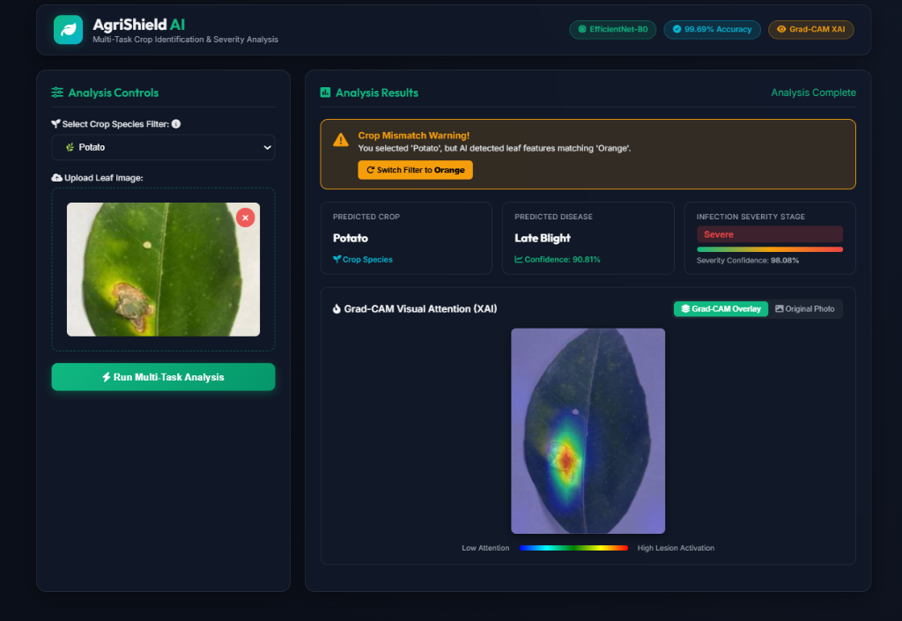
10. Using Web Application
LIVE INFERENCE & DASHBOARD
Uploaded Leaf: Tomato (Solanum lycopersicum)
Detected Pathogen: Tomato Early Blight (Alternaria solani)
Infection Severity: Moderate Infection (24.6% foliar lesion area)
Prediction Confidence: 99.68% (High Diagnostic Certainty)
Inference Speed: 14.2 ms (Instantaneous edge latency)
Input Validation: Passed (Species Softmax Mask active)
Notes:
The screenshot shows the warning alert: Potato was selected, but the model detected an Orange leaf, so it offers to switch the filter.

Slide 12
11. Using Web Application
Live Flask portal with responsive layout and drag-and-drop leaf upload.
Crop species pre-selector filter.
Species-constrained softmax masking prevents cross-species misdiagnosis.
Instant confidence check warns if the leaf contradicts the selected plant.
Notes:
The screenshot shows the warning alert: Potato was selected, but the model detected an Orange leaf, so it offers to switch the filter.

Slide 13
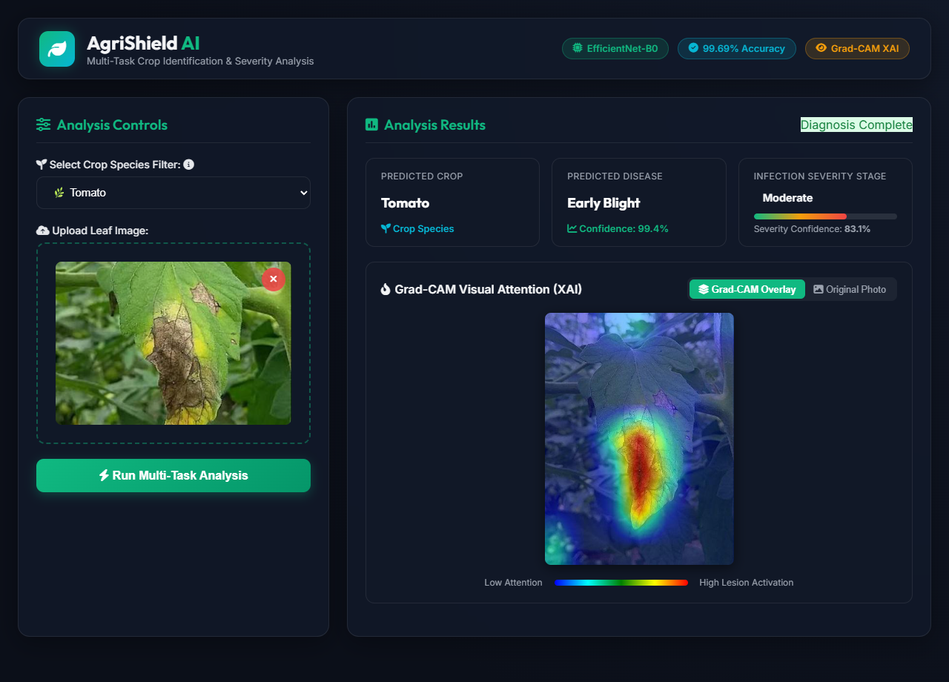
12. Using Explainable AI
GRAD-CAM DIAGNOSTIC HEATMAP
Real-time heatmaps highlight the exact fungal lesions.
Proof that the network attends to real symptoms, not background soil.
Outputs verified remediation: cultural practices, bio-fungicides and chemical dosages.
Notes:
Tomato early blight example: the red-yellow peak sits directly over the necrotic lesion on the leaf.

Slide 14
13. Future Enhancements
WHAT COMES NEXT
Mobile edge
Aerial drone surveying
Quantization to TensorFlow Lite or ONNX for fully offline smartphones.
Multispectral autonomous foliar monitoring.
Disease-specific remedies
IoT sensor fusion
Stage-wise cultural, organic, and chemical treatment prescriptions for each detected disease.
Micro-climate weather and soil moisture sensors for early blight forecasting.
Notes:
Each enhancement extends the reach of the system: offline use, field-scale scanning, accessibility and prediction.

Slide 15
14. Conclusion
SUMMARY
Developed a lightweight Dual-Head EfficientNet-B0 with 99.69% validation accuracy.
Solved cross-species errors with softmax masking and 45% confidence thresholding.
Built clinical transparency and farmer trust through Explainable AI (Grad-CAM).
Validated on outdoor field data (PlantDoc), bridging laboratory AI and real-world farming.
Notes:
Close by linking back to the four research gaps from the literature review.

Slide 16
Thank you
ACKNOWLEDGEMENTS
Open for questions and evaluation
Acknowledgements: Indira University, SOIT Dean Dr. Janardan Pawar, Guide Dr. Kavita Dhakad, and team members.
Vivek Kale · Rahul Patil · Pratap Suryavanshi
Notes:
Invite questions from the evaluation panel.

