Slide 1
Environment Setup
Setting up a Ruby on Rails environment in Windows using Vagrant

Slide 2
Tools of the Trade
Git
Adds unix shell commands in windows
Adds ssh client
Virtual Box
For Running (Linux) VMs for FREE! ☺
Vagrant
For “Painless” setup of VM

Slide 3
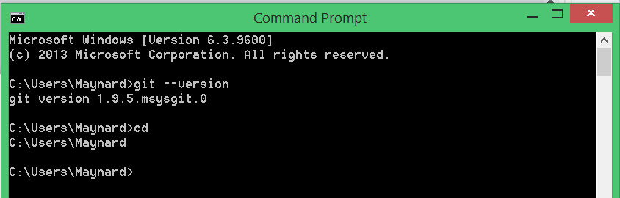
Download and Install Git for Windows
Add git\bin to PATH
To check, type in cmd:
git –version
cd

Slide 4
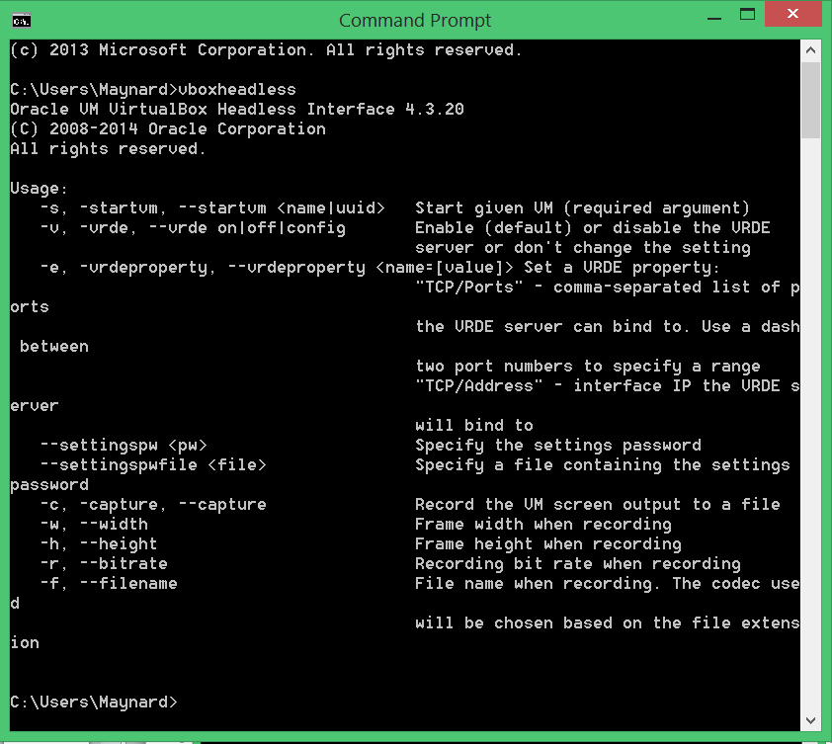
Download and Install Virtual Box
Add Oracle\Virtualbox to PATH
To check, type in cmd:
vboxheadless

Slide 5
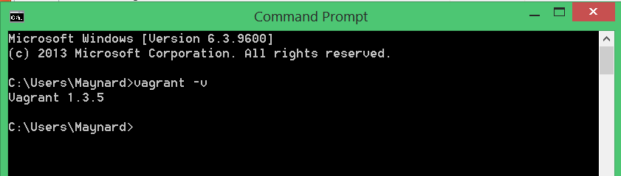
Download and Install Vagrant
To check, type in cmd:
vagrant -v

Slide 6
Let’s Get a Vagrant Box
Create a “container” folder anywhere (Desktop is good)
Create a “projects” folder inside that folder
Open a cmd in “container” folder
Clone the railsmn-dev-box repository:
git clone https://github.com/railsmn/railsmn-dev-box.git
Watch the magic

Slide 7
What is Vagrant?
Easy way to configure and deploy VMs
Reusable and consistent
Awesome

Slide 8
How Vagrant Works
Vagrant Boxes
Virtualizer
(VirtualBox, VMWare, Et.c)
Config
Vagrant File

Slide 9
Configure the Vagrant Box
Open the railsmn-dev-box folder
Edit the Vagrantfile file
Add shared folder by adding:
config.vm.synced_folder ‘<host/folder/path>’, ‘<guest/folder/path>’
use the container/projects folder we created earlier
Save and close the Vagrantfile
open cmd on the railsmn-dev-box folder and run vagrant up
Watch more magic (this may take a while)

Slide 10
While waiting…
Let’s make a Github account!
Go to github.com and register an account
Use a legit email, because it should be your account forever!
Create a project repository
This is where we’ll store our project
Name it whatever for now
Copy the new repo’s https url

Slide 11
Let’s Create a Local Git Repo
open cmd in your projects folder
type git add remote origin <github repo url>
type git init
this tells git to set this folder as a repository
create a text file in inside projects
you can type touch <filename>
type git status
type git add .
type git commit –m “initial commit”
type git push origin master

Slide 12
How Git Works
github.com
Remote
push
pull
Local
Local
commit
change

Slide 13
Check VM and Installed Programs
connect to the vagrant VM by typing vagrant ssh
check the following programs by typing:
MySQL – mysql –u root
RVM – rvm –v
Ruby – rvm list or ruby –v
Rails – rails –v

Slide 14
Install Stuff
Install RVM (Ruby Version Manager)
\curl -sSL https://rvm.io/mpapis.asc | gpg --import -
\curl -sSL https://get.rvm.io | bash
source ~/.bash_profile
rvm –v
Install Ruby 2.0
rvm install 2.0
rvm list

Slide 15
Install Stuff (continued!)
Install Ruby on Rails!
gem install rails --no-ri --no-rdoc
rails -v

Slide 16
Create MySQL DB
while connected to VM via ssh:
login to mysql console by typing mysql –u root
create new database: create database <name>
exit mysql console: exit

Slide 17
Create and Configure Rails App
While still connected to the VM via ssh:
cd to the shared projects folder
create rails app: rails new <app name>
Edit database.yml in <app_name>/config/
set adapter to mysql2
set username to root
set database to <database name>
Edit Gemfile file in <app_name>
change gem mysql to gem mysql2
Install all required gems by running bundle install

Slide 18
Let’s Start That Rails Server
Start the server by typing:
rails server –b0.0.0.0
-b is for binding the server local ip to 0.0.0.0, so that it’s accessible from outside the VM
In the host machine, open a web browser and go to localhost:3000
Celebrate your accomplishment!

Slide 19
Terminal Things
Introduction to Shell Utilities

Slide 20
Goals
Familiarize ourselves with the basics of Bash and Linux/Unix utilities

Slide 21
man bash

Slide 22
The End

Slide 23
Shell
accepts input from the standard input and prints results to the standard output
accesses the operating system's services
command prompt: $ or %

Slide 24
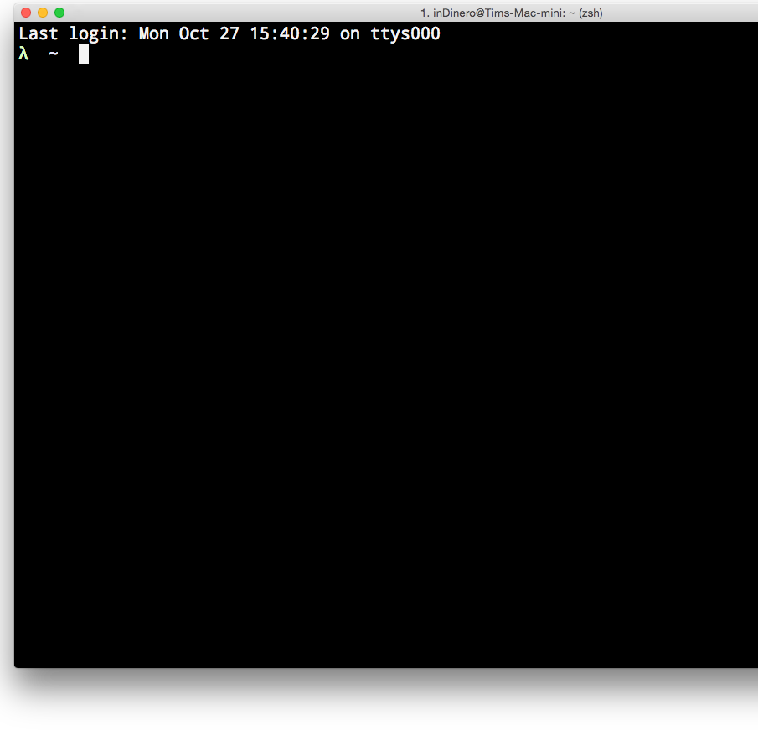
Meet Terminal
allows the user to access the shell

Slide 25
Bash
Unix shell written as a replacement for the Bourne shell.

Slide 26
Pro-Tip:
Use man / apropos

Slide 27
man
man allows the user to view the manual of the specified command. For example, if we want to see the Bash's documentation, we can issue the command man bash.

Slide 28
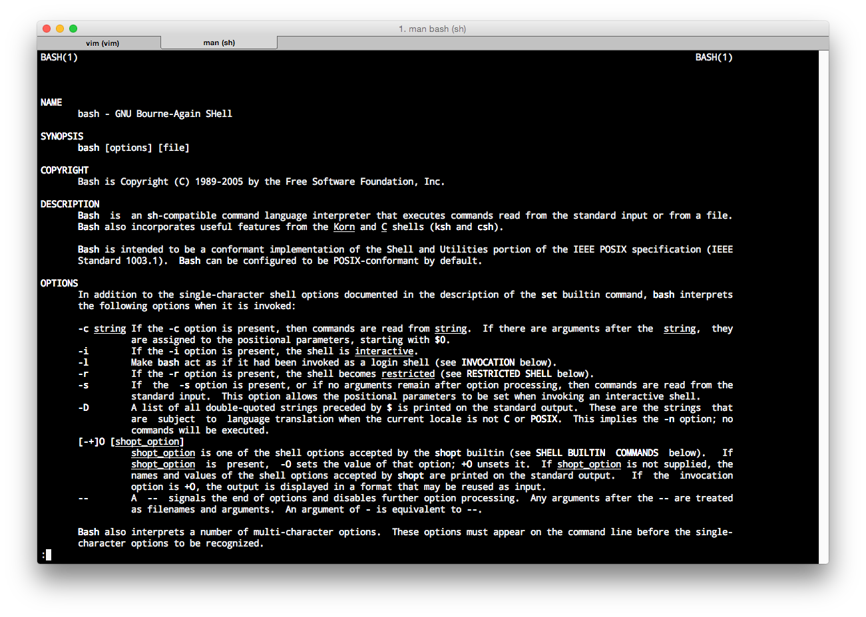

Slide 29
apropos
man's cousin
allows you to search through the entire list of manuals using a keyword if you are not sure which command you want to call
$ apropos process

Slide 30
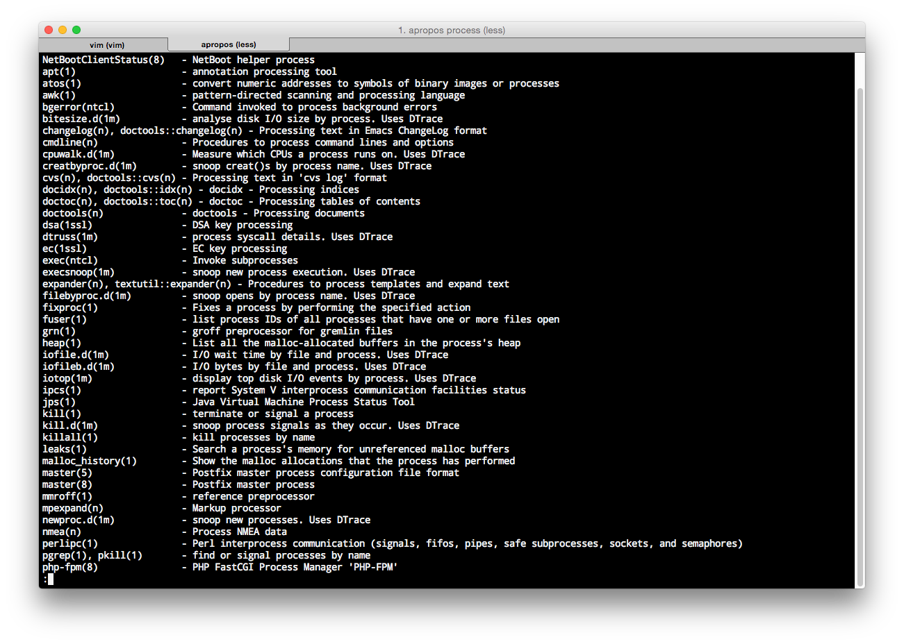

Slide 31
more commands

Slide 32
echo
write to standard input
echo "Sweet Potato"

Slide 33
Environment Variables
Set of dynamic named values that can affect the way running processes will behave on a computer.
env

Slide 34
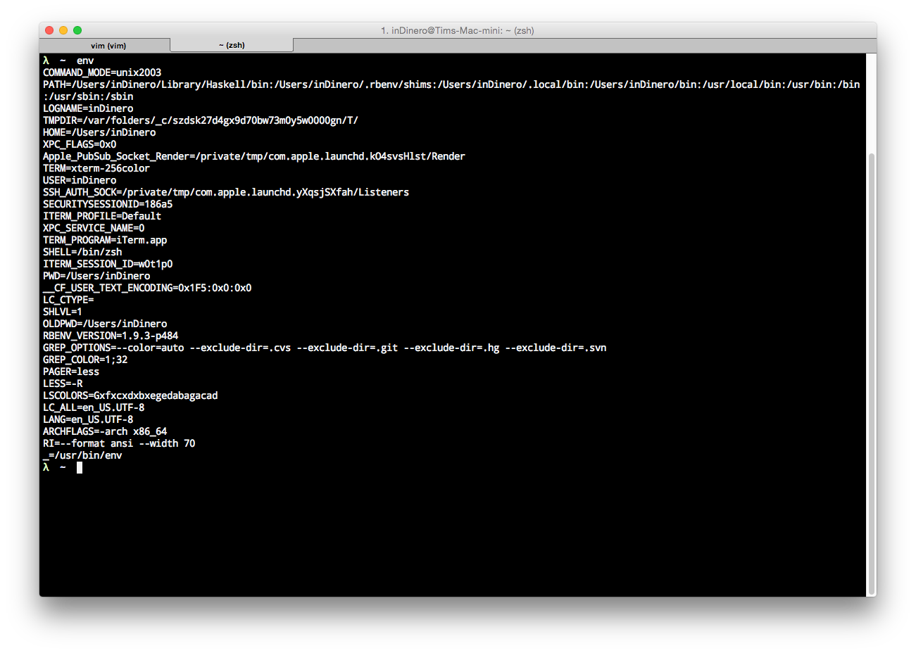
$HOME - your home directory
$PATH - where the shell will look for executables

Slide 35
export
unset
set the export attribute for variables
export RAILS_ENV=development
export PATH=~/bin:$PATH
unset values and attributes of variables and functions
unset RAILS_ENV

Slide 36

Navigation

Slide 37
System is made up of
Files
Directories

Slide 38
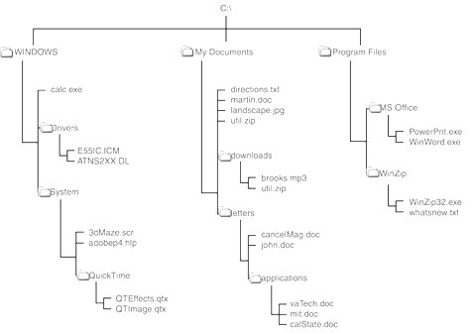
access files and directories
using their path

Slide 39
Paths
/ - Root directory
. - current
.. - parent of the current

Slide 40
Examples:
/home/deploy/apps/myapp
/home/deploy/./myapp
/home/deploy/../myapp

Slide 41
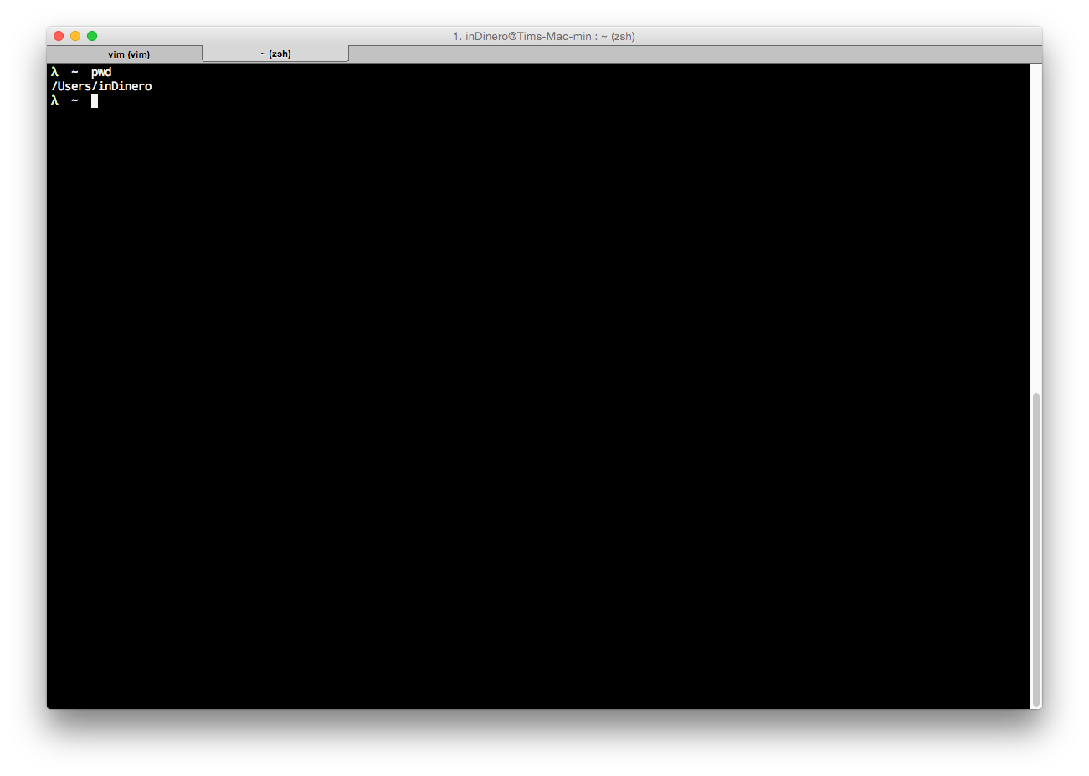
pwd

Slide 42
ls
command to list the files and directories
remember man
man ls

Slide 43
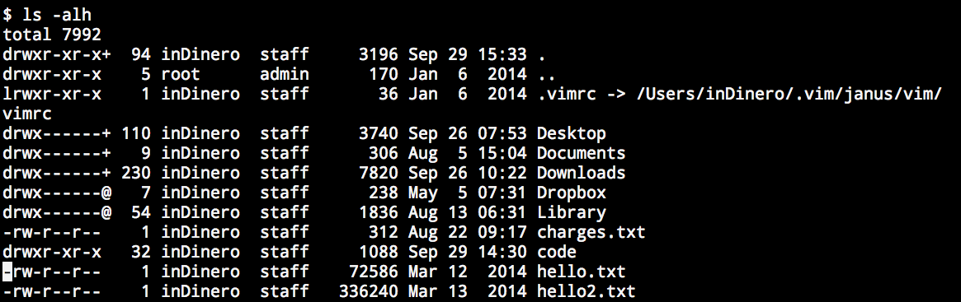

Slide 44
Anatomy of a shell command

Slide 45
cd
mkdir
change directory
cd dir_name
cd without an argument changes the directory to $HOME
make a directory
mkdir <dir_name>
mkdir -p this/will/create/the/whole/path/all/the/way/down

Slide 46
rm
cp
remove file
rm thing
AKA unlink
Be careful: rm without any options will delete the file without prompting the user.
copy a file or a directory
cp src dest
cp -r src_dir dest_dir

Slide 47
mv
cat
move a file or directory
mv src dest
show a stream to STDOUT
cat file1 file2 ...

Slide 48
less/more
head/tail
view contents of a file
head shows the first lines of a file.
tail shows the last lines of a file.

Slide 49
touch
wc
sets the modification and access times of files
If any file does not exist, it is created with default permissions
touch myfile
displays the number of lines, words, and bytes contained in each input file, or standard input (if no file is specified) to the standard output
wc myfile

Slide 50
grep
find
searches any given input files, selecting lines that match one or more patterns
grep pattern file1 file2
recursively descends the directory tree for each path listed, evaluating an expression in terms of each file in the tree
find . -iname '*uby*'

Slide 51
which
ln
takes a list of command names and searches the path for each executable file that would be run had these commands actually been invoked
which ruby
utility creates a new directory entry (linked file) which has the same modes as the original file.
It is useful for maintaining multiple copies of a file in many places at once without using up storage for the copies; instead, a link points to the original copy. There are two types of links; hard links and symbolic links. How a link points to a file is one of the differences between a hard and symbolic link. man ln
ln -sn src dest

Slide 52
Redirection
Before a command is executed, its input and output may be redirected using a special notation interpreted by the shell.
man bash
>
>>

Slide 53
Pipelines
a sequence of one or more commands separated by the character |
[time [-p]] [ ! ] command [ | command2 ... ]
standard output of a command is connected to the standard input of command2 via a pipe
echo "Hello\nWorld" | wc -l

Slide 54

File Permissions
OSes always have some form of access control
restrict access to a files

Slide 55
id
print the real and effective user and group IDS

Slide 56
ls -al
drwxr-xr-x 32 inDinero staff 1088 Sep 29 14:30 code
The first set of three characters is the permission for the owner of the file: `rwx` means the owner can read, write, and search the directory.
The second set of three characters is the permission for the group the file belongs to. `r-x` means, the group has read and search permissions, but no write permission.
The last set of three characters is the permission for others -- neither the owner nor the group.

Slide 57
chmod
chown
change file mode bits
chmod +x somescript
chmod +rw afile
chmod o-rw file2
man chmod
change file owner and group
chown deploy:deploy some_file

Slide 58
Processes

Slide 59
“Everything is a file or a process.”
–Linux

Slide 60
Running a process
type the command and press ENTER
the command should be in the $PATH

Slide 61
Managing Processes
ps
kill
report a snapshot of the current processes
ps aux
man ps
send a signal to a process
kill -9 pid
man kill

Slide 62
Modifying the $PATH
create a bin directory in your $HOME
edit ~/.bash_profile to add the ~/bin path
create a new terminal session

Slide 63
Exercises
Download (clone): https://github.com/iamteem/hairy_dangerzone
Using redirection, list the contents (filenames and directories) of the directory hairy_dangerzone to a file named hairy_dangerzone_contents.txt.
Find all files in the directory containing 'airy'. (Hint: use man bash for '* expansion') and save the results to airy.txt
List all the environment variables and their values containing 'E' and save that to a file. How many were variables were returned?
Using `head` and `tail`, save lines 11-17 of lib/hairy_dangerzone.rb to a file named 'hairy_dz_11_17.txt'
Notes:
1. git clone https://github.com/iamteem/hairy_dangerzone.git
2. touch hariy_dangerzone_contents.txt
ls >> hariy_dangerzone_contents.txt
3. find . -iname ‘*airy*’
4. env | grep E >> <filename>
5. head lib/hairy_dangerzone.rb -n 11 | tail -n 8 >> hairy_dz_11_17.txt

Slide 64
Exercises
Run irb.
Get the process ID of irb and terminate it.

