Slide 1
Design and Implementation of a Command Line Calculator"
VIABHAV SHARMA
(RA2011026010106)

Slide 2
ABSTRACT
Briefly introduce the purpose and goal of the project
Mention the importance of command line calculators and their relevance to the study of compiler design
Mention the use of Python programming language and its suitability for this project

Slide 3
Project Aim
State the aim of the project: "To design and implement a command line calculator capable of handling basic arithmetic operations, variables, and functions using Python programming language"
Mention the focus on a user-friendly interface and proper error handling
Highlight the use of lexical analysis and syntax parsing concepts in compiler design

Slide 4
Project Design
Explain the overall design of the command line calculator
Mention the key components: lexer, parser, memory manager, error handler, and user interface
Describe the role of each component and their interactions
Emphasize the use of lexical analysis and syntax parsing in the lexer and parser components

Slide 5
Project Design
Explain the overall design of the command line calculator
Mention the key components: lexer, parser, memory manager, error handler, and user interface
Describe the role of each component and their interactions
Emphasize the use of lexical analysis and syntax parsing in the lexer and parser components

Slide 6
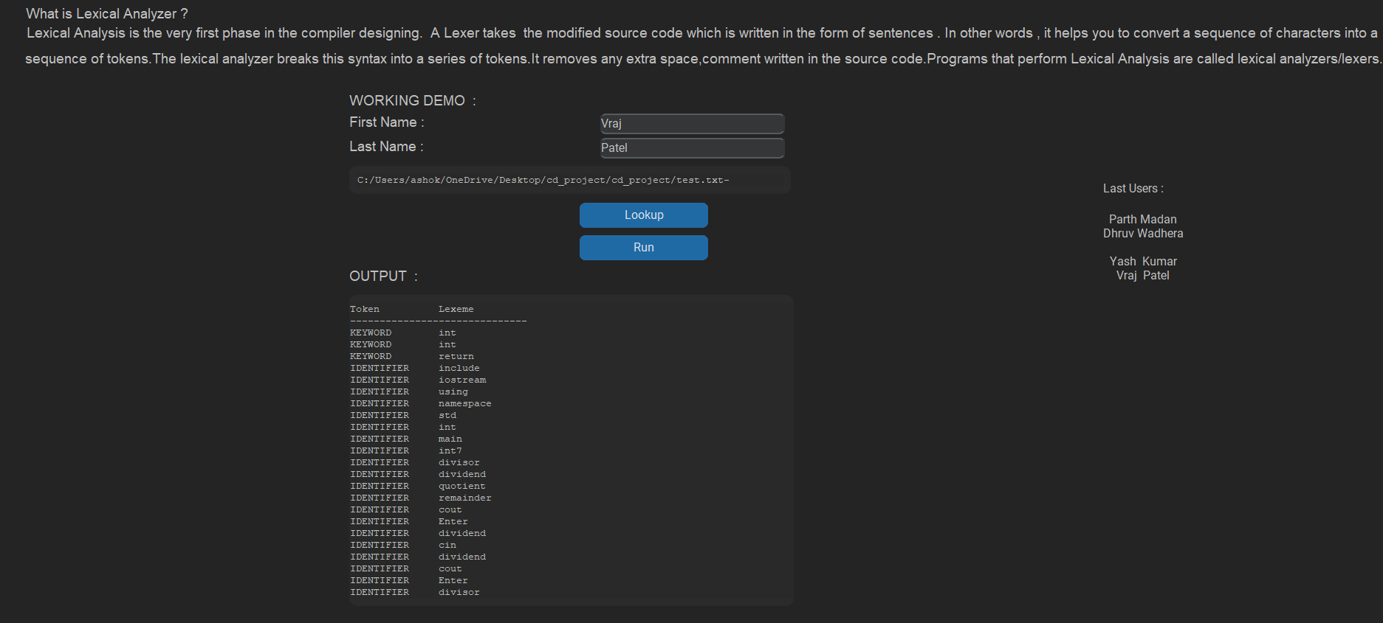
MODULE DESCRIPTION:

Slide 7
CONCLUSION
Summarize the main points discussed throughout the presentation
Highlight the achievements and contributions of the project
Mention any future possibilities for extending or improving the command line calculator

Slide 8
THANK YOU

