Slide 1
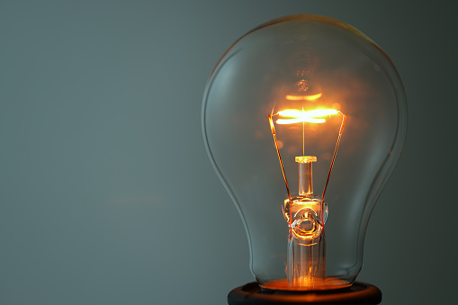
Inventor of light bulb Tomas Edison

Slide 2
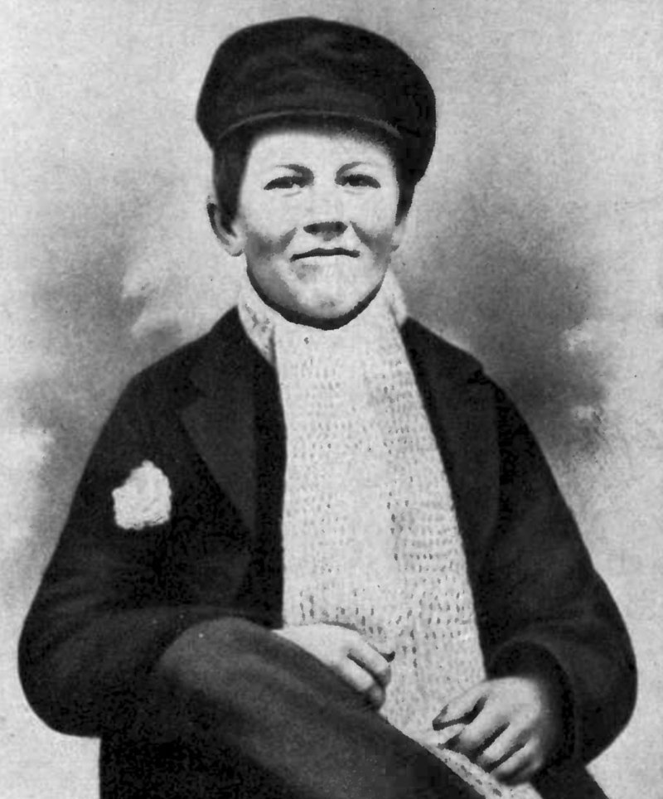
Thomas Edison, the inventor of the light bulb, was born on February 11, 1847, in Mylene, Ohio.
A part of his childhood
He started to study at school. After three months of being at school, he was given with the wording "incapable of learning" to his mother - a teacher, who, taking into account the characteristics of the child, took up his education herself.
The inquisitive boy, already at the age of nine, had read a serious work on natural and experimental philosophy and made all the experiments from it.

Slide 3

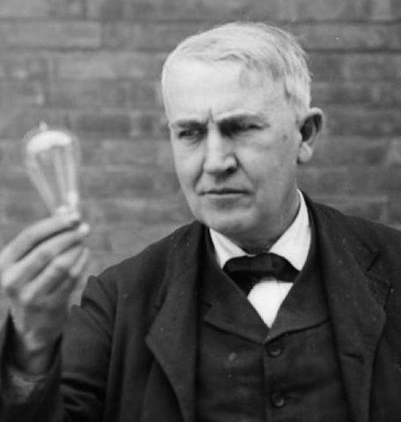
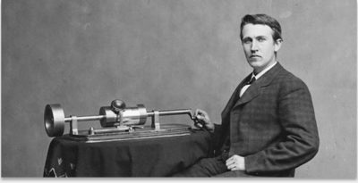
Thomas Edison, basically, did not create any new developments, but improved the devices already designed by other scientists. However, he did it so brilliantly that he turned ordinary things into the greatest inventions of the millennium.

Slide 4
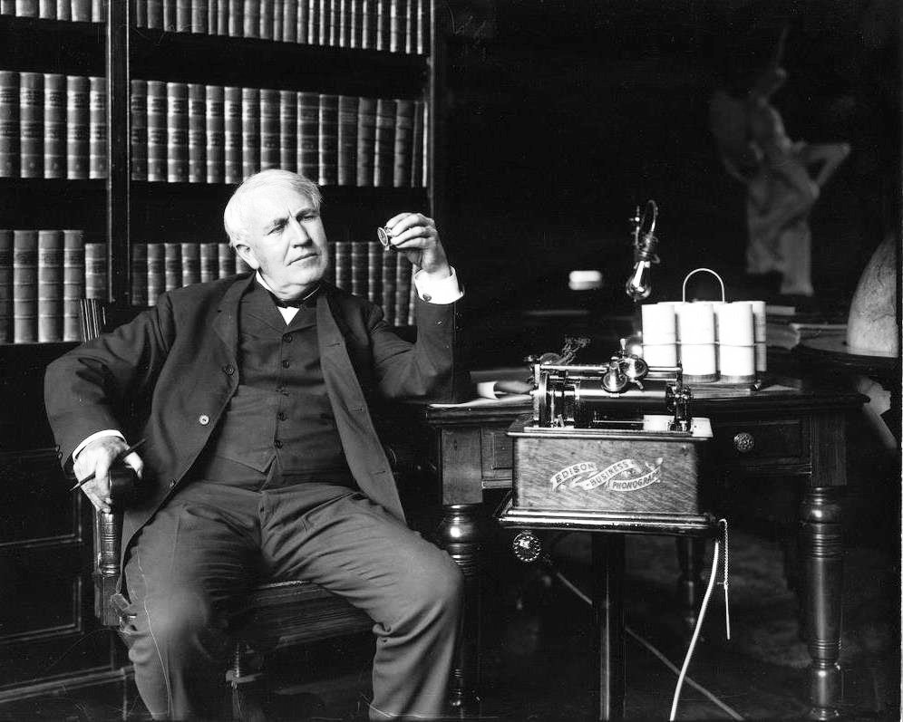
He improved a light bulb and nowadays light bulbs are improved by many investors. But T. Edison made huge contribution to improve them.

Slide 5

The role of the light bulb in our life is difficult to overestimate. It is enough to recall the moments when the electricity in the house suddenly turns off - a feeling of helplessness, and sometimes panic, covers almost everyone. By the way, before the invention of the light bulb, people slept an average of 10 hours a day, after - no more than 7.5. The light bulb has changed our lives.

Slide 6
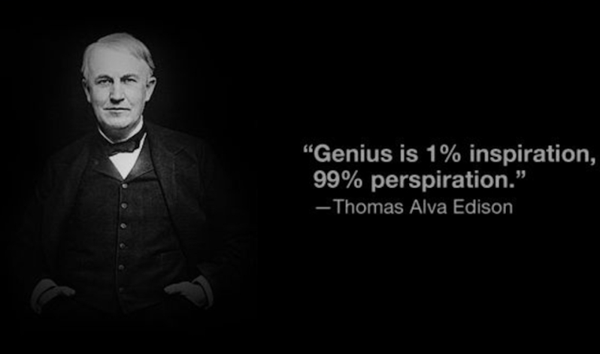
Thank you

