Slide 1
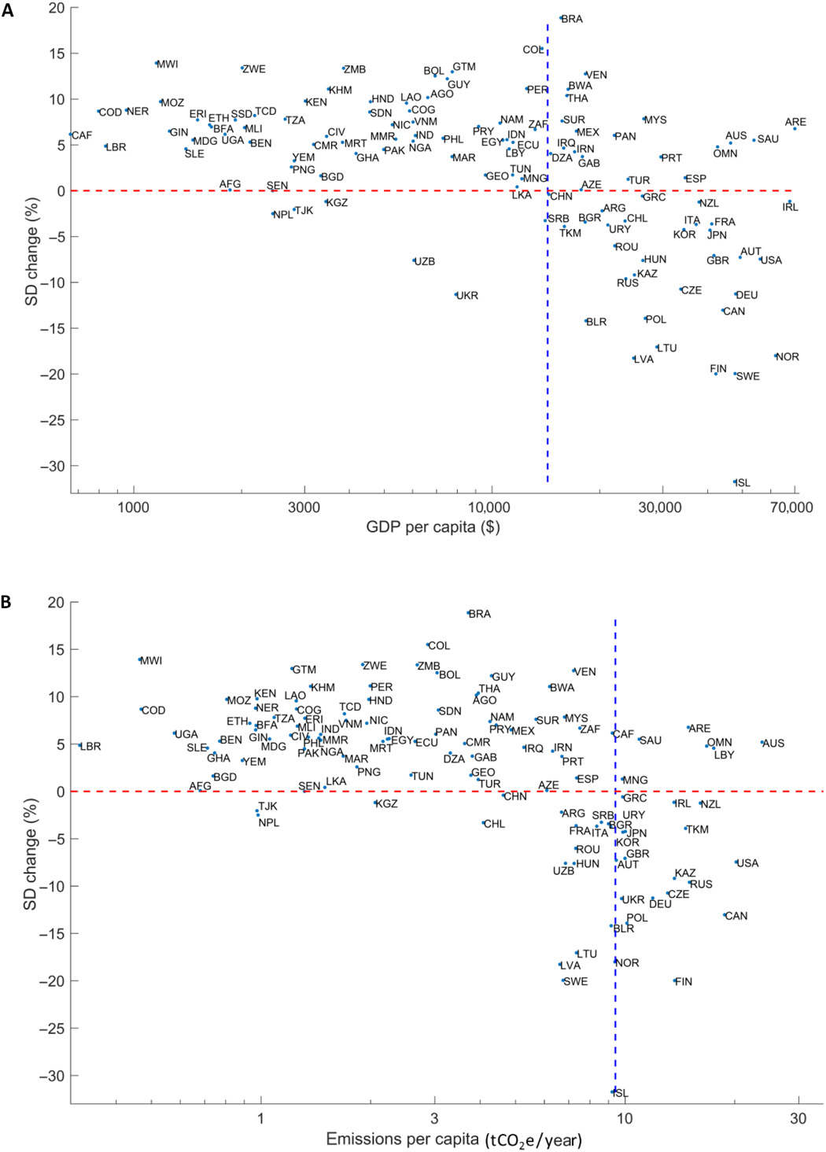
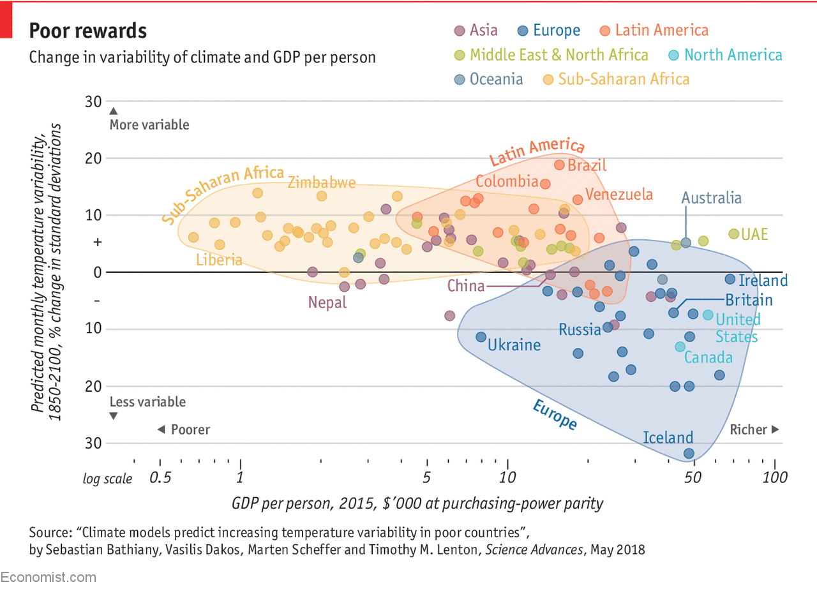

Fig. 5 Relative change in SD of monthly temperature anomalies until the end of the 21st century versus per capita GDP and greenhouse gas emissions.
Sebastian Bathiany et al. Sci Adv 2018;4:eaar5809
Published by AAAS
Notes:
Relative change in SD of monthly temperature anomalies until the end of the 21st century versus per capita GDP and greenhouse gas emissions. (A) Per capita GDP and (B) per capita greenhouse gas emissions (without land use and forestry) between 1990 and 2013 in different countries. The red line marks zero change in temperature variability. The blue lines mark half of the world population (A) and half of the total worldwide emissions (B).

