Slide 1
Observational Studies

Slide 2
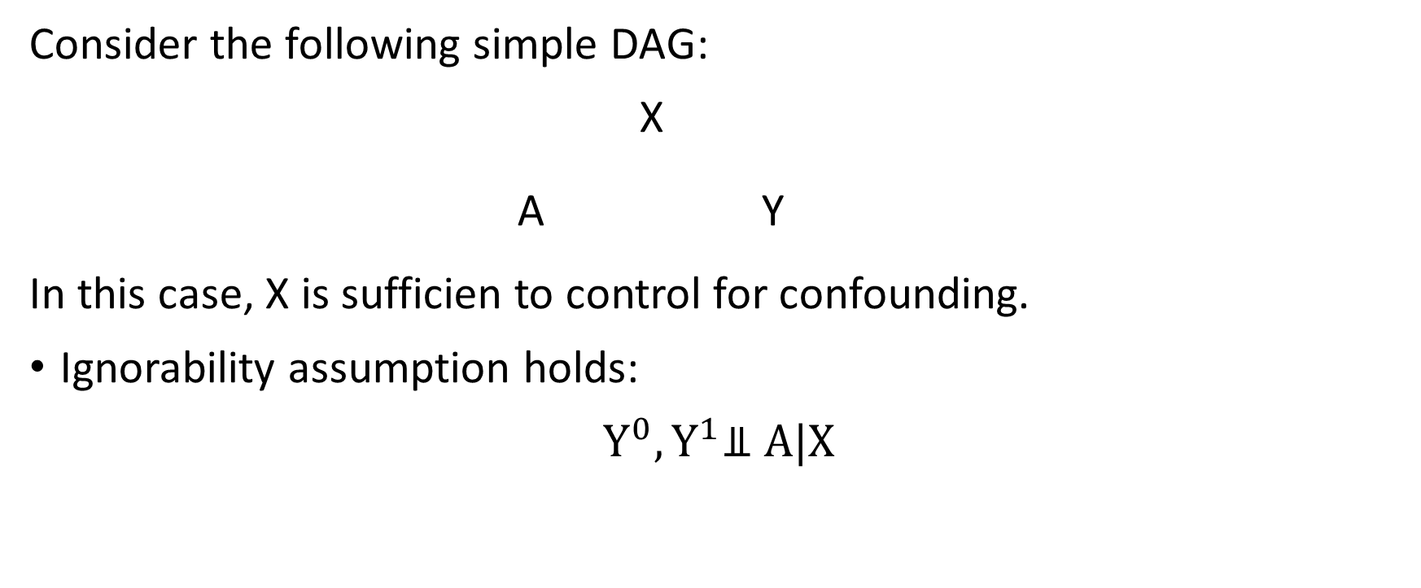
Set-up
Consider the following simple DAG:
X
A Y
In this case, X is sufficien to control for confounding.
Ignorability assumption holds:
$Y^{0},Y^{1}$⫫ A|X

Slide 3
Randomized Trials
In a randomized trial, treatment assignment A would be determined by a coin toss – efectively erasing the arrow for X to A.
Observational
X
A Y
Randomized
X
A Y
No backdoor path from A to Y

Slide 4
Randomized Trials
In a randomized trial:
The distribution of X will be the same in both treatment groups.
Population of Interest
Marginal distribution of X
Randomly selected group gets A=0
Randomly selected group gets A=1
=
Distribution of X given A=0
Distribution of X given A=1

Slide 5
Randomized Trials
Distribution of pre-treatment variables X that affect Y are the same in both treatment groups
Covariate balance
Thus, if the outcome distribution ends up differing, it will not be because of differences in X.
X is dealt with at the design phase.

Slide 6
Why not always randomize?
Randomized trials are expensive.
Sometimes randomizing treatment/exposure is unethical.
Some (many) people will refuse to participate in trials.
Randomized trials take time (you have to wait for outcome data).
In some cases, by the time you have outcome data, the question might no longer be relevant.

Slide 7
Observational Studies
Planned, prospective, observational studies with active data collection:
Like trials: data collected on a common set of variables at planned time; outcome carefully measuredl study protocols
Unlike trials: regulations much weaker, since not intervening; broader population eligible for the study
Databases, retrospective, passive data collection:
e.g., electronic medical records; claims; registries
Large sample sizes; inexpensive; potential for rapid analysis
Data quality typically lower; no uniform standard of collection

Slide 8
Observational Studies
In observational studies, the distribution of X will differ between treatment groups.
For example, i older people are more likely to get A=1, we might see distributions like this:s

Slide 9
Matching
In the case where older people are more likely to get A=1
At younger ages, there are more people with A=0
At older ages, there are more people with A=1
In a randomized trial, for any particular age, there should be about the same number of treated and untreated people.
By matching treated people to control people of the same age, there will be about the same number of treated and controls at any age.

