Slide 1
Conditional Probability
B.A. Brumback (2022) Fundamentals of Causal Inference page 20-26.

Slide 2
What-If? Study
See table 1.3 page 9
T=1 naltrexone
T=0 placebo
A=1 reduced drinking
H=1 unsuppressed HIV load at baseline
Y=1 unsuppressed HIV load at month 4

Slide 3
Conditional Probability
The viral load at month 4 is unsuppresed (Y=1) given a participant:
given placebo T=0
did not reduce drinking A=0
suppressed viral load at baseline H=0
P=(Y=1|T=0,A=0,H=0) = 3 / (3 + 15) = 0.1667
T | A | H | Y | n
0 | 0 | 0 | 0 | 15
0 | 0 | 0 | 1 | 3

Slide 4
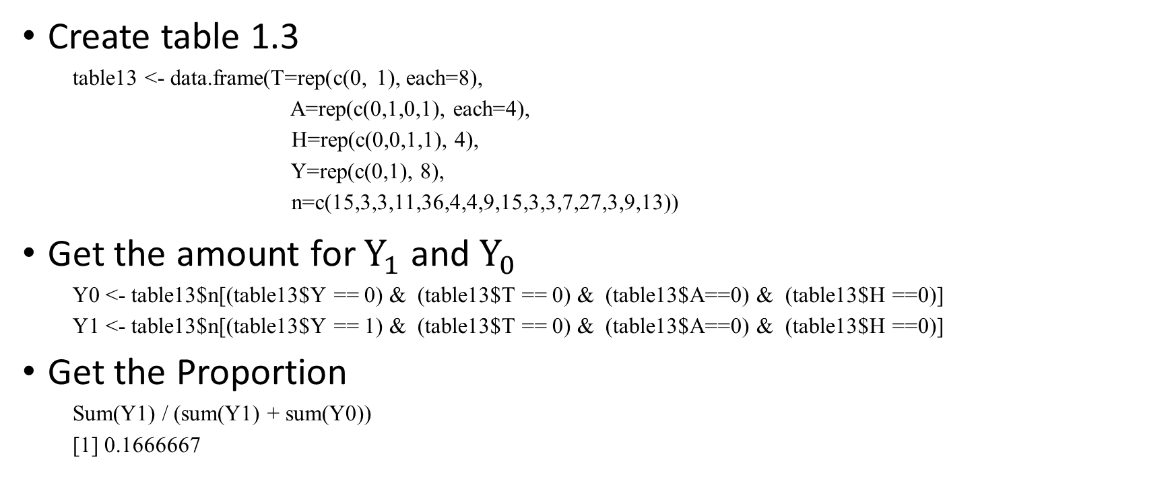
Calculate proporions with R
Create table 1.3
table13 <- data.frame(T=rep(c(0, 1), each=8),
A=rep(c(0,1,0,1), each=4),
H=rep(c(0,0,1,1), 4),
Y=rep(c(0,1), 8),
n=c(15,3,3,11,36,4,4,9,15,3,3,7,27,3,9,13))
Get the amount for $Y_{1}$ and $Y_{0}$
Y0 <- table13$n[(table13$Y == 0) & (table13$T == 0) & (table13$A==0) & (table13$H ==0)]
Y1 <- table13$n[(table13$Y == 1) & (table13$T == 0) & (table13$A==0) & (table13$H ==0)]
Get the Proportion
Sum(Y1) / (sum(Y1) + sum(Y0))
[1] 0.1666667

Slide 5
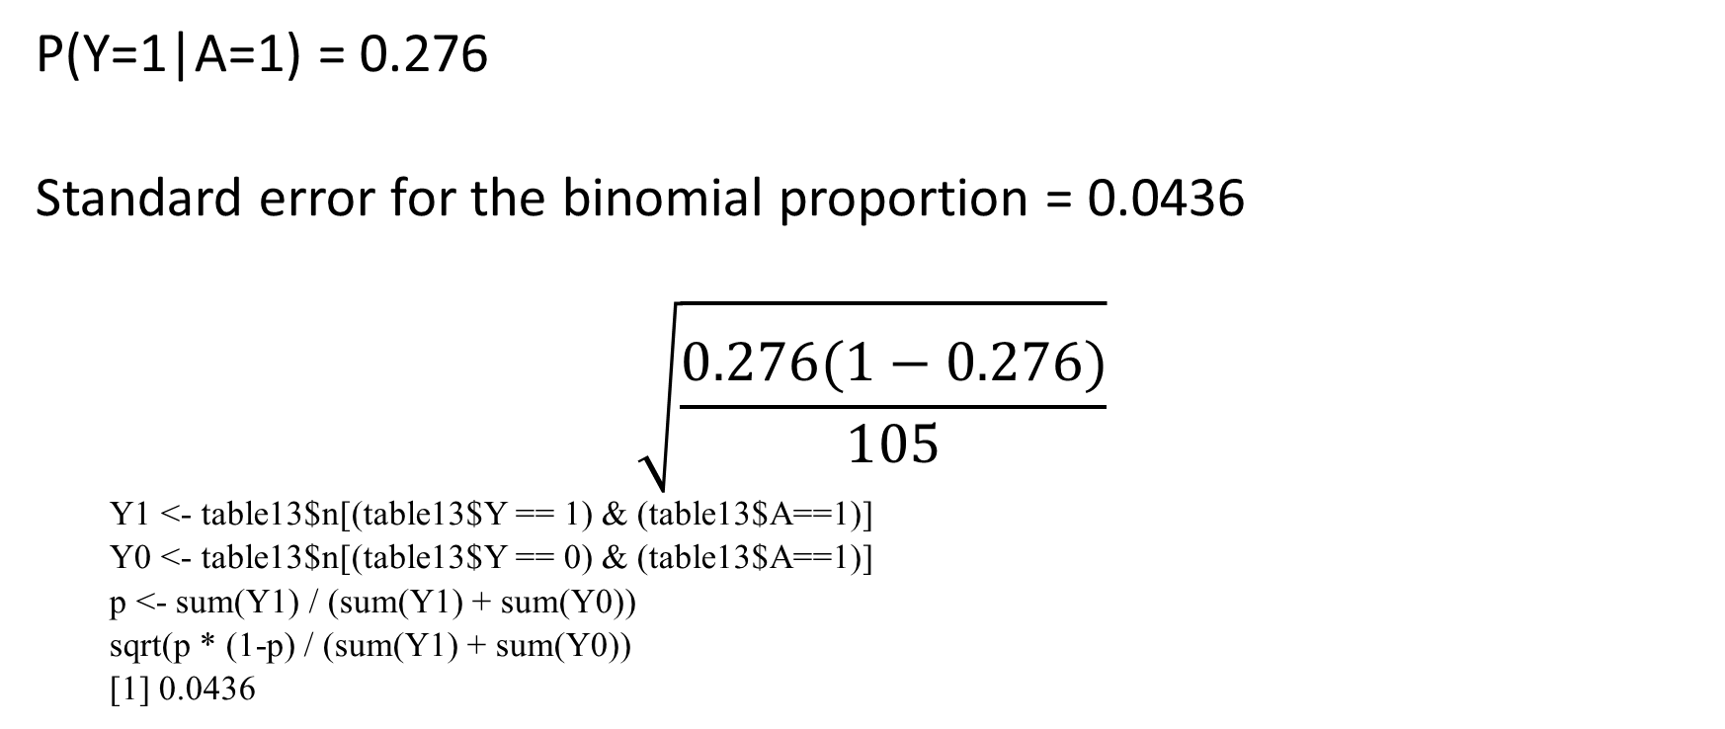
Estimation
P(Y=1|A=1) = 0.276
Standard error for the binomial proportion = 0.0436
$$\sqrt{\frac{0.276(1−0.276)}{105}}$$
Y1 <- table13$n[(table13$Y == 1) & (table13$A==1)]
Y0 <- table13$n[(table13$Y == 0) & (table13$A==1)]
p <- sum(Y1) / (sum(Y1) + sum(Y0))
sqrt(p * (1-p) / (sum(Y1) + sum(Y0))
[1] 0.0436

Slide 6

Conditional Expectation
$$E(Y|T,H)=\sum_{y}{yP(Y=y|T,H)}$$
y ranges over all possibile values of Y.
T and H are conditional variables

