Slide 1
Stratification

Slide 2
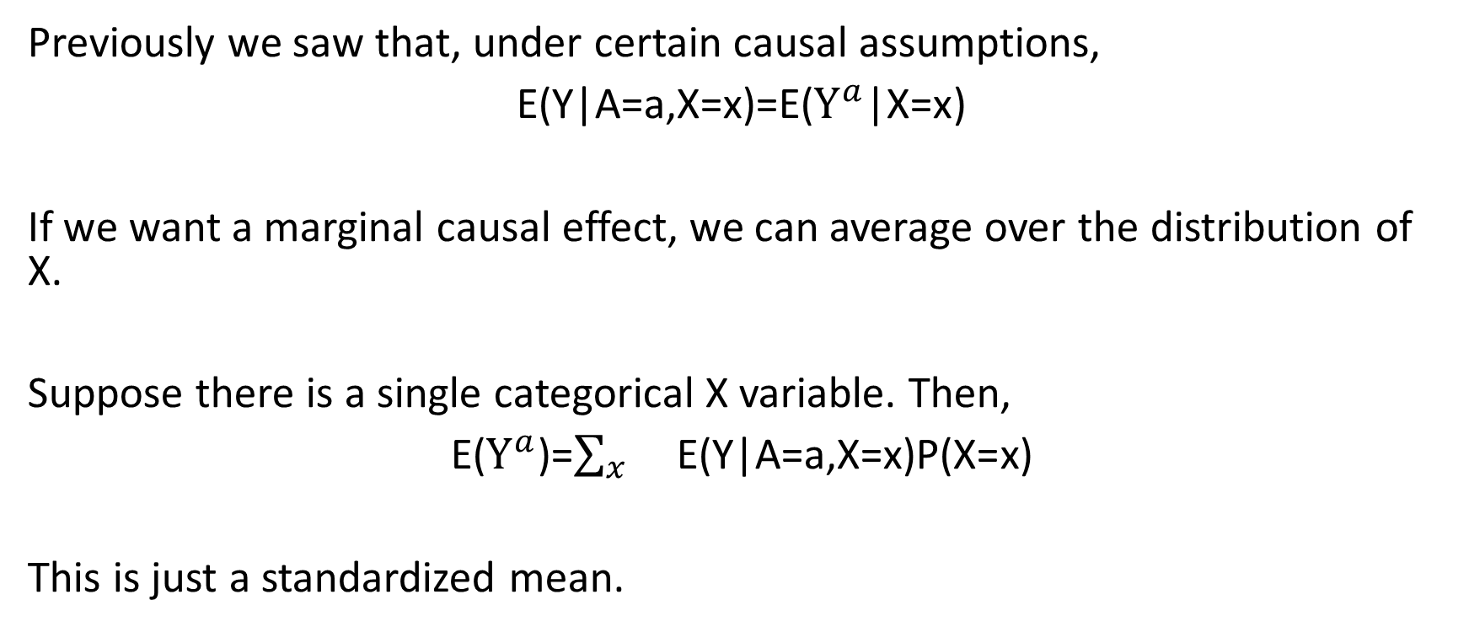
Conditioning and marginalizing
Previously we saw that, under certain causal assumptions,
E(Y|A=a,X=x)=E($Y^{a}$|X=x)
If we want a marginal causal effect, we can average over the distribution of X.
Suppose there is a single categorical X variable. Then,
E($Y^{a}$)=$\sum_{x}{}$E(Y|A=a,X=x)P(X=x)
This is just a standardized mean.

Slide 3
Standardization
Standardization involves stratifying and then averaging
i.e., obtain a treatment effect within each stratum and then pool across stratum, weighting by the probability (size) of each stratum
From data, you could estimate a treatment effect by computing means under each treatment within each stratum, and then pooling across stratum

Slide 4
Standardization example
Study comparing two diabetes treatments: new initiators of saxagliptin versus sitagliptin.
Outcome: Major Adverse Cardiac Event (MACE)
Challenge:
Saxagliptin users were more likely to have had past use of some other oral antidiabetic (OAD) drug.
Patients with past use of OAD drugs are at higher risk for MACE.

Slide 5
Standardization example
Main idea:
Compute rate of MACE for saxagliptin and sitagliptin initiators in two subpopulations:
patients who have had no prior OAD use
patients who have had prior OAD use
Then take weighted average, where weights are based on propotion of people in each subpopulation.
This is a causal effect if, within levels of the prior OAD use variable, treatment can be thought of as randomized (ignorability given prior OAD use).

Slide 6
Standardization example
Raw Data (Unstratified)
 | MACE=yes | MACE=no | Total
Saxa=yes | 350 | 3650 | 4000
Saxa=no | 500 | 6500 | 7000
Total | 850 | 10150 | 11000
Probability of MACE given Saxa=yes: 350/4000=0.088
Probability of MACE given Saxa=no: 500/7000=0.071

Slide 7
Standardization example
Prior OAD use=no
Prior OAD use=yes
 | MACE=yes | MACE=no | Total
Saxa=yes | 50 | 950 | 1000
Saxa=no | 200 | 3800 | 4000
Total | 250 | 4750 | 5000
 | MACE=yes | MACE=no | Total
Saxa=yes | 300 | 2700 | 3000
Saxa=no | 300 | 2700 | 3000
Total | 600 | 5400 | 6000
Saxa users more likely to have prio OAD use.
People with prior OAD use at higher risk for MACE (regardless of treatment).

Slide 8
Standardization example
Prior OAD use=no
Prior OAD use=yes
 | MACE=yes | MACE=no | Total
Saxa=yes | 50 | 950 | 1000
Saxa=no | 200 | 3800 | 4000
Total | 250 | 4750 | 5000
 | MACE=yes | MACE=no | Total
Saxa=yes | 300 | 2700 | 3000
Saxa=no | 300 | 2700 | 3000
Total | 600 | 5400 | 6000
Probability of MACE if Saxa=yes: 50/100-0.05
Probability of MACE if Saxa=no: 200/4000=0.05
Probability of MACE if Saxa=yes: 300/3000-0.10
Probability of MACE if Saxa=no: 300/3000=0.10

Slide 9

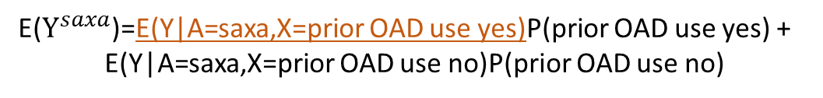
Mean potential outcome for saxagliptin
Prior OAD use=no
Prior OAD use=yes
 | MACE=yes | MACE=no | Total
Saxa=yes | 50 | 950 | 1000
Saxa=no | 200 | 3800 | 4000
Total | 250 | 4750 | 5000
 | MACE=yes | MACE=no | Total
Saxa=yes | 300 | 2700 | 3000
Saxa=no | 300 | 2700 | 3000
Total | 600 | 5400 | 6000
E($Y^{saxa}$)=E(Y|A=saxa,X=prior OAD use yes)P(prior OAD use yes) +
E(Y|A=saxa,X=prior OAD use no)P(prior OAD use no)
E($Y^{saxa}$)=(300/3000)P(prior OAD use yes) +
E(Y|A=saxa,X=prior OAD use no)P(prior OAD use no)

Slide 10

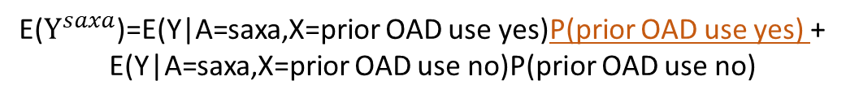
Mean potential outcome for saxagliptin
Prior OAD use=no
Prior OAD use=yes
 | MACE=yes | MACE=no | Total
Saxa=yes | 50 | 950 | 1000
Saxa=no | 200 | 3800 | 4000
Total | 250 | 4750 | 5000
 | MACE=yes | MACE=no | Total
Saxa=yes | 300 | 2700 | 3000
Saxa=no | 300 | 2700 | 3000
Total | 600 | 5400 | 6000
E($Y^{saxa}$)=E(Y|A=saxa,X=prior OAD use yes)P(prior OAD use yes) +
E(Y|A=saxa,X=prior OAD use no)P(prior OAD use no)
E($Y^{saxa}$)=(300/3000)(6000/11000) +
E(Y|A=saxa,X=prior OAD use no)P(prior OAD use no)

Slide 11

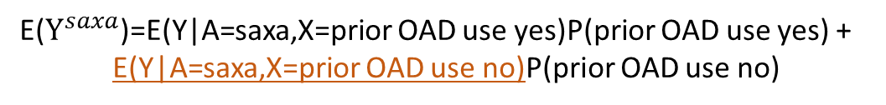
Mean potential outcome for saxagliptin
Prior OAD use=no
Prior OAD use=yes
 | MACE=yes | MACE=no | Total
Saxa=yes | 50 | 950 | 1000
Saxa=no | 200 | 3800 | 4000
Total | 250 | 4750 | 5000
 | MACE=yes | MACE=no | Total
Saxa=yes | 300 | 2700 | 3000
Saxa=no | 300 | 2700 | 3000
Total | 600 | 5400 | 6000
E($Y^{saxa}$)=E(Y|A=saxa,X=prior OAD use yes)P(prior OAD use yes) +
E(Y|A=saxa,X=prior OAD use no)P(prior OAD use no)
E($Y^{saxa}$)=(300/3000)(6000/11000) +
E($Y^{saxa}$)=(50/1000)P(prior OAD use no)

Slide 12

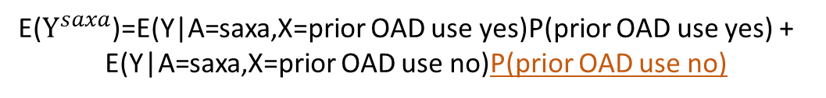
Mean potential outcome for saxagliptin
Prior OAD use=no
Prior OAD use=yes
 | MACE=yes | MACE=no | Total
Saxa=yes | 50 | 950 | 1000
Saxa=no | 200 | 3800 | 4000
Total | 250 | 4750 | 5000
 | MACE=yes | MACE=no | Total
Saxa=yes | 300 | 2700 | 3000
Saxa=no | 300 | 2700 | 3000
Total | 600 | 5400 | 6000
E($Y^{saxa}$)=E(Y|A=saxa,X=prior OAD use yes)P(prior OAD use yes) +
E(Y|A=saxa,X=prior OAD use no)P(prior OAD use no)
E($Y^{saxa}$)=(300/3000)(6000/11000) +
E($Y^{saxa}$)=(50/1000)(5000/11000)= 0.077

Slide 13

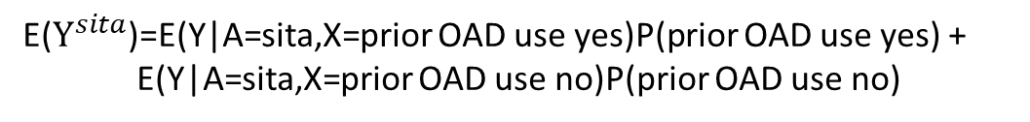
Mean potential outcome for sitagliptin
Prior OAD use=no
Prior OAD use=yes
 | MACE=yes | MACE=no | Total
Saxa=yes | 50 | 950 | 1000
Saxa=no | 200 | 3800 | 4000
Total | 250 | 4750 | 5000
 | MACE=yes | MACE=no | Total
Saxa=yes | 300 | 2700 | 3000
Saxa=no | 300 | 2700 | 3000
Total | 600 | 5400 | 6000
E($Y^{sita}$)=E(Y|A=sita,X=prior OAD use yes)P(prior OAD use yes) +
E(Y|A=sita,X=prior OAD use no)P(prior OAD use no)
E($Y^{saxa}$)=(300/3000)(6000/11000) +
E($Y^{saxa}$)=(200/4000)(5000/11000)= 0.077

Slide 14
Problems with Standardization
Typically, there will bre many X variables needed to achieve ignorability.
Stratification would lead to many empty cells.
For example, if you stratify on age and blood pressure, there will be many combinations of age an blood pressure for which you have no data.
Thus, we need alternatives to standardization.
In the coming weeks, we will explore several popular methods for estimating causal effects: matching, inverse probability of treatment weighting, propensity score methods.

