Slide 1
Potential Outcomes and Counterfactuals

Slide 2
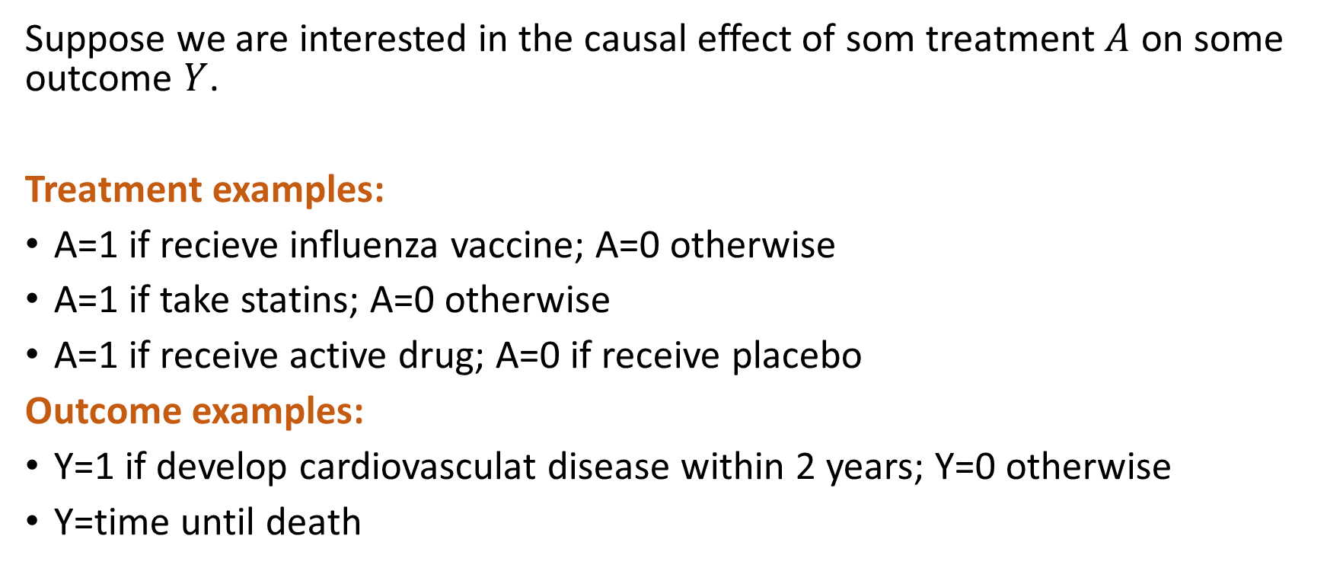
Treatments and Outcomes
Suppose we are interested in the causal effect of som treatment $A$ on some outcome $Y$.
Treatment examples:
A=1 if recieve influenza vaccine; A=0 otherwise
A=1 if take statins; A=0 otherwise
A=1 if receive active drug; A=0 if receive placebo
Outcome examples:
Y=1 if develop cardiovasculat disease within 2 years; Y=0 otherwise
Y=time until death

Slide 3
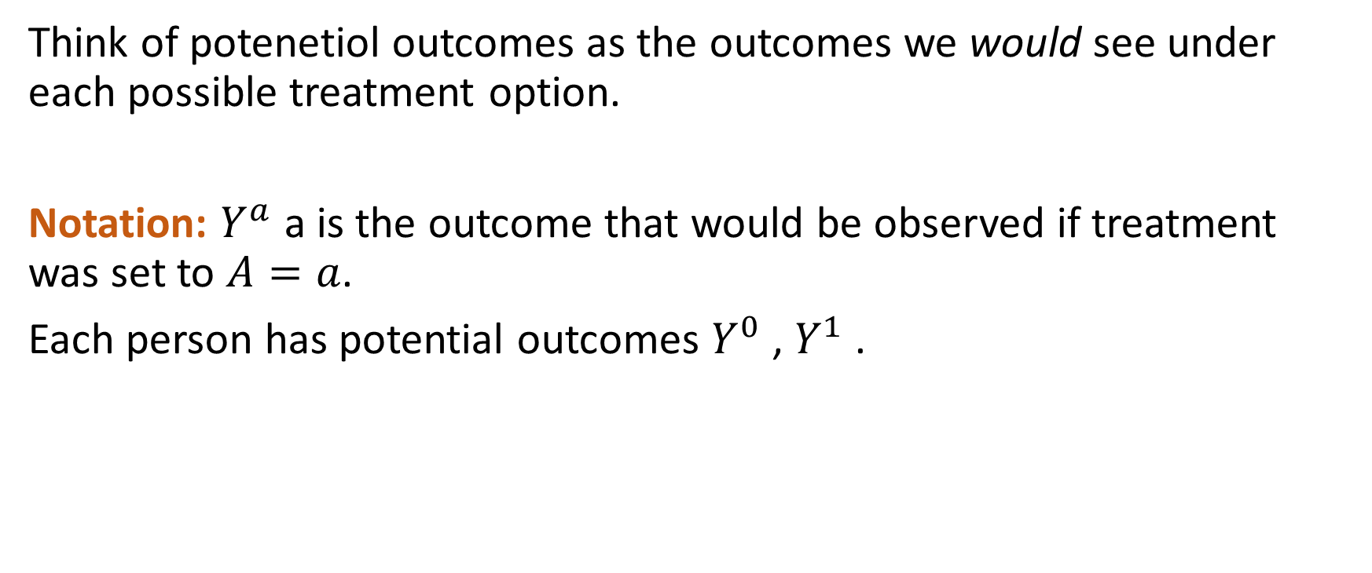
Potential Outcomes
Think of potenetiol outcomes as the outcomes we would see under each possible treatment option.
Notation: $Y^{a}$ a is the outcome that would be observed if treatment was set to $A=a$.
Each person has potential outcomes $Y^{0}$ , $Y^{1}$ .

Slide 4
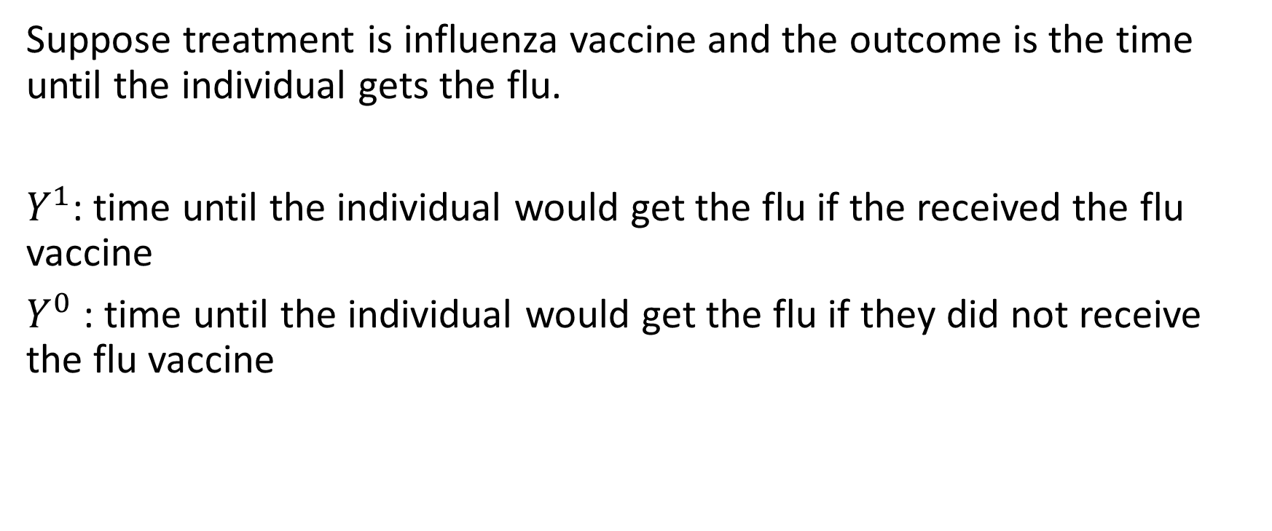
Potential Outcomes Example 1
Suppose treatment is influenza vaccine and the outcome is the time until the individual gets the flu.
$Y^{1}$: time until the individual would get the flu if the received the flu vaccine
$Y^{0}$: time until the individual would get the flu if they did not receive the flu vaccine

Slide 5
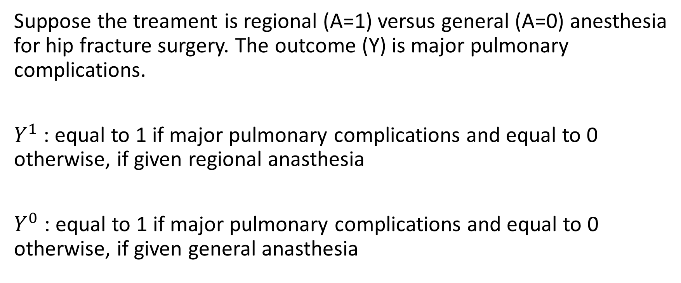
Potential Outcomes Example 2
Suppose the treament is regional (A=1) versus general (A=0) anesthesia for hip fracture surgery. The outcome (Y) is major pulmonary complications.
$Y^{1}$: equal to 1 if major pulmonary complications and equal to 0 otherwise, if given regional anasthesia
$Y^{0}$: equal to 1 if major pulmonary complications and equal to 0 otherwise, if given general anasthesia

Slide 6
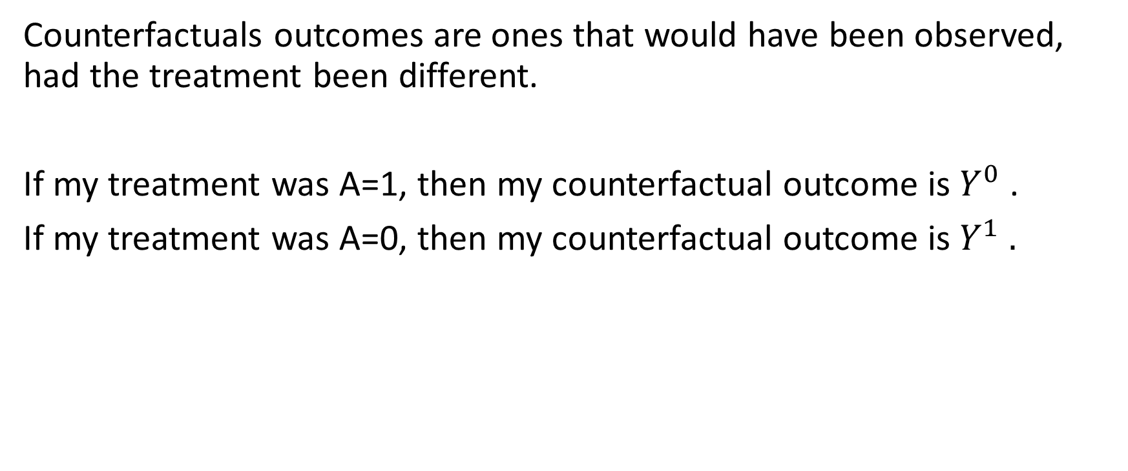
Counterfactuals
Counterfactuals outcomes are ones that would have been observed, had the treatment been different.
If my treatment was A=1, then my counterfactual outcome is $Y^{0}$.
If my treatment was A=0, then my counterfactual outcome is $Y^{1} .$

Slide 7
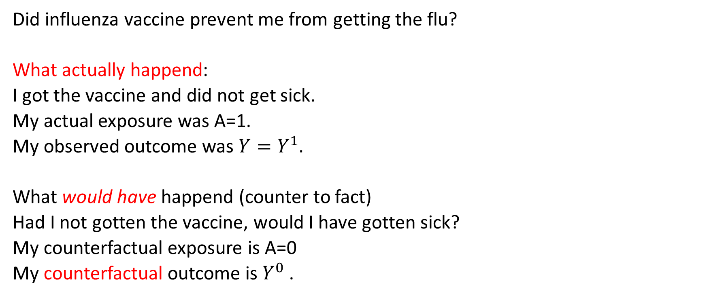
Counterfactuals
Did influenza vaccine prevent me from getting the flu?
What actually happend:
I got the vaccine and did not get sick.
My actual exposure was A=1.
My observed outcome was ${Y=Y}^{1}.$
What would have happend (counter to fact)
Had I not gotten the vaccine, would I have gotten sick?
My counterfactual exposure is A=0
My counterfactual outcome is $Y^{0}$.

Slide 8
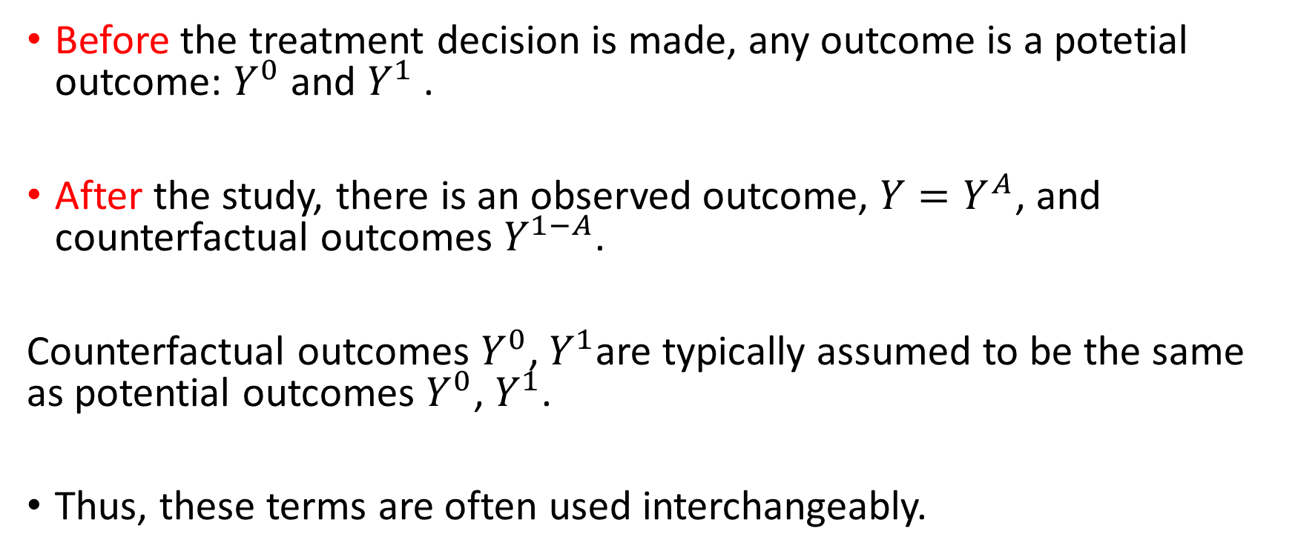
Potential Outcomes and Counterfactuals
Before the treatment decision is made, any outcome is a potetial outcome: $Y^{0}$ and $Y^{1}$.
After the study, there is an observed outcome, ${Y=Y}^{A}$, and counterfactual outcomes $Y^{1−A}$.
Counterfactual outcomes $Y^{0}$, $Y^{1}$are typically assumed to be the same as potential outcomes $Y^{0}$, $Y^{1}$.
Thus, these terms are often used interchangeably.

