Slide 1
Hypothetical Interventions

Slide 2
Intervention
It is cleanest to think of causal effects of interventions or actions
Causal effect of variables that can be manipulated.
Holland (1986) famously wrote “no causation without manipulation”
Causal effects of (hypothetical) interventions are generally well defined.
Outcome if prescribed drug A versus outcome if prescribed drug B

Slide 3
One Version of Treatment
It is common to assume there are no hidden versions of treatment.
For example, if we were interested in the causal effect of body mass index (BMI) on health outcomes, we have a problem because:
There are many potential ways that one could achieve a BMI of a particular value.
These different ways might also be associated with different outcomes.
Weight is not directly manipulable. Better to think of causal effects of interventions that aim at manipulating weight.

Slide 4
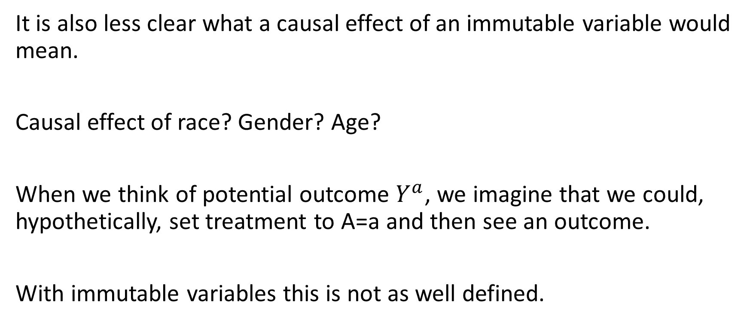
Immutable variables
It is also less clear what a causal effect of an immutable variable would mean.
Causal effect of race? Gender? Age?
When we think of potential outcome $Y^{a}$, we imagine that we could, hypothetically, set treatment to A=a and then see an outcome.
With immutable variables this is not as well defined.

Slide 5
Manipulable versus not manipulable
No direct intervention | Manipulable (intervention)
Race | Name on resume
Obesity | Bariatric surgery
Socioeconomic status | Gift o money

Slide 6
Causal Effects
For the remainder of the course, we will primarily focus on treatments/exposures that could be thought of a interventions.
Treatments that we can imagine being randomized (manipulated) in a hypothetical trial
There are, of course, causal effrects of variables like age, race, gender, and ovesity, but they do not fit as cleanly in the potential outcomes framework.
We focus on causal effects on hypothetical interventions because:
Their meaning is well defined
Potentially actionable

Slide 7
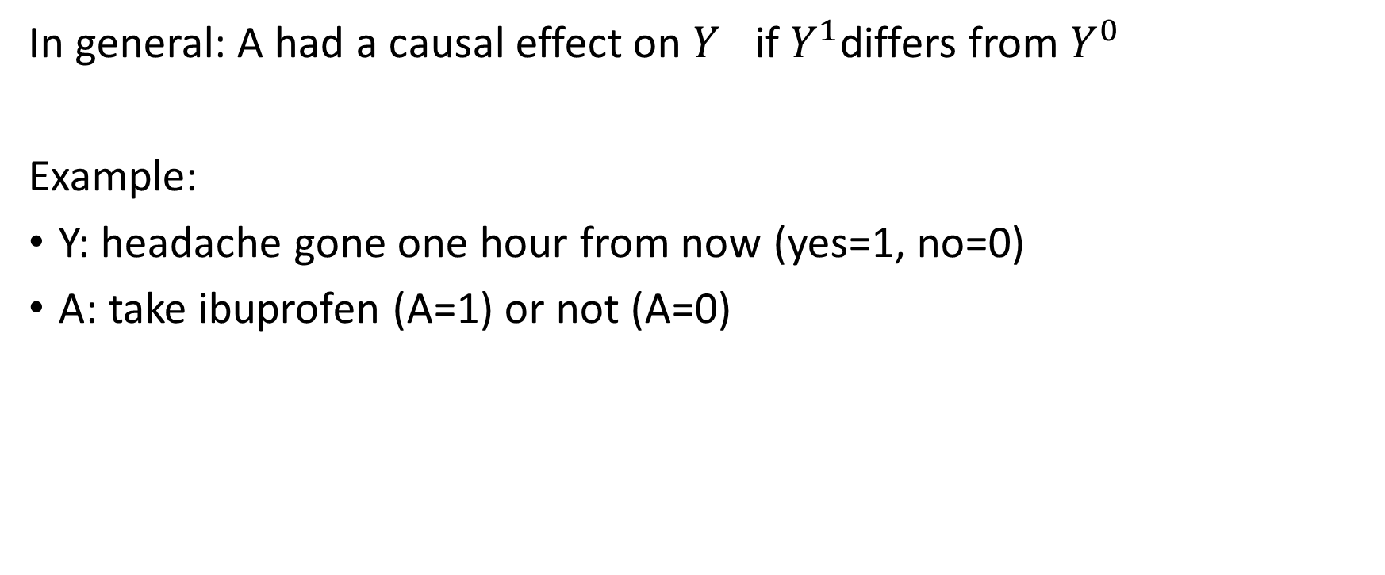
What are Causal Effects?
In general: A had a causal effect on $Y^{}$if $Y^{1}$differs from $Y^{0}$
Example:
Y: headache gone one hour from now (yes=1, no=0)
A: take ibuprofen (A=1) or not (A=0)

Slide 8
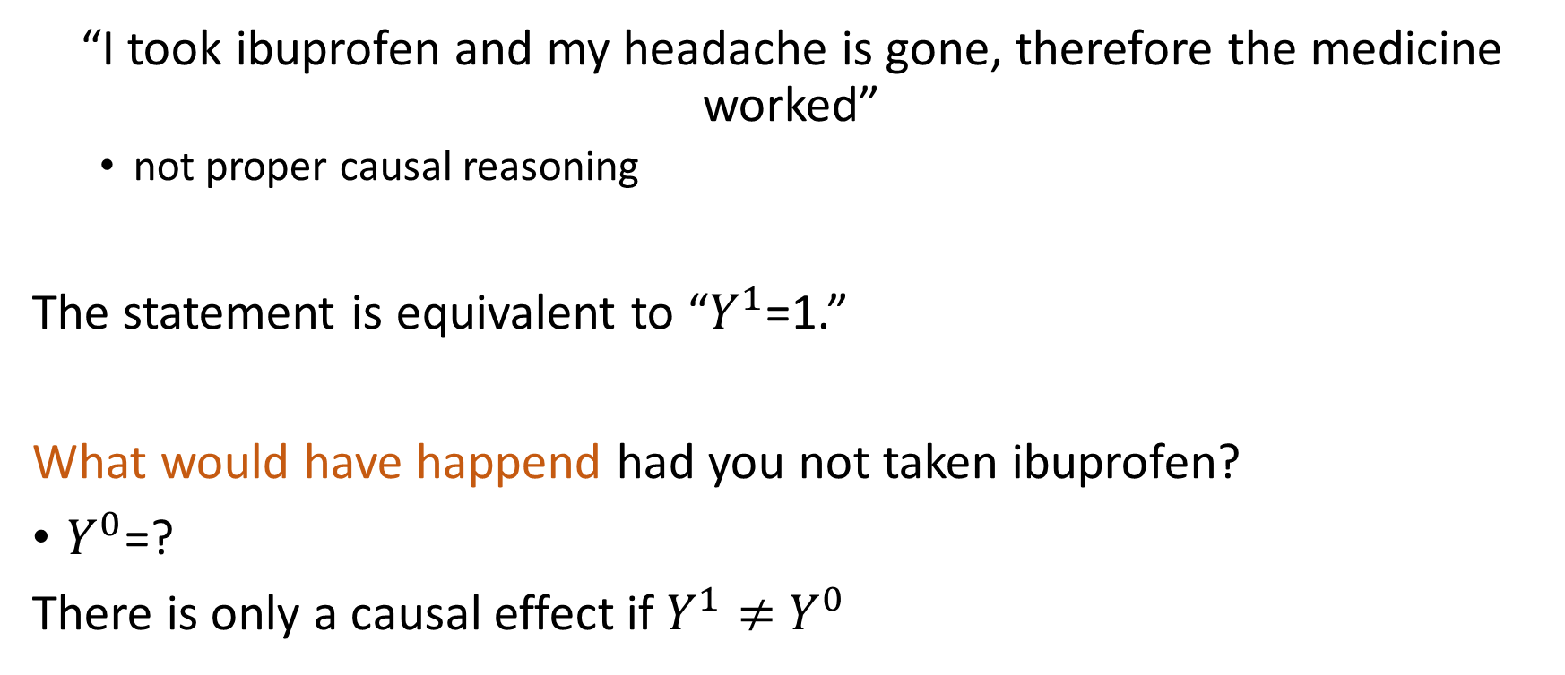
What are Causal Effects?
“I took ibuprofen and my headache is gone, therefore the medicine worked”
not proper causal reasoning
The statement is equivalent to “$Y^{1}$=1.”
What would have happend had you not taken ibuprofen?
$Y^{0}$=?
There is only a causal effect if $Y^{1}≠$ $Y^{0}$

Slide 9
Fundamental Problem of Causal Inference
The Fundamental Problem of Causal Inference is that we can only observe one potential outcome for each person.
However, with certain assumptions, we can estimate population level (average) causal effects.
Hopeless: What would have happened to me had I not taken ibuprofen? (unit level causal effect)
Posibble: What would the rate of headache remission be if everyone took ibuprofen when they had a headache versus if no one did?

