Slide 1
Causal Effects

Slide 2
Hypothetical Worlds – Average Causal Effect
Population of Interest
World 1
Everyone gets A=0
World 2
Everyone gets A=1
mean (Y)
mean (Y)
Difference is avarage causal effect

Slide 3

Average Causal Effect
E($Y^{1}−Y^{0})$
Average value of Y if everyone was treated with A=1 minus the average value of Y if everyone was treated with A=0
If Y is binary this is a risk difference

Slide 4
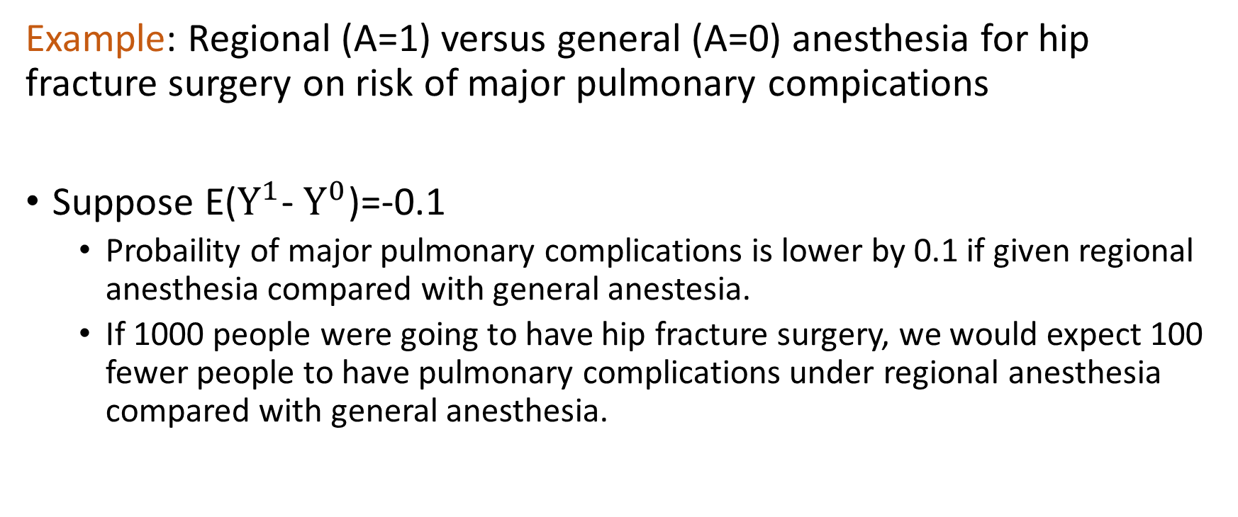
Average Causal Effect Example 1
Example: Regional (A=1) versus general (A=0) anesthesia for hip fracture surgery on risk of major pulmonary compications
Suppose E($Y^{1}$- $Y^{0}$)=-0.1
Probaility of major pulmonary complications is lower by 0.1 if given regional anesthesia compared with general anestesia.
If 1000 people were going to have hip fracture surgery, we would expect 100 fewer people to have pulmonary complications under regional anesthesia compared with general anesthesia.

Slide 5
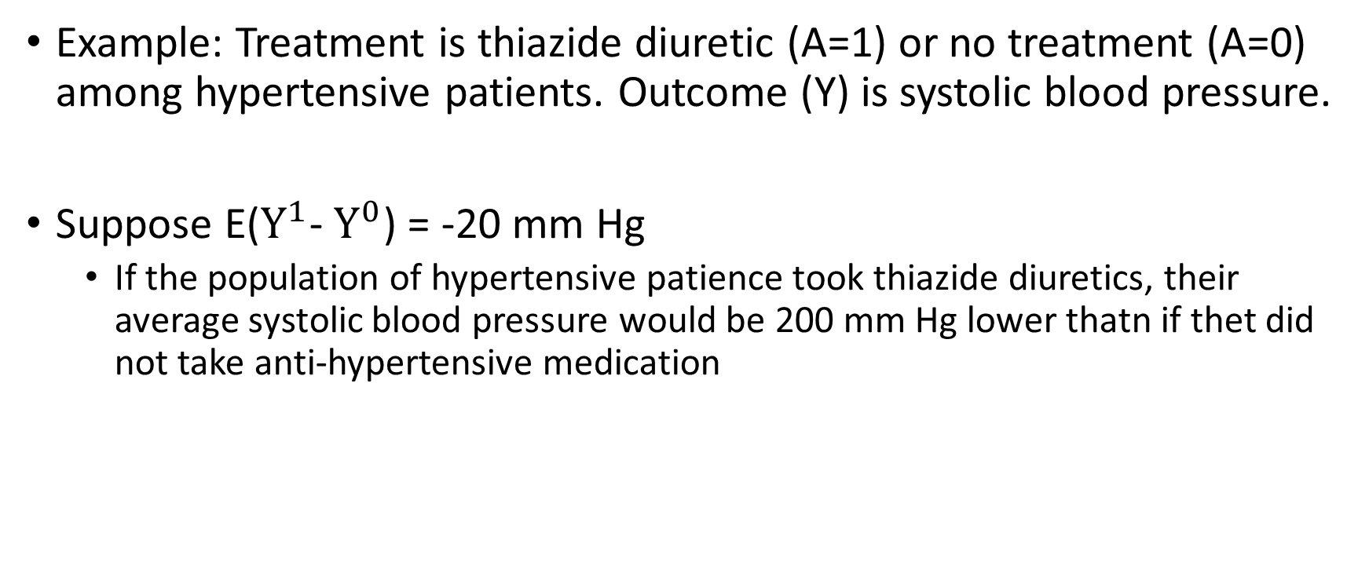
Average Causal Effect Example 2
Example: Treatment is thiazide diuretic (A=1) or no treatment (A=0) among hypertensive patients. Outcome (Y) is systolic blood pressure.
Suppose E($Y^{1}$- $Y^{0}$) = -20 mm Hg
If the population of hypertensive patience took thiazide diuretics, their average systolic blood pressure would be 200 mm Hg lower thatn if thet did not take anti-hypertensive medication

Slide 6
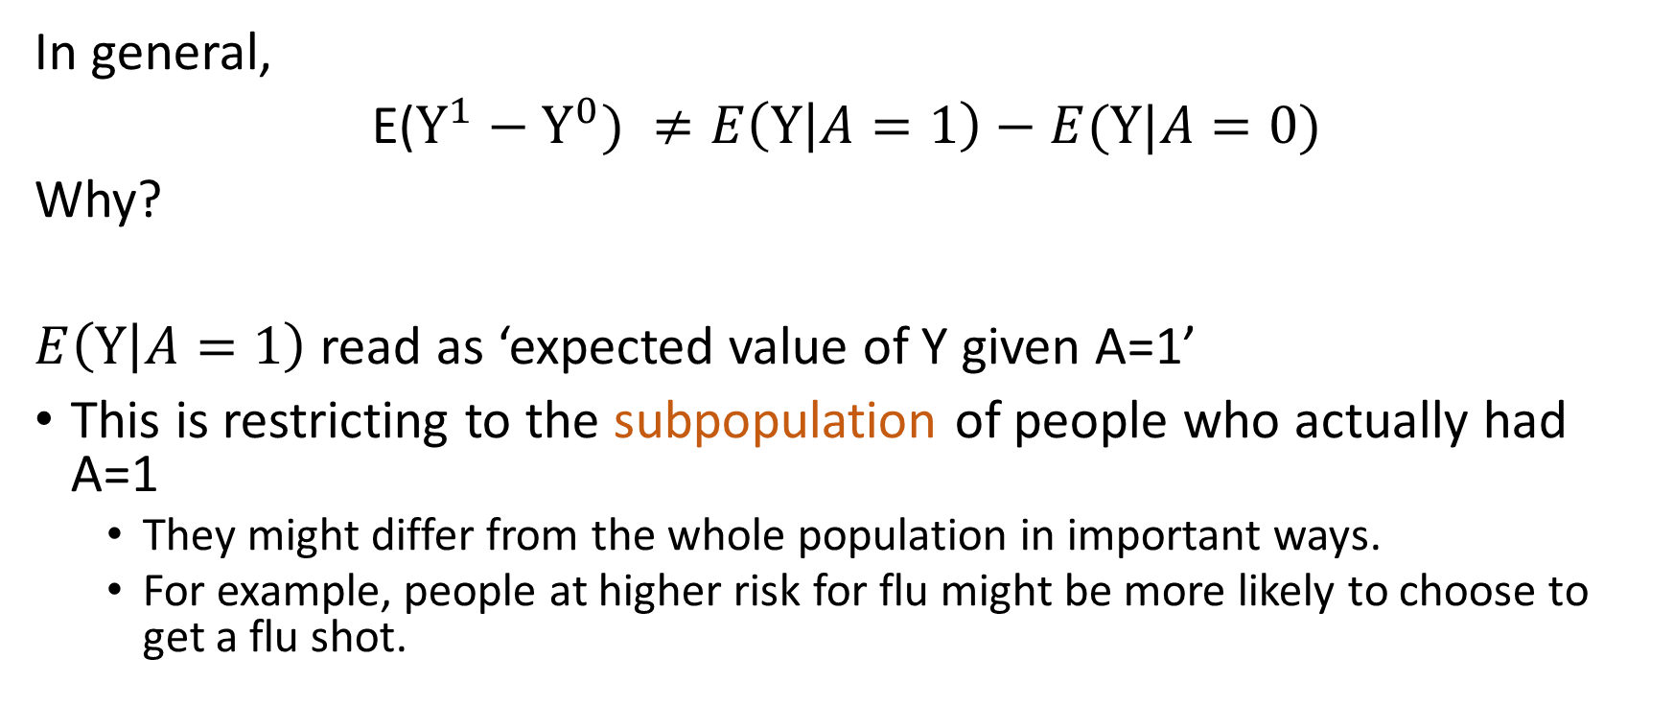
Conditioning on, versus setting, treatment
In general,
E($Y^{1}−Y^{0}) ≠E\left(Y | A=1\right)−E(Y|A=0)$
Why?
$E\left(Y | A=1\right)$ read as ‘expected value of Y given A=1’
This is restricting to the subpopulation of people who actually had A=1
They might differ from the whole population in important ways.
For example, people at higher risk for flu might be more likely to choose to get a flu shot.

Slide 7
Real World
Population of Interest
Some people get A=0
Some perple get A=1
mean (Y)
mean (Y)
Average difference in outcome between subpopulation defined by treatment group

Slide 8
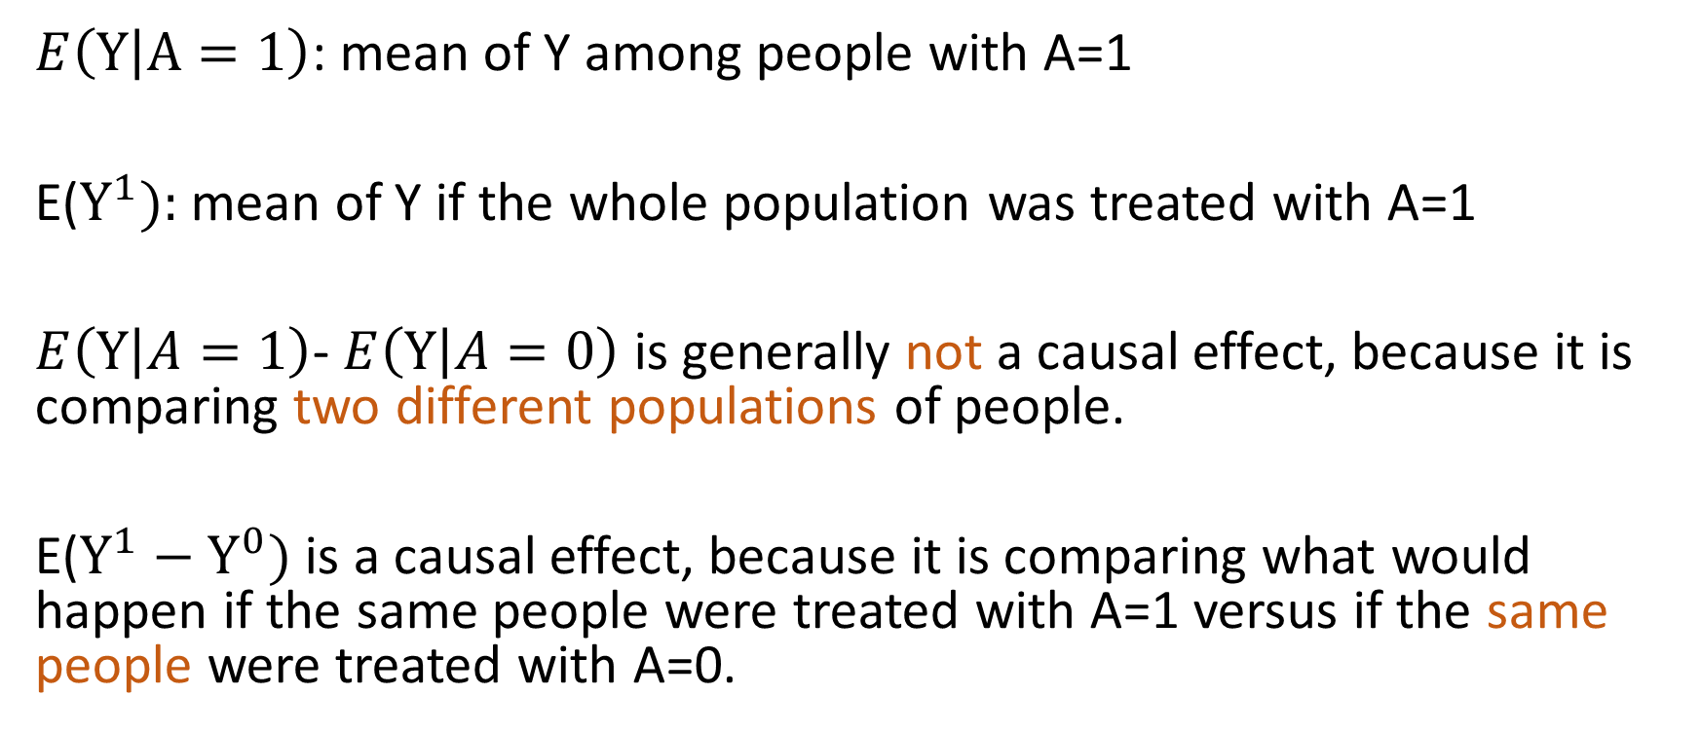
Conditioning Versus Setting
$E\left(Y | A=1\right)$: mean of Y among people with A=1
E($Y^{1}):$ mean of Y if the whole population was treated with A=1
$E\left(Y | A=1\right)$- $E\left(Y | A=0\right)$ is generally not a causal effect, because it is comparing two different populations of people.
E($Y^{1}−Y^{0})$ is a causal effect, because it is comparing what would happen if the same people were treated with A=1 versus if the same people were treated with A=0.

Slide 9
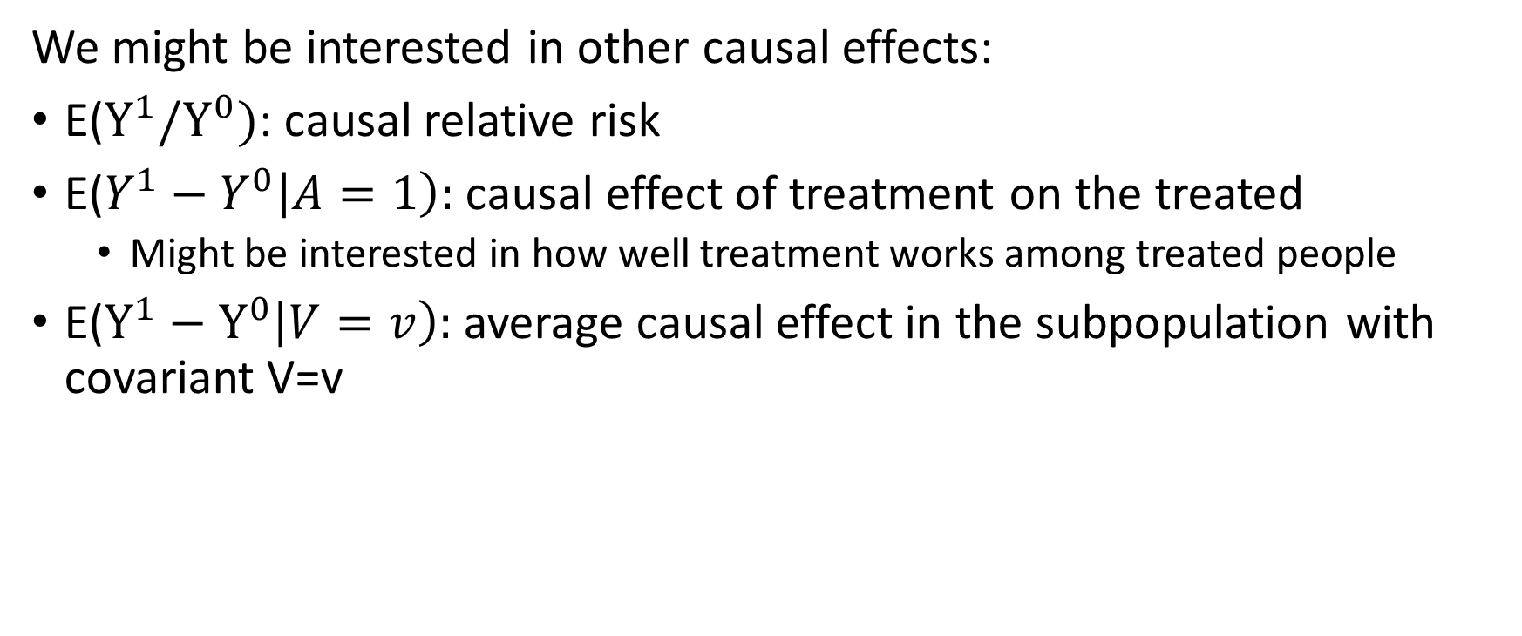
Other Causal Effects
We might be interested in other causal effects:
E($Y^{1}/Y^{0})$: causal relative risk
E($Y^{1}−Y^{0}\left|A=1\right):$ causal effect of treatment on the treated
Might be interested in how well treatment works among treated people
E($Y^{1}−Y^{0}\left|V=v\right):$ average causal effect in the subpopulation with covariant V=v

Slide 10
Causal Effect of Treatment on the Treated
Treated Population
World1
Everyone gets
A=0
World 2
Everyone gets
A=1
mean (Y)
mean (Y)
Causal effect of treatment on treated

Slide 11
Challenge
We only ovbserve one treatment and one outcome for each person.
Fundamental Problem of Causal Inference
How do we use observed data to link observed outcomes to potential outcomes?
What assumptions are necessary to estimate causal effects from observed data?

