Slide 1
Causal assumptions

Slide 2
Identifiability
Identifiability of causal effects requires making some untestable assumptions. These are generally called causal assumptions.
The most common are:
Stable Unit Treatment Value Assumption
Consistency
Ignorability
Positivity
Assumptions will be about the observed data: Y, A, and a set of pre-treatment covariates X

Slide 3
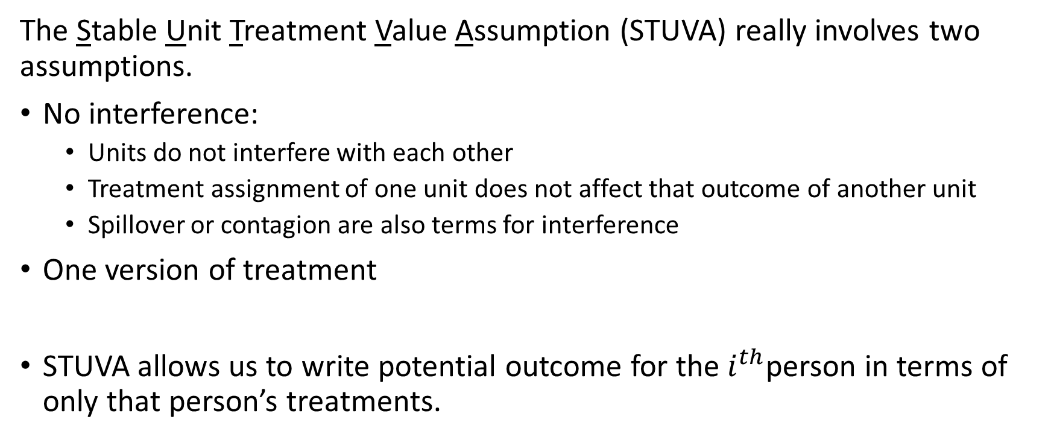
STUVA
The Stable Unit Treatment Value Assumption (STUVA) really involves two assumptions.
No interference:
Units do not interfere with each other
Treatment assignment of one unit does not affect that outcome of another unit
Spillover or contagion are also terms for interference
One version of treatment
STUVA allows us to write potential outcome for the $i^{th}$person in terms of only that person’s treatments.

Slide 4
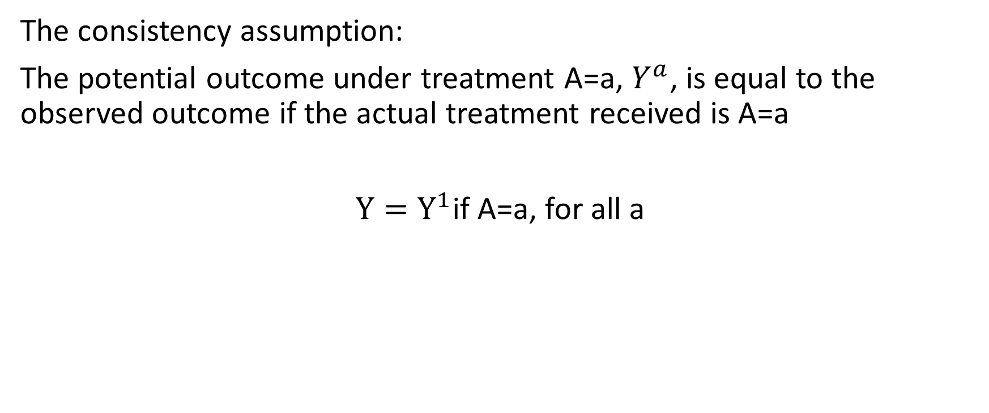
Consistency assumption
The consistency assumption:
The potential outcome under treatment A=a, $Y^{a}$, is equal to the observed outcome if the actual treatment received is A=a
${Y=Y}^{1}$if A=a, for all a

Slide 5
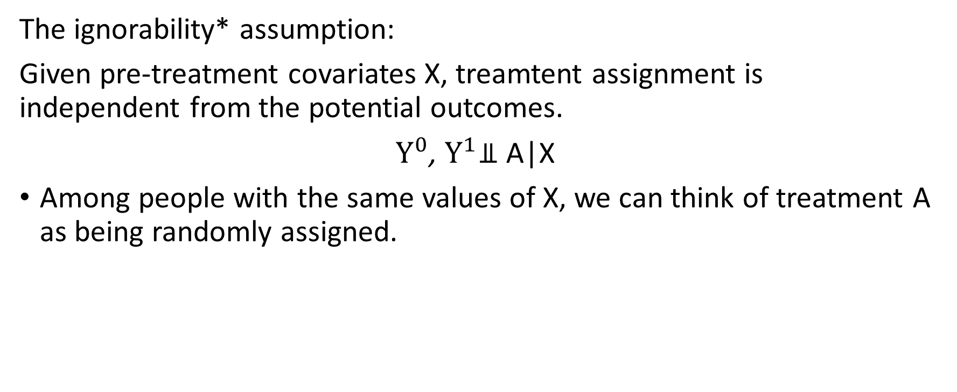
Ignorability assumption
The ignorability* assumption:
Given pre-treatment covariates X, treamtent assignment is independent from the potential outcomes.
$Y^{0}$, $Y^{1}$⫫ A|X
Among people with the same values of X, we can think of treatment A as being randomly assigned.

Slide 6
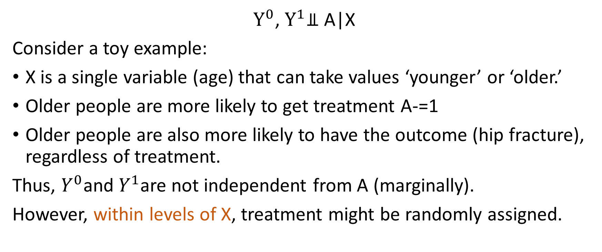
Ignorability assumption
$Y^{0}$, $Y^{1}$⫫ A|X
Consider a toy example:
X is a single variable (age) that can take values ‘younger’ or ‘older.’
Older people are more likely to get treatment A-=1
Older people are also more likely to have the outcome (hip fracture), regardless of treatment.
Thus, $Y^{0}$and $Y^{1}$are not independent from A (marginally).
However, within levels of X, treatment might be randomly assigned.

Slide 7
Positivity assumption
The positivity assumption essentially states that, for every set of values for X, treatment assignment was not deterministic:
P(A=a|X=x)>0 for all a and x
If for some values of X, treatment was deterministic, then we would have no observed values of Y for the treatment groups for those values of X.
Variables in treatment assignment is important for identification.

Slide 8
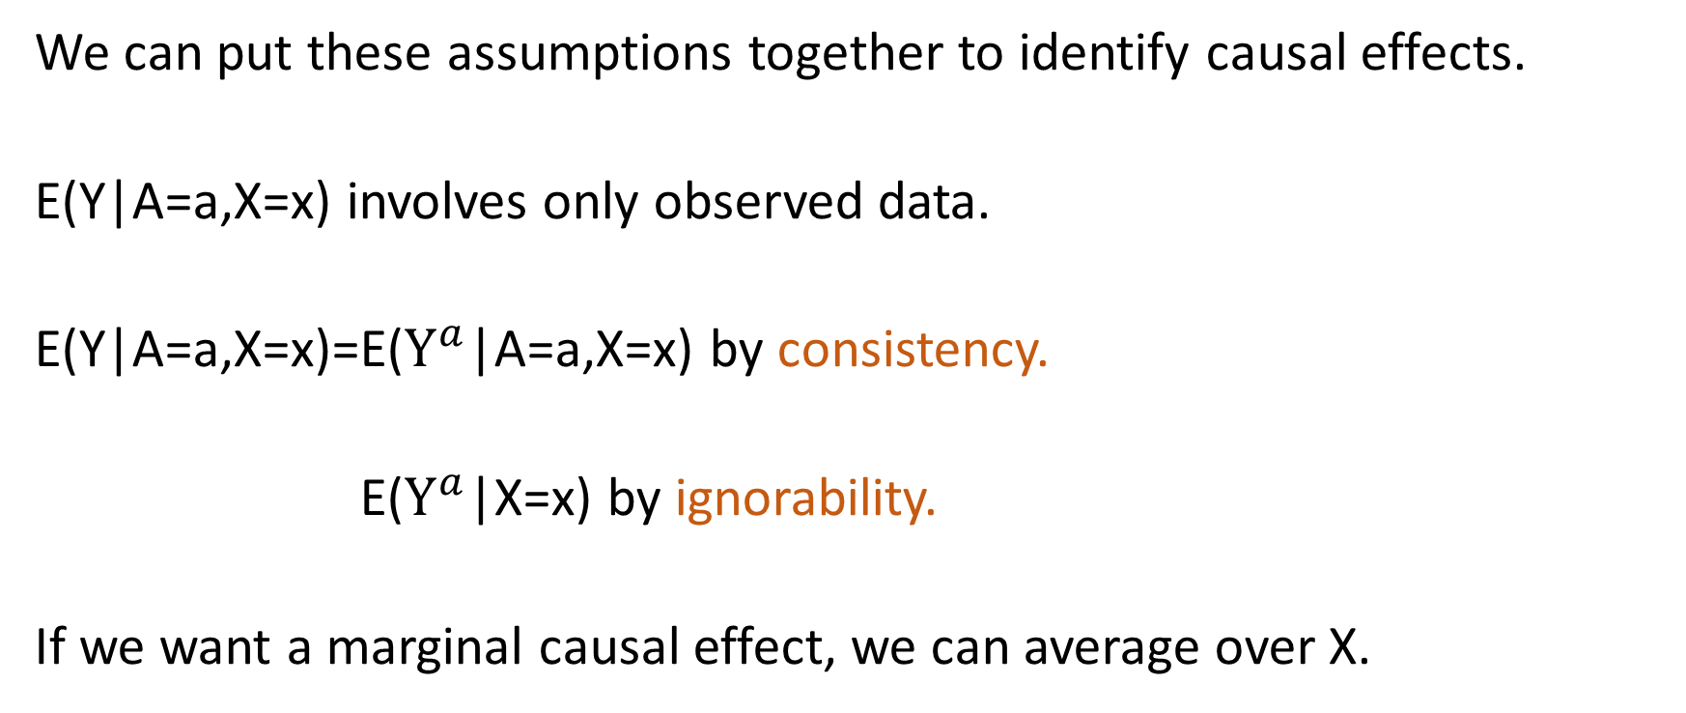
Observed Data and Potential Outcomes
We can put these assumptions together to identify causal effects.
E(Y|A=a,X=x) involves only observed data.
E(Y|A=a,X=x)=E($Y^{a}$|A=a,X=x) by consistency.
E(Y|A=a,X=x)=E($Y^{a}$|X=x) by ignorability.
If we want a marginal causal effect, we can average over X.

