Slide 1
Confounding

Slide 2
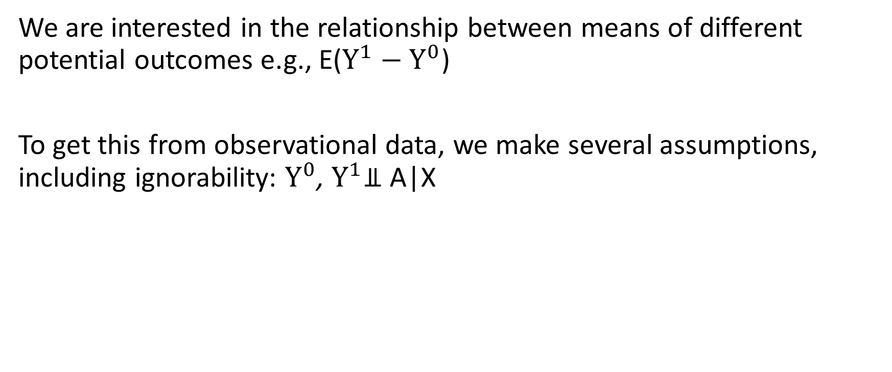
Review
We are interested in the relationship between means of different potential outcomes e.g., E($Y^{1}−Y^{0}$)
To get this from observational data, we make several assumptions, including ignorability: $Y^{0}$, $Y^{1}$⫫ A|X

Slide 3
Ignorability
Suppose treatment assignment depends on the potential outcomes (e.g., ‘sicker’ patients are more likely to be treated).
Treated patients higher risk of bad outcome
Need to account for these pre-treatment differences in health
Suppose X are measures of health: history of various diseases, age, weight, smoking, alcohol, etc.
Whitin levels of X (i.e., people of the same age with the same co-morbid conditions, of the same weight, with same history of smoking, etc), it might be the case the ‘sicker’ patients ar not more likely to get treatment (that’s ignorability)

Slide 4
Confounding
Confounders are often defined as variables that affect treatment and affect the outcome.
If I assign treatment based on a coin flip, then taat affects treatment but should not affect outcome ( the coin flip is not a confounder).
If people with a family history of cancer are more likely to develop cancer (the outcome), but family history was not a factor in the treatment decision, then family history is not a confounder.
If older people are at higher risk of cardiovascular disease (the outcome) and are more likely to receive statins (the treatment), then age is a confounder.

Slide 5
Confounder Control
We are interested in:
Identifying a set of variables X that will make the ignorability assumption hold.
If we do this then this set of variables is sufficient ot control for confounding
Using statistical methods (covered later in the course) to control for these variables and estimate causal effects.

Slide 6
Causal Graphs
Which variables to control for is not a simple question
We would like to indentify a set of variables X that will achieve ignorability – i.e., a set that is sufficient to control for confounding.

