Slide 1
Conditional independence (d-separation)

Slide 2
Blocking
Path can be blocked by conditioning on nodes in the path.
Consider the path:
A G B
If we condition on G (a node in the middle of a chain), we clock the path from A to B.

Slide 3
Blocking
Suppose temparature (A) affects whether or not sidewalks are icy (G), which affects whether or not someone falls (B).
A G B
A and B are accociated (marginally)
However, if we restrict to situation where sidewalks are icy (condition on G), then temperature and falling are not associated via this path.

Slide 4
Blocking
Associations on a fork can also be blocked.
Consider that path:
A G B
If we condition on G, this path from A to B is blocked.

Slide 5
Colliders
The opposite situation occures if a collider is conditioned on.
Consider the path:
A G B
Here, A and B are not associated via this path (information collides at G).
However, conditioning on G induces an association between A and B.

Slide 6
Conditioning on colliders
Suppose:
A is the state of an on/off switch.
B is the state of a different on/off switch.
G is whether the lightbulb is lit up.
A is determined from a coin flip. B is determined from a separate, independent coin flip. G is lit up only if both A and B are in the on state.
This DAG describes the relationship:
A G B

Slide 7
Conditioning on colliders
A G B
Then:
A and B are independent.
If I tell you that B is on, it tells you nothing about A.
A and B are dependent, given G.
If I tell you that the light is off (G), than A must be off if B is on, and vice versa. A path between A and B is opened by the conditioning on G.

Slide 8
Rules for d-separation
A path is d-separated by a set of nodes C if:
It contains a chain (D E F) and the middle part is in C.
OR
It contains a fork (D E F) and the middle part is in C.
OR
It contains an inverted fork (D E F) and the middle part is not in C, nor are any descendants of it.

Slide 9
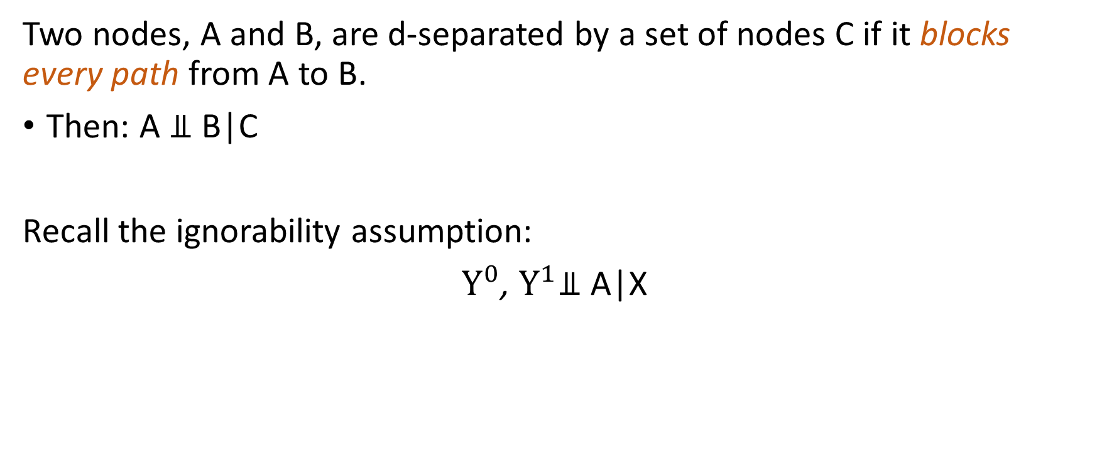
d-separation
Two nodes, A and B, are d-separated by a set of nodes C if it blocks every path from A to B.
Then: A ⫫ B|C
Recall the ignorability assumption:
$Y^{0}$, $Y^{1}$⫫ A|X

