Slide 1
Confounders revisited

Slide 2
Confounders
Recall that the informal definition of a confounder is:
A variable that affects both the treatment and the outcome
A simple DAG where X is a confounder between the relationship between treatment A and outcome Y:
X
A Y

Slide 3
Confounders
Consider a slightly more complicated situation:
V W
A Y
V affects A (directly).
V affects Y (indirectly, through its effect on W).
It is reasonable to argue that V is a confounder

Slide 4
Controlling for confounding
What matters is not identifying specific confounders, but identifying a set of variables that are sufficient to control for confounding.
We deed to block backdoor paths from treatment to outcome

Slide 5
Frontdoor paths
A frontdoor path from A to Y is one that begins with an arrow emanating out of A.
Examples:
X X
A Y A Z Y
A -> Y is a frontdoor A -> Z -> Y is a frontdoor
path from A to Y. path from A to Y.

Slide 6
Frontdoor paths
We do not worry about frontdoor paths, because they capture effects of treatment.
DAG 1 DAG 2
X X
A Y A Z Y
DAG 1: A directly affects Y DAG 2: A affects Y indirectly through its effect on Z

Slide 7
Frontdoor paths
If we are interested in the causal effect of A on Y, we should not control for Z in this DAG:
X
A Z Y
We care about : if we manipulate A, how is Y affected>
Controlling for Z would be controlling for an effect of treatment.
Causal mediation analysis involes understanding frontdoor paths from A to Y.

Slide 8
Backdoor paths
Backdoor paths from treatment A to outcome Y are paths from A to Y that travel through arrows going in A:
X
A Y
Here, A <- X -> Y is a backdoor path from A to Y.
Backdoor paths confound the relationship between A and Y.

Slide 9
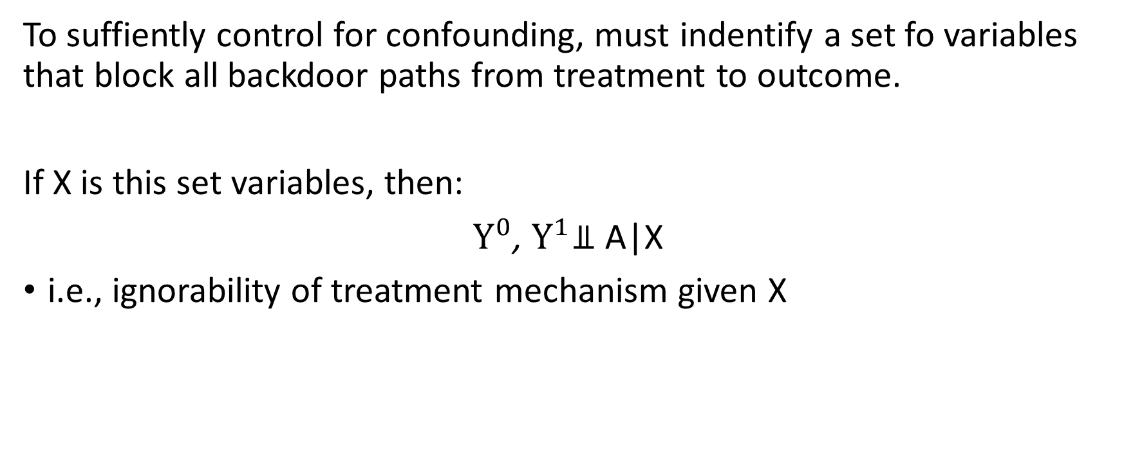
Backdoor paths
To suffiently control for confounding, must indentify a set fo variables that block all backdoor paths from treatment to outcome.
If X is this set variables, then:
$Y^{0}$, $Y^{1}$⫫ A|X
i.e., ignorability of treatment mechanism given X

Slide 10
Criteria
In the next lectures, we will discuss two criteria for identifying sets of variables that are sufficient to control for confounding.
Backdoor path criterion
Disjunctive cause criterion

